Slide 1
MongoDB geospatial and Android
How to hack together a location based app in 25 minutes or less
Paul Scott <pscott209@gmail.com>
Herman Smith <herman@uherd.it>

Slide 2
Who are we?
Paul Scott
  Senior developer at DStv Online in Johannesburg, South Africa
  Long time FOSS contributor and developer (eLearning, mapping, GIS and web frameworks)
  Perennial tinkerer
Herman Smith
  Lead mobile developer at Touchlab based in Cape Town, South Africa
  Firm believer in Open Source being the most direct route to the greater good
  Enthusiastic “ham” coder

Slide 3
MongoDB Geospatial
Geonames data set used
CC-BY license, so please do contribute back too!
Bottle.py used for REST service
  Why? Because I said so. (Also, it only took 5 minutes to write)
Python + PyMongo used to set up the database
Grab the code and example data (US and ZA) at https://github.com/paulscott56/OSCON2012
Set up your environment
  MongoDB (https://www.10gen.com/)
  Python (http://www.python.org/)
  PyMongo (http://pypi.python.org/pypi/pymongo/)
  An Android device (beg, borrow, steal if you don't have one already)
http://pypi.python.org/pypi/pymongo/

Slide 4
Import the data
Run the geoloader.py script
  Do this while we go through the code – it takes a while
What does it do?
  Opens the .txt files containing the geonames dump for the 2 countries and parses the CSV data
  Large files, so we hand csvReader some additional resources to use.
  Once off script, so it isn't the best code ever – ignore that...
  Inserts the data into a Mongo collection called 'places' in a database called 'geopoints'
  Create index on 'name' field and on the geo field 'loc'
    2D index on loc – this is where the spatial magic happens!
Use mongostat to see how your MongoDB server is performing!

Slide 5
Run some queries to check all went well
Mongo
  Use geopoints
    db.places.find({"name" : "Oregon Convention Center"}).limit(5).pretty()
    db.places.count()
    db.places.getIndexes()
    db.places.ensureIndex({“population” : 1})
Bottle.py
  http://bottlepy.org
  Start REST server with: python georest.py
  Configured to use port 8080 but you can change that
  Change host to local or wherever you want it to live
http://bottlepy.org

Slide 6
Bottle Python code
PUT method to add records to the database
GET documents by name
  Takes 1 parameter: name=<name>
  Return JSON of the MongoDB document(s) matching name
  Try it out!
    http://localhost:8080/documents/Oregon%20Convention%20Center
    URLEncoded – we will deal with that later!
GET documents by loc
  http://localhost:8080/loc?lat=18.512740000000001&lon=-33.891150000000003
  Pass in latitude and longitude and optional radius of search
  Gets a bunch of documents back in area. Uses $within $center but we could have done $near too

Slide 7
Clients
API
    Abstraction
    Everything is a client
    HTTP
    JSON

Slide 8
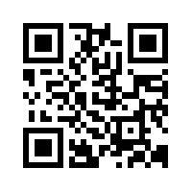
Android App
Install the client on your android devices
  Enable the installation of applications from Unknown /
  non-Market sources
    Under “Settings>Security>Unknown Sources”
  But beware (there be dragons)
    The app should run on versions of Android > 2.x
  Download & Install
    http://geo.uherd.it/gs.apk

Slide 9
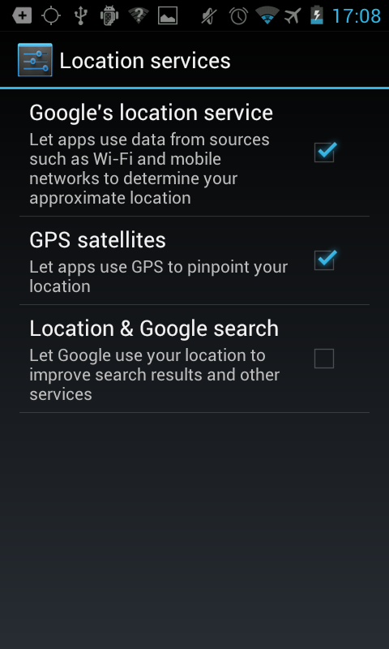
Android App
After installing from
        http://geo.uherd.it/gs.apk
  Launch the Application
  If GPS location is not enabled the app will upon first use take you to the Location services section from where you must enable location by means of GPS
  https://github.com/hermandroid/geospatial.git

Slide 10
Android App
Sourcecode available for checkout on github
  https://github.com/hermandroid/geospatial.git

Slide 11
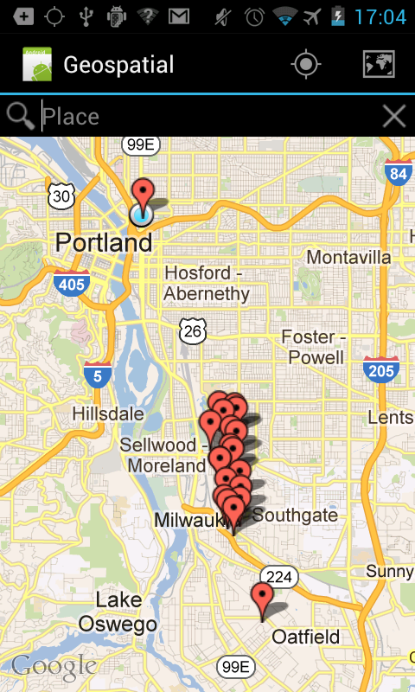
Android App
Search
  Select the crosshair ( in the action bar )
  This will center the map around your current location & search for POI's in your proximity
  Zoom deeper to view individual pins
  Touch on a pin to reveal a popover containing more info

Slide 12
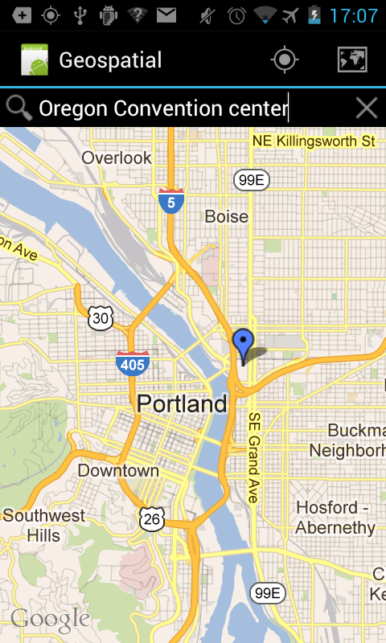
Android App
Search
  Clear out the last search results by touching the X (to the right of search bar)
  Type in a search term in the search bar and touch the search button (magnifying glass)

Slide 13
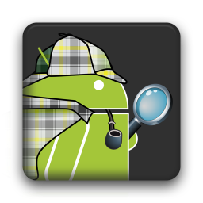
Android App
Components & Libraries
  GSON
    Gson is a Java library that can be used to convert Java Objects into their JSON representation. It can also be used to convert a JSON string to an equivalent Java object.
  LoopJ
    An asynchronous callback-based Http client for Android built on top of Apache’s HttpClient libraries.
  ActionbarSherlock
    An extension of the compatibility library designed to facilitate the use of the action bar design pattern across all (almost all) versions of Android with a single API

Slide 14
Thanks! Questions or comments?
Mail us at pscott209@gmail.com or herman@uherd.it
Chat to us after sessions or at coffe breaks
Thank you very much!
Don't forget to rate this talk!

