Slide 1
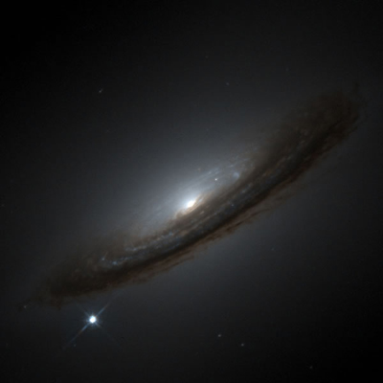

What can SN Ia tell us
about a clumpy
Universe?
UK Cosmo
Sussex 2023
Paul Shah
Ofer Lahav
Pablo Lemos

Slide 2
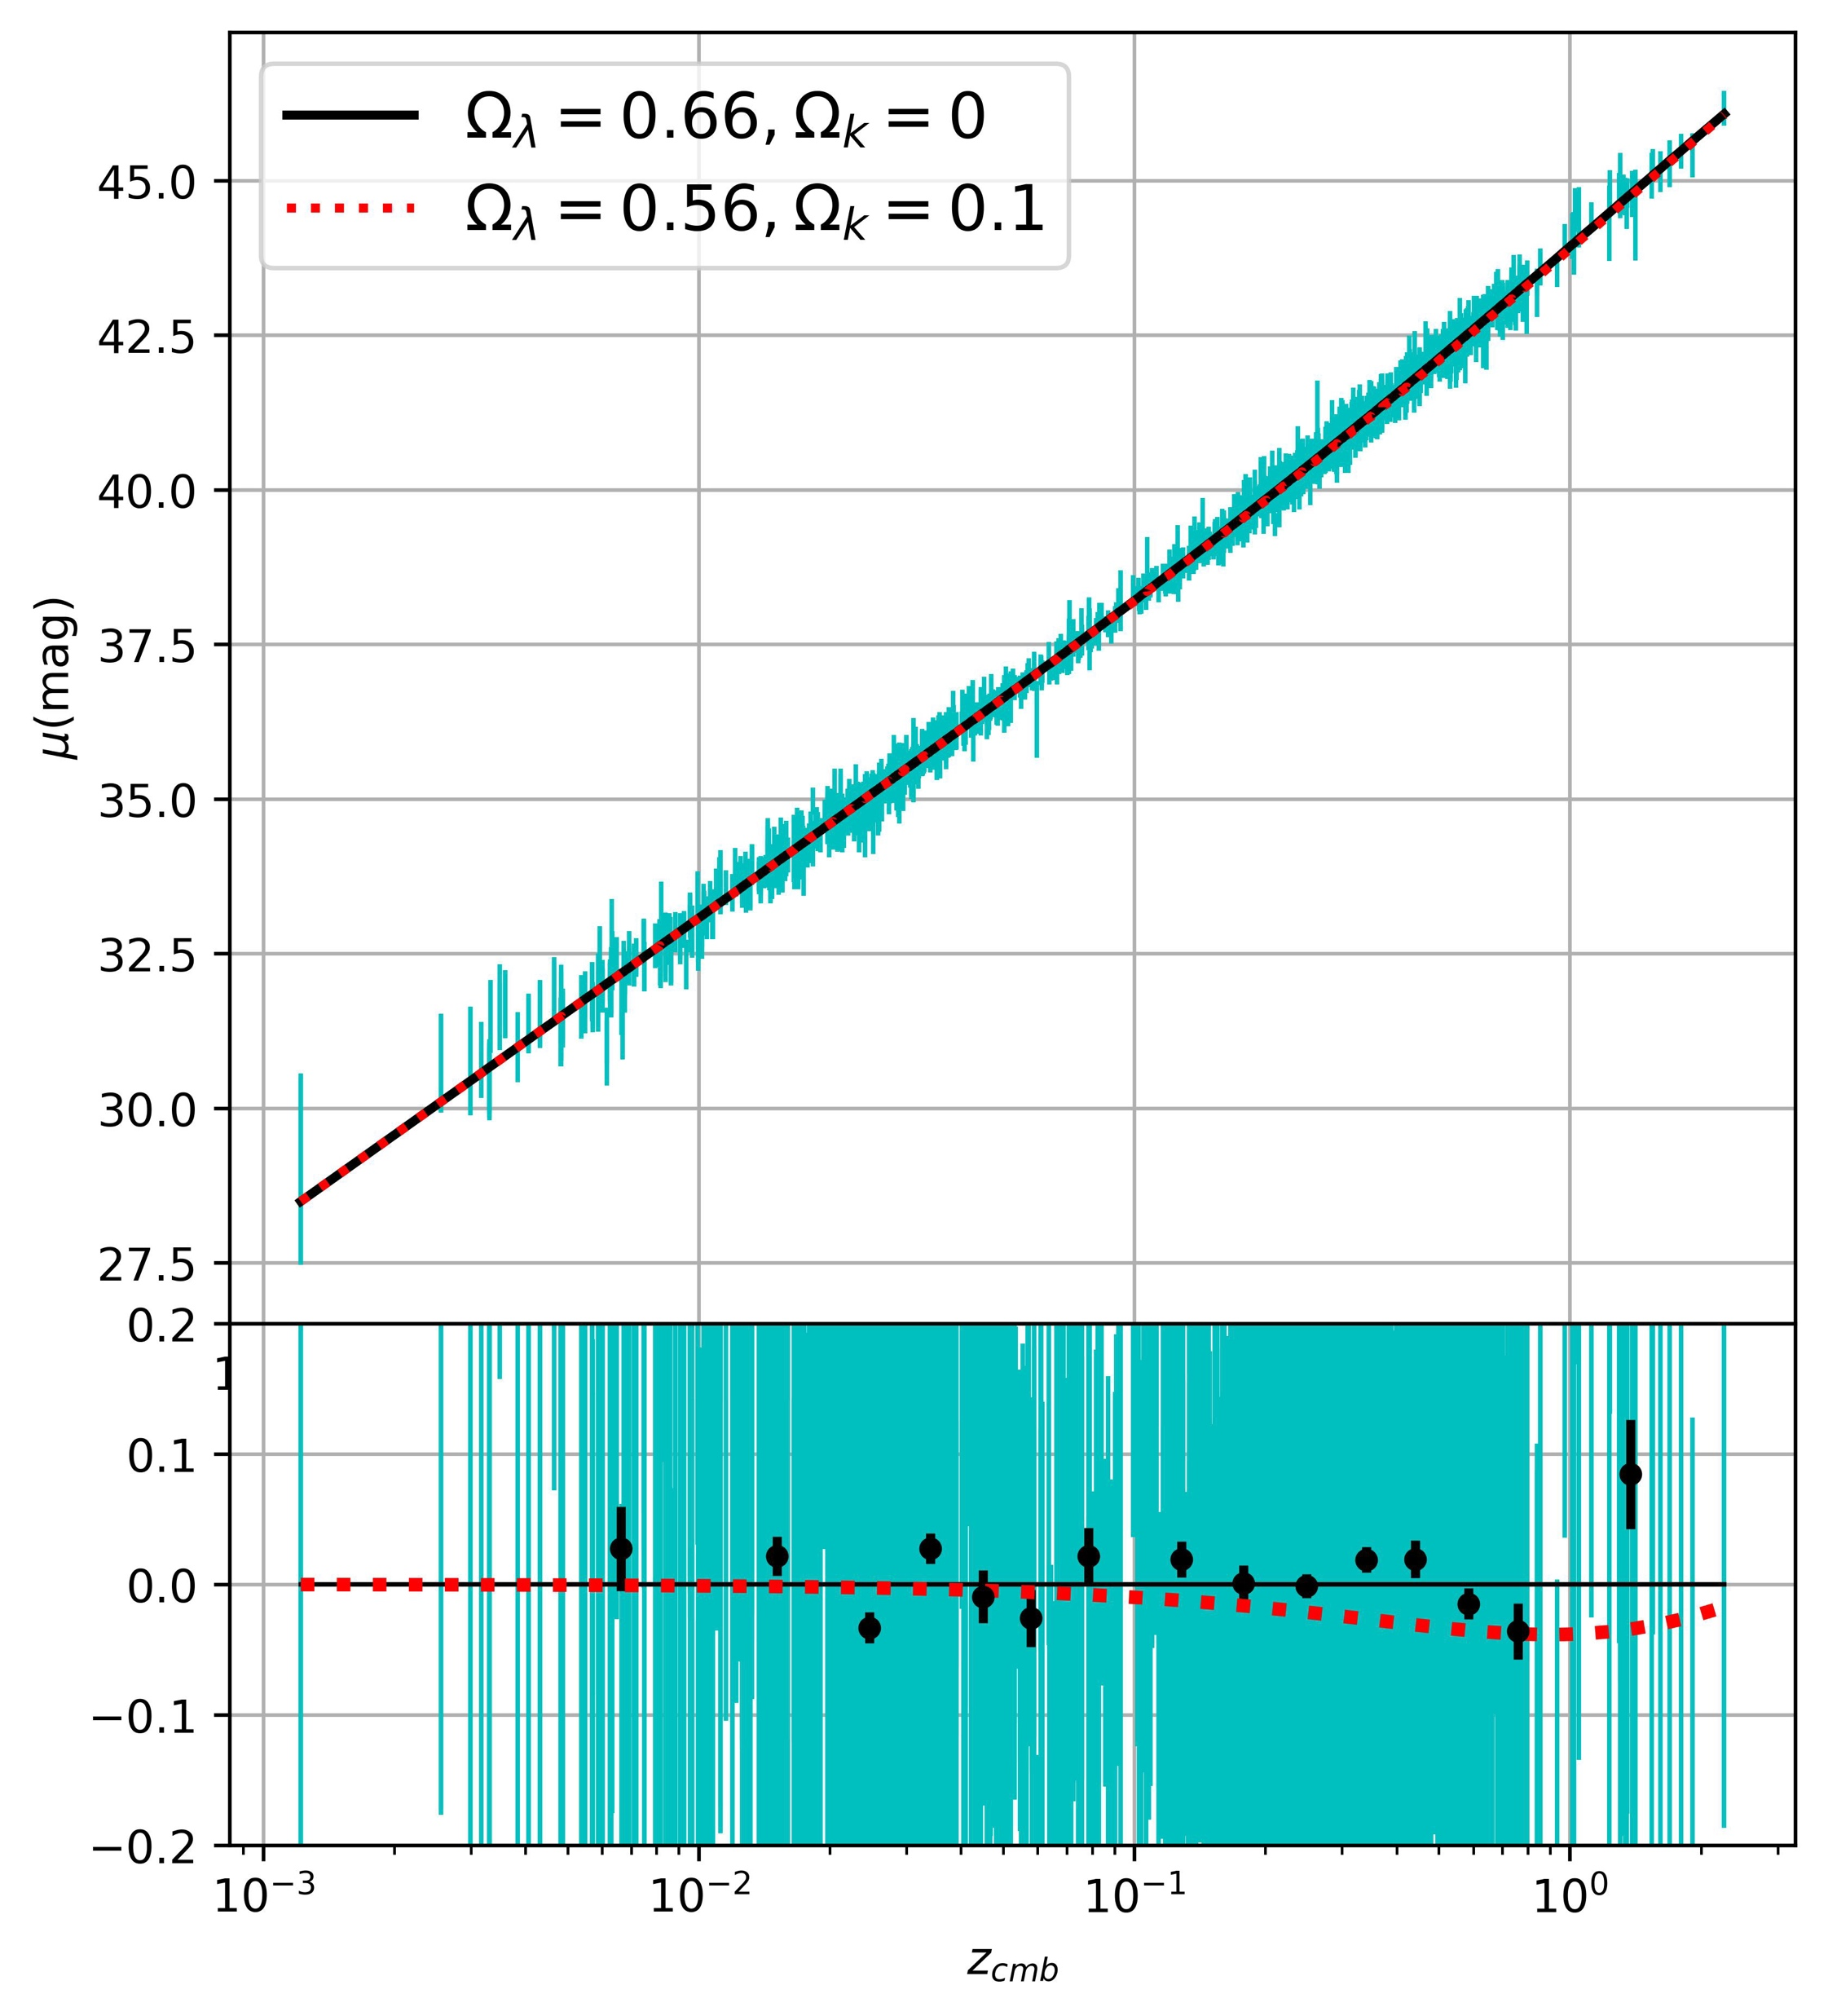

Type Ia supernovae : cosmology is solved!
“Standardisable candles” (Phillips 1993, Tripp and Branch 1999)
Observed distance modulus $μ_{obs}$from
light curve magnitude $m$
$colour$ $c$
stretch $x_{1}$
Nuisance parameters $M, α, β, Δ_{M}$
Malmquist bias adjustment $Δ_{B}$
$μ_{obs}=m−M+αx_{1}−βc+Δ_{M}+Δ_{B}$
Model distance modulus $μ_{mod}(H_{0}, Ω_{M}, Ω_{Λ}) \text{from} \text{your} \text{favourite} \text{cosmological} \text{model}$
$Δμ=μ_{obs}−μ_{mod}$
Fit to minimize $χ^{2}=Δμ^{T} C^{−1}Δμ$
Data: PantheonPlus, Scolnic 2022

Slide 3
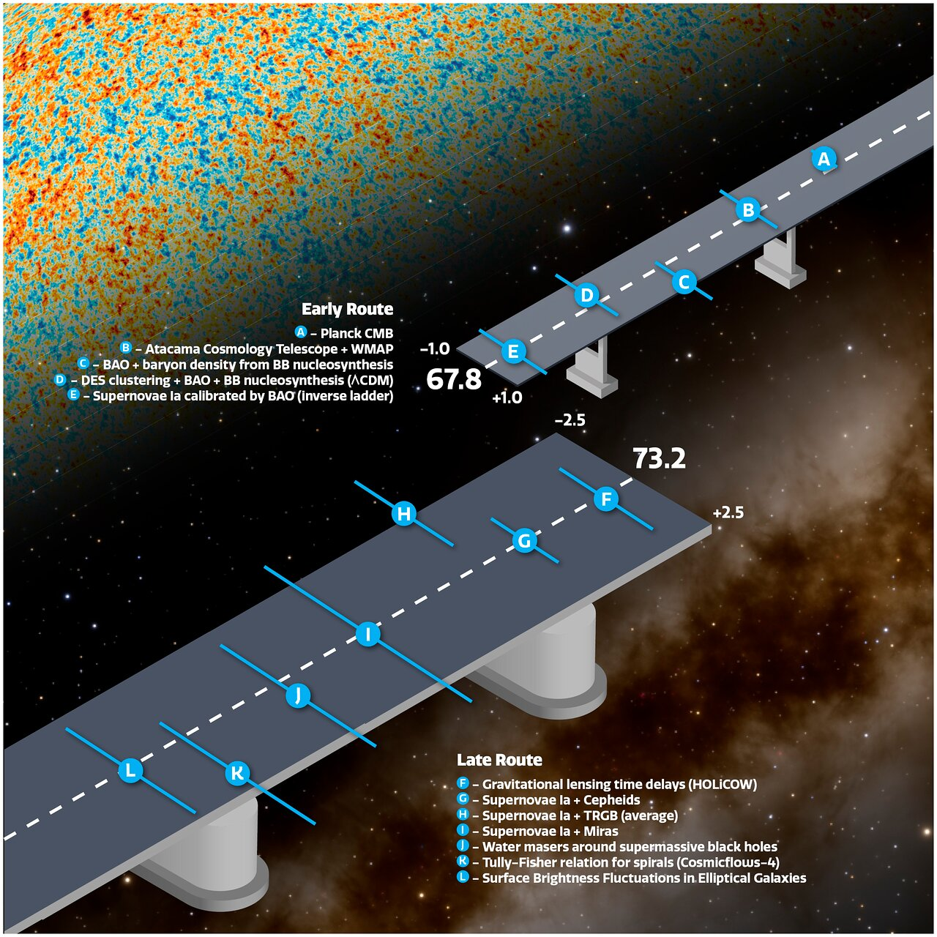

Type Ia supernovae : cosmology is solved!
$$μ_{obs}=m−M+αx_{1}−βc+Δ_{M}+Δ_{B}$$
Calibration of M
Hubble tension or M tension?
SN Ia “environmental” adjustment$Δ_{M}$
Dust or progenitor?
Bias correction $Δ_{B }$
What causes scatter in SN Ia magnitudes?
Is $m$a fair sampling of the universe?
Are SN Ia on over/under-dense lines of sight?
Lemos 2019, Efstathiou 2021
Kelsey 2020, Wiseman 2022
Guy 2010, Chotard 2011, Brout 2020, Popovic 2021
Figure credit : NOIRLab/NSF/AURA/J. da Silva

Slide 4
Type Ia supernovae : cosmology is solved!
$$μ_{obs}=m−M+αx_{1}−βc+Δ_{M}+Δ_{B}$$
Calibration of M
Hubble tension or M tension?
SN Ia “environmental” adjustment$Δ_{M}$
Dust or progenitor?
Bias correction $Δ_{B }$
What causes scatter in SN Ia magnitudes?
Is $m$a fair sampling of the universe?
Are SN Ia on over/under-dense lines of sight?
Lemos 2019, Efstathiou 2021
Kelsey 2020, Wiseman 2022
Guy 2010, Chotard 2011, Brout 2020, Popovic 2021
Figure credit : NOIRLab/NSF/AURA/J. da Silva

Slide 5
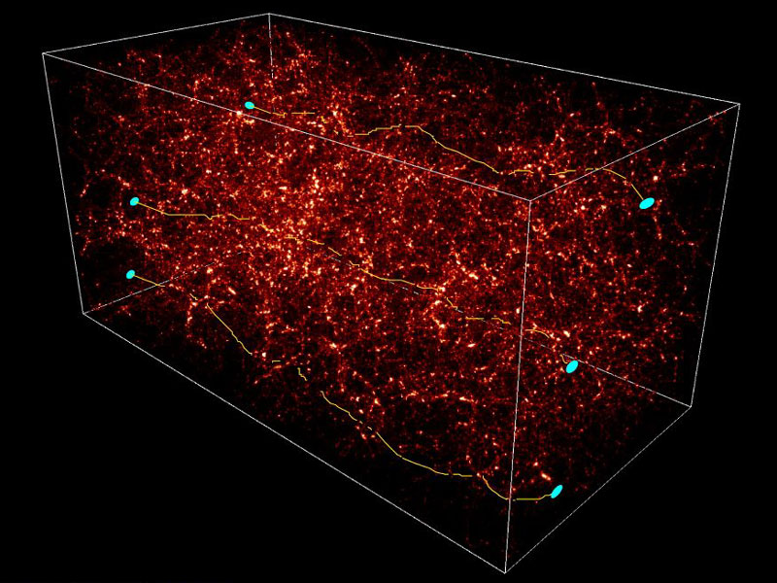

Light propagation in an inhomogeneous universe
Weak lensing correlates luminosity distance $d_{L}$ to foreground
Lensing magnification dominated by small scale structure
Flux is conserved on average
Clumpier universe has more scatter due to lensing$: σ_{lens}∝σ_{8}$
Lensing degrades accuracy of high-z magnitudes
Zel’dovich 1964, Dyer & Roeder 1972
Frieman 1997, Kainulainen 2011
Weinberg 1977, Kaiser & Peacock 2017
Frieman 1997, Marra 2013
Holz 2005
The magnification is small so detecting it is hard (only $1.4σ$ so far..)
Figure credit : S. Columbi, CFHT
Jonsson 2010, Smith 2014, MacAulay 2018

Slide 6
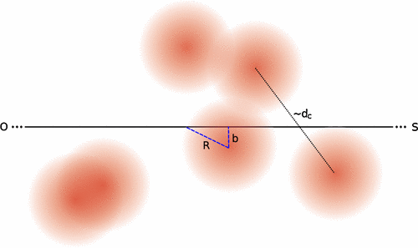
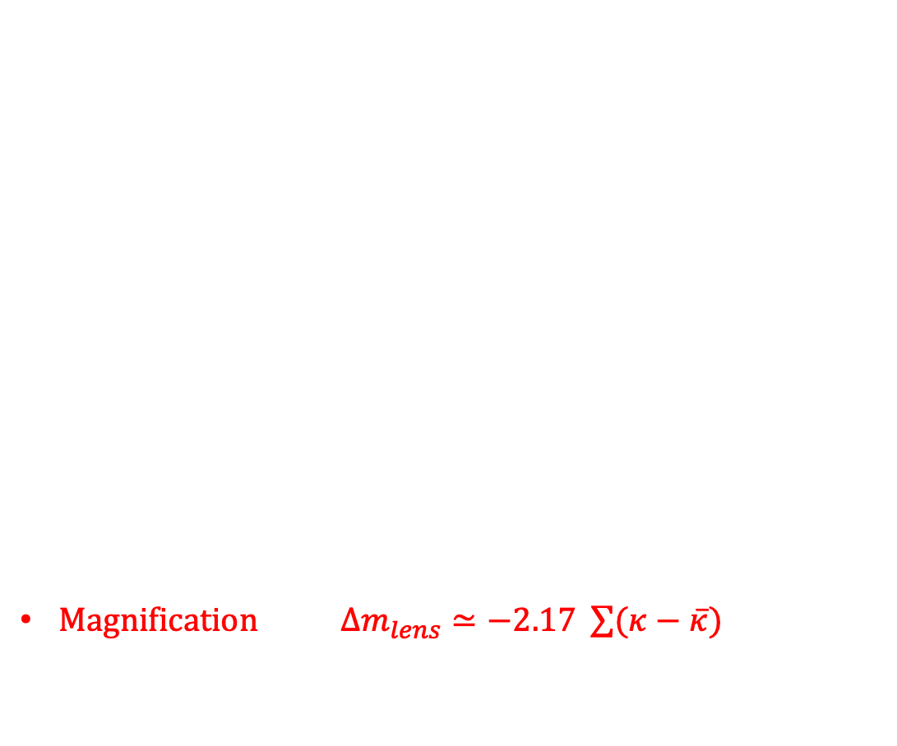
An estimator for weak lensing
Halo model $ρ\left(r\right)=ρ_{non−halo}+\sum{ ρ_{halo}(R)}$
Parameters mass-to-light $Γ$
density radial slope $β$
Convergence $κ=\frac{surface density}{lensing efficiency}$
Magnification $Δm_{lens}≃−2.17 \sum{(κ}−\overline{κ})$
haloes
Shah, Lemos, Lahav 2022

Slide 7
An estimator for weak lensing
Halo model $ρ\left(r\right)=ρ_{non−halo}+\sum{ ρ_{halo}(R)}$
Parameters mass-to-light $Γ$
density radial slope $β$
Convergence $κ=\frac{surface density}{lensing efficiency}$
Magnification $Δm_{lens}≃−2.17 \sum{(κ}−\overline{κ})$
+ galaxy mags
Sn z and galaxy photo-z
Foreground galaxy positions, photo-z
haloes
Shah, Lemos, Lahav 2022

Slide 8
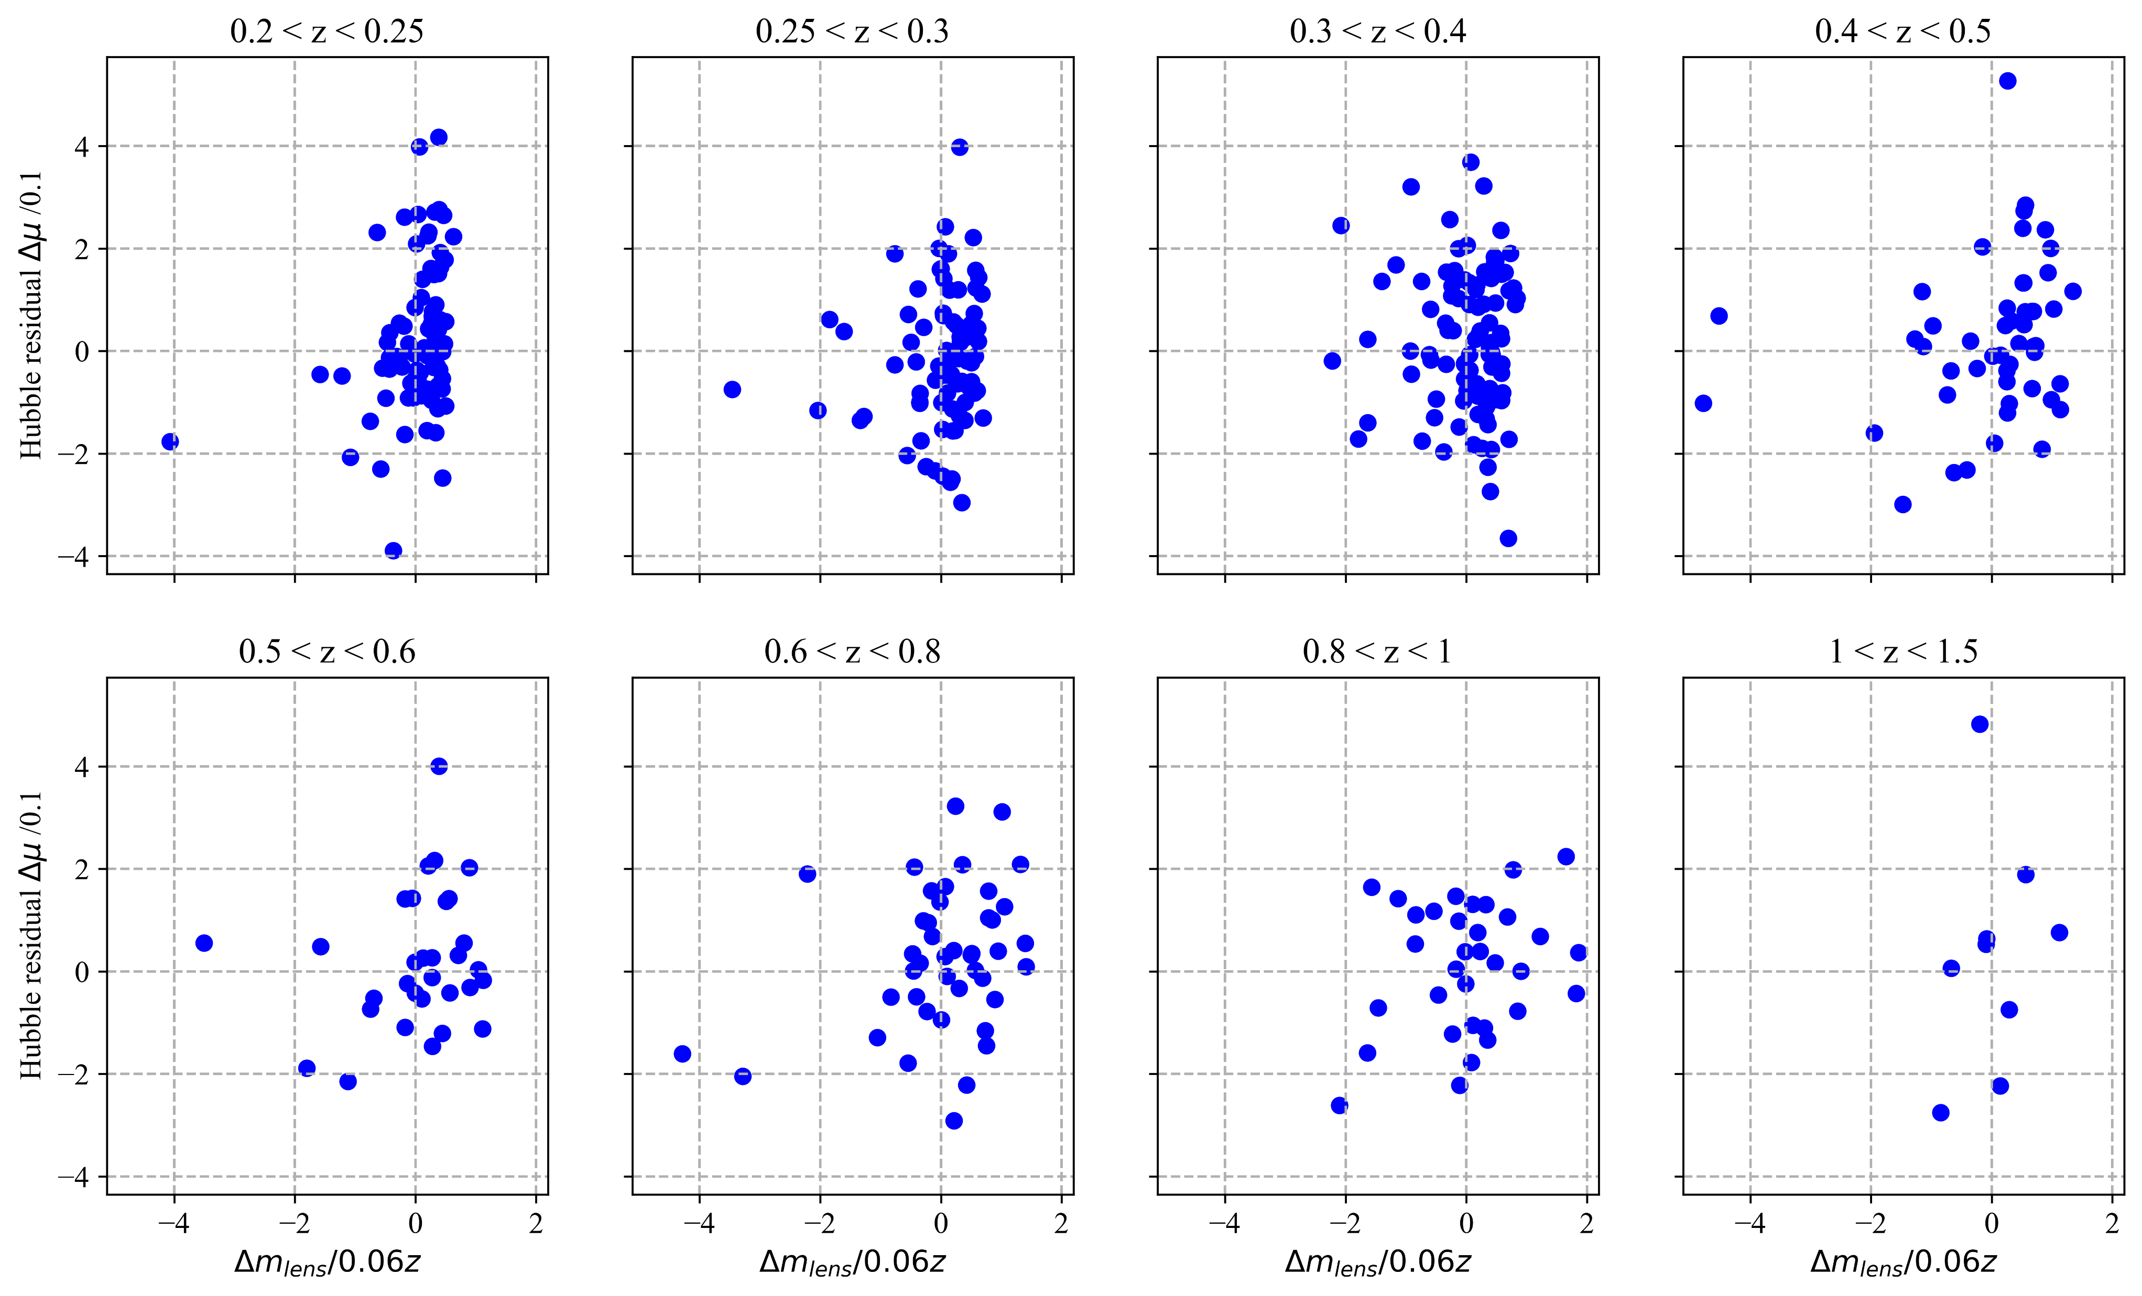

Result 1 : Does it work? Yes
Correlate $Δm_{lens}$ and $μ_{res}=μ_{obs} −μ_{ΛCDM}$
Use Pantheon and SDSS (Scolnic 2018, Eisenstein 2011)
Find $ρ=0.166±0.046 (3.5σ)$
Why better?
Extra signal power from position, photometry of foreground
SN Ia calibration in Pantheon
Shah, Lemos, Lahav 2022

Slide 9
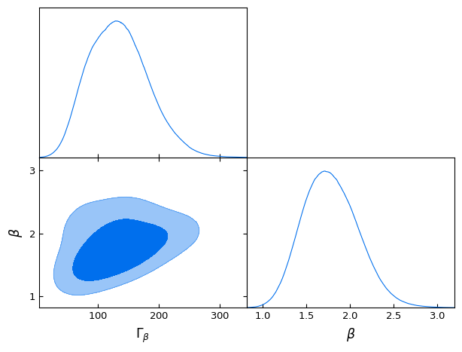

Result 2 : mass and shape of dark matter haloes
Profile slope $β=1.8±0.3$
consistent with NFW halo
Isothermal sphere not favoured (<5%)
Mass-to-light ratio $Γ={197}_{−80}^{+64} h M_{⊙}/L_{⊙}$
$Γ_{cosmic} \sim 400 h M_{⊙}/L_{⊙}$ (Bahcall 2014)
So ~50% of DM density is bound in galactic haloes
Shah, Lemos, Lahav 2022

Slide 10
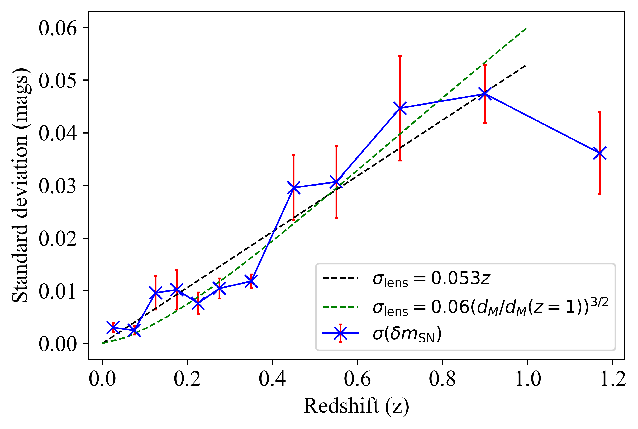
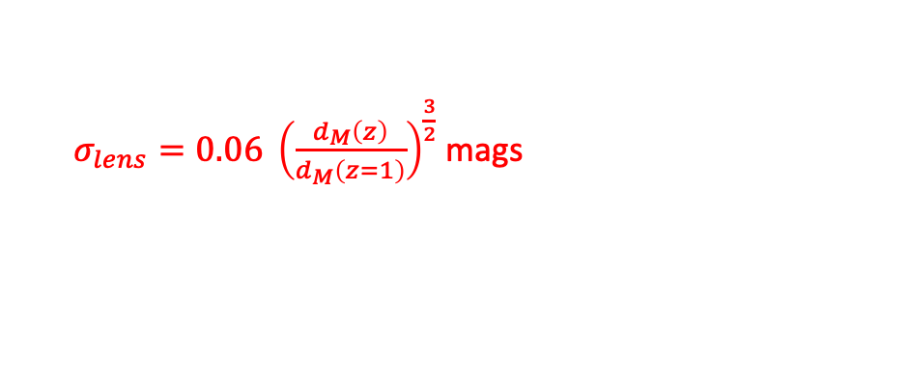
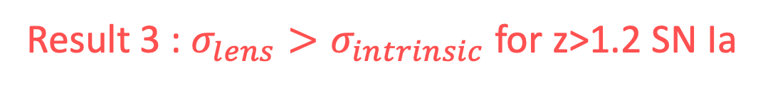
Result 3 : $σ_{lens}>σ_{intrinsic}$ for z>1.2 SN Ia
$σ_{lens}=0.06 {\left(\frac{d_{M}\left(z\right)}{d_{M}\left(z=1\right)}\right)}^{\frac{3}{2}}$ mags
Steeper slope than literature (volume effect)
Some outliers (contamination?)

Slide 11
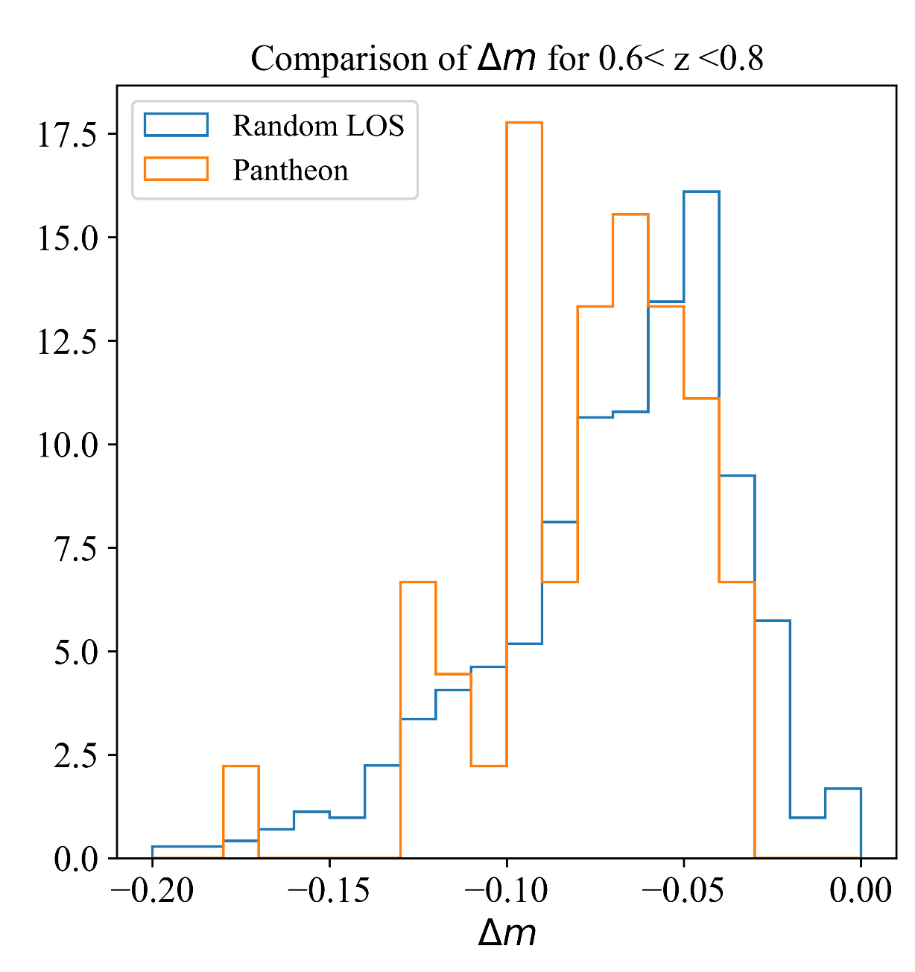

Result 4 : are SN Ia biased probes of cosmological parameters?
Test $Δm_{lens}$between Pantheon and random lines of sight
Moderate evidence Pantheon SN Ia are on slightly over-dense LOS
Over-dense bins coincide with main survey magnitude limits
Use modified $μ=m−M+αx_{1}−βc+Δ_{M}+Δ_{B}−{η Δm}_{lens}$
Lensing is an environmental variable
Foreground voids can mimic w<-1 dark energy due to lensing skew
Difference is $\frac{ΔΩ_{M}}{Ω_{m}}∼2\%$ in ΛCDM, and $Δw∼+0.04$ in wCDM for Pantheon

Slide 12
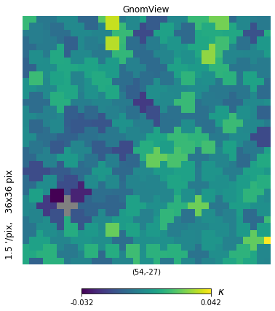
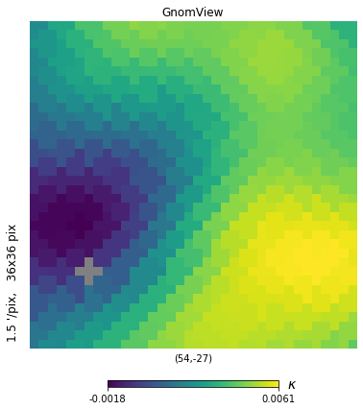
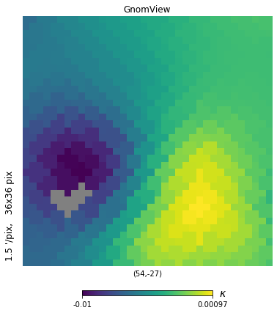
Future work : dark matter maps from SN Ia?
DES Deep Field C1 ~ 1 deg² , sources 0.8 < z < 0.1
Lensing estimator
Smooth over 10’
Map from galaxy shear
Shah, in prep
Jeffreys 2021
Almost no data in common!

Slide 13
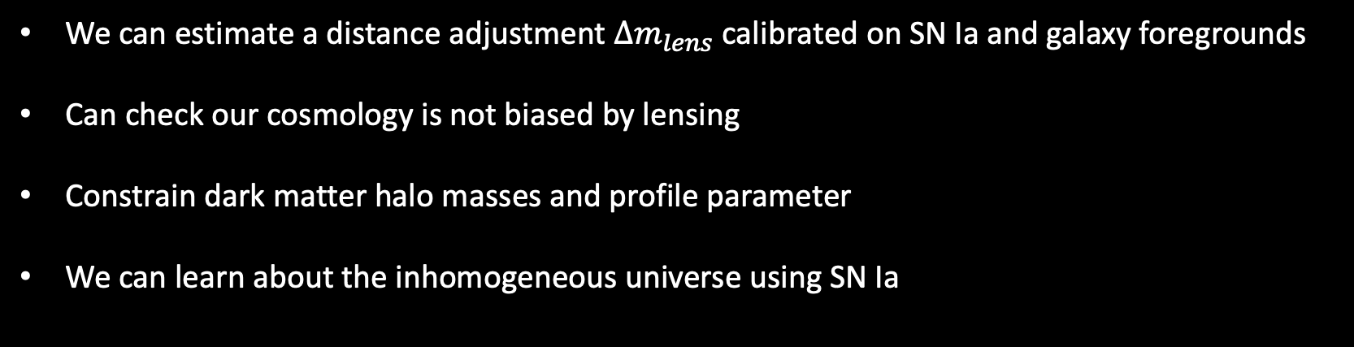
Main takeaways
We can estimate a distance adjustment $Δm_{lens}$ calibrated on SN Ia and galaxy foregrounds
Can check our cosmology is not biased by lensing
Constrain dark matter halo masses and profile parameter
We can learn about the inhomogeneous universe using SN Ia
https://arxiv.org/pdf/2203.09865.pdf
Paul Shah, Pablo Lemos and Ofer Lahav
https://arxiv.org/pdf/2210.10688.pdf
Paul Shah, Pablo Lemos and Ofer Lahav

