Slide 1

UCL Astrophysics
“It’s OK to be wrong*”
Paul Shah
*other outcomes are available

Slide 2
Your speaker
I look old but…
I did a Ph.D. in Theoretical Physics in 1995
I worked as a ‘derivatives’ trader in the City for 20 years
Many traders had similar backgrounds (more than economics…)
When you read the science news before you check what the Nikkei has done overnight…
I am now a post-doc in the Cosmology group at UCL

Slide 3
It’s OK to be wrong*
*Don’t try this in an exam!
School teaches you the ideas that have stood the test of time
You don’t generally get to hear about the ones that didn’t
All those “wrong” ideas seemed right for a while, but eventually failed the test of time
New experimental data
Known flaws became too problematic to ignore
Inconsistency with new ideas from elsewhere
We’ll look at a great story of being wrong in Cosmology
There are many others : e.g. the story of Cecilia Payne and the composition of our Sun

Slide 4
Audience voting!
www.slido.com
Code : 3308935

Slide 5
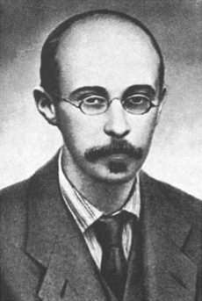
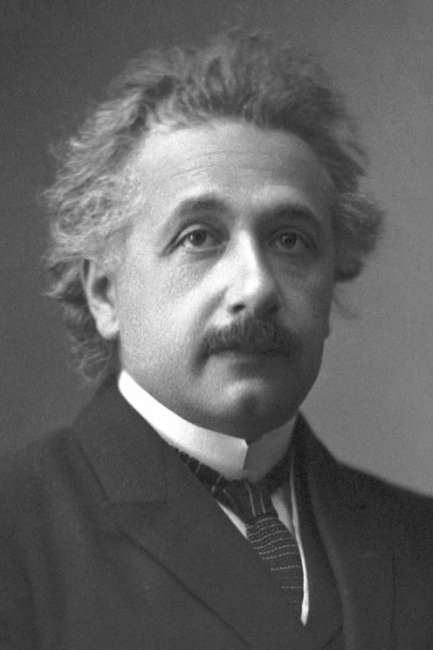
Is the Universe expanding?
Yes
No
Friedmann, 1922
Einstein, 1917

Slide 6
Friedmann’s argument
The dynamics of space are determined by gravity per Einstein’s equations
Imagine a stone thrown upwards from the surface of a planet
The stone starts out quickly, then slows down as gravity drags it back
It will either escape (= go on forever) or fall back (= re-collapse), depending on the size of planet (= amount of matter) vs velocity
What it won’t do is hover!
So also space must expand or contract, it can’t sit still
Yes
Friedmann, 1922

Slide 7
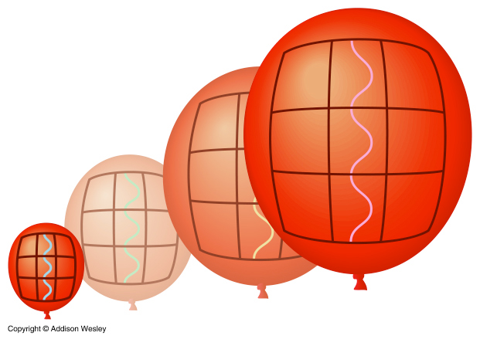
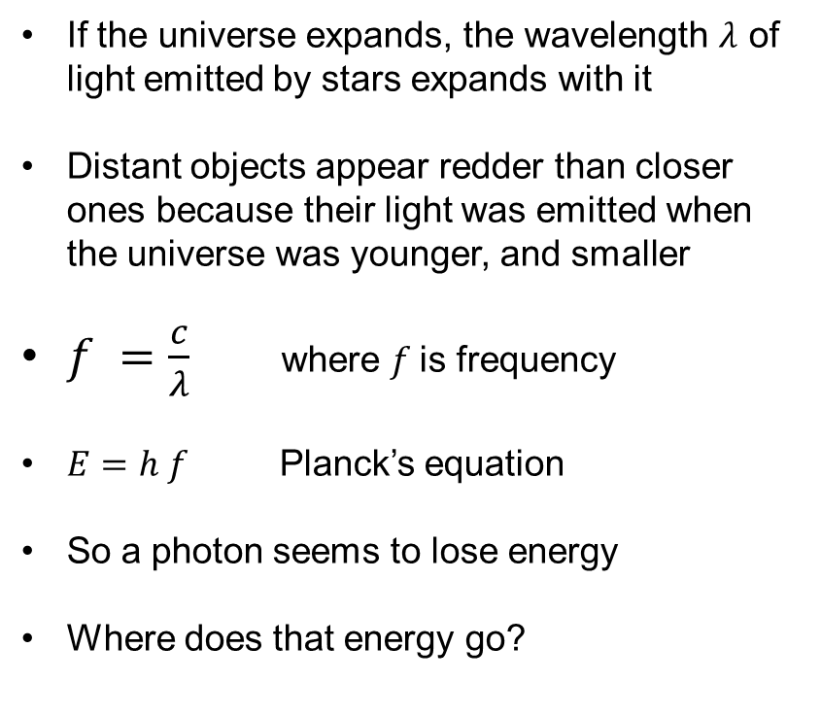
What happens if the universe expands?
If the universe expands, the wavelength $λ$ of light emitted by stars expands with it
Distant objects appear redder than closer ones because their light was emitted when the universe was younger, and smaller
$f =\frac{c}{λ}$ where $f$is frequency
$E=h f$ Planck’s equation
So a photon seems to lose energy
Where does that energy go?

Slide 8


Where does the energy go?
www.slido.com
Code : 3308935

Slide 9
An unpleasant consequence…
The unpleasant, and disturbing consequence of an expanding universe is energy is “lost”, never to be retrieved!
It’s still (almost) conserved in the lab
Because our experiments are small and don’t last long, compared to the age and size of the universe
If the universe expands forever, the last stars eventually die and all the light ever emitted by stars fades away to nothing…

Slide 10
Einstein’s argument
The distribution of stars in the universe is finite, or it is infinite
If it is finite, stars must from time to time, escape into the void, never to return : a problem if you want galaxies to exist
If it is infinite, the gravitional potential energy must also be infinite!
Einstein’s solution : add a Cosmological Constant to the equations of general relativity. It works like anti-gravity and cancels the infinity.
If the amount of this anti-gravity is just right, the universe can be static and need not expand
No
Einstein, 1922

Slide 11
Who was right, Einstein or Friedmann?
www.slido.com
Code : 3308935

Slide 12
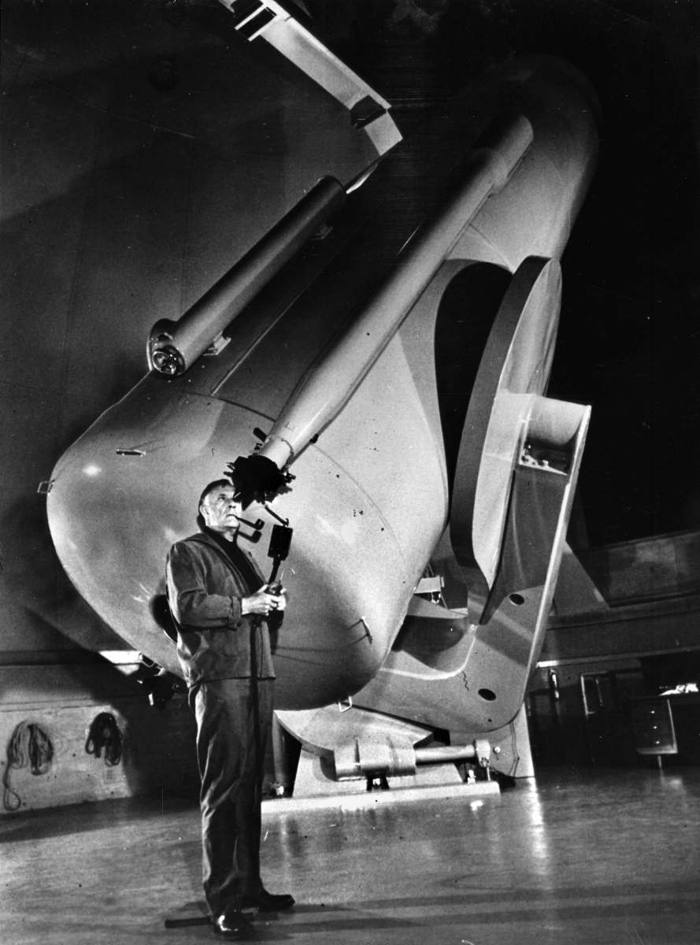
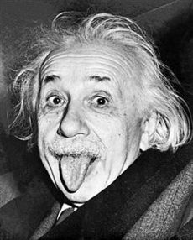
RIP, cosmological constant
Edwin Hubble observed distant galaxies were receding from us
The discovery in 1964 of the cosmic microwave background “clinched the deal” for a Big Bang
it is thermally-emitted light from when the universe was as hot as the sun
shows the universe must have been smaller (by ~1000 times) when the light was emitted (photons had more energy)
There seemed no need for the “weird” cosmological constant
“That was the biggest blunder of my life”
George Gamow, attr. Einstein

Slide 13
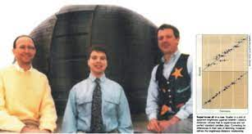
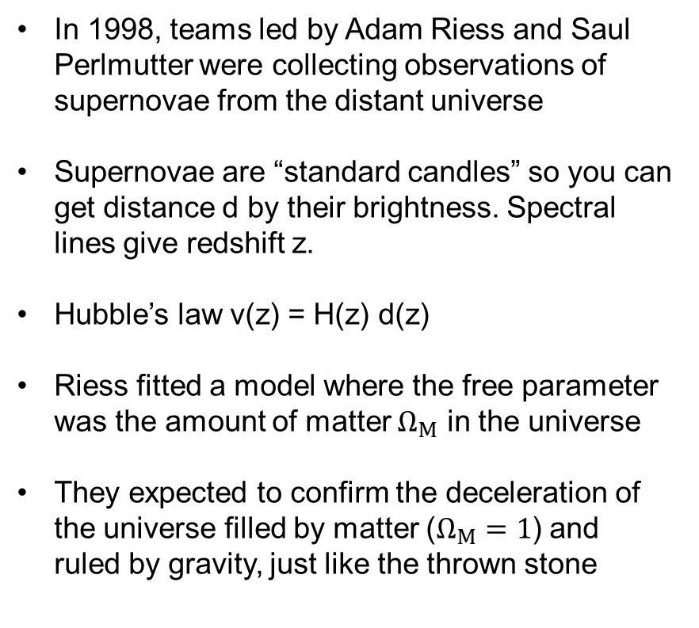
70 years later…
In 1998, teams led by Adam Riess and Saul Perlmutter were collecting observations of supernovae from the distant universe
Supernovae are “standard candles” so you can get distance d by their brightness. Spectral lines give redshift z.
Hubble’s law v(z) = H(z) d(z)
Riess fitted a model where the free parameter was the amount of matter $Ω_{M}$ in the universe
They expected to confirm the deceleration of the universe filled by matter ($Ω_{M}=1$) and ruled by gravity, just like the thrown stone
Bill Press, Adam Riess and Bob Kirschner

Slide 14
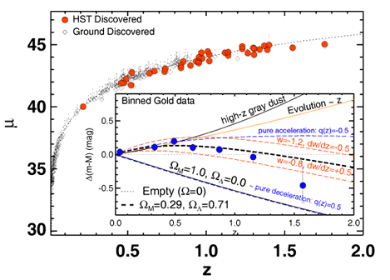
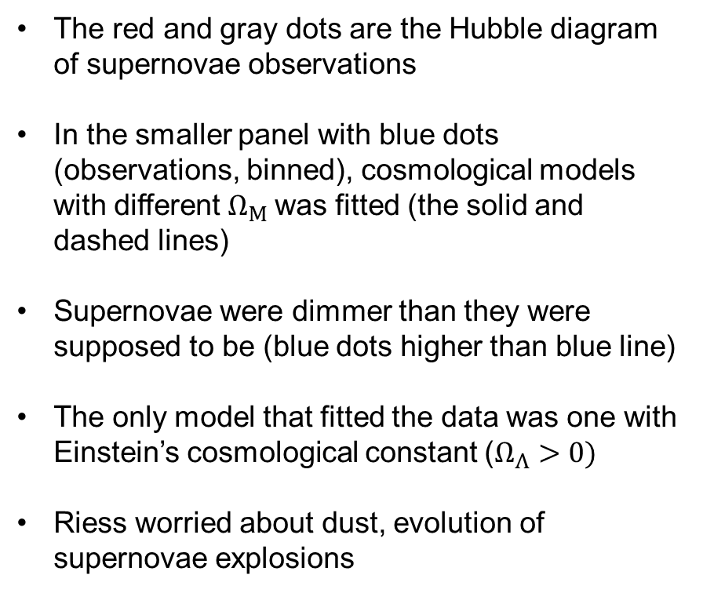
But the data didn’t agree
The red and gray dots are the Hubble diagram of supernovae observations
In the smaller panel with blue dots (observations, binned), cosmological models with different $Ω_{M}$was fitted (the solid and dashed lines)
Supernovae were dimmer than they were supposed to be (blue dots higher than blue line)
The only model that fitted the data was one with Einstein’s cosmological constant ($Ω_{Λ}>0)$
Riess worried about dust, evolution of supernovae explosions
Riess et al, 1998

Slide 15
Your senior team members have got your back?
M. Phillips, Chile, 1/12/1998 04:56 am: “As serious and responsible scientists (ha!), we all know that it is FAR TOO EARLY to be reaching firm conclusions about the value of the cosmological constant…”
R. Kirshner, Santa Barbara, CA, 1/12/1998 10:18 am: “I am worried. In your heart you know [the cosmological constant] is wrong, though your head tells you that you don’t care and you’re just reporting the observations… It would be silly to say ‘we MUST have a nonzero [cosmological constant]’ only to retract it next year.”
B. Schmidt, Australia, 1/11/1998 7:13 pm: “It is true that the new SNe say that [the cosmological constant] is greater than zero… How confident are we in this result? I find it very perplexing…
J. Tonry, Hawaii, 1/12/1998 11:40 am: “…who remembers the detection of the magnetic monopole and other gaffes?…on the other hand, we should not be shy about getting our results out with appropriate disclaimers…”

Slide 16
Your senior team members have got your back?
N. Suntzeff, Chile, 1/13/1998 1:47 pm: “I really encourage you [Adam] to work your butt off on this. Everyone is right. We need to be careful and publish good stuff with enough discussion to make it believable to ourselves. … If you are really sure that the [cosmological constant] is not zero – my god, get it out! Take responsibility as organizer and grunt. I mean this seriously – you probably never will have another scientific result that is more exciting come your way in your lifetime.
What would you do?

Slide 17
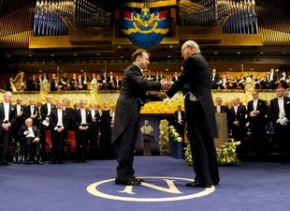
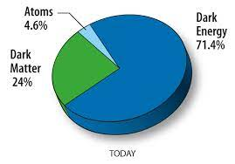
2011 Nobel prize
Dark energy
isn’t matter
has negative pressure
why is there (about) the same amount of it as matter?
will cause the universe to expand forever, maybe even a “Big Rip”
Saul Perlmutter and Brian Schmidt were also recognised
Google it! Adam Riess Nobel prize lecture

Slide 18
It’s OK to risk being wrong
Take the risk of being wrong if
The data fits your theory
Your theory is scientific and consistent
You’ve (mostly) covered off other explanations
You have to be brave to disagree with the consensus
You will get pushback, be prepared to defend your idea
If you are wrong, try to realise that quickly…
You have a finite resource of time and credibility
But you might also just be ahead of your time, like Einstein!

Slide 19
Postscript :
In the Big Bang, what "banged"?
www.slido.com
Code : 3308935

Slide 20
Thank you for listening

Slide 21
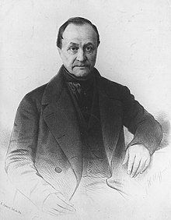
What is the Sun made out of?
“On the subject of stars, all investigations which are not ultimately reducible to simple visual observations are... necessarily denied to us.. We shall never be able by any means to study their chemical composition.”
Auguste Comte, 1835

Slide 22
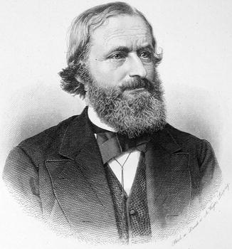
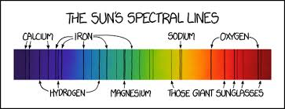

What is the Sun made out of?
Image credit : xkcd comic
Solar spectrum, (not) as drawn by Kirchoff, 1863
Gustav Kirchoff

Slide 23
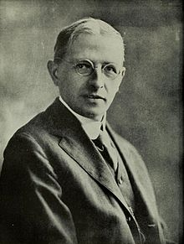
What is the Sun made out of?
“The agreement of the solar and terrestrial lists is such as to confirm very strongly Rowland’s opinion that, if the Earth’s crust should be raised to the temperature of the Sun’s atmosphere, it would give a very similar absorption spectrum. The spectra of the Sun and other stars were similar, so it appeared that the relative abundance of elements in the universe was like that in Earth’s crust”
Henry Norris Russell, Princeton 1914

Slide 24
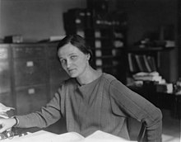
What is the Sun made out of?
Payne used a new equation developed in quantum physics by Saha in 1920 to calculate elemental abundances from line strengths (it depends a lot on temperature) but :
“The enormous abundances derived for [hydrogen and helium] in the stellar atmosphere are almost certainly not real.”
Cecila Payne, Ph.D. student of Russell, 1925

Slide 25
What is the Sun made out of?
Russell’s view appeared to match the data, and was the scientific consensus at the time
He persuaded Payne to doubt her own results
However, Russell realised he was wrong 4 years later and fully acknowledged his mistake
The theory of the power source of stars (nuclear fusion) and the realisation they are the “chemical factories” of the universe took 50 more years to develop, and is still evolving (e.g. gold)
“The reward of the young scientist is the emotional thrill of being the first person in the history of the world to see something or understand something. Nothing can compare with that experience [...]”
Cecilia Payne, 1977, Russell Prize acceptance speech

Slide 26
It’s OK to be wrong*
You can be wrong for the right reasons
Russell’s view was an OK fit to data at the time
But there were inconsistencies (how old was the Sun?)
If you have a better idea, have confidence in yourself!
If you are wrong, try to realise that quickly…
“When the facts change, I change my mind. What do you do, sir?”
Paul Samuelson (attr. John Maynard Keynes)

