Slide 1
APPLYING SHIFTING Reflection AND SCALING OPERATION ON SIGNAL
GROUP MEMBERS:
1. Shovon Paul ( 2015-1-60-130)
2. Jubair Islam Joy ( 2015-1-60-052)
3. Imtiaz Ahmed (2015-1-60-042)

Slide 2
OVERVIEW
Introduction:
Shifting, Reflection and Scaling
Odd & Even part of Signal
Verifying Symmetries of a Signal
Mathematical & Graphical examples
Application

Slide 3
Signal Transformations
Most of these operations performed on the independent variable. There are Three (3) operations, they are
Time Shifting
Reflection
Time Scaling

Slide 4
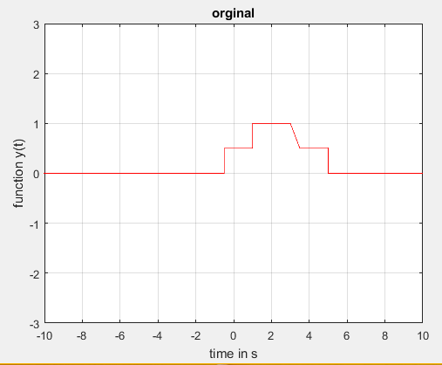
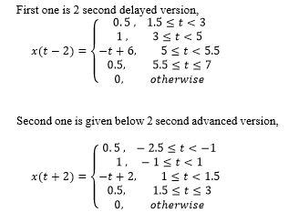
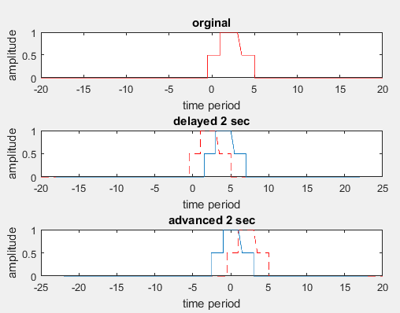
Time Shifting
Signal x(t-t₀) represents a time-shifted version of x(t).
If t₀>0,then the signal is delayed by t₀ seconds.
If t₀<0,then the signal is advanced signal of x(t).

Slide 5
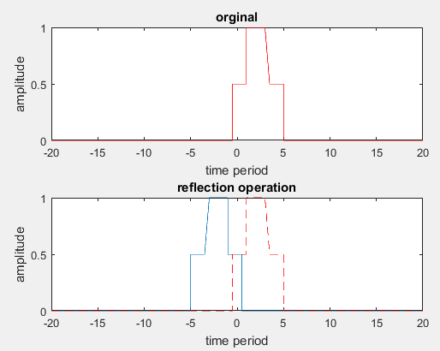
Reflection
The Signal x(-t) is obtained from the signal x(t) by a Reflection
0.5 , -1 ≤ t <0.5
x(-t)= 1 , -3 ≤ t < -1
t+4 , -3.5 ≤ t < -3
0.5 , -5 ≤ t<-3.5
0, otherwise

Slide 6
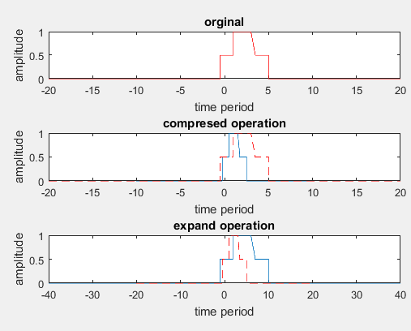
Time Scaling
1. x (Ƞt) is the Scaled version of x(t).
2. If |Ƞ|>1 then x (Ƞt) is the Compressed version
3.If |Ƞ|<1 then x (Ƞt) is the Expended signal.
0.5, -0.25 ≤ t < 0.5
x(2t)= 1 , 0.5 ≤ t < 1.5
-2t+4, 1.5 ≤ t < 1.75
0.5, 1.75 ≤ t ≤ 2.5
0, otherwise
0.5 , - 1 ≤ t < 2
x(0.5t)= 1 , 2 ≤ t <6
-0.5t+4 , 6 ≤ t < 7
0.5, 7 ≤ t ≤ 10
0, otherwise

Slide 7
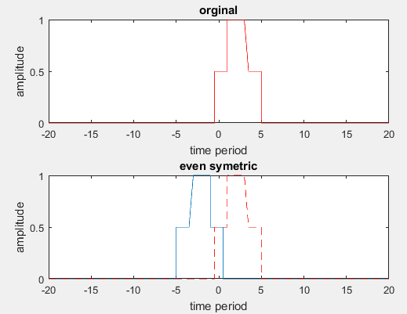
Symmetric Signal
A signal is x(t) Even symmetric if x(t) = x(-t)
It seems that x(t) ≠ x(-t)
So We can say Our Signal is not Even Symmetric

Slide 8
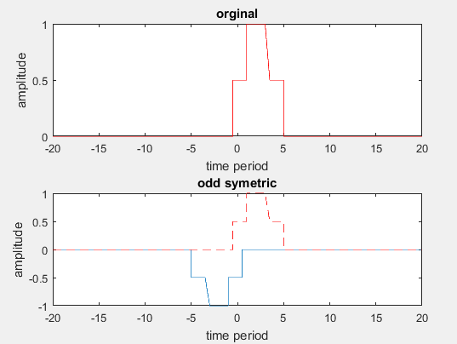
Symmetric Signal
A signal is x(t) Odd symmetric if x(t) = -x(-t)
It seems that x(t) ≠ -x(-t)
So We can say Our Signal is not Odd Symmetric

Slide 9
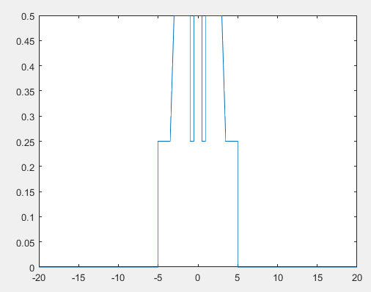
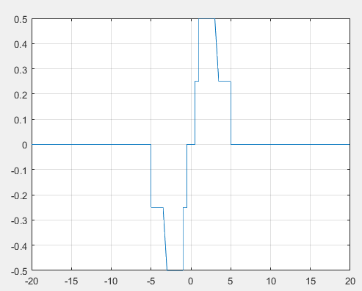
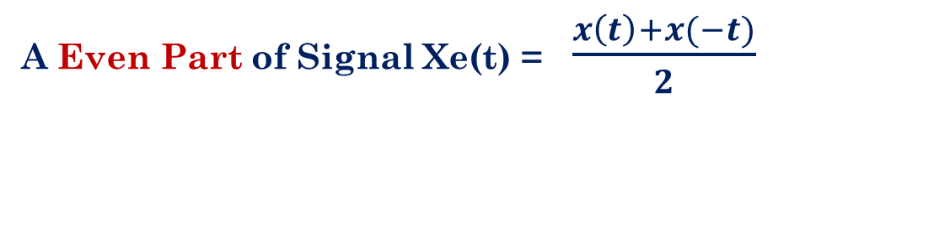

Even & ODD Part of Signal
A Even Part of Signal Xe(t) = $\frac{x\left(t\right)+x(−t)}{2}$
A Odd Part of Signal Xe(t) = $\frac{x\left(t\right)−x(−t)}{2}$

Slide 10
APPLICATIONS
Industrial Control and Automation (Control the velocity or position of an object)
Controlling the position of a Valve of a motor
Transmission of Information (signal) over a Channel
The Channel may be free Space, fiber Optic Cable
Analog Modulation: Transmitting Audio Signals
Higher frequency Range → Good Propagation
Used in CDs, Digital Cellular service, Digital Phone lines and Computer modems.

Slide 11
CONCLUSION
Signal Operations are simply modifications to the time variable of the
signal
These are pretty similar to the mathematical graphical transformation

Slide 12

Any Question or Suggestion

Slide 13

THANK YOU!!

