Slide 1

Unit03 node.js & mongo Part IV
Ranken Technical College

Slide 2
Objectives
Explain how to connect to a MongoDB database using Compass. This assumes that node has already been loaded onto your system

Slide 3
Connecting to MongoDB with Compass
MongoDB Compass is a GUI alternative to access MongoDB. It's an app that makes checking (and editing) databases easier than using the command line
Compass may (or may not) install automatically with a standard Windows 10 MongoDB installation. If it does not, it can be downloaded separated from the following URL: https://docs.mongodb.com/compass/master/install/
Source
https://zellwk.com/blog/local-mongodb/

Slide 4
Connecting to MongoDB with Compass
Compass requires:
A 64-bit version of Microsoft Windows 7 or later.
MongoDB 3.6 or later.
The Microsoft .NET Framework version 4.5 or later. NOTE: The Compass installer prompts you to install the minimum required version of the .NET framework if it is not already installed on your system
Source
https://docs.mongodb.com/compass/master/install/#download-install

Slide 5
Connecting to MongoDB with Compass
To download Compass, open the downloads page. Select the preferred installer (.exe, .msi or .zip archive). Download the latest version of MongoDB Compass for Windows
Double-click the installer file. Follow the prompts to install Compass. You can select the destination of the Compass installation
Once installed, Compass launches and prompts you to configure privacy settings and specify update preferences
Source
https://docs.mongodb.com/compass/master/install/#download-install

Slide 6
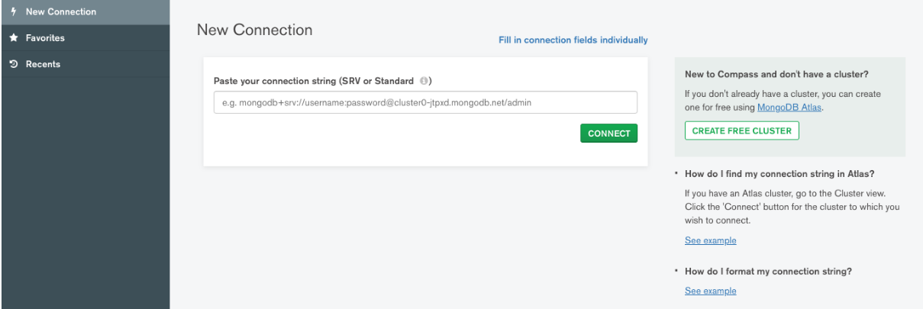
Connecting to MongoDB with Compass
When you open Compass, an initial connection dialog appears:
Source
https://docs.mongodb.com/compass/master/connect/

Slide 7
Connecting to MongoDB with Compass
Compass provides two methods to connect to your deployment:
Providing a deployment connection string
Filling in deployment information in specific fields
Source
https://docs.mongodb.com/compass/master/connect/

Slide 8
Connecting to MongoDB with Compass
Connection String:
Compass supports most Connection String Options supported by MongoDB. By default, Compass's default socketTimeoutMS value is 60000, or 60 seconds. For a complete list of the connection string options which Compass supports, see the Compass Connection README on GitHub at URL: https://github.com/mongodb-js/connection-model/blob/master/README.md#properties
Source
https://docs.mongodb.com/compass/master/connect/

Slide 9
Connecting to MongoDB with Compass
Connection String Steps:
Paste your connection string.
If you have the connection string for your deployment available, you can paste the string directly into the dialog box. You can use either the Standard Connection String Format or the DNS Seedlist Connection Format
To obtain the connection string for an Atlas cluster, navigate to your Atlas Clusters view, click Connect for your desired cluster, click Connect with MongoDB Compass, and Copy the provided connection string
To learn how to format the connection string for a deployment which is not hosted on Atlas, see Connection String URI Format at https://docs.mongodb.com/manual/reference/connection-string/
Source
https://docs.mongodb.com/compass/master/connect/

Slide 10
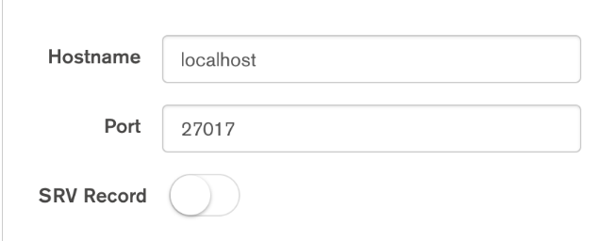
Connecting to MongoDB with Compass
Connection String Steps:
Connect
To connect to your local MongoDB, set Hostname to localhost and Port to 27017. These values are the default for all local MongoDB connections:
Source
https://docs.mongodb.com/compass/master/connect/

Slide 11
Connecting to MongoDB with Compass
Connection String Steps:
Connect
Once you are connected to your MongoDB deployment, you may require specific user roles to access various Compass features. MongoDB Compass securely stores sensitive information entered in the connection form using an API that is specific to your operating system
Source
https://docs.mongodb.com/compass/master/connect/

Slide 12
Connecting to MongoDB with Compass
Connection String Steps:
Disconnect
Click Connect in the menu bar. Select Disconnect from the dropdown menu. Disconnecting from a MongoDB instance closes the Compass connection to the active instance and returns the Compass view to the initial connection dialog
Source
https://docs.mongodb.com/compass/master/connect/

Slide 13
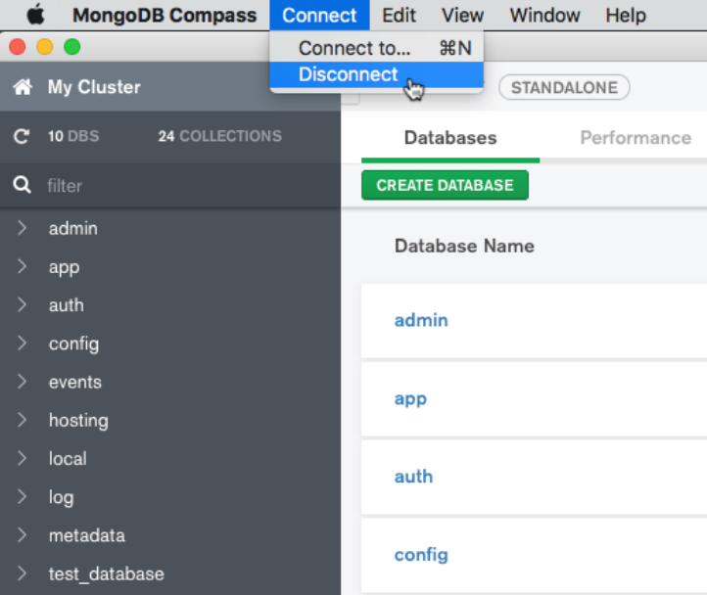
Connecting to MongoDB with Compass
Connection String Steps:
Disconnect
Source
https://docs.mongodb.com/compass/master/connect/

Slide 14
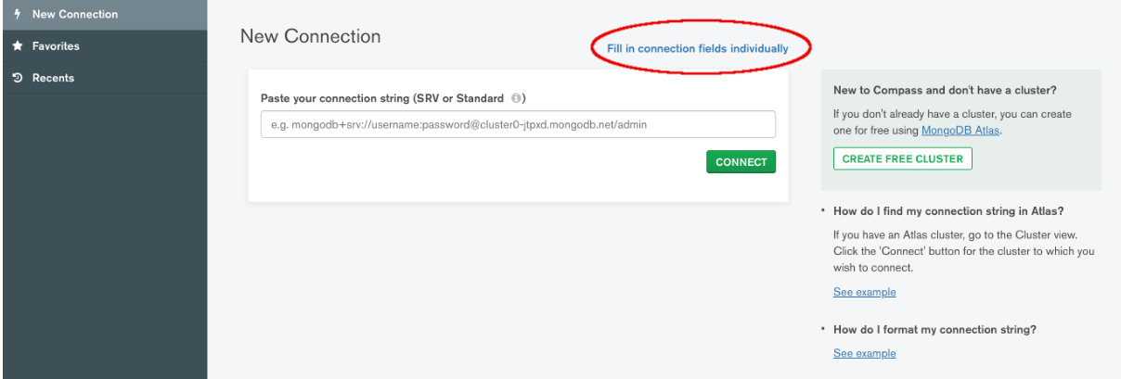
Connecting to MongoDB with Compass
Manually Filling In Individual Connection Fields:
To manually fill in individual connection fields, click Fill in connection fields individually
Source
https://docs.mongodb.com/compass/master/connect/

Slide 15
Connecting to MongoDB with Compass
Manually Filling In Individual Connection Fields:
The Hostname dialog contains the following connection field options:
Hostname. The Hostname of the machine where the deployment is running. If you are running your deployment locally, this value is localhost. If you are connecting to an Atlas cluster, you can get your hostname from your cluster detail view in Atlas
Port, The Port on which the deployment is running. Not required if you are using an SRV Record to connect to your MongoDB deployment. By default, a standalone deployment operates on port 27017. If you are connecting to a replica set, your port may also be 27018 or 27019
Source
https://docs.mongodb.com/compass/master/connect/

Slide 16
Connecting to MongoDB with Compass
Manually Filling In Individual Connection Fields:
The Hostname dialog contains the following connection field options:
SRV Record. This field indicates whether the provided Hostname is an SRV Record. If this toggle is enabled, you do not need to specify a port
Authentication. This field specifies the authentication to use if the deployment requires authentication. Atlas clusters use Username / Password authentication
Favorite Name. This optional field provides a name for the connection. To save the current connection entered as a favorite connection, enter a name in the input and click Create Favorite
Source
https://docs.mongodb.com/compass/master/connect/

Slide 17
Connecting to MongoDB with Compass
Manually Filling In Individual Connection Fields:
(Optionally you can) Specify replica set and security connection options.
The More Options connection screen allows you to specify the following options:
Replica Set Name. If your MongoDB deployment is a replica set, specify the replica set name. Not required if you specify your replica set Hostname as an SRV Record
Read Preference. Specifies how Compass directs read operations. Options are: Primary, Primary Preferred, Secondary, Secondary Preferred, and Nearest
Source
https://docs.mongodb.com/compass/master/connect/

Slide 18
Connecting to MongoDB with Compass
Manually Filling In Individual Connection Fields:
Connect.
Click the Connect button to navigate to the Compass Home Page. Once you are connected to your MongoDB deployment, you may require specific user roles to access various Compass features. MongoDB Compass securely stores sensitive information entered in the connection form using an API that is specific to your operating system
Source
https://docs.mongodb.com/compass/master/connect/

Slide 19
Connecting to MongoDB with Compass
Manually Filling In Individual Connection Fields:
Disconnect.
The disconnect sequence is the same as for using a connection string (Slides 13 – 14)
Source
https://docs.mongodb.com/compass/master/connect/

Slide 20
What We've Covered
How to connect to a MongoDB database using Compass

