Slide 1

Unit03 node.js & mongo Part V
Ranken Technical College

Slide 2
Objectives
Explain how to connect to a MongoDB database using Atlas. This assumes that node has already been loaded onto your system

Slide 3
Connecting to MongoDB with Atlas
MongoDB Atlas is a MongoDB cloud service available on AWS, Azure, and GCP. The website is located at: https://www.mongodb.com/cloud/atlas The user should go here and register for his/her free Atlas account
If the user runs into any installation issues, it is recommended that s/he go to URL: https://studio3t.com/knowledge-base/articles/mongodb-atlas-login-ip-whitelisting/
From the main website, the user can get their first MongoDB Atlas cluster for free by downloading the latest Studio 3T version for their machine
Source
https://studio3t.com/knowledge-base/articles/connect-to-mongodb-atlas/

Slide 4
Connecting to MongoDB with Atlas
The following is included in a free MongoDB Atlas cluster:
512 MB of storage
Shared RAM
Highly available replica sets, end-to-end encryption, automated patches, REST API
Max connections: 100
Network performance: Low
Max databases: 100
Max collections: 500
Source
https://studio3t.com/knowledge-base/articles/connect-to-mongodb-atlas/

Slide 5
Connecting to MongoDB with Atlas
Get the connection string from MongoDB Atlas
The user logs into his/her MongoDB Atlas account. This will take then to the Clusters overview
Source
https://studio3t.com/knowledge-base/articles/connect-to-mongodb-atlas/

Slide 6
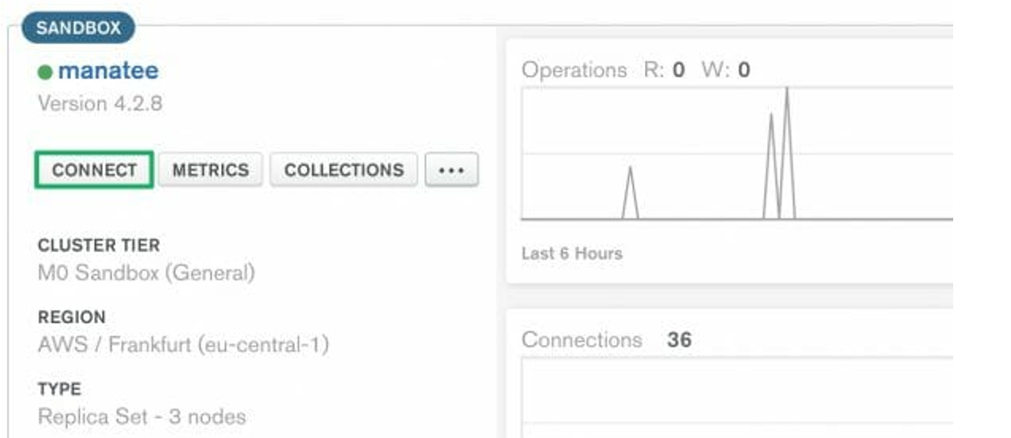
Connecting to MongoDB with Atlas
Click on Connect:
Source
https://studio3t.com/knowledge-base/articles/connect-to-mongodb-atlas/

Slide 7
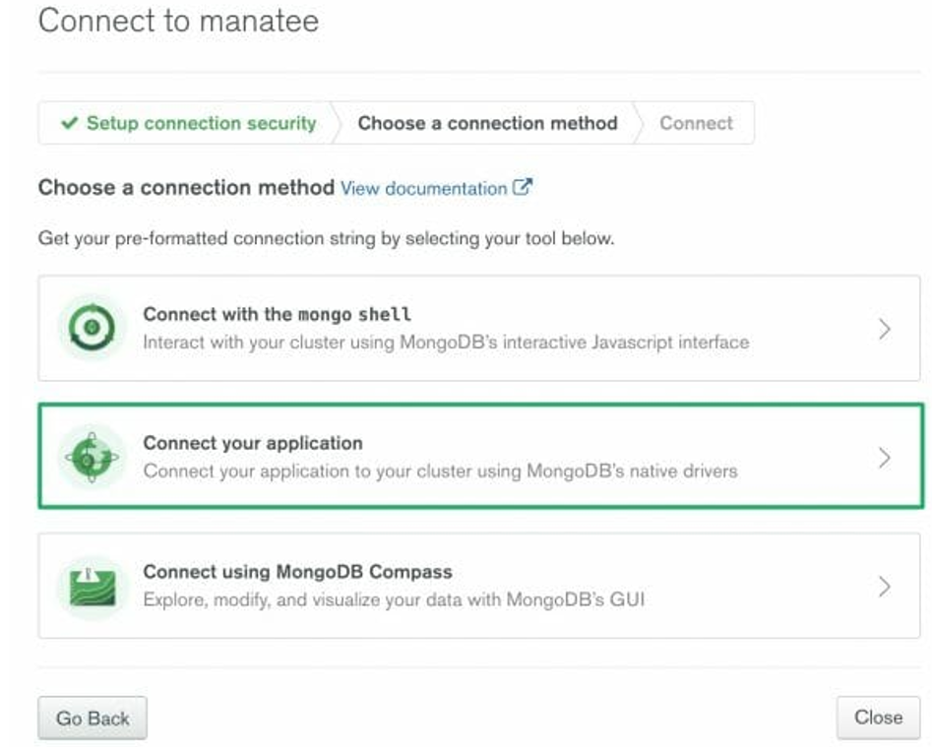
Connecting to MongoDB with Atlas
Choose the desired connection type:
Source
https://studio3t.com/knowledge-base/articles/connect-to-mongodb-atlas/

Slide 8
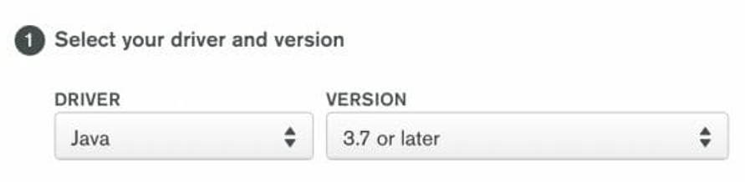
Connecting to MongoDB with Atlas
Choose the driver and driver version. Copy the generated connection string. Later you'll need to paste this into Studio 3T
Source
https://studio3t.com/knowledge-base/articles/connect-to-mongodb-atlas/

Slide 9
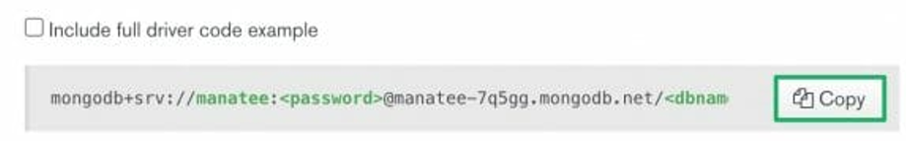
Connecting to MongoDB with Atlas
Add the connection string into your application code. Replace <password> with the user password and <dbname> with the database that connections will use by default
Source
https://studio3t.com/knowledge-base/articles/connect-to-mongodb-atlas/

Slide 10
Connecting to MongoDB with Atlas
Whitelist your IP address
If you have a dynamic IP address, it's worth double-checking the MongoDB Atlas IP Whitelist tab by:
Clicking on Network Access under the Security tab on the left-hand sidebar. This will take you to the IP Whitelist tab.
Clicking on Add IP Address in the top-right corner. This will open the Add IP Whitelist Entry dialog
Clicking on Add current IP address. MongoDB will automatically detect your current address, then click Confirm
Source
https://studio3t.com/knowledge-base/articles/connect-to-mongodb-atlas/

Slide 11
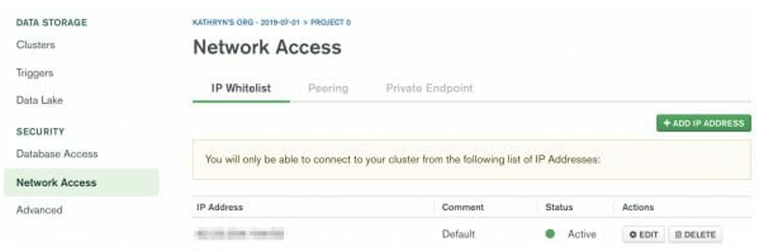
Connecting to MongoDB with Atlas
Whitelist your IP address
Source
https://studio3t.com/knowledge-base/articles/connect-to-mongodb-atlas/

Slide 12
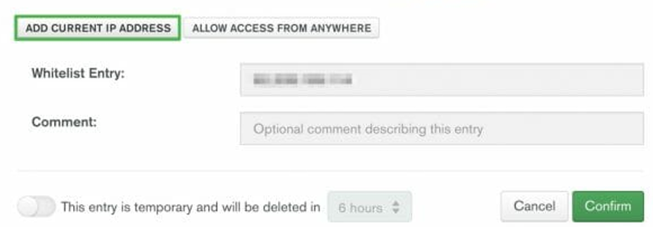
Connecting to MongoDB with Atlas
Add IP Whitelist Entry
Atlas only allows client connections to a cluster from entries in the project's whitelist
Source
https://studio3t.com/knowledge-base/articles/connect-to-mongodb-atlas/

Slide 13
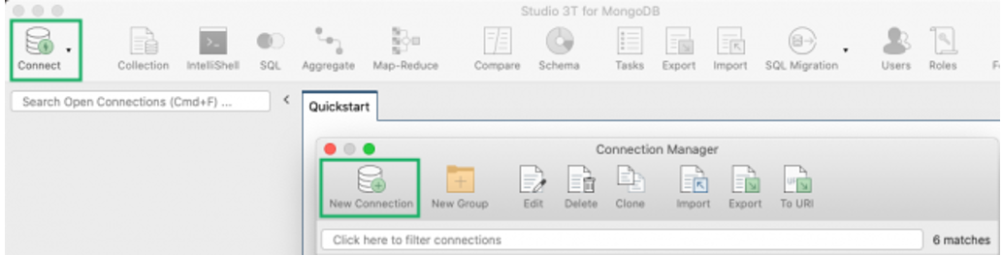
Connecting to MongoDB with Atlas
Connect to Studio 3T
Open Studio 3T and click on Connect in the top-left corner of the toolbar. This will open the Connection Manager. Click on New Connection in the top-left corner, which will open a new connection window
Source
https://studio3t.com/knowledge-base/articles/connect-to-mongodb-atlas/

Slide 14
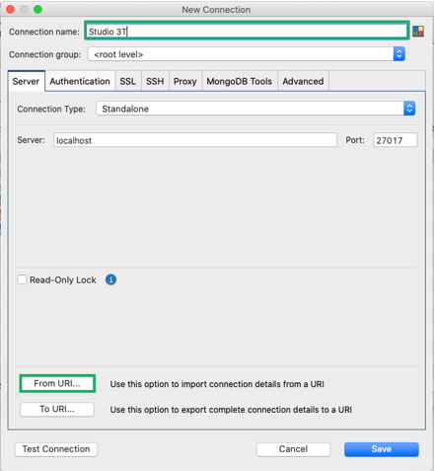
Connecting to MongoDB with Atlas
Connect to Studio 3T
Name the connection and click on the From URI button
Source
https://studio3t.com/knowledge-base/articles/connect-to-mongodb-atlas/

Slide 15
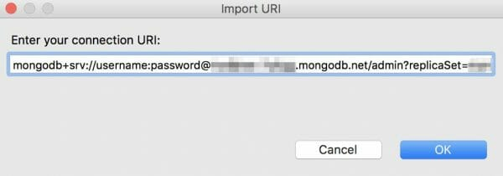
Connecting to MongoDB with Atlas
Connect to Studio 3T
Paste the connection string you copied from MongoDB Atlas.
Replace the placeholder "<password>" with your actual password and "<dbname>" with the name of the database that connections will use by default. Click OK
Source
https://studio3t.com/knowledge-base/articles/connect-to-mongodb-atlas/

Slide 16
Connecting to MongoDB with Atlas
If desired, Import data in JSON, CSV, BSON/mongodump or SQL
If you have an empty cluster, you can import JSON, CSV, BSON/mongodump or SQL to MongoDB with Studio 3T’s Import Wizard
Source
https://studio3t.com/knowledge-base/articles/connect-to-mongodb-atlas/

Slide 17
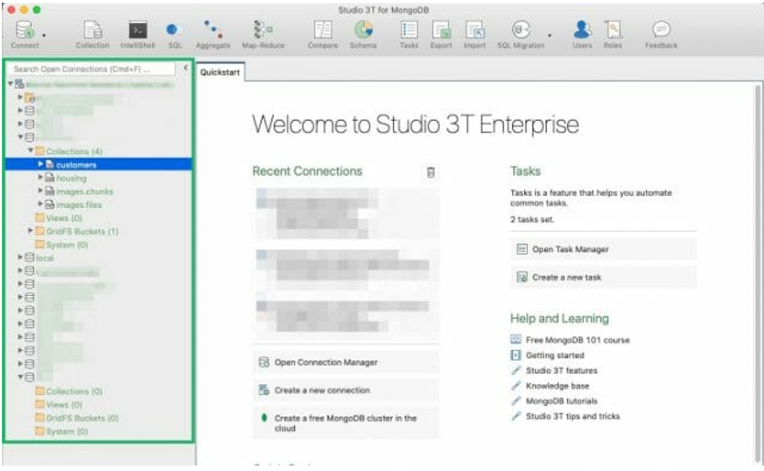
Connecting to MongoDB with Atlas
If desired, Explore MongoDB data
Click on a collection in the Connection Tree to open a Collection Tab, which is the starting point of all data exploration in Studio 3T
Source
https://studio3t.com/knowledge-base/articles/connect-to-mongodb-atlas/

Slide 18
What We've Covered
How to connect to a MongoDB database using Atlas

