Slide 1

Unit03 node.js & mongo Part VI
Ranken Technical College

Slide 2
Objectives
Review the use of some major MongoDB methods

Slide 3
Creating a MongoDB Database
Creating a Database
To create a database in MongoDB, start by creating a MongoClient object, then specify a connection URL with the correct IP address and the name of the database you want to create.
MongoDB will create the database if it does not exist, and make a connection to it
Source
https://www.w3schools.com/nodejs/nodejs_mongodb_create_db.asp

Slide 4
Creating a MongoDB Database
As an example, create node folder mongo_db_example
Create a package.js file via the command: npm init -y
Make MongoDB available via the command: npm install mongodb -s
Add the following file: index.js with the code shown on the next page
Source
https://www.w3schools.com/nodejs/nodejs_mongodb_create_db.asp

Slide 5
Creating a MongoDB Database
var MongoClient = require('mongodb').MongoClient;
var url = "mongodb://localhost:27017/mydb";
MongoClient.connect(url, function(err, db) {
if (err) throw err;
console.log("Database created!");
db.close();
});
Source
https://www.w3schools.com/nodejs/nodejs_mongodb_create_db.asp

Slide 6
Creating a MongoDB Database
Run node index.js which should give this result:
Database created!
It is important to realize that in MongoDB, a database is not created until it gets content. MongoDB waits until you have created a collection (table), with at least one document (record) before it actually creates the database (and collection)
Source
https://www.w3schools.com/nodejs/nodejs_mongodb_create_db.asp

Slide 7
Creating a MongoDB Collection
A collection in MongoDB is similar to a table in MySQL. To create a collection in MongoDB, use the createCollection() method
As an example, create file createCollection.js, which creates a collection called "customers" for the mydb database. See the code on the next page
Source
https://www.w3schools.com/nodejs/nodejs_mongodb_createcollection.asp

Slide 8
Creating a MongoDB Collection
var MongoClient = require('mongodb').MongoClient;
var url = "mongodb://localhost:27017/";
MongoClient.connect(url, function(err, db) {
if (err) throw err;
var dbo = db.db("mydb");
dbo.createCollection("customers", function(err, res) {
if (err) throw err;
console.log("Collection created!");
db.close();
});
});
Source
https://www.w3schools.com/nodejs/nodejs_mongodb_createcollection.asp

Slide 9
Creating a MongoDB Collection
Run node createCollection.js which should give this result:
Collection created!
Again, realize that in MongoDB, a database is not created until it gets content. MongoDB waits until you have created a collection (table), with at least one document (record) before it actually creates the database (and collection)
Source
https://www.w3schools.com/nodejs/nodejs_mongodb_createcollection.asp

Slide 10
Inserting a MongoDB Record
To insert a record, or document as it is called in MongoDB, into a collection, use the insertOne() method. The first parameter of the insertOne() method is an object containing the name(s) and value(s) of each field in the document you want to insert. It also takes a callback function where you can work with any errors, or the result of the insertion
See the code on the next page for an example (save as insertRecord.js)
Source
https://www.w3schools.com/nodejs/nodejs_mongodb_insert.asp

Slide 11
Inserting a MongoDB Record
var MongoClient = require('mongodb').MongoClient;
var url = "mongodb://localhost:27017/";
MongoClient.connect(url, function(err, db) {
if (err) throw err;
var dbo = db.db("mydb");
var myobj = { name: "Company Inc", address: "Highway 37" };
dbo.collection("customers").insertOne(myobj, function(err, res) {
if (err) throw err;
console.log("1 document inserted");
db.close();
});
});
Source
https://www.w3schools.com/nodejs/nodejs_mongodb_insert.asp

Slide 12
Inserting a MongoDB Record
Run node insertRecord.js which should give this result:
1 document inserted
Note: If you try to insert documents in a collection that do not exist, MongoDB will create the collection automatically
Source
https://www.w3schools.com/nodejs/nodejs_mongodb_insert.asp

Slide 13
Inserting Multiple MongoDB Records
To insert multiple documents into a collection in MongoDB, you use the insertMany() method. The first parameter of the insertMany() method is an array of objects, containing the data to insert. It also takes a callback function where you can work with any errors, or the result of the insertion:
As an example, see the code on the next page for an example (save as insert_Multiple_Records.js)
Source
https://www.w3schools.com/nodejs/nodejs_mongodb_insert.asp

Slide 14
Inserting Multiple MongoDB Records
var MongoClient = require('mongodb').MongoClient;
var url = "mongodb://localhost:27017/";
MongoClient.connect(url, function(err, db) {
if (err) throw err;
var dbo = db.db("mydb");
var myobj = [
{ name: 'Jeff', address: '755 Parr Rd.'},
{ name: 'Paul', address: '4431 Finney Ave.'},
{ name: 'Evan', address: '4431 Finney Ave'},
];
Source
https://www.w3schools.com/nodejs/nodejs_mongodb_insert.asp

Slide 15
Inserting Multiple MongoDB Records
dbo.collection("customers").insertMany(myobj, function(err, res) {
if (err) throw err;
console.log("Number of documents inserted: " + res.insertedCount);
db.close();
});
});
Source
https://www.w3schools.com/nodejs/nodejs_mongodb_insert.asp

Slide 16
Inserting a MongoDB Record
Run node insert_Multiple_Records.js which should give this result:
Number of documents inserted: 3
Source
https://www.w3schools.com/nodejs/nodejs_mongodb_insert.asp

Slide 17
Find a MongoDB Record
In MongoDB use the find and findOne methods to find data in a collection
To select data from a collection in MongoDB, use the findOne() method, which returns the first occurrence in the selection. The first parameter of the findOne() method is a query object. In this example we use an empty query object, which selects all documents in a collection (but returns only the first document)
As an example, create the find_One.js file shown next
Source
https://www.w3schools.com/nodejs/nodejs_mongodb_ifind.asp

Slide 18
Find a MongoDB Record
var MongoClient = require('mongodb').MongoClient;
var url = "mongodb://localhost:27017/";
MongoClient.connect(url, function(err, db) {
if (err) throw err;
var dbo = db.db("mydb");
dbo.collection("customers").findOne({}, function(err, result) {
if (err) throw err;
console.log(result.name);
db.close();
});
});
Source
https://www.w3schools.com/nodejs/nodejs_mongodb_find.asp

Slide 19
Find a MongoDB Record
Run node find_One.js which should give this result:
Company Inc
Source
https://www.w3schools.com/nodejs/nodejs_mongodb_find.asp

Slide 20
Find All MongoDB Records
The find() method returns all occurrences in the selection. The first parameter of the find() method is a query object
In the next example (find_All.js) an empty query object, which selects all documents in the customers collection is used
No parameters in the find() method gives a result similar to SELECT * in MySQL.
Source
https://www.w3schools.com/nodejs/nodejs_mongodb_ifind.asp

Slide 21
Find All MongoDB Records
var MongoClient = require('mongodb').MongoClient;
var url = "mongodb://localhost:27017/";
MongoClient.connect(url, function(err, db) {
if (err) throw err;
var dbo = db.db("mydb");
dbo.collection("customers").find({}).toArray(function(err, result) {
if (err) throw err;
console.log(result);
db.close();
});
});
Source
https://www.w3schools.com/nodejs/nodejs_mongodb_find.asp

Slide 22
Find All MongoDB Records
var MongoClient = require('mongodb').MongoClient;
var url = "mongodb://localhost:27017/";
MongoClient.connect(url, function(err, db) {
if (err) throw err;
var dbo = db.db("mydb");
dbo.collection("customers").find({}).toArray(function(err, result) {
if (err) throw err;
console.log(result);
db.close();
});
});
Source
https://www.w3schools.com/nodejs/nodejs_mongodb_find.asp

Slide 23
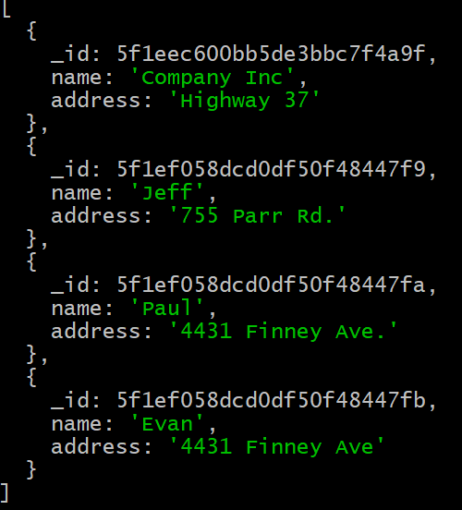
Find Multiple MongoDB Records
Run node find_All.js which should give this result:
Source
https://www.w3schools.com/nodejs/nodejs_mongodb_find.asp

Slide 24
Find Some MongoDB Records
The second parameter of the find() method is the projection object that describes which fields to include in the result. This parameter is optional, and if omitted, all fields will be included in the result
In example find_Some.js on the next page, you return the fields "name" and "address" of all documents in the customers collection
Source
https://www.w3schools.com/nodejs/nodejs_mongodb_find.asp

Slide 25
Find Some MongoDB Records
var MongoClient = require('mongodb').MongoClient;
var url = "mongodb://localhost:27017/";
MongoClient.connect(url, function(err, db) {
if (err) throw err;
var dbo = db.db("mydb");
dbo.collection("customers").find({}, { projection: { _id: 0, name: 1, address: 1 } }).toArray(function(err, result) {
if (err) throw err;
console.log(result);
db.close();
});
});
Source
https://www.w3schools.com/nodejs/nodejs_mongodb_find.asp

Slide 26
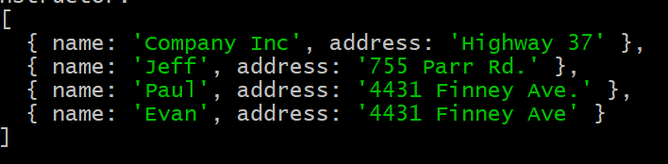
Find Multiple MongoDB Records
Run node find_Some.js which should give this result:
Source
https://www.w3schools.com/nodejs/nodejs_mongodb_find.asp

Slide 27
Query MongoDB Records
When finding documents in a collection, you can filter the result by using a query object. The first argument of the find() method is a query object, and is used to limit the search
In the following example (show_Finney.js), the output is limited to an address of "4431 Finney Ave."
Source
https://www.w3schools.com/nodejs/nodejs_mongodb_query.asp

Slide 28
Query MongoDB Records
var MongoClient = require('mongodb').MongoClient;
var url = "mongodb://localhost:27017/";
MongoClient.connect(url, function(err, db) {
if (err) throw err;
var dbo = db.db("mydb");
var query = { address: "4431 Finney Ave" };
dbo.collection("customers").find(query).toArray(function(err, result) {
if (err) throw err;
console.log(result);
db.close();
});
});
Source
https://www.w3schools.com/nodejs/nodejs_mongodb_query.asp

Slide 29
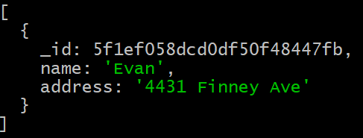
Query MongoDB Records
Run node show_Finney.js which should give this result:
Source
https://www.w3schools.com/nodejs/nodejs_mongodb_query.asp

Slide 30
Sort MongoDB Records
The sort() method is used to sort the result in ascending or descending order. The sort() method takes one parameter, an object defining the sorting order
In the example below (sort_By_Name.js), the results are sorted alphabetically by name
Source
https://www.w3schools.com/nodejs/nodejs_mongodb_sort.asp

Slide 31
Sort MongoDB Records
var MongoClient = require('mongodb').MongoClient;
var url = "mongodb://localhost:27017/";
MongoClient.connect(url, function(err, db) {
if (err) throw err;
var dbo = db.db("mydb");
var mysort = { name: 1 };
dbo.collection("customers").find().sort(mysort).toArray(function(err, result) {
if (err) throw err;
console.log(result);
db.close();
});
});
Source
https://www.w3schools.com/nodejs/nodejs_mongodb_sort.asp

Slide 32
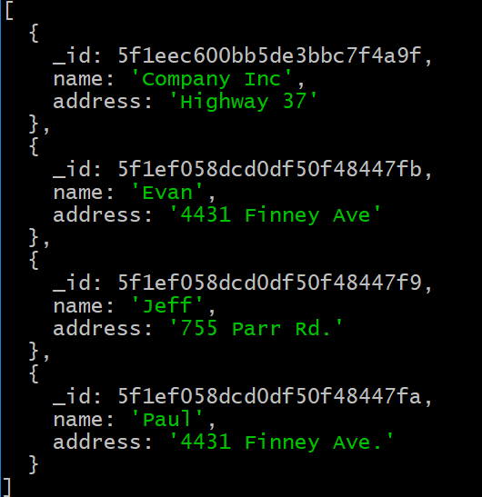
Sort MongoDB Records
Run node sort_By_name.js which should give this result:
Source
https://www.w3schools.com/nodejs/nodejs_mongodb_query.asp

Slide 33
What We've Covered
Some major MongoDB methods

