Slide 1

Aplicatie de management al unui service auto
Trif Paul & Pitariu Vlad

Slide 2
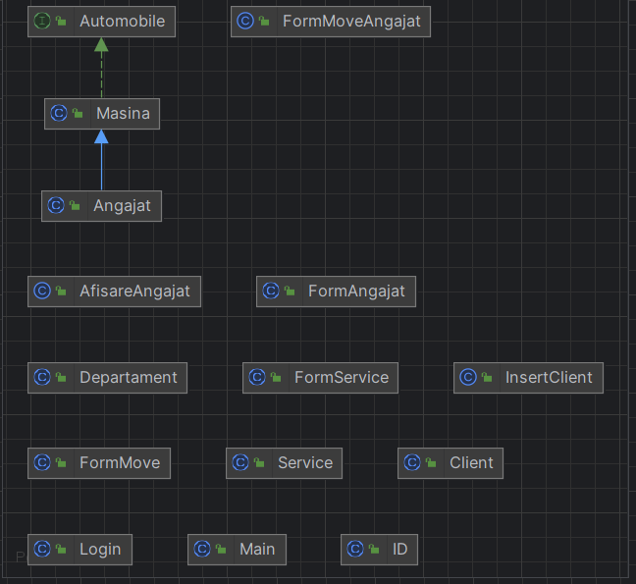
Diagrama UML

Slide 3
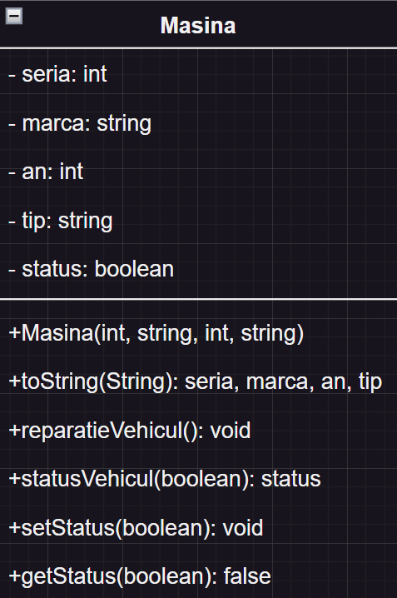
Clasa Masina

Slide 4
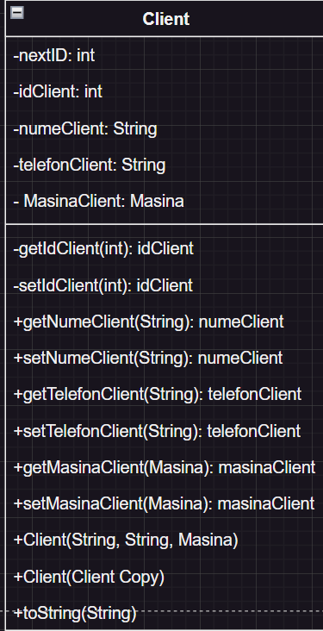
Clasa Client

Slide 5
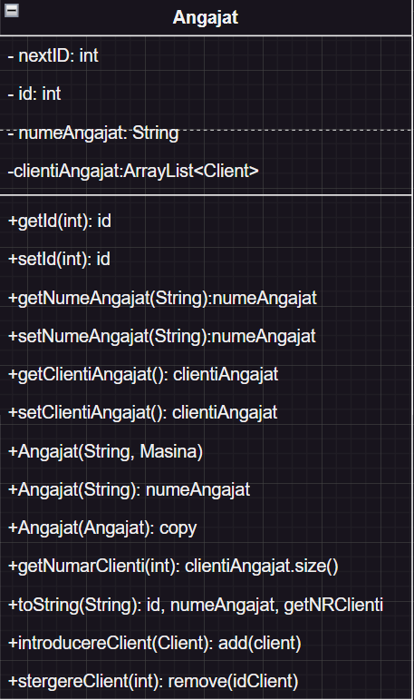
Clasa Angajat

Slide 6
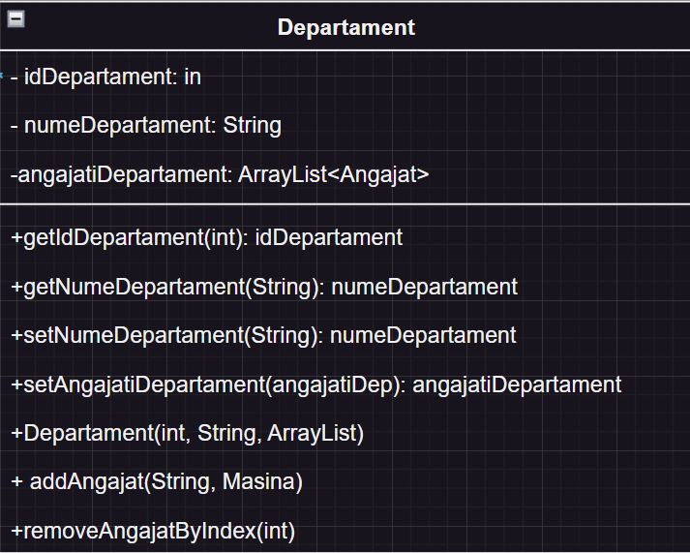
Clasa Departament

Slide 7
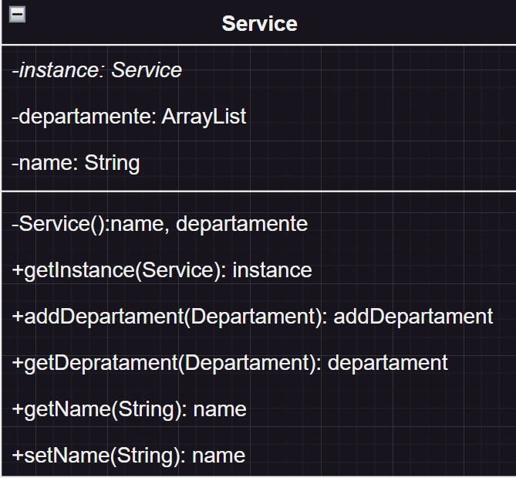
Clasa Service

Slide 8
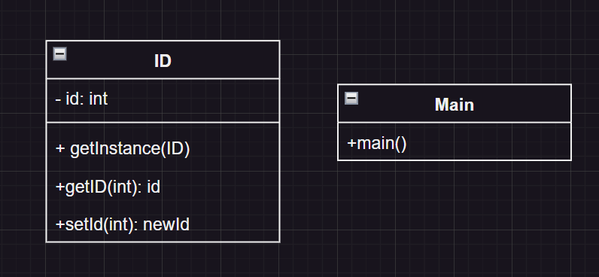
Clasa ID&main

Slide 9
Interfata Automobil

Slide 10
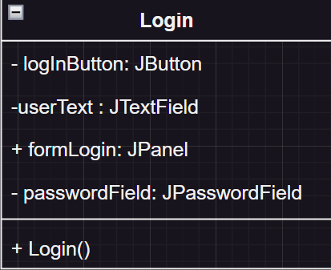
Form Login

Slide 11
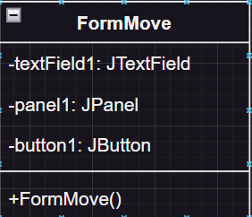
Form Move

Slide 12
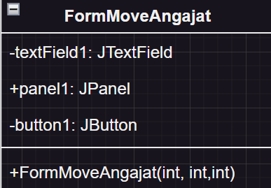
Form MoveAngajat

Slide 13
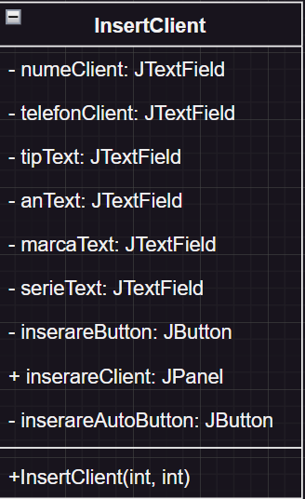
Form InsertClient

Slide 14
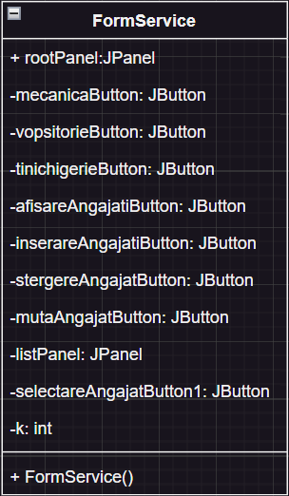
Form Service

Slide 15
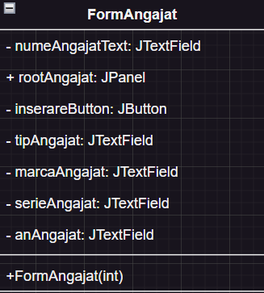
Form Angajat

Slide 16
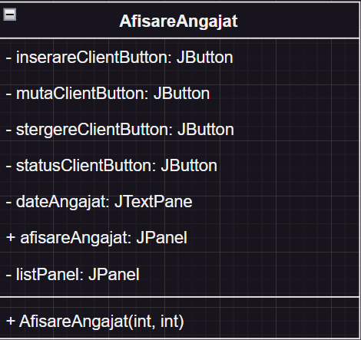
Form AfisareAngajat

