Slide 1
Ambulance Blinking LED Project:
Supervised By
Md.Ashiquzzaman
Name | Student ID
1.Md. Shahadat Hossain | 23-50077-1
2.Moynul Islam Sajid | 23-50410-1
3.Turjoy Paul | 23-50286-1
4.Shayak Badruzzaman Utsha | 23-50122-1
5.Samiul Hassan | 23-50403-1

Slide 2
Introduction: A blinking LED circuit using a relay is a simple circuit that can be used to create an LED flasher. The circuit uses a relay to control the LED's blinking frequency, and it is relatively easy to build. In this report, we will discuss the components required to build the circuit, the circuit diagram, and the working principle of the circuit.

Slide 3
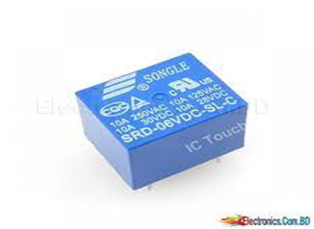
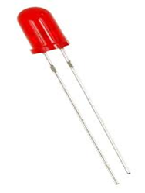
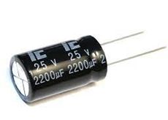
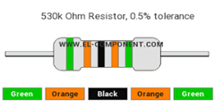
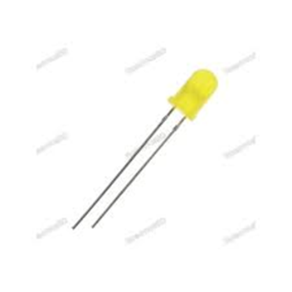
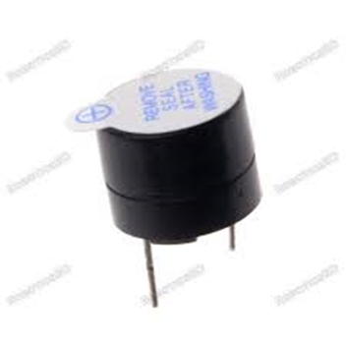
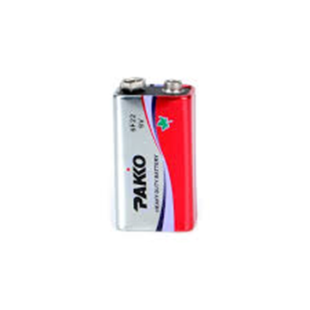
Apparatuses:
Capacitor
Relay
(6V)
Red Led Light
Yellow LED Light
Buzzer(5V)
Power source (9V)

Slide 4
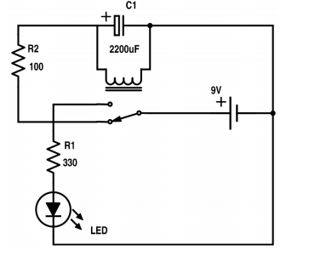
Circuit diagrams:

Slide 5
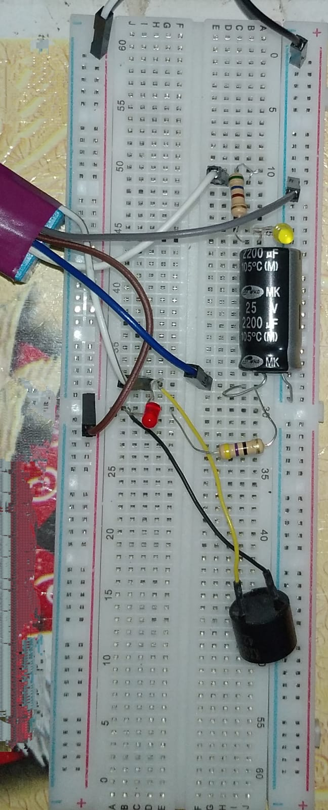
Breadboard layout:

Slide 6
PROCEDURE:
At first when the battery was connected, current would run through R2 and C1 back to the battery. So, the yellow light was lighting.
In the very beginning when the capacitor was dischargeable , almost all the current would flow through it instead of the relay-coil. But, as the capacitor was charging, more current started to flow through the relay-coil instead.
When enough current was running through the relay-coil, the electromagnet would pull the switch. So, it changed position.
Now, since the capacitor had some energy built up, it would make the electromagnet keep pulling the switch even though the battery had disconnected from it. While the switch was in this position, current would flow from the battery to R1. Then red LED was binking and the buzzer was ringing.
When there was no more energy left in the capacitor, the electromagnet stops pulling and the switch goes back to its original position again .

Slide 7
ADVANTAGES OF THE PROJECT:
1.Emergency Signaling:
•In Ambulances: LED blinking lights and a siren (buzzer) provide a clear and easily recognizable signal to other road users that an emergency vehicle is approaching. This helps them quickly yield the right of way, ensuring a faster response time for critical medical assistance.
•Other Sectors: In industrial settings, warehouses, and construction sites, LED lights and buzzers are used to indicate emergencies, evacuations, or hazardous situations.
2. Quick Identification:
•Ambulances: LED lights in different colors are used to convey the urgency of the situation. For instance, red lights and a continuous siren might indicate an active emergency response, while amber lights might signify caution during non-emergency transport.
•Other Sectors: LED lights are used to differentiate between various statuses or conditions in machinery, equipment, and processes.
3. Public Awareness:
•Ambulances: The combined effect of flashing LED lights and sirens alerts pedestrians and drivers, encouraging them to clear the way and facilitating smoother traffic flow.
•Other Sectors: In public safety applications, such as police vehicles or fire trucks, these components draw attention to the presence of law enforcement or emergency services.
5. Communication:
•Ambulances: Different patterns of LED blinking lights and varying siren tones can convey information to other drivers, like signaling the intention to pass or indicating that the emergency vehicle is approaching slowly.
•Other Sectors: LED lights and buzzers can be used to communicate specific events, errors, or status changes in various systems, enhancing situational awareness for operators.

Slide 8
DISCUSSION:
The purpose of the circuit is to blink the led light by using relay.
A relay works as a pin or switch which is controlled the two led light and buzzer.
Capacitor are used for upgrading the voltage of led light and frequency of buzzer.
Relay has two pin or direction so that it can control the two led light.
The size of the capacitor and the resistor (R2) shown in the circuit diagram determines how fast the light blinks.
If R2 is too large, the electromagnet never turns ON. If it’s too small, the electromagnet turns on so fast that it may not see the light turn OFF.
.

Slide 9
REFERENCE:
Robert L. Boylestad, “Introductory Circuit Analysis”, 13th Edition, Prentice Hall, New York.
Electrical Circuit-1 (DC) Lab manual Dept. of EEE, Faculty of Engineering, American International University-Bangladesh (AIUB).
https://youtu.be/4hzpkiQuVWY

