Slide 1





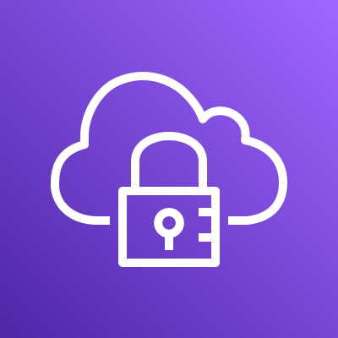




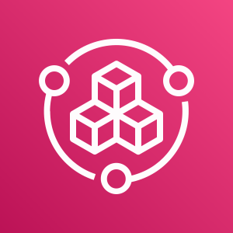
End users (customers)
Company offices
Employees
Developers
AWS Cloud
Availability Zone 1
Availability Zone 2
Availability Zone 1
Availability Zone 2
Availability Zone 1
Availability Zone 2
Production VPC
Management VPC
Development VPC
Public subnet
Public subnet
Public subnet
Public subnet
Public subnet
Public subnet
AWS Client VPN
AWS Client VPN
Private subnet
Private subnet
Private subnet
Private subnet
Private subnet
Private subnet
Peering connection
Peering connection
Isolated subnet
Isolated subnet
Isolated subnet
Isolated subnet
AWS Config
Amazon Route 53
AWS Service Catalog

Slide 2


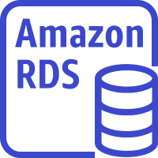
End users (customers)
Company offices
Employees
Developers
AWS Cloud
Availability Zone 1
Availability Zone 2
Availability Zone 1
Availability Zone 2
Availability Zone 1
Availability Zone 2
Production VPC
Management VPC
Development VPC
Public subnet
Public subnet
Public subnet
Public subnet
Public subnet
Public subnet
Application Load Balancer
Application Load Balancer
AWS Client VPN
AWS Client VPN
Application Load Balancer
Application Load Balancer
Private subnet
Private subnet
Private subnet
Private subnet
Private subnet
Private subnet
Peering connection
Peering connection
Application server
Application server
DevOps resources
Dev server
Dev server
Isolated subnet
Isolated subnet
Isolated subnet
Isolated subnet
Database server
Database server
Database server
Database server
AWS Config
Amazon Route 53
AWS Service Catalog

Slide 3
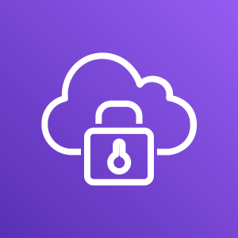
Employees (developers)
Management VPC
Allowed
Allowed
AWS Client VPN
Production VPC
Development VPC
Not allowed

