Slide 1
Al-Driven Framework for Optimized Management of Local Body and MP Funds
The Team
Group no.16
Ronal Shoey George
Paul Binu
Paulu Wilson
Project Guide: Sumi

Slide 2
Contents
Background
Literature Survey
The Problem statement
Proposed Solution
Implementation
Performance Comparison
Result
Future Scope
Relevance
Conclusion
References

Slide 3
Background
Challenges in Local Body & MP Fund Management
Inefficient Fund Allocation → Misaligned priorities, lack of data-driven strategy.
Poor Project Prioritization → No systematic approach based on public demand & feasibility.
Delays & Cost Overruns → Ineffective monitoring, bureaucratic inefficiencies.
Fraud & Anomalies → Weak financial oversight, lack of transparency.
Limited Public Engagement → Minimal citizen involvement, reduced accountability.
Notes:
Concerning

Slide 4
Literature Survey
"Strengths and Challenges of Local Governance “
https://mospi.gov.in/sites/default/files/Statistical_year_book_india_chapters/ch42.pdf
Advantages
Decentralized Governance – Empowers local self-governance in rural and urban areas.
Improved Public Services – Ensures better infrastructure, sanitation, and utilities.
Community Participation – Encourages citizen involvement in decision-making.
Disadvantages
Limited Financial Autonomy – Dependence on state and central grants for funding.
Bureaucratic Hurdles – Delays in decision-making due to multiple levels of authority.
Corruption & Mismanagement – Risk of fund misuse and inefficiency in administration.
Uneven Development – Some regions benefit more due to political and resource disparities.
Lack of Skilled Leadership – Elected representatives may lack expertise in governance.
Notes:
Functional resonance imaging (fMRI)
It measures brain activity. MRI measures brain structure.

Slide 5
Literature Survey
"Enhancing Science Communication: A Structured Approach to Public Engagement“
https://doi.org/10.1371/journal.pone.0148867
Advantages:
Informing the Public
Building Trust
Tailored Messaging
Disadvantages:
Over-Simplification Risk
Perceived Bias
Time-Consuming
Notes:
Functional resonance imaging (fMRI)
It measures brain activity. MRI measures brain structure.

Slide 6
Literature Survey
“Implications of the use of artificial intelligence in public governance: A systematic literature review and a research agenda”
https://doi.org/10.1016/j.giq.2021.101577\
Advantages
Comprehensive Review – Covers AI applications in public governance.
Identifies Key Challenges & Opportunities – Highlights crucial areas for improvement.
Structured Research Agenda – Provides a clear roadmap for future studies.
Emphasizes Transparency & Accountability – Focuses on ethical AI implementation.
Disadvantages
Relies on Qualitative Analysis Only – Lacks quantitative data support.
Lacks Real-World Case Studies – No practical examples provided.
Recommendations Are Too Broad – Lacks specificity for implementation.
Ignores AI Adoption in Developing Countries – Limited global perspective.
Notes:
Functional resonance imaging (fMRI)
It measures brain activity. MRI measures brain structure.

Slide 7
Literature Survey
“Evaluating Random Forests and Decision Trees: Key Insights and Limitations”
https://www.researchgate.net/publication/259235118_Random_Forests_and_Decision_TreesAdvantage
Advantages
Comprehensive Comparison – Analyzes Random Forests vs. Decision Trees (J48) on 20 datasets with multiple metrics.
Practical Relevance – Uses real-world UCI datasets, making results applicable to ML tasks.
Robust Experimentation – Uses 10-fold cross-validation to ensure reliable results.
Strong Performance Insight – Demonstrates Random Forests' higher accuracy and reduced overfitting.
Clear Explanation – Covers Decision Trees, ensemble methods, and Random Forest workings.
Disadvantages
Limited Scope – Focuses only on Random Forests and J48, missing other models.
No Hyperparameter Tuning – Lacks details on tuning parameters like tree depth.
Shallow Analysis – Focuses mainly on accuracy without considering computational costs.
Notes:
Functional resonance imaging (fMRI)
It measures brain activity. MRI measures brain structure.

Slide 8
Literature Survey
“Ensembling Methods: Strengths and Weaknesses”
https://doi.org/10.1613/jair.614 Advantages
Higher Accuracy – Improves classification performance.
Reduces Overfitting – Bagging stabilizes models.
Enhances Weak Learners – Boosting focuses on difficult cases.
Works Well with Trees – Boosting improves decision trees.
Better Generalization – Increases model reliability.
Disadvantages:
Computationally Expensive – Requires more resources.
Sensitive to Noise – Boosting may overfit noisy data.
Notes:
Functional resonance imaging (fMRI)
It measures brain activity. MRI measures brain structure.

Slide 9
Literature Survey
“Using natural language processing to support peer-feedback in the age of artificial intelligence: A cross-disciplinary framework and a research agenda”
https://doi.org/10.1111/bjet.13336
Advantages:
Structured NLP Framework
Peer-Feedback Process Model
NLP-Based Adaptive Support
Terminological and Procedural Scheme
Cross-Disciplinary Approach
Disadvantages:
Education-Focused Framework
Lack of Governance-Specific NLP Models
Limited Real-World Implementation
No Integration with Financial Optimization
Potential Scalability Issues
Notes:
Functional resonance imaging (fMRI)
It measures brain activity. MRI measures brain structure.

Slide 10
Literature Survey
"Detecting Anomalies in Financial Data Using Machine Learning Algorithms"
https://doi.org/10.3390/systems10050130
Advantages:
Improves audit efficiency by reducing manual effort.
Detects hidden fraudulent and erroneous transactions.
Handles large data volumes, overcoming sampling limitations.
Utilizes both supervised and unsupervised machine learning.
Evaluates models on real financial datasets for practical use.
Disadvantages:
Limited scope, excluding alternative techniques like reinforcement learning.
Uses synthetic anomalies, which may not fully represent real-world cases.
Some models require high computational resources.
Notes:
Functional resonance imaging (fMRI)
It measures brain activity. MRI measures brain structure.

Slide 11
The Problem Statement
To analyze Local Body and MP fund management, addressing inefficiencies, project delays, fraud risks, and lack of public engagement through a data-driven framework.

Slide 12
Proposed Solution
Fund Allocation Optimization
Predictive analytics to identify high-need areas.
Clustering algorithms to group regions by priority.
Optimization models for equitable fund distribution.
2. Project Prioritization
NLP to analyze community feedback and proposals.
Decision-making models to assess feasibility & impact.
3. Fraud Detection & Compliance
Anomaly detection for irregular fund usage.
Image recognition for project validation.
4. Monitoring & Progress Tracking
IoT devices for real-time tracking.
Computer vision on satellite imagery for monitoring.
ML-powered dashboards for project visualization.
Notes:
Concerning

Slide 13
Proposed Solution Continuation
5. Public Engagement and Feedback
NLP-powered chatbots to collect citizen feedback.
AI-based sentiment analysis on social media.
Recommender systems to suggest projects based on preferences.
6. Impact Assessment
ML models to compare pre- and post-implementation data.
Predictive models to forecast long-term project outcomes.
7. Budget Planning & Resource Forecasting
Time-series forecasting for budget predictions.
Dynamic programming for optimal resource allocation.
8. Transparency & Reporting
AI-powered automated report generation.
Interactive dashboards for public and stakeholder insights.

Slide 14
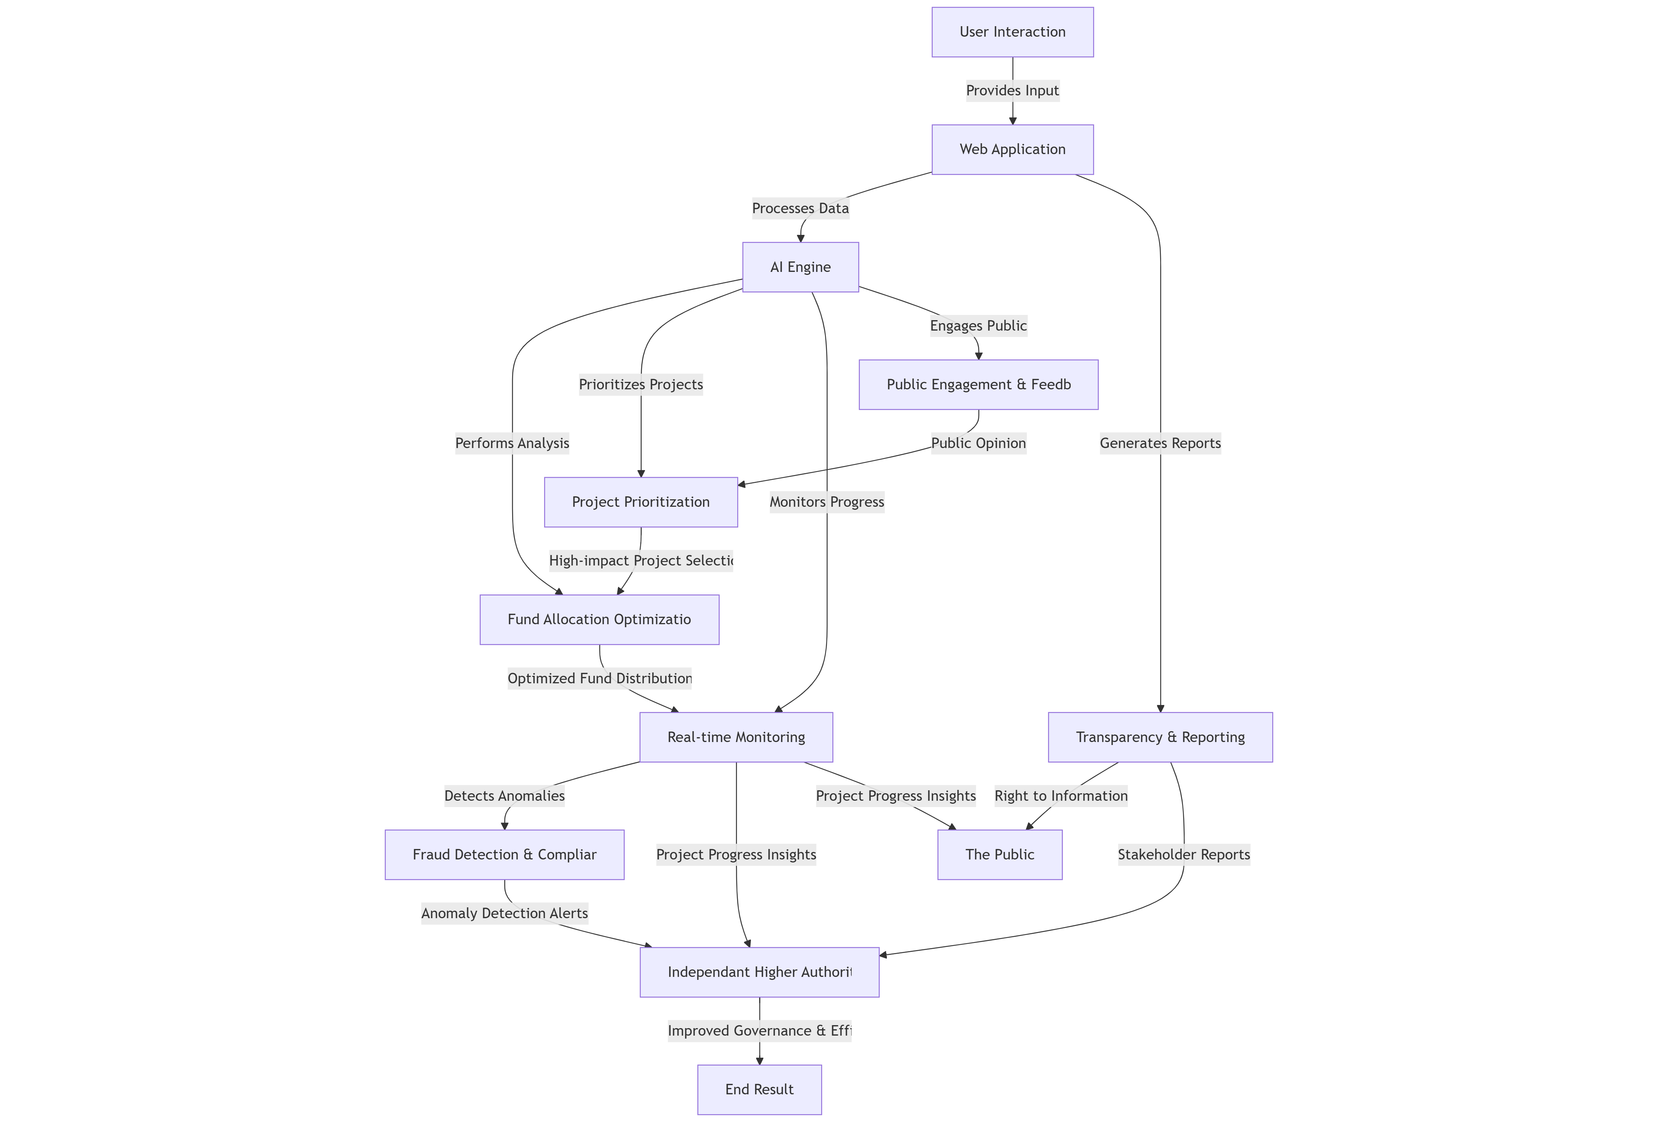
Proposed Solution Continuation

Slide 15
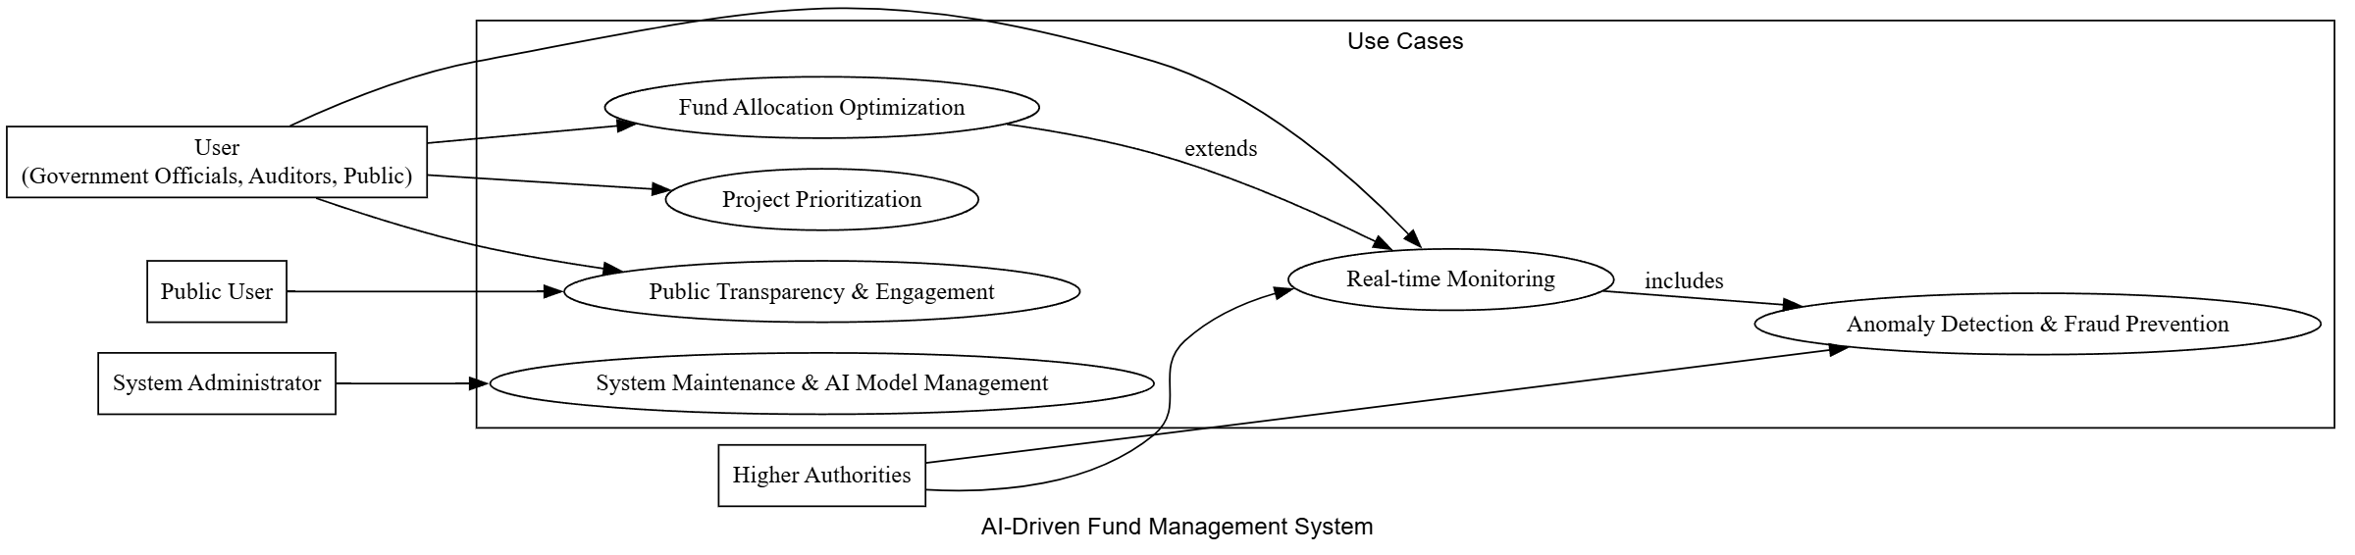
Proposed Solution Continuation

Slide 16
Implementation
Basic workflow
User Input & NLP Categorization
Users submit project requests with location.
NLP classifies projects into sectors.
Project Processing & Grouping
Similar projects within 5km radius are merged.
Data is stored & updated in the database.
AI-Based Prioritization & Ranking
ML ranks projects based on category, cost, duration.
Extracts key details from PDFs using Google Gemini API.
Notes:
Concerning

Slide 17
Implementation
Basic workflow
Financial Tracking & Fraud Detection
Compares expenditures with market rates.
Flags anomalies using Z-score detection.
Visualization & Reporting
Projects displayed on an interactive map.
Dashboard for fund tracking & alerts.
Notes:
Concerning

Slide 18
Implementation continuation
Methodology
NLP Categorization – spaCy classifies project requests.
Geospatial Grouping – Geopy merges projects within 5km.
ML Prioritization – Random Forest ranks projects by cost & duration.
Anomaly Detection – Z-score test flags fund misallocations.
Data Extraction – Google Gemini API extracts key details from PDFs.
Visualization – React-Leaflet maps project locations. D3.js for piechart
Backend server – Flask to host backend server
Notes:
Concerning

Slide 19
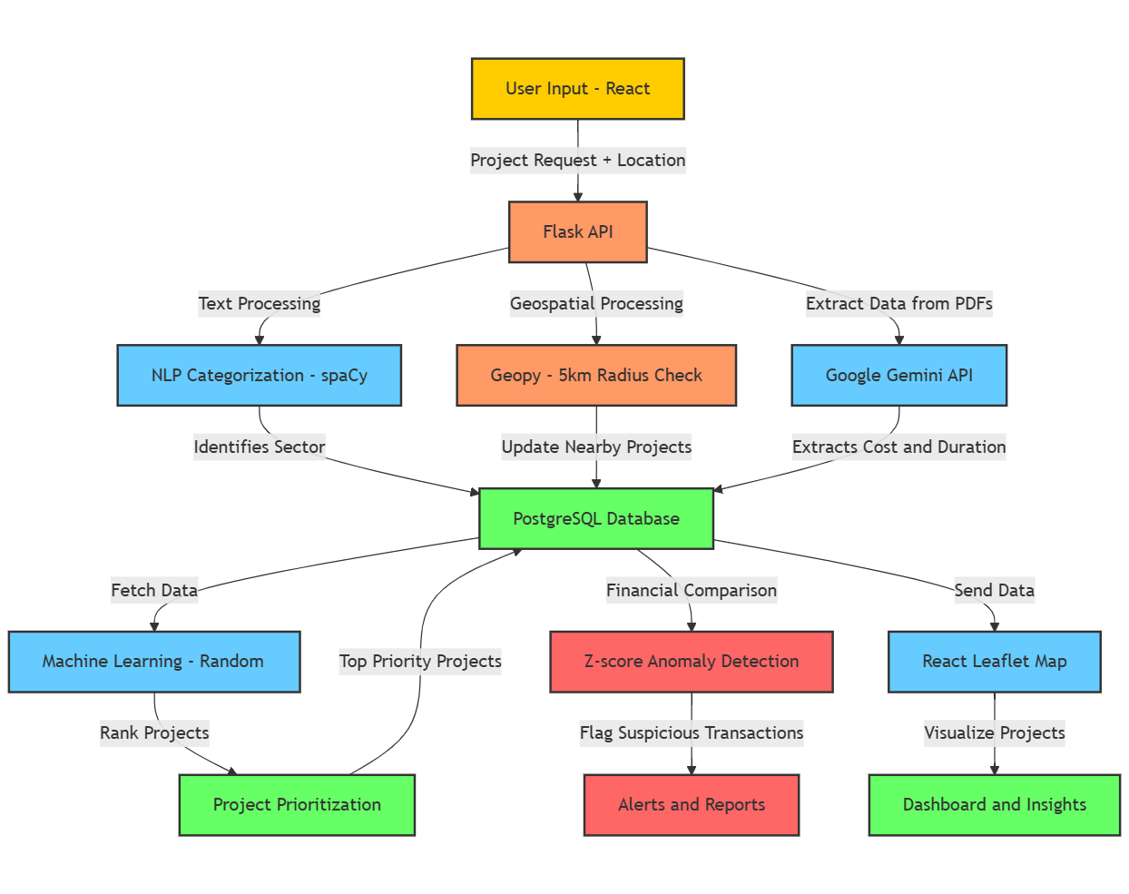
Implementation continuation
Architecture
Notes:
Concerning

Slide 20
Implementation continuation Frontend development
Tech Stack:
React.js – UI framework for dynamic user interactions.
Axios – API calls to Flask backend.
Leaflet.js – Interactive map for project visualization.
User Input & Project Submission:
Users enter project request & location.
Data is sent to Flask API for processing.
Displaying Projects & Map Integration:
List view of categorized projects.
React-Leaflet map shows project locations.
Live Updates & UI Enhancements:
Uses useEffect & state hooks for real-time updates.
Responsive design for better user experience.

Slide 21
Implementation continuation
Backend development
Tech Stack:
Flask, PostgreSQL, spaCy/Gemini API, Geopy for data processing.
Random Forest & Z-score test for project ranking & fraud detection.
Core Functions:
Receives & processes user requests via Flask API.
Groups projects within 5km & updates database.
Ranks projects based on cost, duration, and impact.
Flags anomalies in fund allocation.
Tools & IDEs:
VS Code, Postman, Jupyter Notebook.

Slide 22
Implementation continuation
Backend development
Database (PostgreSQL/SQLite)
Stores projects, locations, request counts, and fund data.
Groups similar projects within a 5km radius using Geopy.
Model Training (Random Forest Regressor)
Trains on project data (cost, duration, category).
Predicts project priority based on real-time inputs.
Google Gemini API (PDF Processing)
Extracts project details (cost, timeline, keywords) from PDFs.
Converts unstructured text into structured data for ranking.

Slide 23
Implementation continuation
Packages and modules required:
Backend Packages
Flask – Handles API requests.
PostgreSQL/SQLite – Stores project data, locations, and fund details.
Geopy – Groups projects within a 5km radius.
spaCy / Google Gemini API – NLP-based project categorization & PDF data extraction.
Pandas, NumPy – Data preprocessing and handling.

Slide 24
Implementation continuation
Packages and modules required:
Machine Learning Modules
Scikit-learn (Random Forest Regressor) – Project prioritization.
SciPy (Z-score Test) – Anomaly detection in fund allocations.

Slide 25
Implementation continuation
Packages and modules required:
Frontend Packages
React.js – User interface development.
Axios – Handles API communication.
Leaflet.js – Maps for project visualization.

Slide 26
Performance Comparison
Criteria | Manual Process | AI-Driven System
Effort | High (Manual Data Handling) | Low (Automated Processing)
Speed | Slow (Multiple Approvals) | Fast (Instant Categorization)
Time Consumption | High (Days to Prioritize) | Low (Real-Time Predictions)
Response | Delayed (Human Decision-Making) | Quick (AI-Based Insights)
Accuracy | Inconsistent (Human Errors) | High (Data-Driven Analysis)

Slide 27
Result
Accurate project categorization using NLP.
Efficient fund allocation with ML prioritization.
Fraud detection via Z-score anomaly detection.
Interactive visualization of projects & fund usage.

Slide 28
Future Scope
How can this be improved?
Enhancing NLP with GPT-based models.Blockchain integration for transparent fund tracking.
Real-time ML updates based on new data.
Expanding geospatial analysis for better project grouping.

Slide 29
Relevance
Why is this important?
Addresses real-world issues in MP/MLA fund management.
Optimizes public resource allocation using AI.
Improves governance transparency & reduces corruption.
Aligns with smart city & digital governance initiatives.

Slide 30
Conclusion
What did we infer from this?
AI and NLP improve project categorization and prioritization.
Data-driven fund allocation enhances efficiency and fairness.
Fraud detection ensures transparency and accountability.
Scalable and adaptable for real-world governance applications.
Lays the foundation for smarter, AI-powered public fund management.

Slide 31
References
Related research works.
“Ensembling Methods: Strengths and Weaknesses”
https://doi.org/10.1613/jair.614
“Using natural language processing to support peer-feedback in the age of artificial intelligence: A cross-disciplinary framework and a research agenda”
https://doi.org/10.1111/bjet.13336
"Detecting Anomalies in Financial Data Using Machine Learning Algorithms"
https://doi.org/10.3390/systems10050130

Slide 32
Thank You

