Slide 1
The FREQ Procedure
Origin | Frequency | Percent | Cumulative Frequency | Cumulative Percent
Asia | 158 | 36.92 | 158 | 36.92
Europe | 123 | 28.74 | 281 | 65.65
USA | 147 | 34.35 | 428 | 100.00

Slide 2
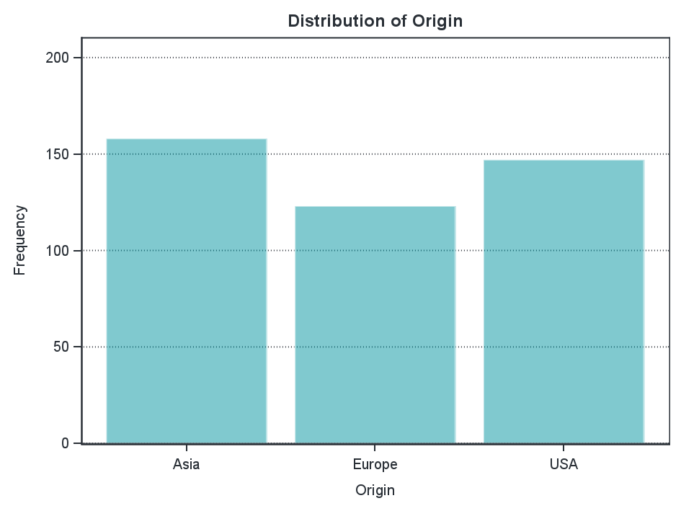
The FREQ Procedure

Slide 3
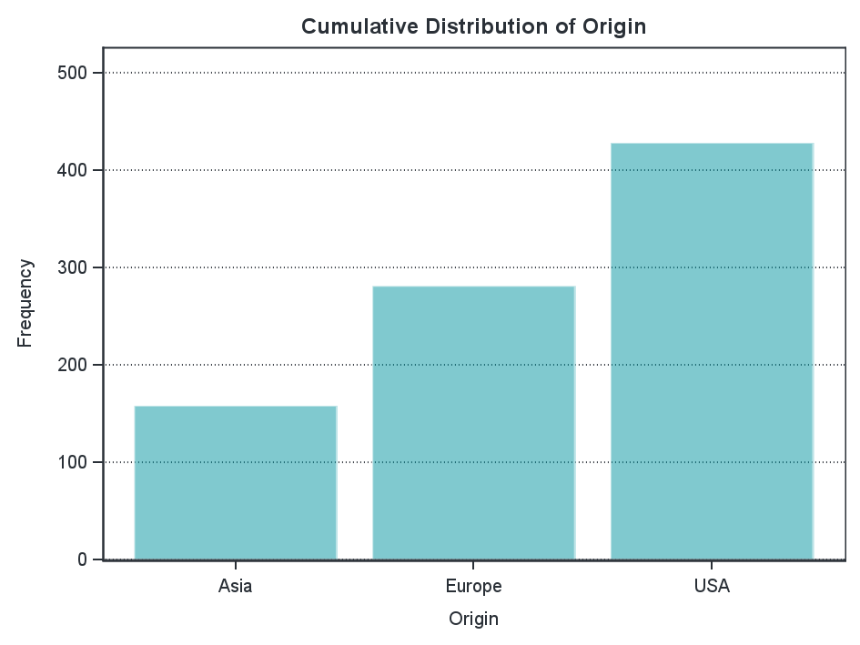
The FREQ Procedure

Slide 4
The MEANS Procedure
Analysis Variable : MPG_City MPG (City)
Origin | N Obs | N | Mean | Std Dev | Minimum | Maximum
Asia | 158 | 158 | 22.0126582 | 6.7333066 | 13.0000000 | 60.0000000
Europe | 123 | 123 | 18.7317073 | 3.2895093 | 12.0000000 | 38.0000000
USA | 147 | 147 | 19.0748299 | 3.9829920 | 10.0000000 | 29.0000000

Slide 5
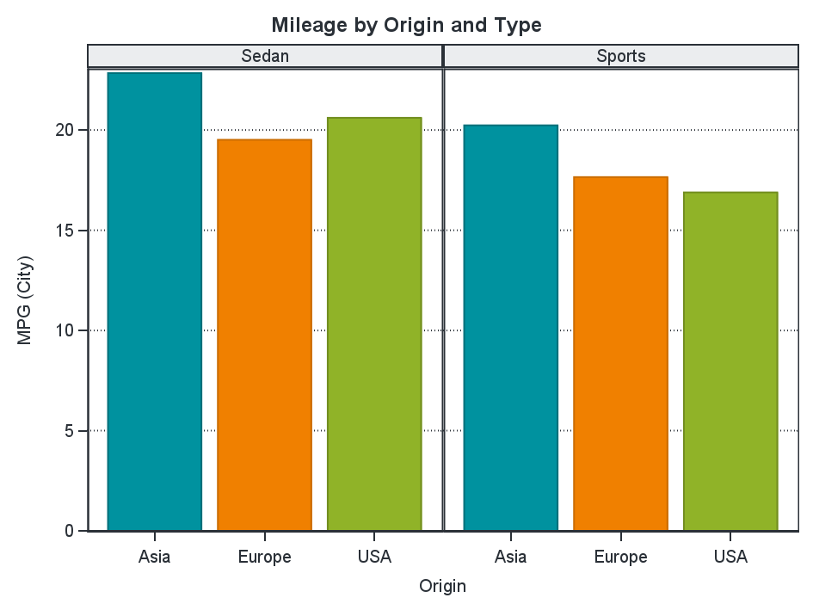

Slide 6
