Slide 1



ORGANIZATIONAL STRUCTURE FOR MANAGING INFORMATION ASSURANCE

Slide 2



OVERVIEW
This presentation is focused on organizational structure for managing Information Assurance (IA) refers to how responsibilities, authority, and accountability for information security are distributed within an organization.

Slide 3
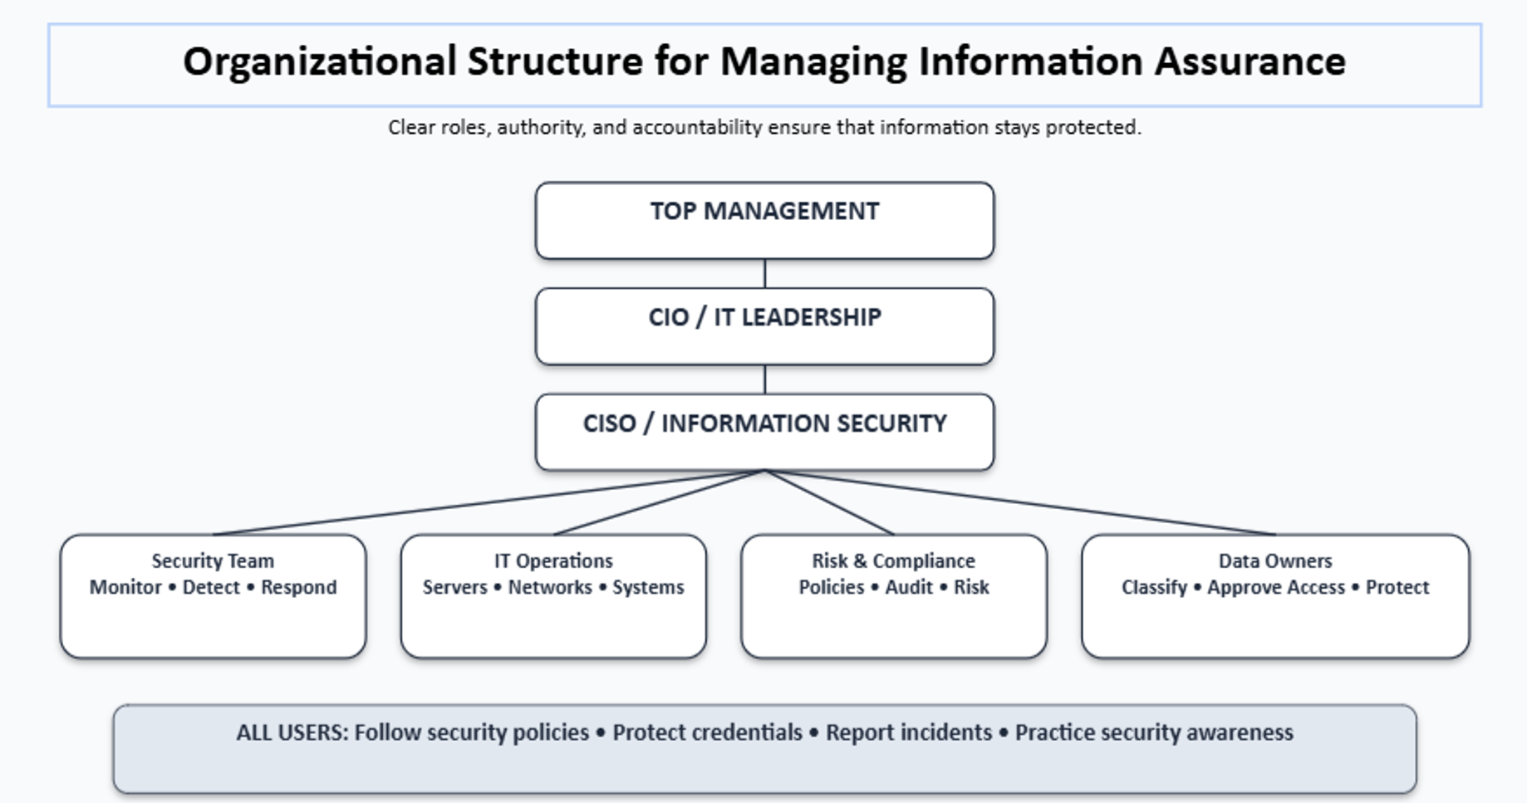

Slide 4
Top Management
Role: Provides leadership, funding, and support for Information Assurance.
Responsibilities:
  Approves security policies
  Allocates budget and resources
  Establishes organizational security priorities
  Accepts or rejects significant risks
  Ensures security supports organizational objectives

Slide 5

Chief Information Officer (CIO)
The CIO oversees the organization's information technology and ensures that IT supports organizational goals.
Responsibilities include:
  IT strategy
  Technology resources
  IT operations
  Coordination between IT and management

Slide 6
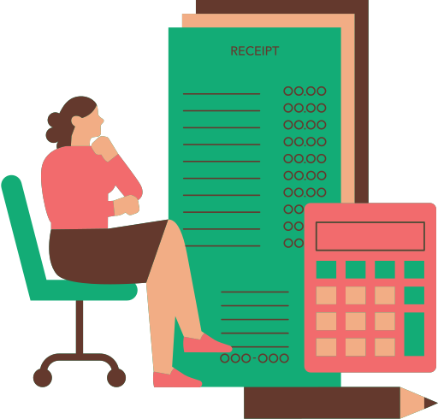
Chief Information
Security Officer (CISO)
The CISO is primarily responsible for the
organization's information security program.
Responsibilities:
  Develop security strategies
  Establish security policies
  Manage cybersecurity risks
  Coordinate incident response
  Monitor security performance
  Report major security issues to management

Slide 7
Information Security Team
The security team implements and monitors security controls.
Possible roles include:
Security Analyst
Security Engineer
Security Administrator
Incident Response Specialist
Security Operations Center (SOC) personnel
Digital Forensics Specialist

Slide 8

IT Operations Team
The IT team manages the technology infrastructure that needs to be protected.
Responsibilities may include:
  Servers
  Networks
  Databases
  Applications
  Endpoints
  Backups
  System updates and patches
  User accounts

Slide 9

Risk and Compliance Team
This team helps ensure that the organization identifies and manages security risks and complies with applicable requirements.
Responsibilities:
  Risk assessments
  Security audits
  Compliance monitoring
  Policy review
  Risk reporting
  Control assessment

Slide 10
Data Owners
A data owner is responsible for determining how particular information should be protected.
Data owners determine:
Who should access the data
How sensitive the data is
How long it should be retained
What protections are required

Slide 11
All Employees and Users
Security is everyone's responsibility.
Employees and users should:
  Follow security policies
  Protect passwords
  Report suspicious activity
  Avoid unauthorized software
  Handle sensitive information properly
  Complete security awareness training

Slide 12
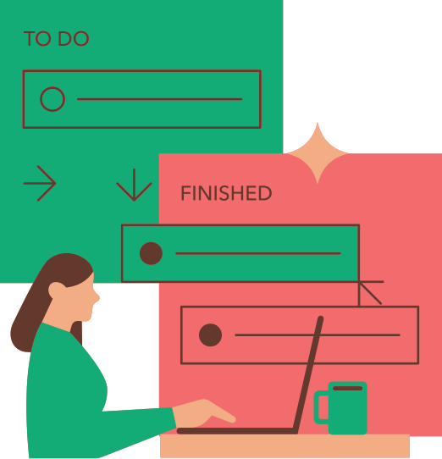
Three Important Principles
1. Responsibility
Everyone should know what they are responsible for.
2. Authority
People should have enough authority and resources to perform their security responsibilities.
3. Accountability
Individuals should be held responsible for their actions involving organizational information and systems.

Slide 13

Effective Information Assurance is
achieved when people, processes,
technology, and management work
together to protect organizational
information.

