Slide 1
Basic Text Processing
Sentence Segmentation and Decision Trees

Slide 2
Sentence Segmentation
!, ? are relatively unambiguous
Period “.” is quite ambiguous
Sentence boundary
Abbreviations like Inc. or Dr.
Numbers like .02% or 4.3
Build a binary classifier
Looks at a “.”
Decides EndOfSentence/NotEndOfSentence
Classifiers: hand-written rules, regular expressions, or machine-learning

Slide 3
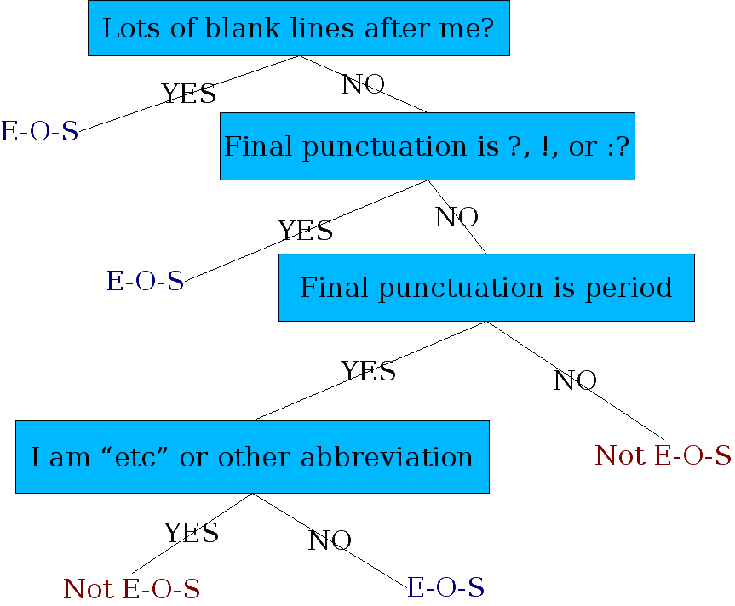
Determining if a word is end-of-sentence: a Decision Tree

Slide 4
More sophisticated decision tree features
Case of word with “.”: Upper, Lower, Cap, Number
Case of word after “.”: Upper, Lower, Cap, Number
Numeric features
Length of word with “.”
Probability(word with “.” occurs at end-of-s)
Probability(word after “.” occurs at beginning-of-s)

Slide 5
Implementing Decision Trees
A decision tree is just an if-then-else statement
The interesting research is choosing the features
Setting up the structure is often too hard to do by hand
Hand-building only possible for very simple features, domains
For numeric features, it’s too hard to pick each threshold
Instead, structure usually learned by machine learning from a training corpus

Slide 6
Decision Trees and other classifiers
We can think of the questions in a decision tree
As features that could be exploited by any kind of classifier
Logistic regression
SVM
Neural Nets
etc.

Slide 7
Basic Text Processing
Sentence Segmentation and Decision Trees

