Slide 1
Minimum Edit Distance
Definition of Minimum Edit Distance

Slide 2
How similar are two strings?
Spell correction
The user typed “graffe”
Which is closest?
graf
graft
grail
giraffe
Computational Biology
Align two sequences of nucleotides
Resulting alignment:
AGGCTATCACCTGACCTCCAGGCCGATGCCC
TAGCTATCACGACCGCGGTCGATTTGCCCGAC
-AGGCTATCACCTGACCTCCAGGCCGA--TGCCC---
TAG-CTATCAC--GACCGC--GGTCGATTTGCCCGAC
Also for Machine Translation, Information Extraction, Speech Recognition

Slide 3
Edit Distance
The minimum edit distance between two strings
Is the minimum number of editing operations
Insertion
Deletion
Substitution
Needed to transform one into the other

Slide 4
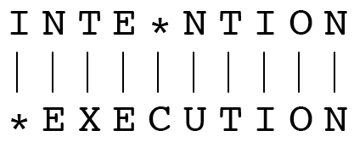
Minimum Edit Distance
Two strings and their alignment:

Slide 5
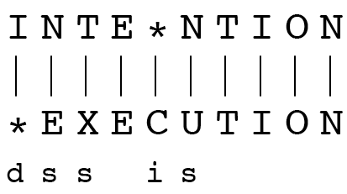
Minimum Edit Distance
If each operation has cost of 1
Distance between these is 5
If substitutions cost 2 (Levenshtein)
Distance between them is 8

Slide 6
Alignment in Computational Biology
Given a sequence of bases
An alignment:
Given two sequences, align each letter to a letter or gap
AGGCTATCACCTGACCTCCAGGCCGATGCCC
TAGCTATCACGACCGCGGTCGATTTGCCCGAC
-AGGCTATCACCTGACCTCCAGGCCGA--TGCCC---
TAG-CTATCAC--GACCGC--GGTCGATTTGCCCGAC

Slide 7
Other uses of Edit Distance in NLP
Evaluating Machine Translation and speech recognition
R Spokesman confirms senior government adviser was shot
H Spokesman said the senior adviser was shot dead
S I D I
Named Entity Extraction and Entity Coreference
IBM Inc. announced today
IBM profits
Stanford President John Hennessy announced yesterday
for Stanford University President John Hennessy

Slide 8
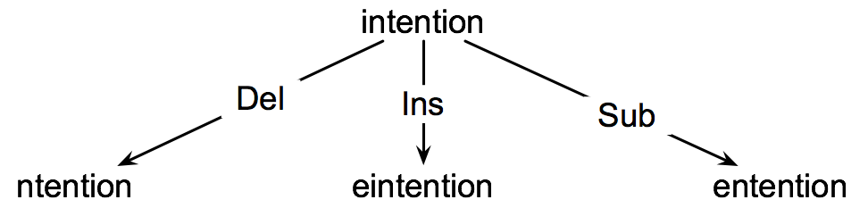
How to find the Min Edit Distance?
Searching for a path (sequence of edits) from the start string to the final string:
Initial state: the word we’re transforming
Operators: insert, delete, substitute
Goal state: the word we’re trying to get to
Path cost: what we want to minimize: the number of edits

Slide 9
Minimum Edit as Search
But the space of all edit sequences is huge!
We can’t afford to navigate naïvely
Lots of distinct paths wind up at the same state.
We don’t have to keep track of all of them
Just the shortest path to each of those revisted states.

Slide 10
Defining Min Edit Distance
For two strings
X of length n
Y of length m
We define D(i,j)
the edit distance between X[1..i] and Y[1..j]
i.e., the first i characters of X and the first j characters of Y
The edit distance between X and Y is thus D(n,m)

Slide 11
Minimum Edit Distance
Definition of Minimum Edit Distance

