Slide 1
Minimum Edit Distance
Weighted Minimum Edit Distance

Slide 2
Weighted Edit Distance
Why would we add weights to the computation?
Spell Correction: some letters are more likely to be mistyped than others
Biology: certain kinds of deletions or insertions are more likely than others

Slide 3
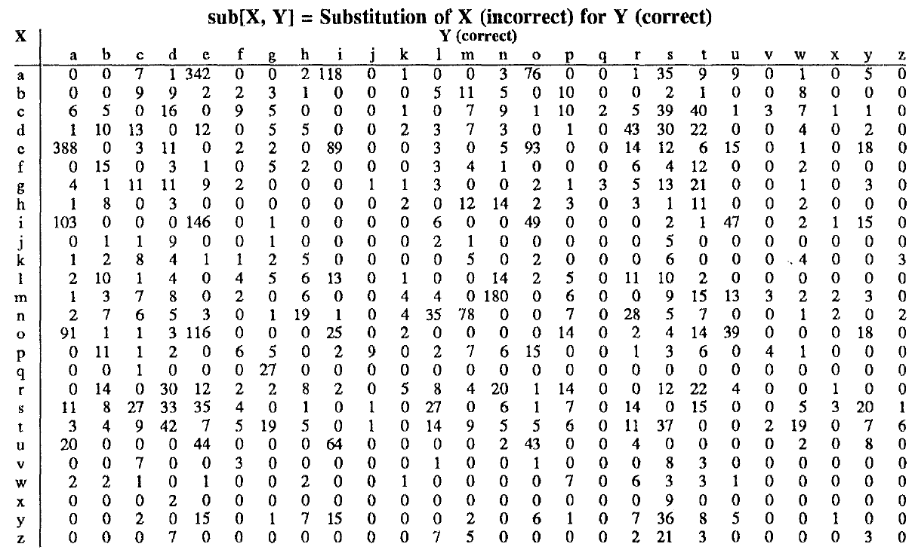
Confusion matrix for spelling errors

Slide 4
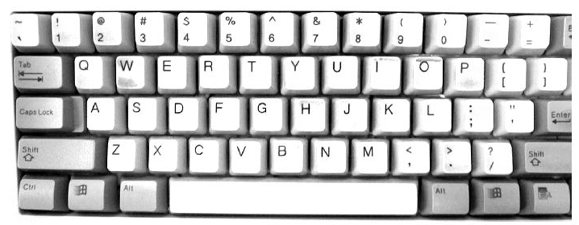

Slide 5
Weighted Min Edit Distance
Initialization:
D(0,0) = 0
D(i,0) = D(i-1,0) + del[x(i)]; 1 < i ≤ N
D(0,j) = D(0,j-1) + ins[y(j)]; 1 < j ≤ M
Recurrence Relation:
D(i-1,j) + del[x(i)]
D(i,j)= min D(i,j-1) + ins[y(j)]
D(i-1,j-1) + sub[x(i),y(j)]
Termination:
D(N,M) is distance

Slide 6
Where did the name, dynamic programming, come from?
…The 1950s were not good years for mathematical research. [the] Secretary of Defense …had a pathological fear and hatred of the word, research…
I decided therefore to use the word, “programming”.
I wanted to get across the idea that this was dynamic, this was multistage… I thought, let’s … take a word that has an absolutely precise meaning, namely dynamic… it’s impossible to use the word, dynamic, in a pejorative sense. Try thinking of some combination that will possibly give it a pejorative meaning. It’s impossible.
Thus, I thought dynamic programming was a good name. It was something not even a Congressman could object to.”
Richard Bellman, “Eye of the Hurricane: an autobiography” 1984.

Slide 7
Minimum Edit Distance
Weighted Minimum Edit Distance

