Slide 1
Language Modeling
Estimating N-gram Probabilities

Slide 2
Estimating bigram probabilities
The Maximum Likelihood Estimate

Slide 3

An example
<s> I am Sam </s>
<s> Sam I am </s>
<s> I do not like green eggs and ham </s>

Slide 4
More examples: Berkeley Restaurant Project sentences
can you tell me about any good cantonese restaurants close by
mid priced thai food is what i’m looking for
tell me about chez panisse
can you give me a listing of the kinds of food that are available
i’m looking for a good place to eat breakfast
when is caffe venezia open during the day

Slide 5
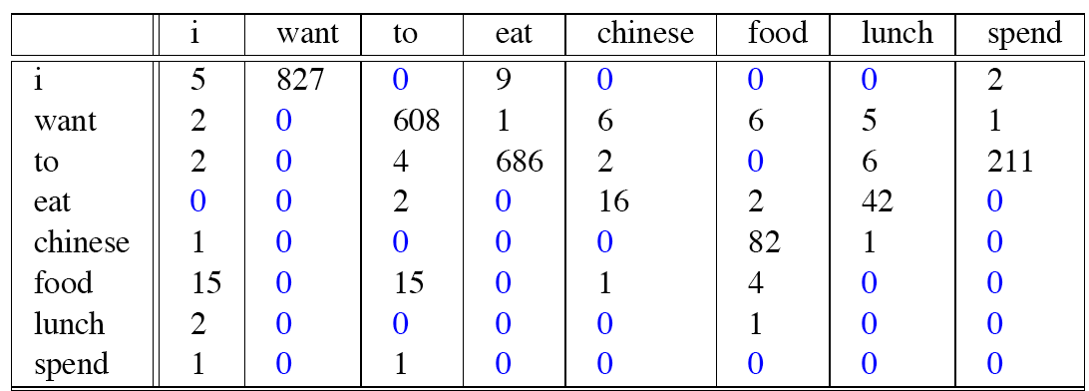
Raw bigram counts
Out of 9222 sentences

Slide 6
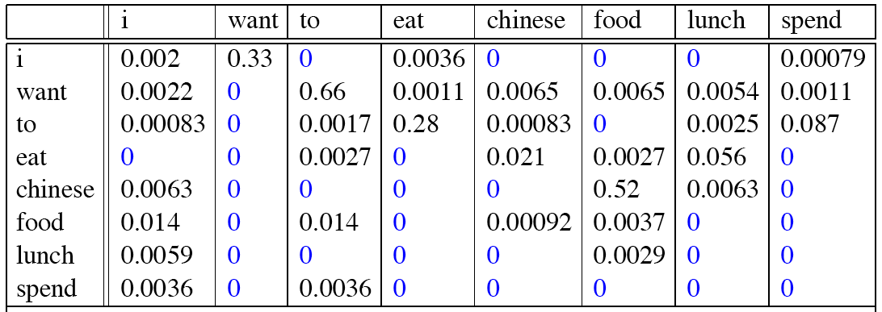
Raw bigram probabilities
Normalize by unigrams:
Result:

Slide 7
Bigram estimates of sentence probabilities
P(<s> I want english food </s>) =
P(I|<s>)
× P(want|I)
× P(english|want)
× P(food|english)
× P(</s>|food)
= .000031

Slide 8
What kinds of knowledge?
P(english|want) = .0011
P(chinese|want) = .0065
P(to|want) = .66
P(eat | to) = .28
P(food | to) = 0
P(want | spend) = 0
P (i | <s>) = .25

Slide 9
Practical Issues
We do everything in log space
Avoid underflow
(also adding is faster than multiplying)

Slide 10
Language Modeling Toolkits
SRILM
http://www.speech.sri.com/projects/srilm/

Slide 11
Google N-Gram Release, August 2006
…

Slide 12
Google N-Gram Release
serve as the incoming 92
serve as the incubator 99
serve as the independent 794
serve as the index 223
serve as the indication 72
serve as the indicator 120
serve as the indicators 45
serve as the indispensable 111
serve as the indispensible 40
serve as the individual 234
http://googleresearch.blogspot.com/2006/08/all-our-n-gram-are-belong-to-you.html

Slide 13
Google Book N-grams
http://ngrams.googlelabs.com/

Slide 14
Language Modeling
Estimating N-gram Probabilities

