Slide 1
Language Modeling
Evaluation and Perplexity

Slide 2
Evaluation: How good is our model?
Does our language model prefer good sentences to bad ones?
Assign higher probability to “real” or “frequently observed” sentences
Than “ungrammatical” or “rarely observed” sentences?
We train parameters of our model on a training set.
We test the model’s performance on data we haven’t seen.
A test set is an unseen dataset that is different from our training set, totally unused.
An evaluation metric tells us how well our model does on the test set.

Slide 3
Extrinsic evaluation of N-gram models
Best evaluation for comparing models A and B
Put each model in a task
spelling corrector, speech recognizer, MT system
Run the task, get an accuracy for A and for B
How many misspelled words corrected properly
How many words translated correctly
Compare accuracy for A and B

Slide 4
Difficulty of extrinsic (in-vivo) evaluation of N-gram models
Extrinsic evaluation
Time-consuming; can take days or weeks
So
Sometimes use intrinsic evaluation: perplexity
Bad approximation
unless the test data looks just like the training data
So generally only useful in pilot experiments
But is helpful to think about.

Slide 5
Intuition of Perplexity
mushrooms 0.1
pepperoni 0.1
anchovies 0.01
….
fried rice 0.0001
….
and 1e-100
The Shannon Game:
How well can we predict the next word?
Unigrams are terrible at this game. (Why?)
A better model of a text
is one which assigns a higher probability to the word that actually occurs
I always order pizza with cheese and ____
The 33rd President of the US was ____
I saw a ____

Slide 6
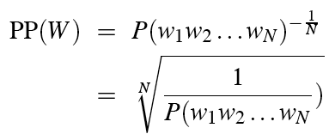
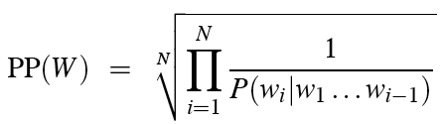
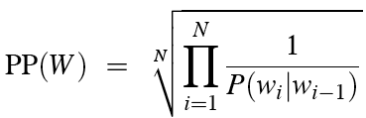
Perplexity
The best language model is one that best predicts an unseen test set
Gives the highest P(sentence)
Perplexity is the probability of the test set, normalized by the number of words:
Chain rule:
For bigrams:
Minimizing perplexity is the same as maximizing probability

Slide 7
The Shannon Game intuition for perplexity
From Josh Goodman
How hard is the task of recognizing digits ‘0,1,2,3,4,5,6,7,8,9’
Perplexity 10
How hard is recognizing (30,000) names at Microsoft.
Perplexity = 30,000
If a system has to recognize
Operator (1 in 4)
Sales (1 in 4)
Technical Support (1 in 4)
30,000 names (1 in 120,000 each)
Perplexity is 53
Perplexity is weighted equivalent branching factor

Slide 8
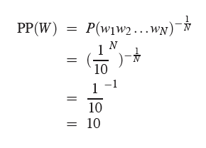
Perplexity as branching factor
Let’s suppose a sentence consisting of random digits
What is the perplexity of this sentence according to a model that assign P=1/10 to each digit?

Slide 9
Lower perplexity = better model
Training 38 million words, test 1.5 million words, WSJ
N-gram Order | Unigram | Bigram | Trigram
Perplexity | 962 | 170 | 109

Slide 10
Language Modeling
Evaluation and Perplexity

