Slide 1
Language Modeling
Generalization and zeros

Slide 2
The Shannon Visualization Method
Choose a random bigram
(<s>, w) according to its probability
Now choose a random bigram (w, x) according to its probability
And so on until we choose </s>
Then string the words together
<s> I
I want
want to
to eat
eat Chinese
Chinese food
food </s>
I want to eat Chinese food

Slide 3
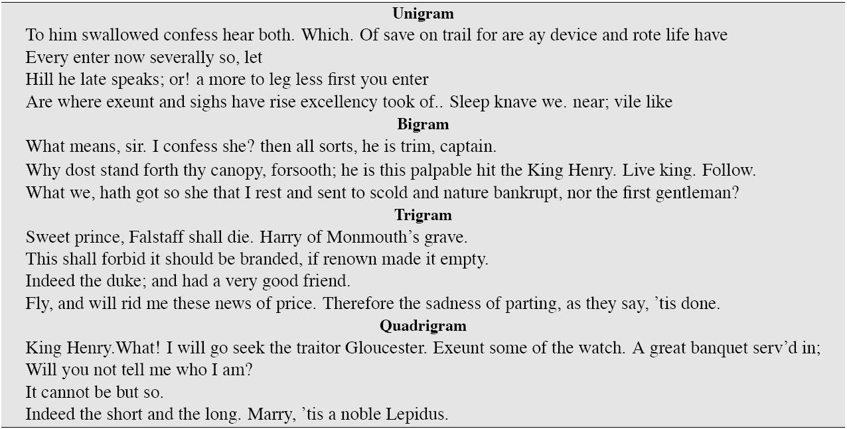
Approximating Shakespeare

Slide 4
Shakespeare as corpus
N=884,647 tokens, V=29,066
Shakespeare produced 300,000 bigram types out of V²= 844 million possible bigrams.
So 99.96% of the possible bigrams were never seen (have zero entries in the table)
Quadrigrams worse: What's coming out looks like Shakespeare because it is Shakespeare

Slide 5
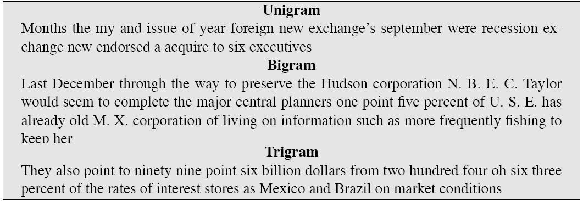
The wall street journal is not shakespeare (no offense)

Slide 6
The perils of overfitting
N-grams only work well for word prediction if the test corpus looks like the training corpus
In real life, it often doesn’t
We need to train robust models that generalize!
One kind of generalization: Zeros!
Things that don’t ever occur in the training set
But occur in the test set

Slide 7
Zeros
Training set:
… denied the allegations
… denied the reports
… denied the claims
… denied the request
P(“offer” | denied the) = 0
Test set
… denied the offer
… denied the loan

Slide 8
Zero probability bigrams
Bigrams with zero probability
mean that we will assign 0 probability to the test set!
And hence we cannot compute perplexity (can’t divide by 0)!

Slide 9
Language Modeling
Generalization and zeros

