Slide 1
Language Modeling
Smoothing: Add-one (Laplace) smoothing

Slide 2
The intuition of smoothing (from Dan Klein)
When we have sparse statistics:
Steal probability mass to generalize better
P(w | denied the)
3 allegations
2 reports
1 claims
1 request
7 total
allegations
attack
man
reports
outcome
…
claims
request
P(w | denied the)
2.5 allegations
1.5 reports
0.5 claims
0.5 request
2 other
7 total
allegations
allegations
attack
man
outcome
reports
…
claims
request

Slide 3
Add-one estimation
Also called Laplace smoothing
Pretend we saw each word one more time than we did
Just add one to all the counts!
MLE estimate:
Add-1 estimate:

Slide 4
Maximum Likelihood Estimates
The maximum likelihood estimate
of some parameter of a model M from a training set T
maximizes the likelihood of the training set T given the model M
Suppose the word “bagel” occurs 400 times in a corpus of a million words
What is the probability that a random word from some other text will be “bagel”?
MLE estimate is 400/1,000,000 = .004
This may be a bad estimate for some other corpus
But it is the estimate that makes it most likely that “bagel” will occur 400 times in a million word corpus.

Slide 5
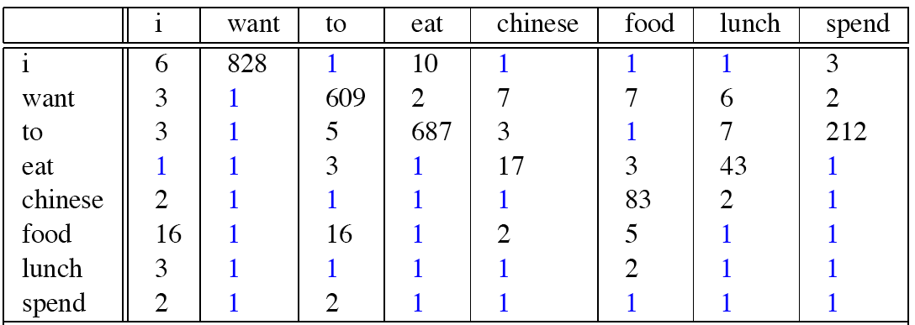
Berkeley Restaurant Corpus: Laplace smoothed bigram counts

Slide 6

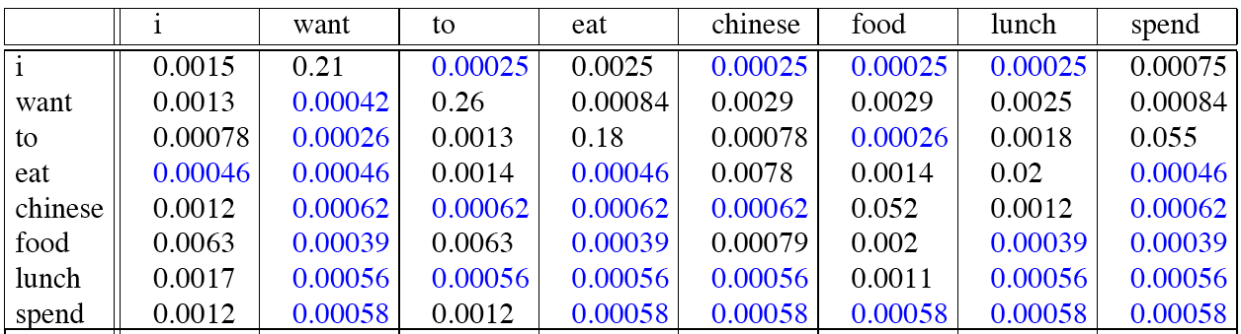
Laplace-smoothed bigrams

Slide 7
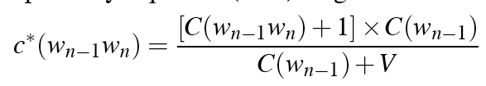
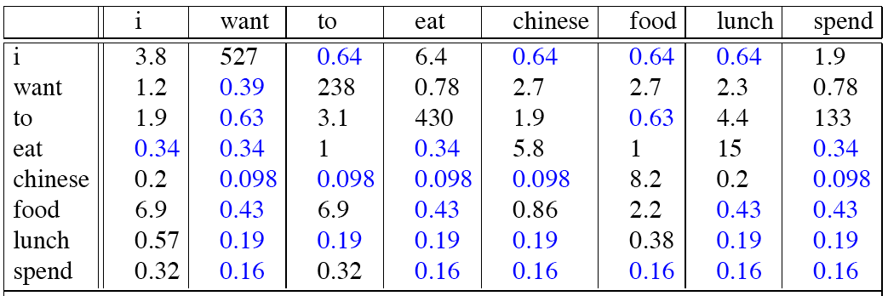
Reconstituted counts

Slide 8
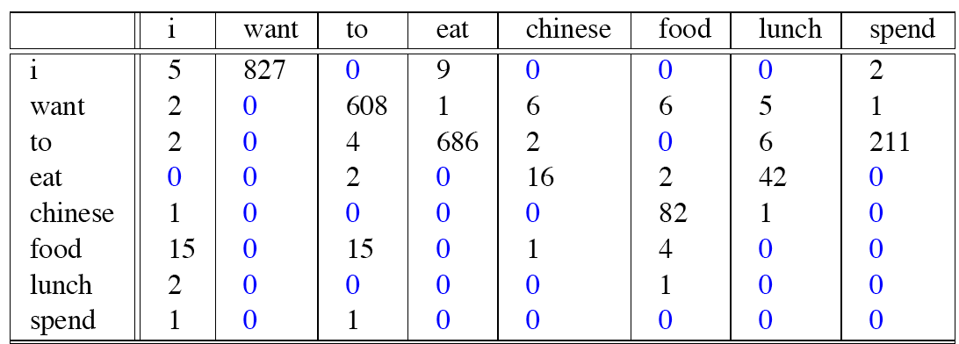
Compare with raw bigram counts
Notes:
C(want to) went from 608 to 238, P(to|want) from .66 to .26!
Discount d= c*/c
d for “chinese food” =.10!!! A 10x reduction

Slide 9
Add-1 estimation is a blunt instrument
So add-1 isn’t used for N-grams:
We’ll see better methods
But add-1 is used to smooth other NLP models
For text classification
In domains where the number of zeros isn’t so huge.

Slide 10
Language Modeling
Smoothing: Add-one (Laplace) smoothing

