Slide 1
Spelling Correction and the Noisy Channel
State-of-the-art Systems

Slide 2
HCI issues in spelling
If very confident in correction
  Autocorrect
Less confident
  Give the best correction
Less confident
  Give a correction list
Unconfident
  Just flag as an error

Slide 3
State of the art noisy channel
We never just multiply the prior and the error model
Independence assumptions→probabilities not commensurate
Instead: Weigh them
Learn λ from a development test set

Slide 4
Phonetic error model
Metaphone, used in GNU aspell
  Convert misspelling to metaphone pronunciation
    “Drop duplicate adjacent letters, except for C.”
    “If the word begins with 'KN', 'GN', 'PN', 'AE', 'WR', drop the first letter.”
    “Drop 'B' if after 'M' and if it is at the end of the word”
    …
  Find words whose pronunciation is 1-2 edit distance from misspelling’s
  Score result list
    Weighted edit distance of candidate to misspelling
    Edit distance of candidate pronunciation to misspelling pronunciation

Slide 5
Improvements to channel model
Allow richer edits (Brill and Moore 2000)
  ent→ant
  ph→f
  le→al
Incorporate pronunciation into channel (Toutanova and Moore 2002)

Slide 6
Channel model
Factors that could influence p(misspelling|word)
  The source letter
  The target letter
  Surrounding letters
  The position in the word
  Nearby keys on the keyboard
  Homology on the keyboard
  Pronunciations
  Likely morpheme transformations

Slide 7
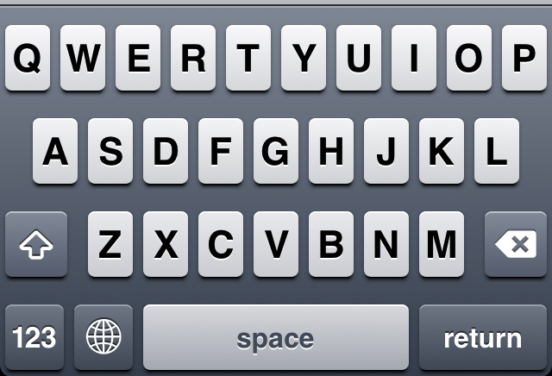
Nearby keys

Slide 8
Classifier-based methods for real-word spelling correction
Instead of just channel model and language model
Use many features in a classifier (next lecture).
Build a classifier for a specific pair like:
whether/weather
    “cloudy” within +- 10 words
    ___ to VERB
    ___ or not

