Slide 1
Spelling Correction and the Noisy Channel
The Noisy Channel Model of Spelling

Slide 2
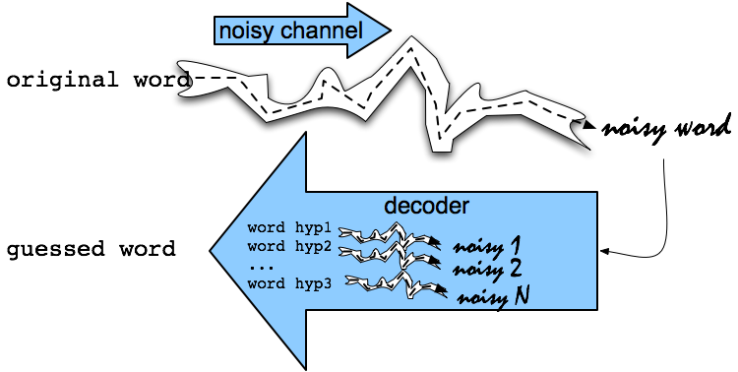
Noisy Channel Intuition

Slide 3
Noisy Channel
We see an observation x of a misspelled word
Find the correct word w
Notes:
Bayes Rule

Slide 4
History: Noisy channel for spelling proposed around 1990
IBM
Mays, Eric, Fred J. Damerau and Robert L. Mercer. 1991. Context based spelling correction. Information Processing and Management, 23(5), 517–522
AT&T Bell Labs
Kernighan, Mark D., Kenneth W. Church, and William A. Gale. 1990. A spelling correction program based on a noisy channel model. Proceedings of COLING 1990, 205-210

Slide 5
Non-word spelling error example
acress

Slide 6
Candidate generation
Words with similar spelling
Small edit distance to error
Words with similar pronunciation
Small edit distance of pronunciation to error

Slide 7
Damerau-Levenshtein edit distance
Minimal edit distance between two strings, where edits are:
Insertion
Deletion
Substitution
Transposition of two adjacent letters

Slide 8
Words within 1 of acress
Error | Candidate Correction | Correct Letter | Error Letter | Type
acress | actress | t | - | deletion
acress | cress | - | a | insertion
acress | caress | ca | ac | transposition
acress | access | c | r | substitution
acress | across | o | e | substitution
acress | acres | - | s | insertion
acress | acres | - | s | insertion

Slide 9
Candidate generation
80% of errors are within edit distance 1
Almost all errors within edit distance 2
Also allow insertion of space or hyphen
thisidea → this idea
inlaw → in-law

Slide 10
Language Model
Use any of the language modeling algorithms we’ve learned
Unigram, bigram, trigram
Web-scale spelling correction
Stupid backoff

Slide 11
Unigram Prior probability
Counts from 404,253,213 words in Corpus of Contemporary English (COCA)
word | Frequency of word | P(word)
actress | 9,321 | .0000230573
cress | 220 | .0000005442
caress | 686 | .0000016969
access | 37,038 | .0000916207
across | 120,844 | .0002989314
acres | 12,874 | .0000318463

Slide 12
Channel model probability
Error model probability, Edit probability
Kernighan, Church, Gale 1990
Misspelled word x = x₁, x₂, x₃… x_{m}
Correct word w = w₁, w₂, w₃,…, w_{n}
P(x|w) = probability of the edit
(deletion/insertion/substitution/transposition)

Slide 13
Computing error probability: confusion matrix
del[x,y]: count(xy typed as x)
ins[x,y]: count(x typed as xy)
sub[x,y]: count(x typed as y)
trans[x,y]: count(xy typed as yx)
Insertion and deletion conditioned on previous character

Slide 14
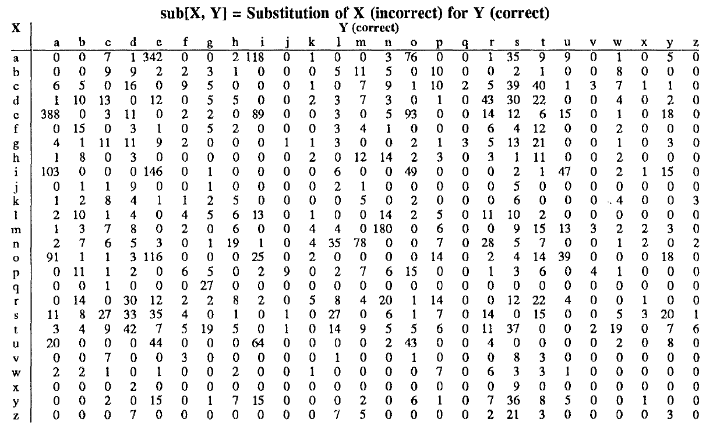
Confusion matrix for spelling errors

Slide 15
Generating the confusion matrix
Peter Norvig’s list of errors
Peter Norvig’s list of counts of single-edit errors

Slide 16
Channel model
Kernighan, Church, Gale 1990

Slide 17
Channel model for acress
Candidate Correction | Correct Letter | Error Letter | x|w | P(x|word)
actress | t | - | c|ct | .000117
cress | - | a | a|# | .00000144
caress | ca | ac | ac|ca | .00000164
access | c | r | r|c | .000000209
across | o | e | e|o | .0000093
acres | - | s | es|e | .0000321
acres | - | s | ss|s | .0000342

Slide 18
Noisy channel probability for acress
Candidate Correction | Correct Letter | Error Letter | x|w | P(x|word) | P(word) | 10^{9 *}P(x|w)P(w)
actress | t | - | c|ct | .000117 | .0000231 | 2.7
cress | - | a | a|# | .00000144 | .000000544 | .00078
caress | ca | ac | ac|ca | .00000164 | .00000170 | .0028
access | c | r | r|c | .000000209 | .0000916 | .019
across | o | e | e|o | .0000093 | .000299 | 2.8
acres | - | s | es|e | .0000321 | .0000318 | 1.0
acres | - | s | ss|s | .0000342 | .0000318 | 1.0

Slide 19
Noisy channel probability for acress
Candidate Correction | Correct Letter | Error Letter | x|w | P(x|word) | P(word) | 10^{9 *}P(x|w)P(w)
actress | t | - | c|ct | .000117 | .0000231 | 2.7
cress | - | a | a|# | .00000144 | .000000544 | .00078
caress | ca | ac | ac|ca | .00000164 | .00000170 | .0028
access | c | r | r|c | .000000209 | .0000916 | .019
across | o | e | e|o | .0000093 | .000299 | 2.8
acres | - | s | es|e | .0000321 | .0000318 | 1.0
acres | - | s | ss|s | .0000342 | .0000318 | 1.0

Slide 20
Using a bigram language model
“a stellar and versatile acress whose combination of sass and glamour…”
Counts from the Corpus of Contemporary American English with add-1 smoothing
P(actress|versatile)=.000021 P(whose|actress) = .0010
P(across|versatile) =.000021 P(whose|across) = .000006
P(“versatile actress whose”) = .000021*.0010 = 210 x10⁻¹⁰
P(“versatile across whose”) = .000021*.000006 = 1 x10⁻¹⁰

Slide 21
Using a bigram language model
“a stellar and versatile acress whose combination of sass and glamour…”
Counts from the Corpus of Contemporary American English with add-1 smoothing
P(actress|versatile)=.000021 P(whose|actress) = .0010
P(across|versatile) =.000021 P(whose|across) = .000006
P(“versatile actress whose”) = .000021*.0010 = 210 x10⁻¹⁰
P(“versatile across whose”) = .000021*.000006 = 1 x10⁻¹⁰

Slide 22
Evaluation
Some spelling error test sets
Wikipedia’s list of common English misspelling
Aspell filtered version of that list
Birkbeck spelling error corpus
Peter Norvig’s list of errors (includes Wikipedia and Birkbeck, for training or testing)

Slide 23
Spelling Correction and the Noisy Channel
The Noisy Channel Model of Spelling

