Slide 1
Spelling Correction and the Noisy Channel
The Spelling Correction Task

Slide 2
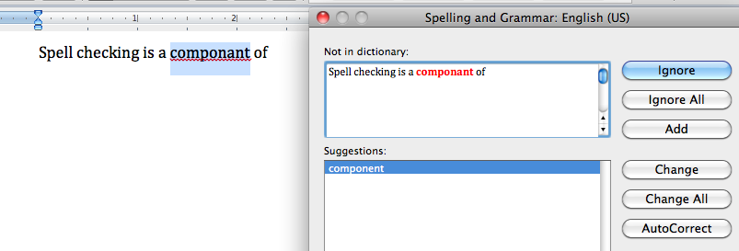
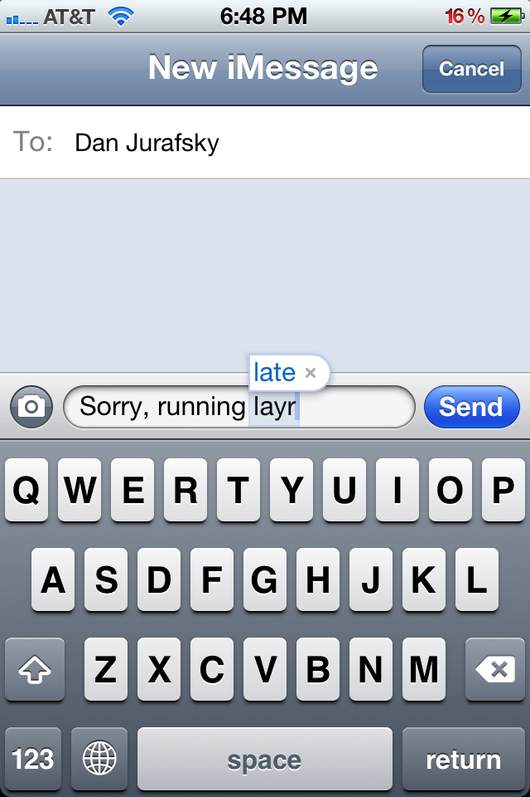
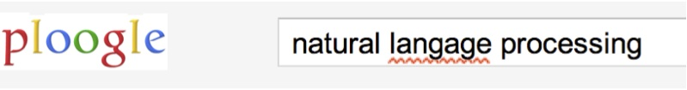
Applications for spelling correction
Word processing
Phones
Web search

Slide 3
Spelling Tasks
Spelling Error Detection
Spelling Error Correction:
Autocorrect
hte→the
Suggest a correction
Suggestion lists

Slide 4
Types of spelling errors
Non-word Errors
graffe →giraffe
Real-word Errors
Typographical errors
three →there
Cognitive Errors (homophones)
piece→peace,
too → two

Slide 5
Rates of spelling errors
26%: Web queries Wang et al. 2003
13%: Retyping, no backspace: Whitelaw et al. English&German
7%: Words corrected retyping on phone-sized organizer
2%: Words uncorrected on organizer Soukoreff &MacKenzie 2003
1-2%: Retyping: Kane and Wobbrock 2007, Gruden et al. 1983

Slide 6
Non-word spelling errors
Non-word spelling error detection:
Any word not in a dictionary is an error
The larger the dictionary the better
Non-word spelling error correction:
Generate candidates: real words that are similar to error
Choose the one which is best:
Shortest weighted edit distance
Highest noisy channel probability

Slide 7
Real word spelling errors
For each word w, generate candidate set:
Find candidate words with similar pronunciations
Find candidate words with similar spelling
Include w in candidate set
Choose best candidate
Noisy Channel
Classifier

Slide 8
Spelling Correction and the Noisy Channel
The Spelling Correction Task

