Slide 1
Grails Circuit Breaker Plugin
https://github.com/paulwoods/grails-breakerbox
https://travis-ci.org/paulwoods/grails-breakerbox
Paul Woods
8/7/2013
@mr_paul_woods
mr.paul.woods@gmail.com

Slide 2
Goals
Create a grails plugin for a circuit breaker.
Use Spock and TDD for development
Upload to Github.
Build and Test on Travis-ci.

Slide 3
The Problem
def parts = Part.list()
parts.each { Part part ->
try
part.refresh()
} catch(e) {
log.error e.message,e
}
}
What if there are thousands of parts?
What if refresh throws a exception each time?
What if your logger is configured to send a email on each error?

Slide 4
Circuit Breaker
Circuit breaker is a pattern for protecting a software system from a malfunctioning system.
Our plugin will disable a section of code from running after it has thrown too many exceptions.

Slide 5
The Solution
def breaker = new CircuitBreaker(trigger:5)
def parts = Part.list()
parts.each { Part part ->
breaker.protect {
part.refresh()
}
}
breaker.verify()
We configure the breaker to allow 5 exceptions before the breaker is triggered.
The breaker runs the protected code, until it throws 5 times.
After 5 exceptions, the breaker is tripped, the code in the protect closure will not run.
breaker.verify will throw a Circuit Breaker Exception if the breaker caught any exceptions.
The breaker stores all the 5 caught exceptions.

Slide 6
Circuit Breaker States
Normal – The protected code runs normally
Tripped – The protected code does not run
A breaker can be reset from the tripped state to the normal state.

Slide 7
Live Coding – Build the Plugin
See https://github.com/paulwoods/grails-breakerbox for the source code

Slide 8
Travis CI
https://www.travis-ci.org/
Travis CI is a continuous integration cloud-based server.
It can easily test multiple program languages and frameworks. You provide a linux shell script that Travis will run to build/test your project.
It does not store test artifacts. You need to disposition those before your shell script ends.

Slide 9
Configure Travis 1
Create your account.
Connect Travis CI to your github repository.
Follow the instructions:
http://about.travis-ci.org/docs/user/getting-started/
Add the .travis.yml script to your repo.
Travis will run the script after every push.

Slide 10
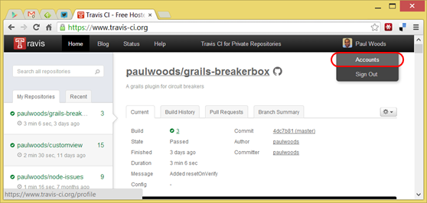
Configure Travis 2
View your Accounts page.

Slide 11
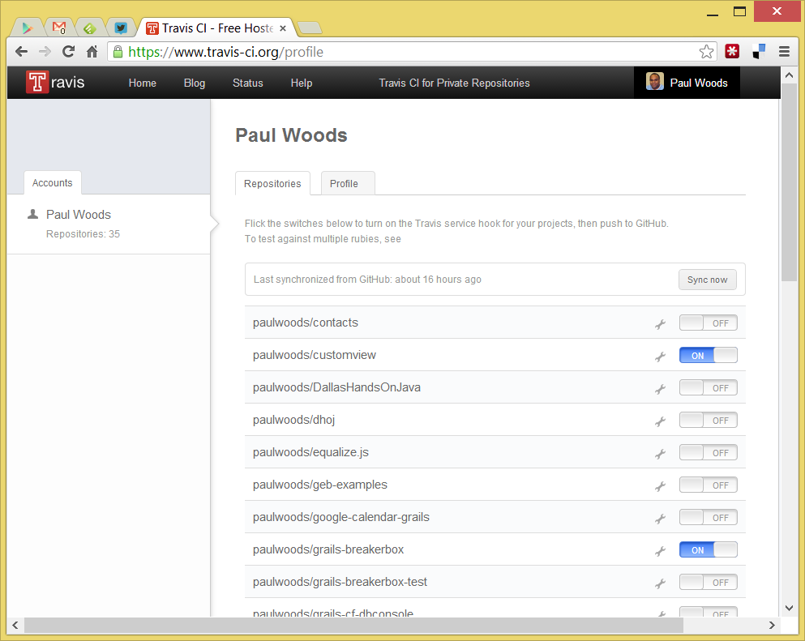
Configure Travis 3
Turn on the project(s) you want Travis to build.
If you don’t see your project, click the Sync Now button.

Slide 12
Configure Travis 4
Create a .travis.yml file in the root of your repository.
Use this one to build and run the unit tests for grails apps.
Push to Github, and Travis will schedule a build (usually within 2 minutes).
language: groovy
jdk:
- oraclejdk7
branches:
only:
- master
before_script:
- chmod +x grailsw
script: ./grailsw refresh-dependencies && ./grailsw "test-app -unit"

Slide 13
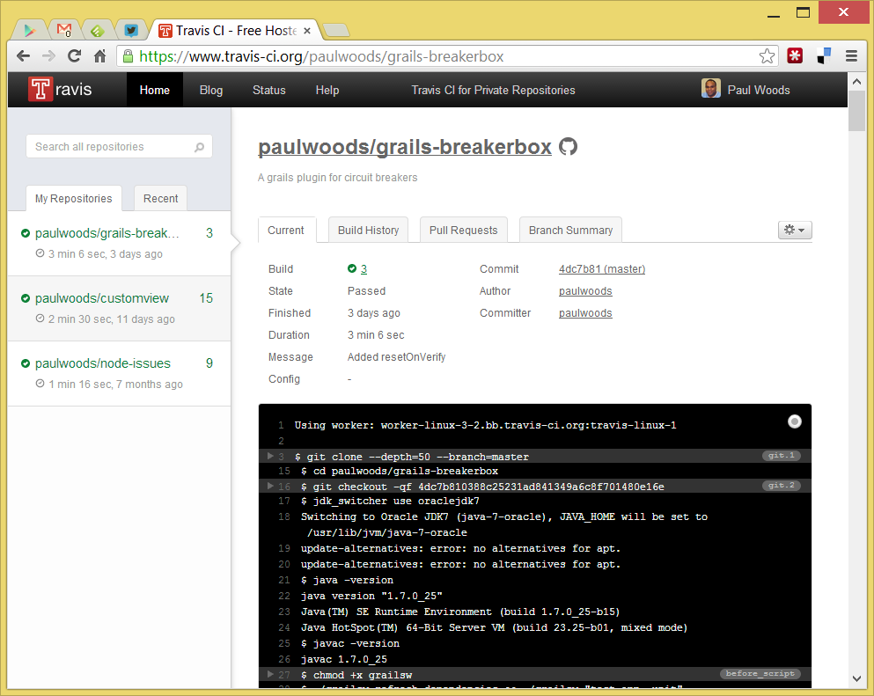
Building and Results
Travis will show the console during the build.
The colors indicate status
Green - successful build
Yellow - build in progress
Red - failed build

Slide 14
Possible Future Actions
Publish on BinTray…
Publish on grails plugins…

