Slide 1
Resources Plugin
Why do I want this? *
Paul Woods
8/1/2012 https://github.com/paulwoods/resources-talk
* = because is Good For You™

Slide 2
What's the problem?
Our web pages are growing.
We used store all of our page code on one file.
The server only had to send one file to render a page *
* = not including images and media, of course

Slide 3
What's the problem?
In 1994 CSS was invented, so we can put CSS into its own file *
Now our servers are sending 2 files to render a page – HTML as CSS
* = http://www.w3.org/Style/LieBos2e/history/

Slide 4
What's the problem?
Somewhere in the early 2000s, we started extracting our javascript from the HTML file and put it into its own file
Now our servers are sending 3 files to render a page – HTML, CSS and JS

Slide 5
What's the problem?
But now, those CSS files grew and grew and grew
So, we split our CSS files into multiple CSS files
Now our servers are sending lots files to render a page – HTML, multple CSS and JS

Slide 6
What's the problem?
Guess what happened to the javascript?
Yep – same thing. It got so big, we needed to split it into multiple files.
Now our servers are sending Lord-knows-how-many files to render a page – HTML, multple CSS and multiple JS

Slide 7
What's the problem?
Did I forget to mention 3rd party javascript?
We use lots of it to make our sites better, but that’s still more files for our server to send.

Slide 8
The servers were sad
They were serving more and more files to more and more users.
They responded by making our sites slow.
Our users (and bosses) don’t like slow sites.

Slide 9
Solutions! FTW
Very Smart People™ came up with methods to fix this problem:
Caching – telling the browser to retain data so it doesn’t need to be downloaded again.
GZip – Shrinking the files so there is less data to download.
Minification – Rewriting CSS and Javascript files so that they are smaller and combined into one file.

Slide 10
Wouldn’t it be nice if I could…
join all of the .css files into one file on the server.
join all of the .js files into one file on the server.
serve just the one css file.
serve just the one js file.
configure which files go into the css file.
configure which files go into the js file.
control the order of the data in the file
configure globally and by-page
cache those files
minify those files

Slide 11
One Solution to Rule Them All*
We can use the Grails Resources** plugin!
Can combine multiple css or javascript files into a single file, at runtime.
Configurable, to allow us to change which files are used on which pages.
Extendable – With additional plugins we can add caching and minifying.
* = actually, multiple solutions combined into one.
** = your VSPs are Marc Palmer and Luke Daley

Slide 12
Demo Site 1
Site one is a one-page app that has several css widgets and javascript files.
We want to use the resources plugin to combine the .css into one file, and the .js files into one file.

Slide 13
Demo Site 1 – Head 1
Four CSS files are linked.
<link rel="stylesheet" href="${resource(dir: 'css', file: 'widget1.css')}" type="text/css">
<link rel="stylesheet" href="${resource(dir: 'css', file: 'widget2.css')}" type="text/css">
<link rel="stylesheet" href="${resource(dir: 'css', file: 'widget3.css')}" type="text/css">
<link rel="stylesheet" href="${resource(dir: 'css', file: 'widget4.css')}" type="text/css">

Slide 14
Demo Site 1 – Head 2
Seven JavaScript files are linked.
<script type="text/javascript" src="${g.resource(dir:'js', file:'jquery-1.7.2.js')}"></script>
<script type="text/javascript" src="${g.resource(dir:'js', file:'underscore-1.3.3.js')}"></script>
<script type="text/javascript" src="${g.resource(dir:'js', file:'modernizr-2.5.2.js')}"></script>
<script type="text/javascript" src="${g.resource(dir:'js', file:'backbone-0.9.2.js')}"></script>
<script type="text/javascript" src="${g.resource(dir:'js', file:'handlebars-1.0.0.beta.6.js')}"></script>
<script type="text/javascript" src="${g.resource(dir:'js', file:'jasmine-1.2.0.js')}"></script>
<script type="text/javascript" src="${g.resource(dir:'js', file:'index-1.0.0.js')}"></script>

Slide 15
Demo Site 1 – Head 3
And one local JavaScript
<script type="text/javascript">
(function(window, $, undefined) {
$(function() {
$("#jquery").html( jQuery.fn.jquery );
$("#underscore").html( _.VERSION );
$("#modernizr").html( Modernizr._version );
$("#backbone").html( Backbone.VERSION );
$("#handlebars").html( Handlebars.VERSION );
$("#jasmine").html( jasmine.getEnv().versionString() );
$("#index").html( site1.VERSION );
});
}(window, jQuery));
</script>

Slide 16
Demo Site 1 – Body
<table>
<thead>
<tr><th>File</th><th>Version</th></tr>
</thead>
<tbody>
<tr><td>jquery</td><td id="jquery">---</td></tr>
<tr><td>underscore</td><td id="underscore">---</td></tr>
<tr><td>modernizr</td><td id="modernizr">---</td></tr>
<tr><td>backbone</td><td id="backbone">---</td></tr>
<tr><td>handlebars</td><td id="handlebars">---</td></tr>
<tr><td>jasmine</td><td id="jasmine">---</td></tr>
<tr><td>index</td><td id="index">---</td></tr>
</tbody>
</table>
<h2 class="widget1">Widget 1</h2>
<h2 class="widget2">Widget 2</h2>
<h2 class="widget3">Widget 3</h2>
<h2 class="widget4">Widget 4</h2>

Slide 17
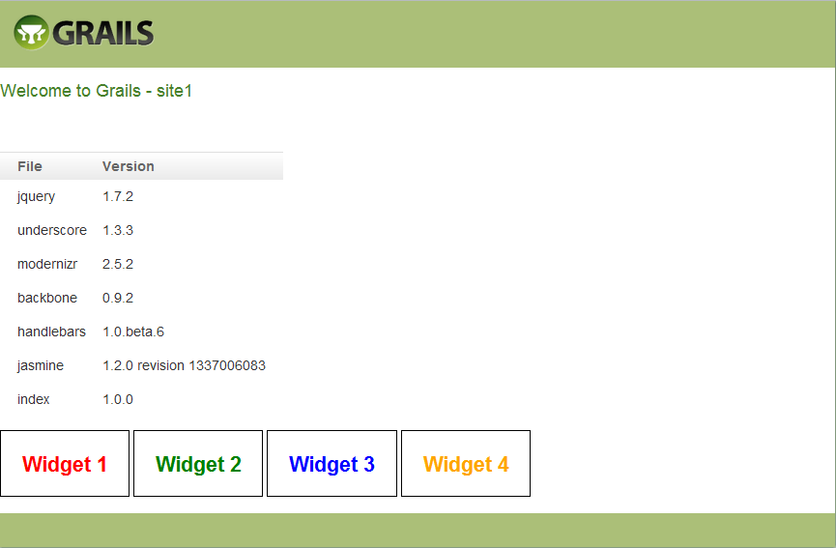
Demo Site 1 – Screen Shot

Slide 18
Lets Use Resources - 1
grails install-plugin resources
* = grails 2.0 already has it installed by default.

Slide 19
Lets Use Resources - 2
Create or Edit the /conf/ApplicationResources.groovy file*
Add a module closure variable
Insert a named closure for your files (aka the ‘Module’)
* = applications prior to grails 2.0 will not have this file. The file name does not have to be ApplicationResources.groovy. It can be anything that ends in Resources.groovy

Slide 20
Lets Use Resources - 3
site1b/grails-app/conf/ApplicationResources.groovy
modules = {
site1b {
resource url:'css/widget1.css'
resource url:'css/widget2.css'
resource url:'css/widget3.css'
resource url:'css/widget4.css'
resource url:'js/jquery-1.7.2.js'
resource url:'js/underscore-1.3.3.js'
resource url:'js/modernizr-2.5.2.js'
resource url:'js/backbone-0.9.2.js'
resource url:'js/handlebars-1.0.0.beta.6.js'
resource url:'js/jasmine-1.2.0.js'
resource url:'js/index-1.0.0.js'
}
}
The resources are similar to the g.resource tag, but these are now r.resource.

Slide 21
Lets Use Resources - 4
In the head section, add r:require and r.layoutResources
<head>
<r:require module="site1b"/>
…
<r:layoutResources/>
</head>

Slide 22
Lets Use Resources - 5
Change any <script> tags to <r:script>
<r:script>
(function(window, $, undefined) {
$(function() {
$("#jquery").html( jQuery.fn.jquery );
$("#underscore").html( _.VERSION );
$("#modernizr").html( Modernizr._version );
$("#backbone").html( Backbone.VERSION );
$("#handlebars").html( Handlebars.VERSION );
$("#jasmine").html( jasmine.getEnv().versionString() );
$("#index").html( site1.VERSION );
});
}(window, jQuery));
</r:script>

Slide 23
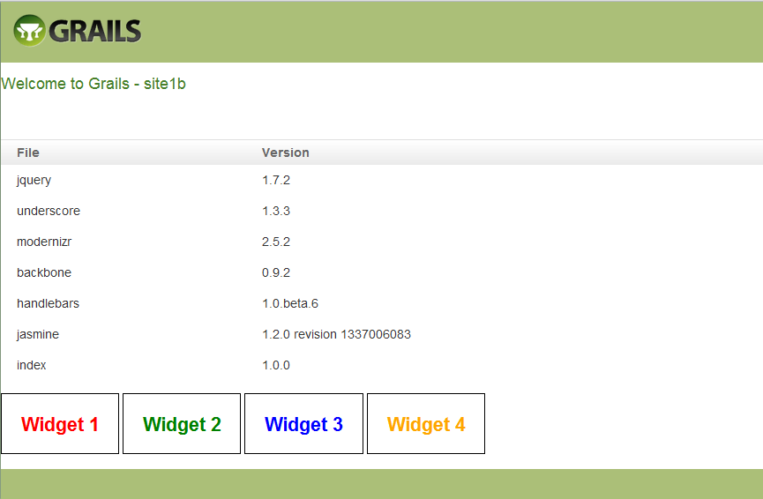
Demo Site2 – Using Resources

Slide 24
Demo Site2 – Source Code 1
Looks exactally the same, but look under the hood (view sources):
In the header the CSS files have been reduced into one file*:
The <script> javascript code is gone from the header.
<link href="/site1b/static/bundle-bundle_site1b_head.css" type="text/css“ rel="stylesheet" media="screen, projection" />
* = there are other .css files in the header. The are part of the layout main.gsp We will remove those later.
** = Click on the link to see what is in the .css file.

Slide 25
Demo Site 2 – Source Code 2
At the end of the body, these is a single linked javascript file.
<script src="/site1b/static/bundle-bundle_site1b_defer.js" type="text/javascript" ></script>
* = click on the javascript link. You will see that all of the .js files have been bundled into one.

Slide 26
Demo Site2 – Source Code 3
Our script file is now at the bottom of the body.
(function(window, $, undefined) {
$(function() {
$("#jquery").html( jQuery.fn.jquery );
$("#underscore").html( _.VERSION );
$("#modernizr").html( Modernizr._version );
$("#backbone").html( Backbone.VERSION );
$("#handlebars").html( Handlebars.VERSION );
$("#jasmine").html( jasmine.getEnv().versionString() );
$("#index").html( site1.VERSION );
});
}(window, jQuery));
</script>
</body>

Slide 27
Wait, What, How?
The plugin took the .css files configured in ApplicationResources, combined them into one file, and made it available at uri:
/site1b/static/bundle-bundle_site1b_head.css
It did the same thing with the javascript and made it available at
/site1b/static/bundle-bundle_site1b_defer.js

Slide 28
But, it moved my javascript
Yep. Today’s practices recommend that javascript be moved to the bottom of the body tag. This allows all of the HTML to be loaded into the DOM before the javascript runs.
Most javascript runs just fine this way, but if you need, you can configure files to be in the head.

Slide 29
Definitions
Lets get a few of the definitions out of the way…

Slide 30
Definitions – module
A module is a group of resources that will be included together on the page. They are defined in ApplicationResources.groovy.
jQuery {
resource url:[dir:"js", file:"jquery-ui-1.8.20.custom.min.js"]
resource url:[dir:"css", file:"jquery-ui-1.8.20.custom.css"]
}

Slide 31
Definitions – disposition
The disposition tells the plugin where (head or body) to place the resource. Use values head or defer. This example puts modernizr in the head and jQuery in the body
modules = {
core {
resource url:'js/modernizr-2.5.2.js', disposition: 'head'
resource url:'js/jquery-1.7.2.js'
}
}

Slide 32
Definitions - bundle
The bundle is the name given to the files in a module, and it is used in the url used to download the files. By default, it’s the same as the module, but you can set it using “defaultBundle”
jQuery {
defaultBundle “ui”
resource url:[dir:"js", file:"jquery-ui-1.8.20.custom.min.js"]
resource url:[dir:"css", file:"jquery-ui-1.8.20.custom.css"]
}

Slide 33
Definitions – r:require
This tag is placed in the head of your page. It tells the resource plugin which module(s) to use on this page.
<head>
<meta name="layout" content="main"/>
<r:require module=“jQuery"/>
…

Slide 34
Definitions – r:layoutResources
This tag denotes the location where the bundled file links will be placed. It must appear twice on your page – once in the head and once in the body. Normally put this tag at the bottom of the head and the bottom of the body.
<head>
…
<r:layoutResources/>
</head>
<body>
…
<r:layoutResources/>
</body>

Slide 35
Definitions – r:script
The r:script tag is similar to the <script> tag, except the plugin may move the javascript to either the head or the body of the page.
<r:script>
window.alert('This is the end of the page!');
</r:script>
<r:script disposition='head'>
window.alert('This is the head of the page!');
</r:script>

Slide 36
Demo 3
In our previous demo, we included Modernizr, but it was incorrect - it needs to in the head, not the body. Lets update our ApplicationResources.groovy

Slide 37
Demo 3
modules = {
site3 {
resource url:'css/widget1.css'
resource url:'css/widget2.css'
resource url:'css/widget3.css'
resource url:'css/widget4.css'
resource url:'js/jquery-1.7.2.js'
resource url:'js/underscore-1.3.3.js'
resource url:'js/modernizr-2.5.2.js‘, disposition:”head”
resource url:'js/backbone-0.9.2.js'
resource url:'js/handlebars-1.0.0.beta.6.js'
resource url:'js/jasmine-1.2.0.js'
resource url:'js/index-1.0.0.js'
}
}

Slide 38
Demo 3 - head
<head>
...
<link href="/site3/static/bundle-bundle_site3_head.css" type="text/css" rel="stylesheet" media="screen, projection" />
<script src="/site3/static/bundle-bundle_site3_head.js" type="text/javascript" ></script>
</head>
We now have a javascript file in the header. Click on the link to see the contents. (spoiler alert: it is the modernizr file).

Slide 39
Multiple Modules
Lets move the modernizr code into its own module, and the backbone files into their own module.

Slide 40
Demo 4 – multi modules
Update ApplicationResources.groovy to use 3 modules
modules = {
modernizr {
resource url:'js/modernizr-2.5.2.js‘, disposition: ’head’
}
backbone {
resource url:'js/underscore-1.3.3.js'
resource url:'js/backbone-0.9.2.js'
resource url:'js/handlebars-1.0.0.beta.6.js'
}
site3 {
resource url:'css/widget1.css'
resource url:'css/widget2.css'
resource url:'css/widget3.css'
resource url:'css/widget4.css'
resource url:'js/jquery-1.7.2.js'
resource url:'js/jasmine-1.2.0.js'
resource url:'js/index-1.0.0.js'
}
}

Slide 41
Demo 4 – r:requre
Add the three modules (comma separated) to the r:require tag:
<r:require modules="modernizr, backbone, site4" />
Note: ‘module=‘ was changed to ‘modules=‘

Slide 42
Demo 4 – Source
head:
<link href="/site4/static/bundle-bundle_site4_head.css" …
<script src="/site4/static/js/modernizr-2.5.2.js“ ...
body:
<script src="/site4/static/bundle-bundle_site4_defer.js“…
<script src="/site4/static/bundle-bundle_backbone_defer.js" …
Each module is placed in its own bundle. Notice there are 2 javascript bundles in the body.

Slide 43
Merging Bundles
Since there are 2 bundles in the body, we can combine them into one bundle by using defaultBundle.
By giving the modules the same defaultBundle name, they will be placed in the same bundle.

Slide 44
Demo 5
Add defaultBundle to the modules.
modules = {
modernizr {
defaultBundle “ui”
resource url:'js/modernizr-2.5.2.js‘, disposition: ’head’
}
backbone {
defaultBundle “ui”
resource url:'js/underscore-1.3.3.js'
resource url:'js/backbone-0.9.2.js'
resource url:'js/handlebars-1.0.0.beta.6.js'
}
site3 {
defaultBundle “ui”
resource url:'css/widget1.css'
resource url:'css/widget2.css'
resource url:'css/widget3.css'
resource url:'css/widget4.css'
resource url:'js/jquery-1.7.2.js'
resource url:'js/jasmine-1.2.0.js'
resource url:'js/index-1.0.0.js'
}
}

Slide 45
Demo 5 - Source
head:
<link href="/site5/static/bundle-ui_head.css" …
<script src="/site5/static/bundle-ui_head.js “ ...
body:
<script src="/site5/static/bundle-ui_defer.js “…
Now, The body only has only one bundle

Slide 46
Ordering Dependencies
If one module depends on another (for instance if site5 depends on jquery) use dependsOn to specify the dependency

Slide 47
Demo 6 - ApplicationResources
modules = {
modernizr {
defaultBundle 'ui'
resource url:'js/modernizr-2.5.2.js', disposition: 'head'
}
backbone {
defaultBundle 'ui'
resource url:'js/underscore-1.3.3.js'
resource url:'js/backbone-0.9.2.js'
resource url:'js/handlebars-1.0.0.beta.6.js'
}
site6 {
dependsOn "modernizr, backbone"
defaultBundle 'ui'
resource url:'css/widget1.css'
resource url:'css/widget2.css'
resource url:'css/widget3.css'
resource url:'css/widget4.css'
resource url:'js/jquery-1.7.2.js'
resource url:'js/jasmine-1.2.0.js'
resource url:'js/index-1.0.0.js'
}
}

Slide 48
Demo 6 – index.gsp
Since site6 pulls in modernizr and backbone, update r:modules to only require site6
<r:require module="site6"/>

Slide 49
Demo 6 – source
Since site6 pulls in modernizr and backbone, update r:modules to only require site6
head:
<link href="/site6/static/bundle-ui_head.css" …
<script src="/site6/static/bundle-ui_head.js “ ...
body:
<script src="/site6/static/bundle-ui_defer.js “…

Slide 50
Other Plugins
cache-resources
Tells the browser to cache the bundled files long-term
zipped-resources
Tells the server to send g-zipped files when possible.
yui-minify-resources
Minifies the css and javascript files

Slide 51
Troubleshooting
If you have missing data in your bundled files, you can enable debug mode.
add _debugResources=y to your url
Turns off bundling and processing for the url
add grails.resources.debug = true to config.groovy
Turns off bundling and processing for the app
Enable logging for the plugin
debug "org.grails.plugin.resource"

