Slide 1
Image Filtering
Zhuoyao Lin & Paul Woringer

Slide 2
Overview
1. What parallelism can we exploit ?
2. Our implementations
3. Analysis of results

Slide 3
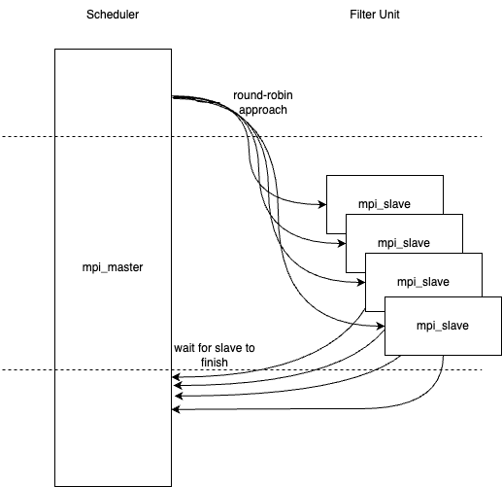
Parallelism Approach: MPI
Master Node: Scheduler
Slave Node: Filter Execution Unit

Slide 4
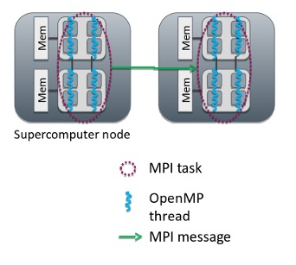
Parallelism Approach:
MPI + OpenMP
Exploiting the parallelism on the `for` loops

Slide 5
CUDA
Separate implementation with MPI and OpenMP
Only implemented for filtering
Only put the most generic mathematical operation of filter into Device function

Slide 6
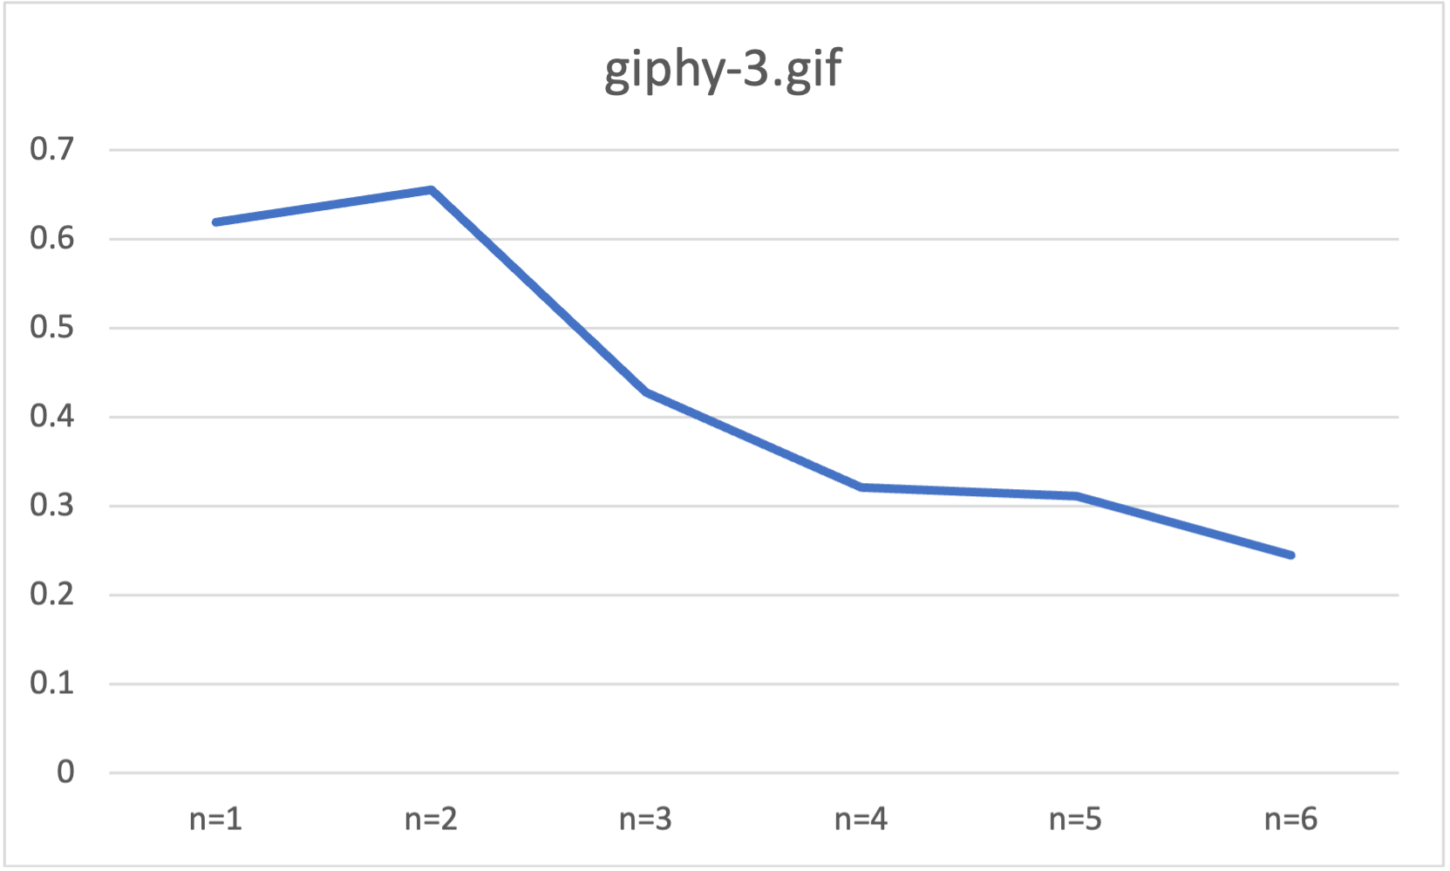
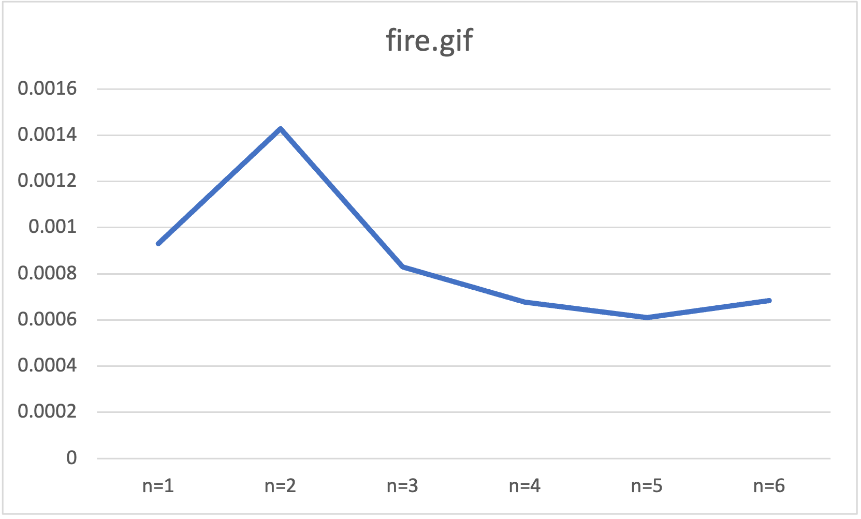
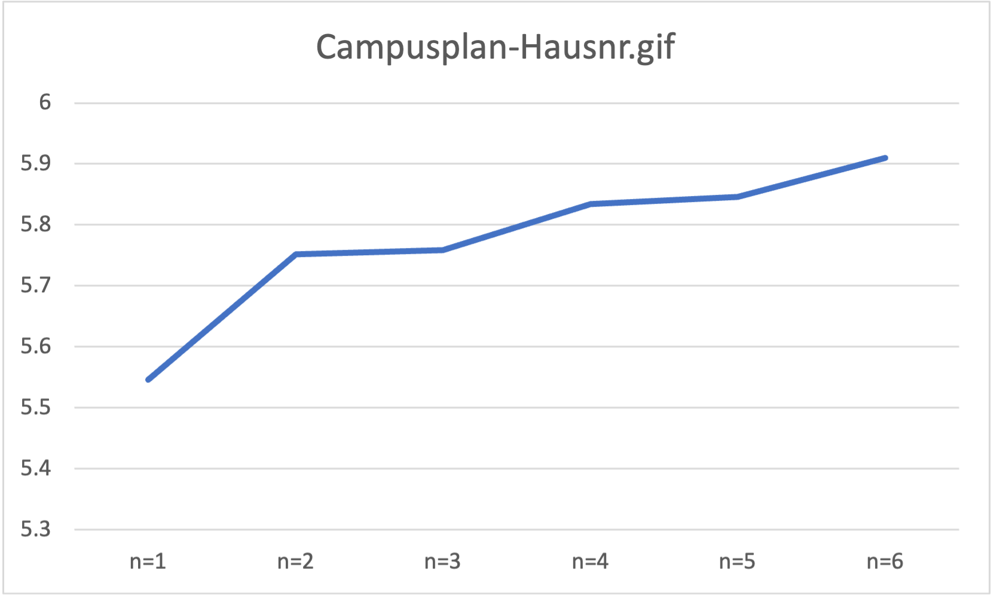
MPI
Performance Analysis
Total execution time

Slide 7
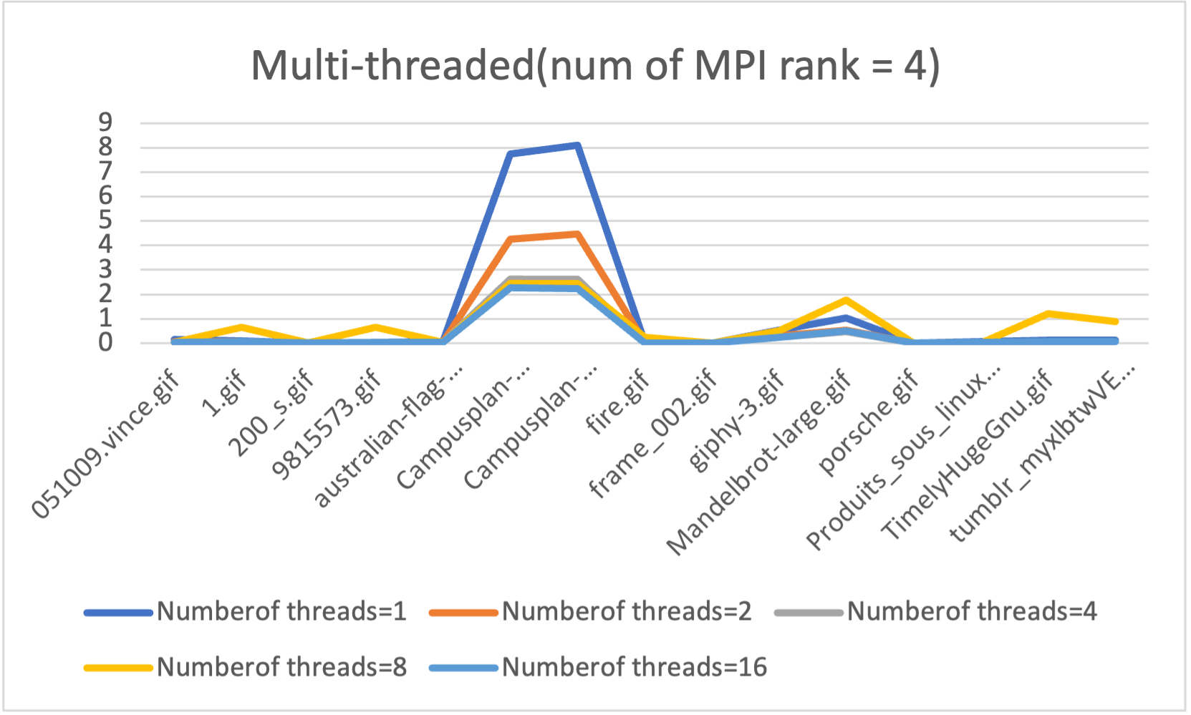
Performance Analysis
MPI + OpenMP
Total execution time

Slide 8
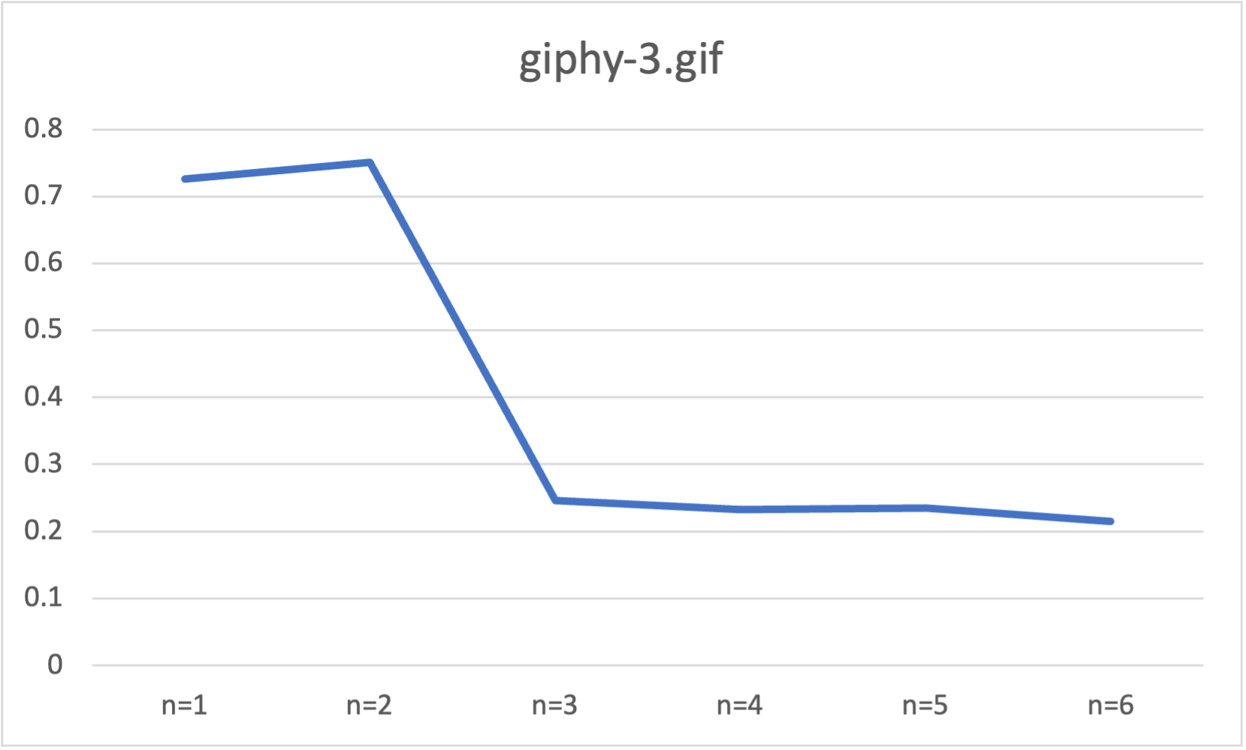
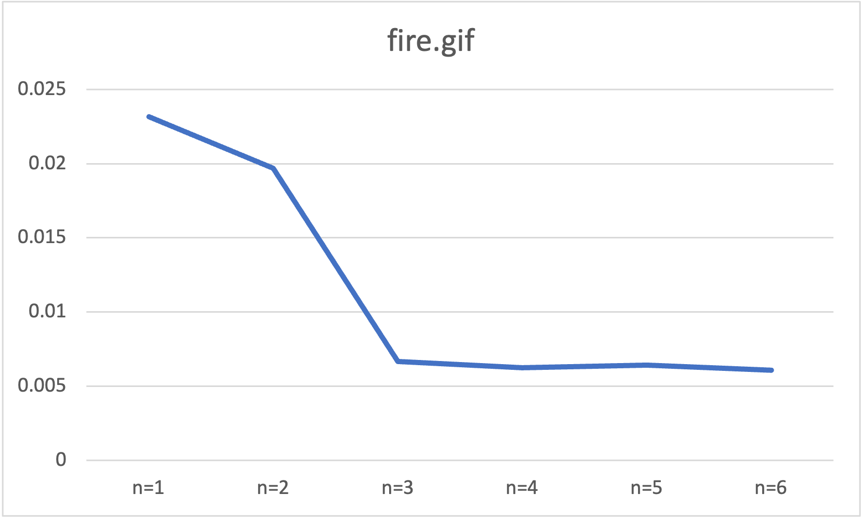
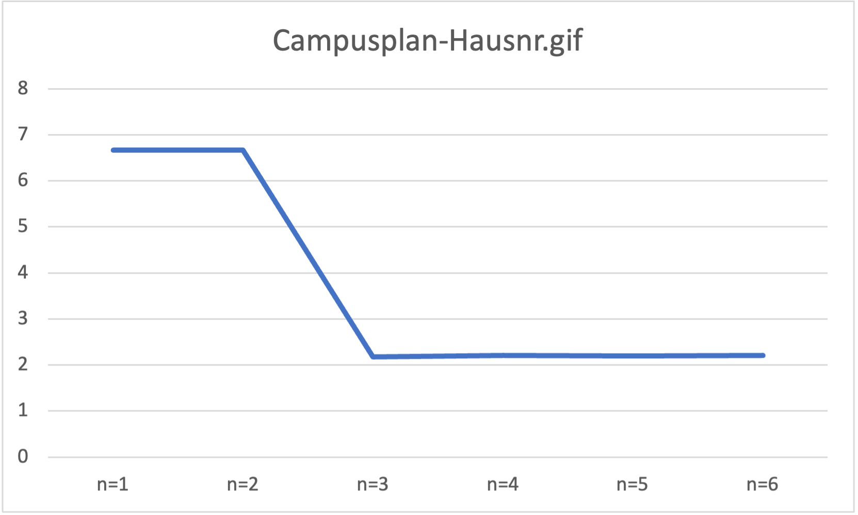
Performance Analysis
MPI + OpenMP
Total execution time

Slide 9
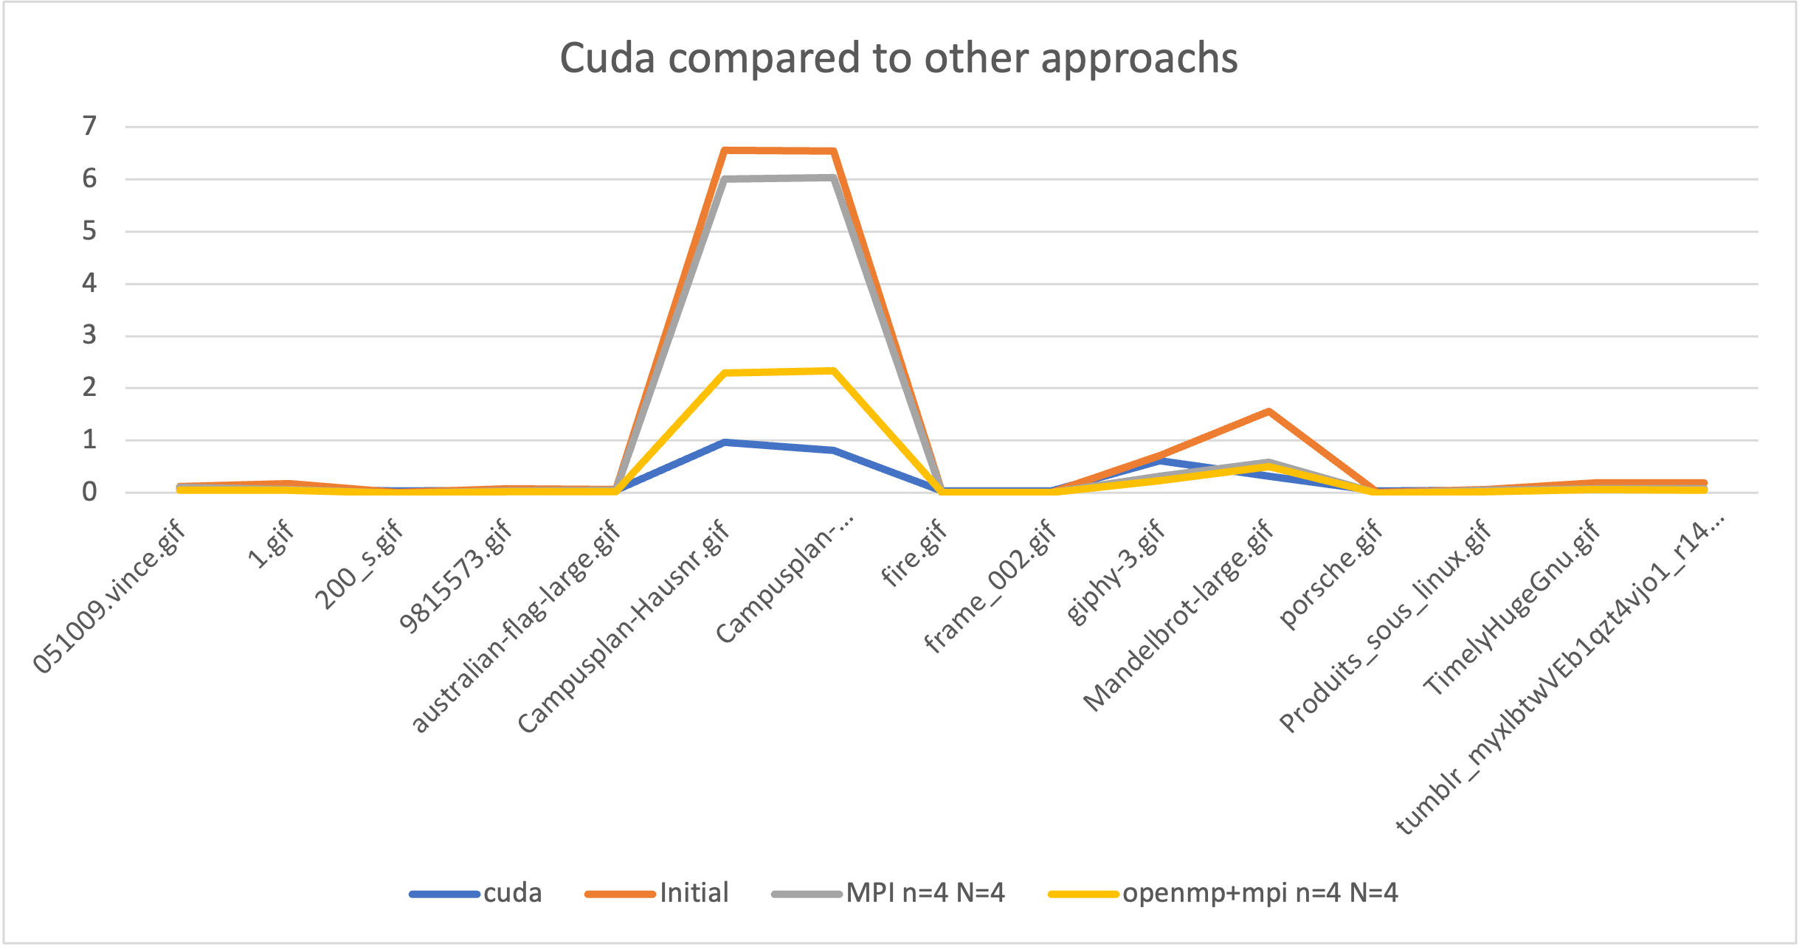
Performance Analysis
CUDA
Total execution time

Slide 10
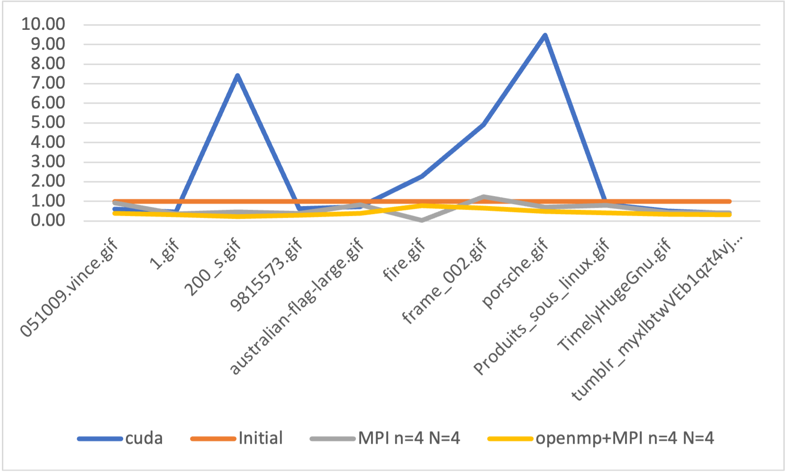
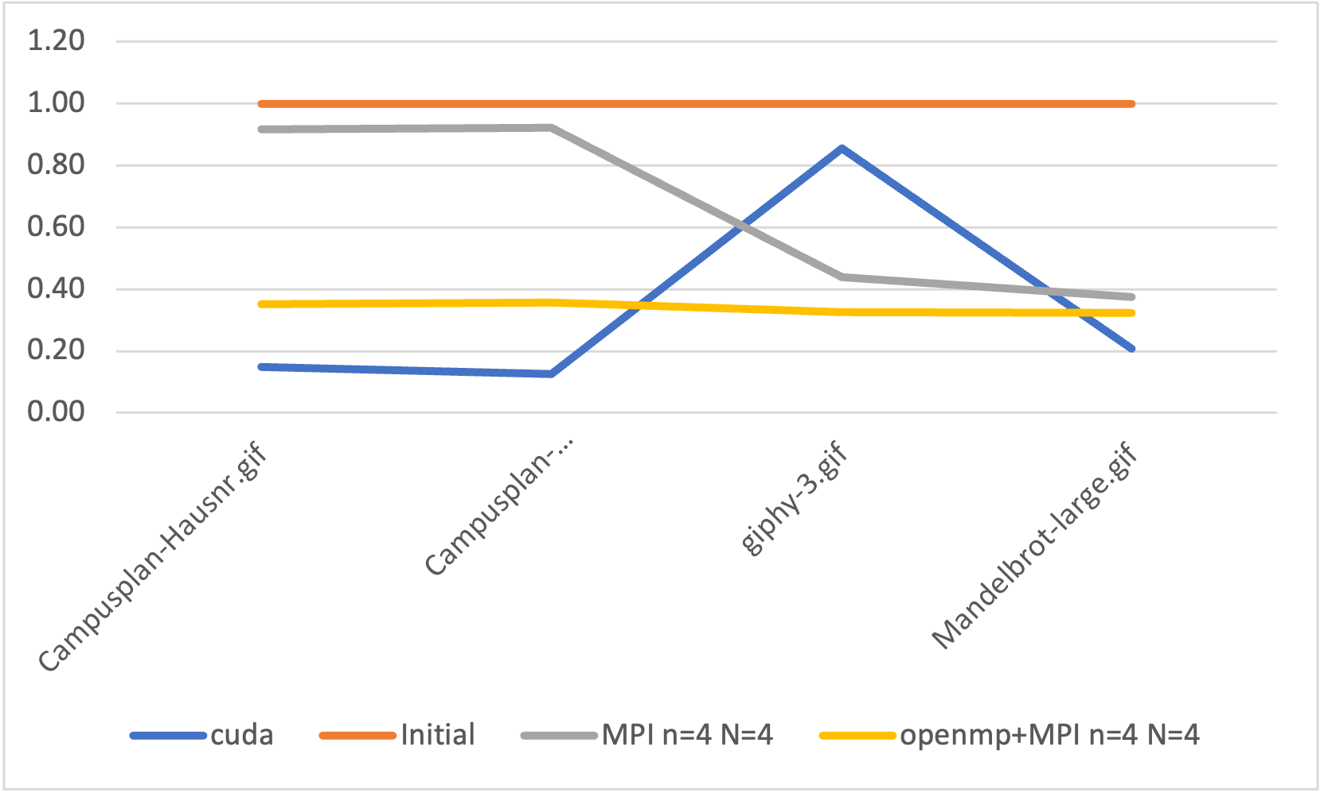
Performance Analysis
CUDA
Small gifs
Large gifs with few images
Total execution time/initial execution time

Slide 11
Conclusion
Use of data parallelism
Significant improvements with MPI, MPI+OpenMP, CUDA, depends on input shape
Room for improvement:
Image splitting,
Reducing amount of communications

