Slide 1
How green is Europe's electricity?
EU-27 generation mixes, lifecycle intensity, and the role of nuclear · 2010–2024
Scientific Visualization · replace with author names
Dataset
Scope
Sample
Unit
OWID Energy
2026-09-10
EU-27 · ISO3
2010–2024
405 country–years
27/27 in 2024
gCO₂eq / kWh
lifecycle
Electricity indicators mainly from Ember, harmonized by Our World in Data.
https://catalog.ourworldindata.org/garden/energy/2026-09-10/owid_energy/owid_energy.csv
Notes:
State version pinning and that every number comes from the verified pipeline.

Slide 2
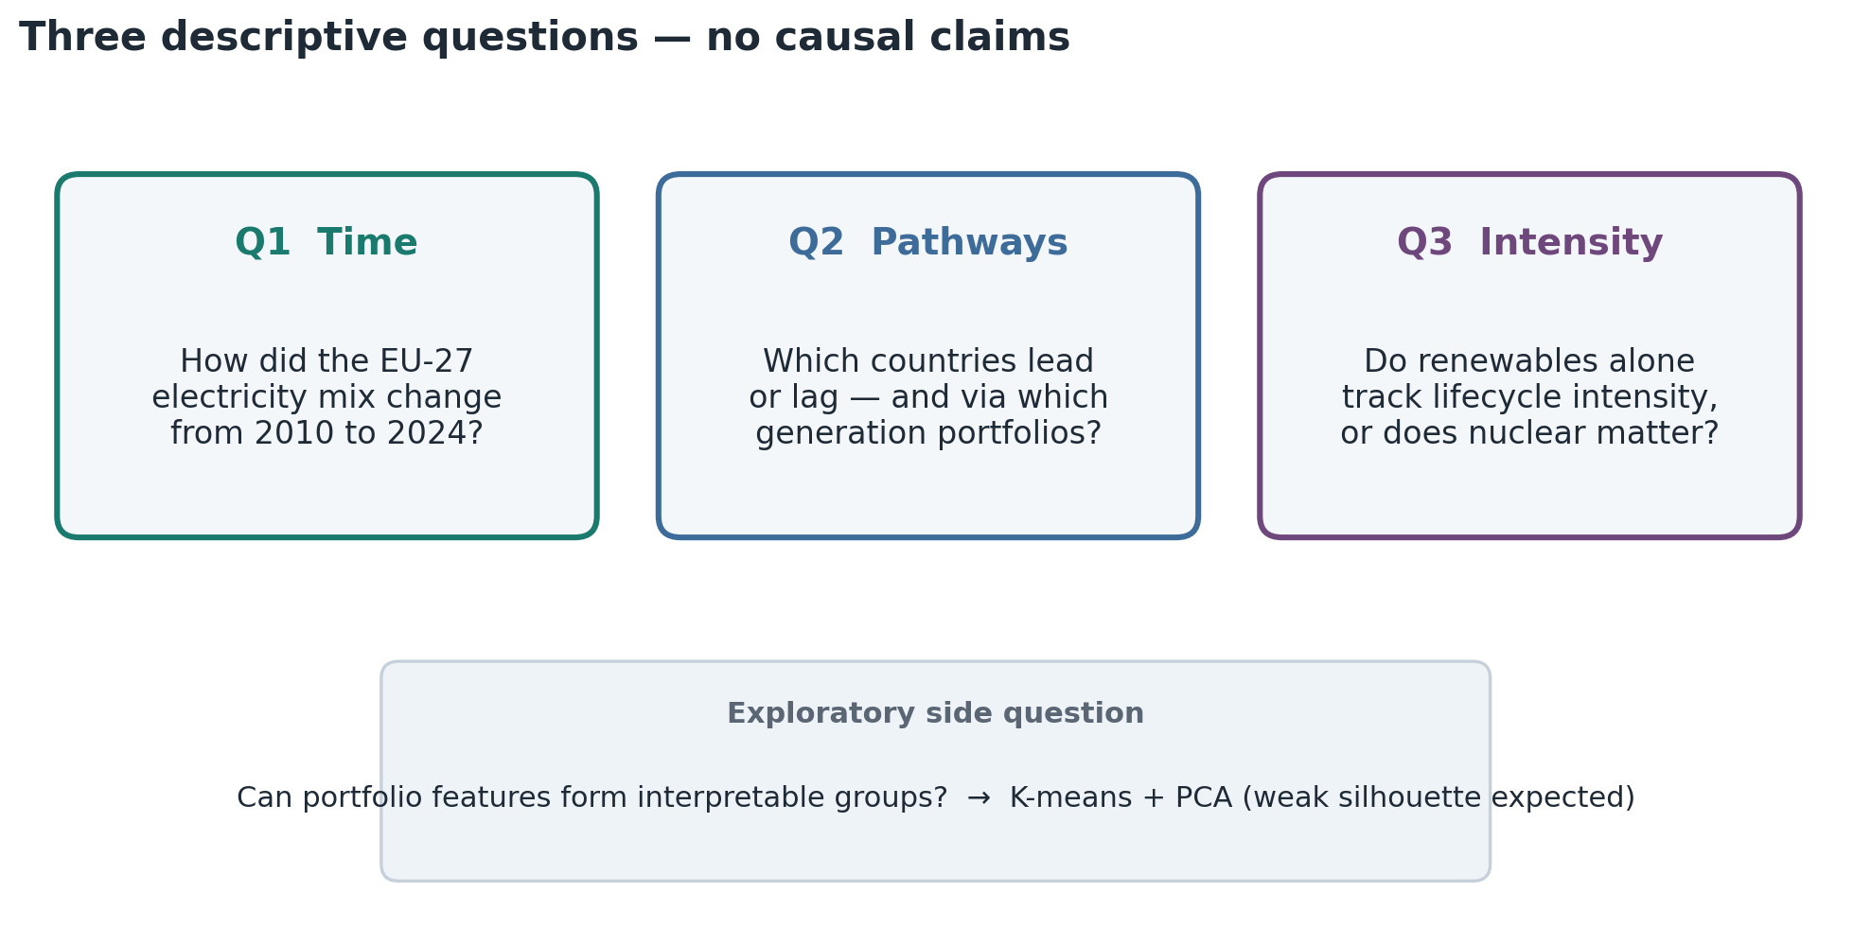
Research questions
OWID Energy 2026-09-10 · electricity mainly Ember · gCO₂eq/kWh = lifecycle intensity
Notes:
Keep questions descriptive. Clustering is a side question with weak separation.

Slide 3
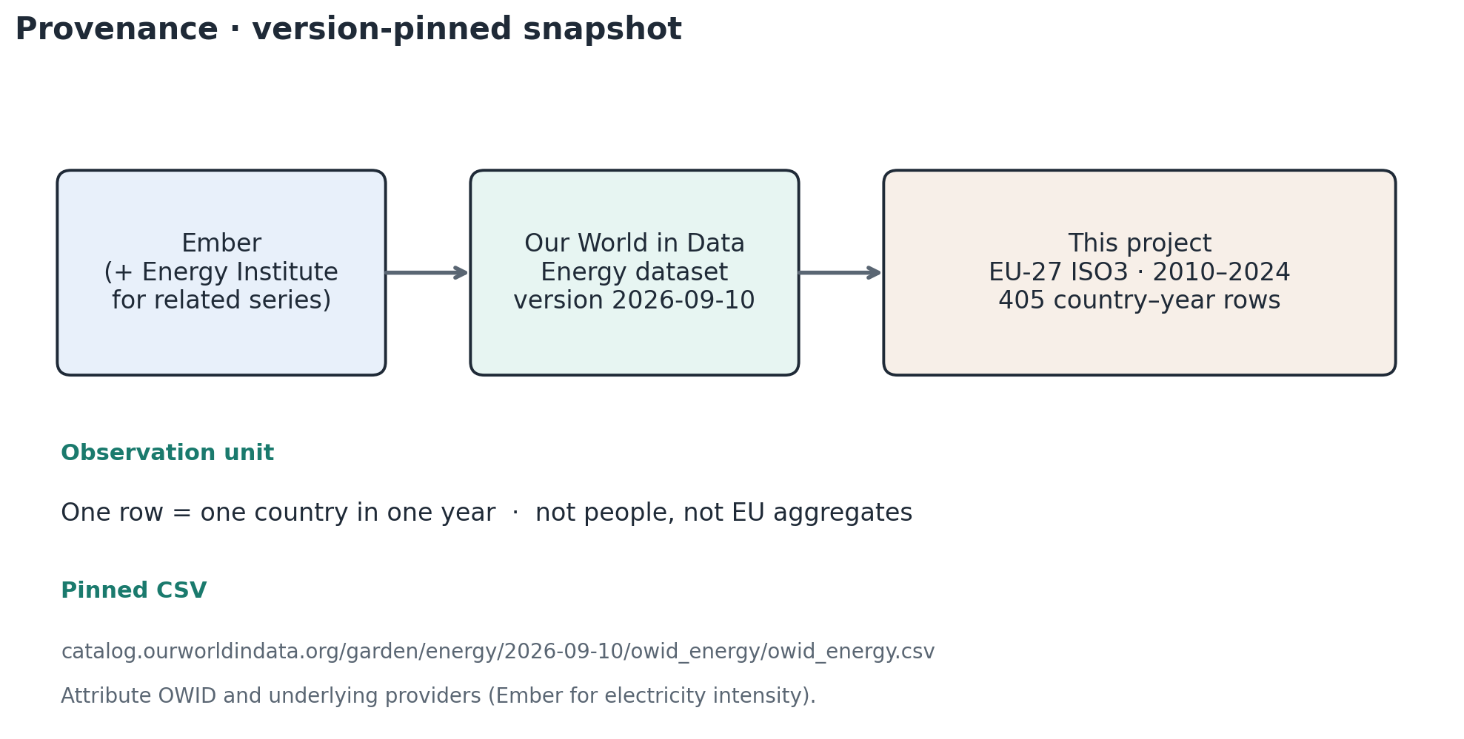
Source and provenance
OWID Energy 2026-09-10 · electricity mainly Ember · gCO₂eq/kWh = lifecycle intensity
Notes:
Credit Ember and OWID. Observation = country-year.

Slide 4
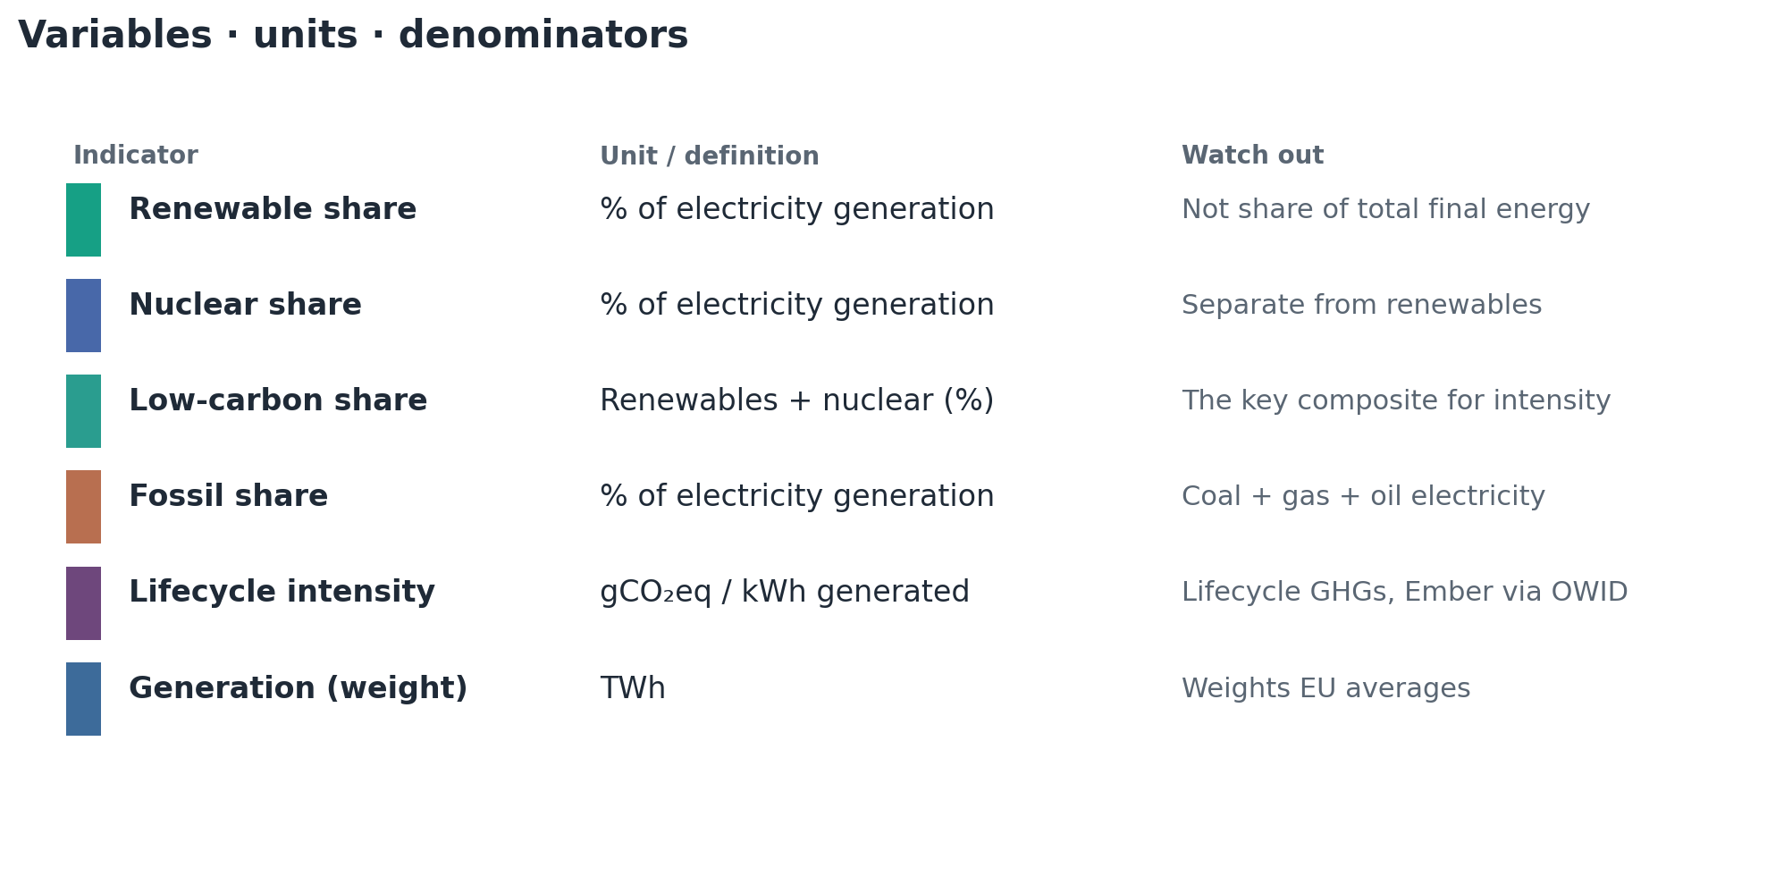
Variables, units and denominators
OWID Energy 2026-09-10 · electricity mainly Ember · gCO₂eq/kWh = lifecycle intensity
Notes:
Stress: electricity shares ≠ final-energy renewables share. Intensity is lifecycle gCO2eq/kWh.

Slide 5
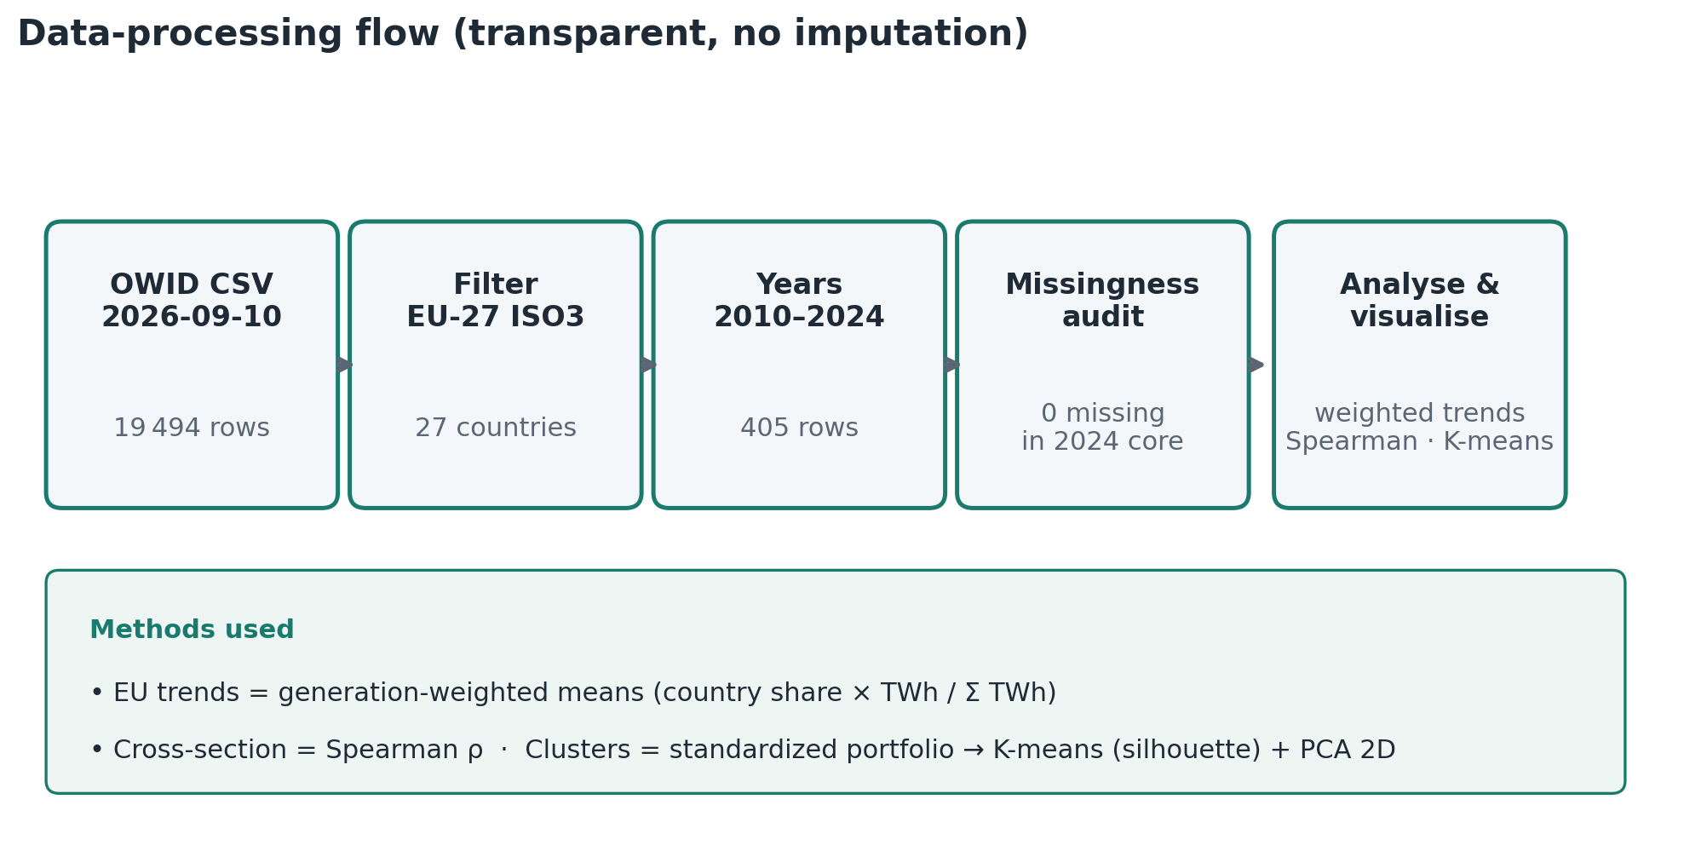
Cleaning and methodology
OWID Energy 2026-09-10 · electricity mainly Ember · gCO₂eq/kWh = lifecycle intensity
Notes:
No imputation. Generation-weighted EU means. Spearman for association. Exploratory K-means.

Slide 6
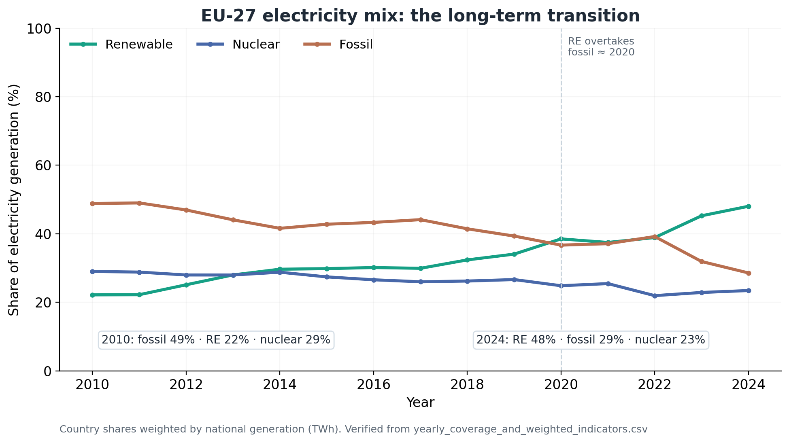
How Europe's electricity mix changed
Renewables 22% → 48% · Fossil 49% → 29% · Nuclear 29% → 23% (generation-weighted)
Notice
Renewables overtook fossil around 2020 after a long climb. Nuclear declined slowly but remains material.
Method reminder
EU lines are weighted by each country's electricity generation (TWh), so large systems dominate.
OWID Energy 2026-09-10 · electricity mainly Ember · gCO₂eq/kWh = lifecycle intensity
Notes:
Walk the three lines. Mention 2021–22 pause. Weights matter.

Slide 7
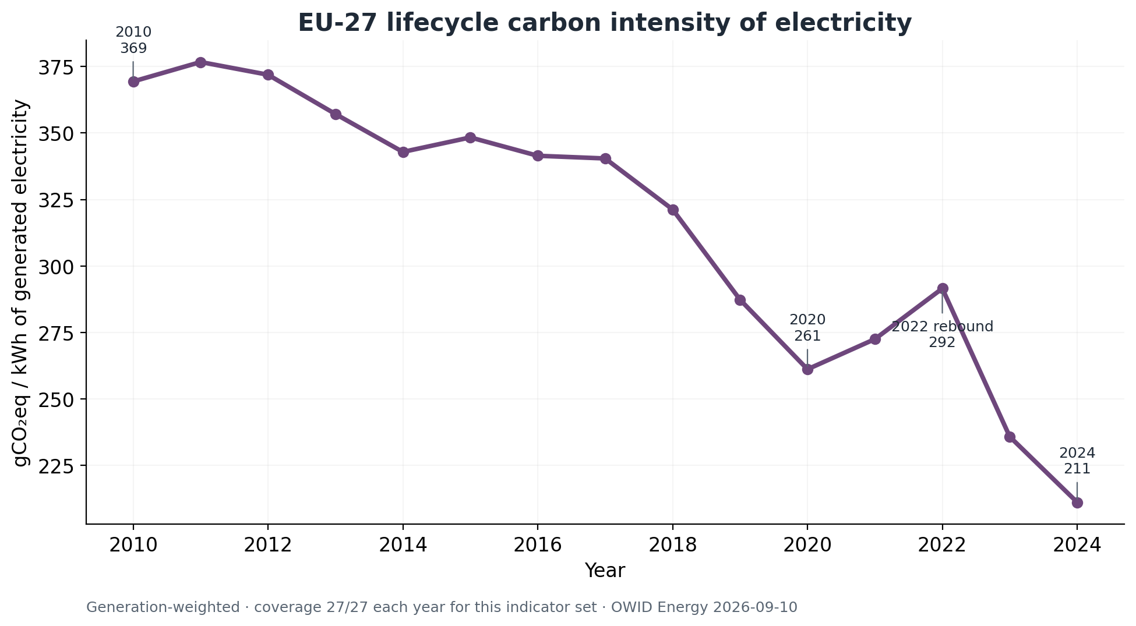
Carbon intensity through time
Lifecycle intensity fell from 369 to 211 gCO₂eq/kWh (2010→2024), with a 2021–22 rebound
Notice
≈43% lower intensity by 2024. The 2022 rebound (~292) is visible before the sharp drop.
Caveat
Coverage here is 27/27 for this indicator set. Generation ≠ consumption (imports matter for demand).
OWID Energy 2026-09-10 · electricity mainly Ember · gCO₂eq/kWh = lifecycle intensity
Notes:
Highlight 2020 trough, 2022 rebound, 2024 low. Units: lifecycle gCO2eq per kWh generated.

Slide 8
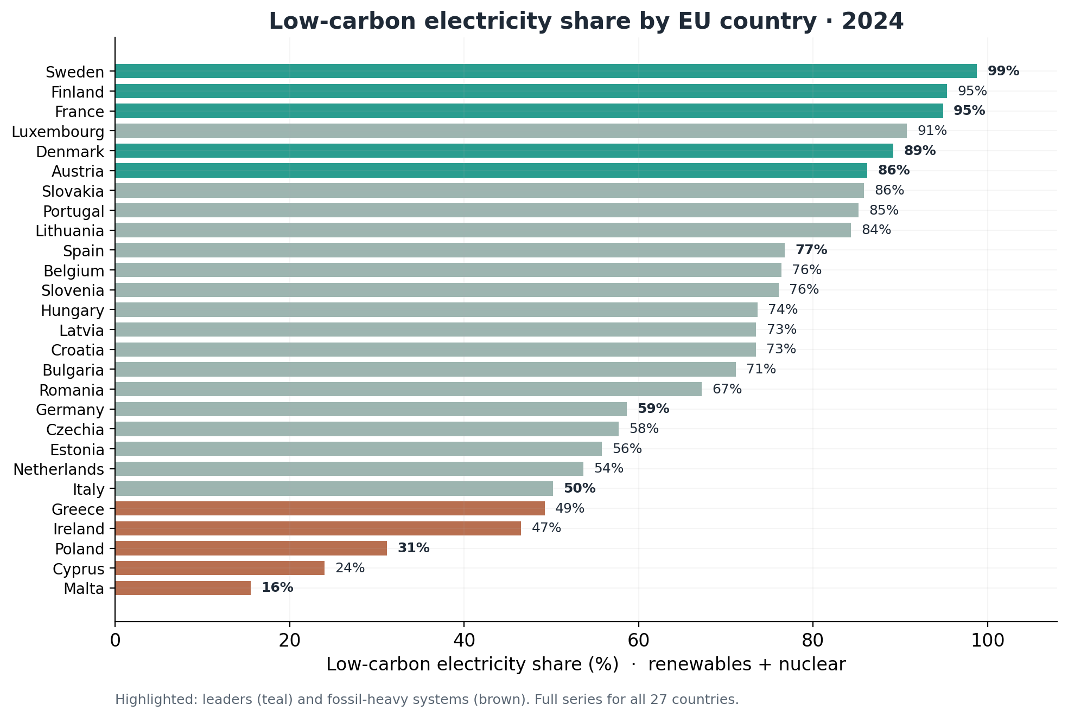
Leaders and laggards · 2024
Low-carbon share spans ~16% (Malta) to ~99% (Sweden) — all 27 countries shown
Notice
Top systems differ: Sweden (RE+nuclear), France (nuclear-led), Denmark (RE-led). Bottom: Poland, Cyprus, Malta.
Full chart
Same ranking without spotlight colours: figures/03_low_carbon_ranking.png in the repository.
OWID Energy 2026-09-10 · electricity mainly Ember · gCO₂eq/kWh = lifecycle intensity
Notes:
Do not cherry-pick. Leaders use different recipes.

Slide 9
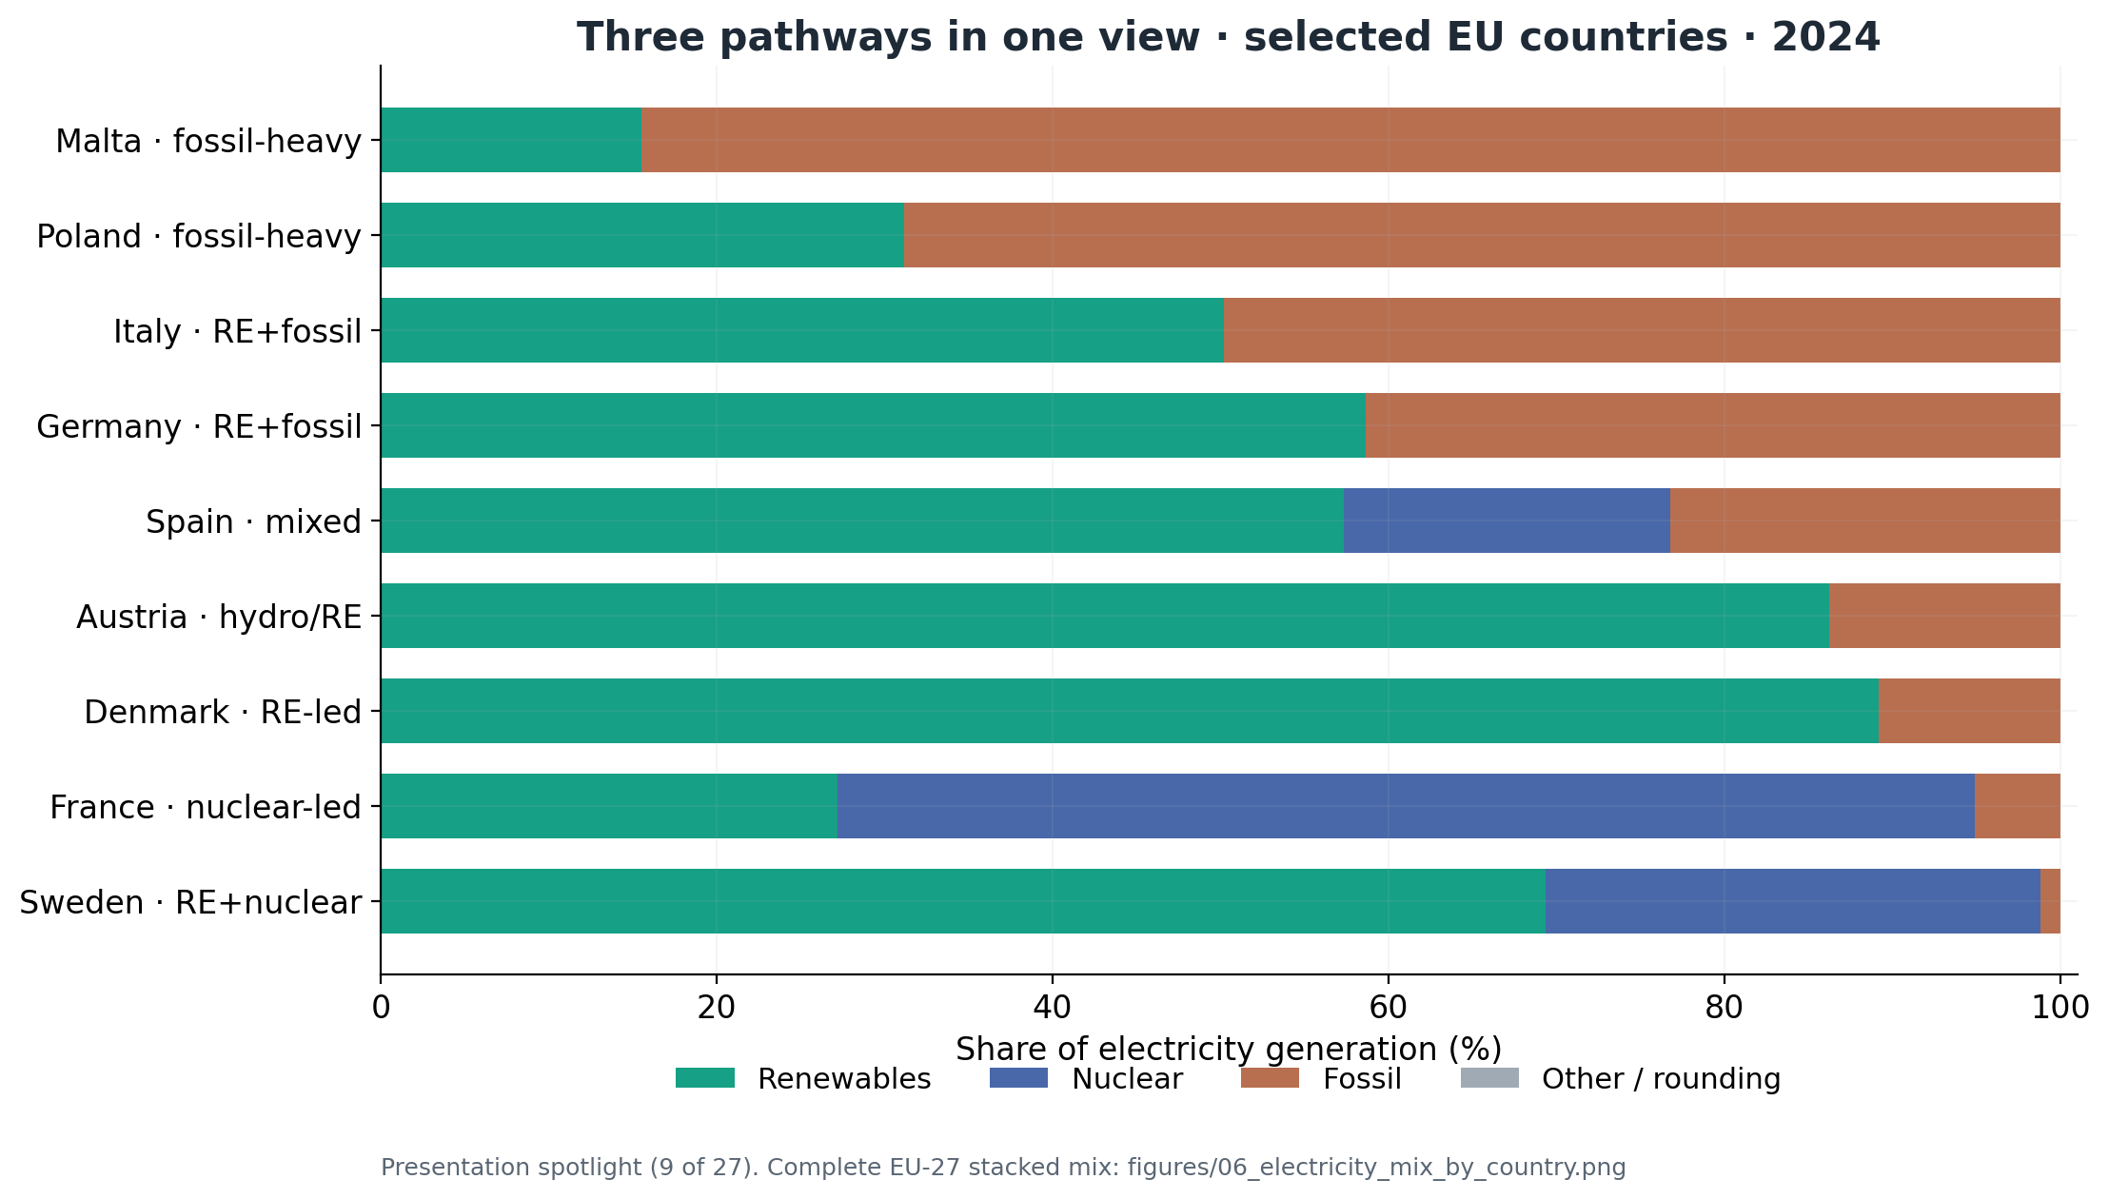
Three pathways to electricity generation
Presentation spotlight of 9 representative countries · full EU-27 mix retained in the repository
Notice
Same low fossil share can mean very different mixes: Denmark ≈ all renewables; France ≈ nuclear.
Full visualisation
All 27 stacked bars: figures/06_electricity_mix_by_country.png
OWID Energy 2026-09-10 · electricity mainly Ember · gCO₂eq/kWh = lifecycle intensity
Notes:
This sets up slides 10–11: renewables alone miss nuclear pathways.

Slide 10
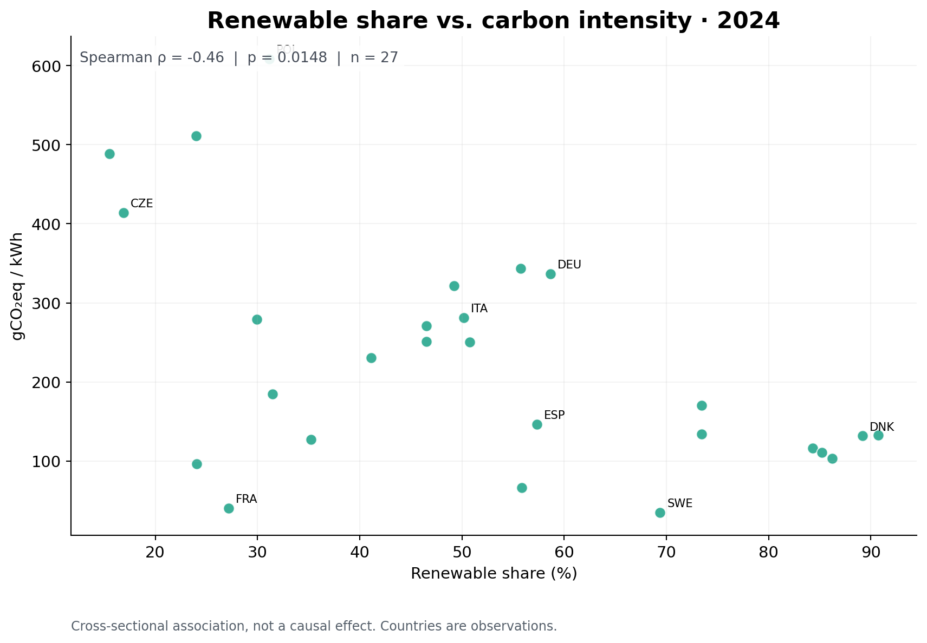
Story beat 1 · Are renewables enough?
Renewables only
Spearman ρ = −0.46
p = 0.015
n = 27 countries (2024)
What to notice
• Moderate negative association only.
• France: ~27% renewables, yet ~40 gCO₂eq/kWh.
• Poland: modest RE share, ~608 gCO₂eq/kWh.
• Renewables matter — but they are not the whole low-carbon story.
OWID Energy 2026-09-10 · electricity mainly Ember · gCO₂eq/kWh = lifecycle intensity
Notes:
Make France the teaching point. Association ≠ causation. Hold for the contrast on the next slide.

Slide 11
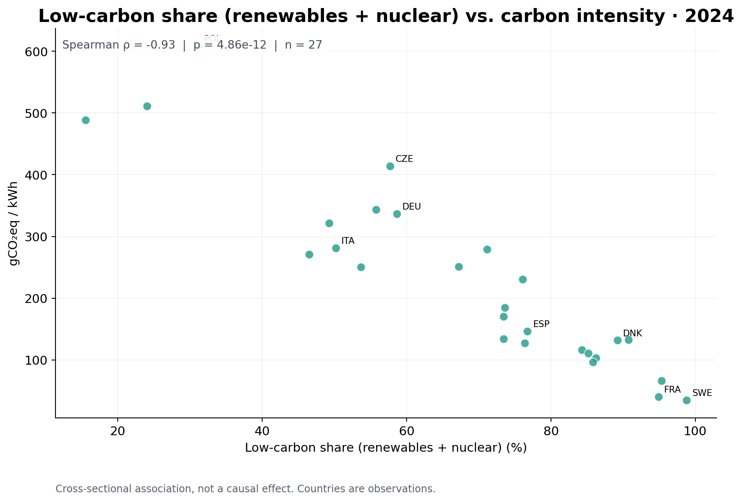
Story beat 2 · What changes when nuclear is included?
Low-carbon = RE + nuclear
Spearman ρ = −0.93
p ≈ 4.9×10⁻¹²
n = 27 countries (2024)
Compare with previous slide
• |ρ| jumps from 0.46 → 0.93.
• Nuclear closes the France / Slovakia gap.
• Still descriptive — not a causal claim.
• Definition: low-carbon share of electricity generation.
OWID Energy 2026-09-10 · electricity mainly Ember · gCO₂eq/kWh = lifecycle intensity
Notes:
Pause on the ρ contrast. Reiterate no causality. This is the main scientific-visualization insight.

Slide 12
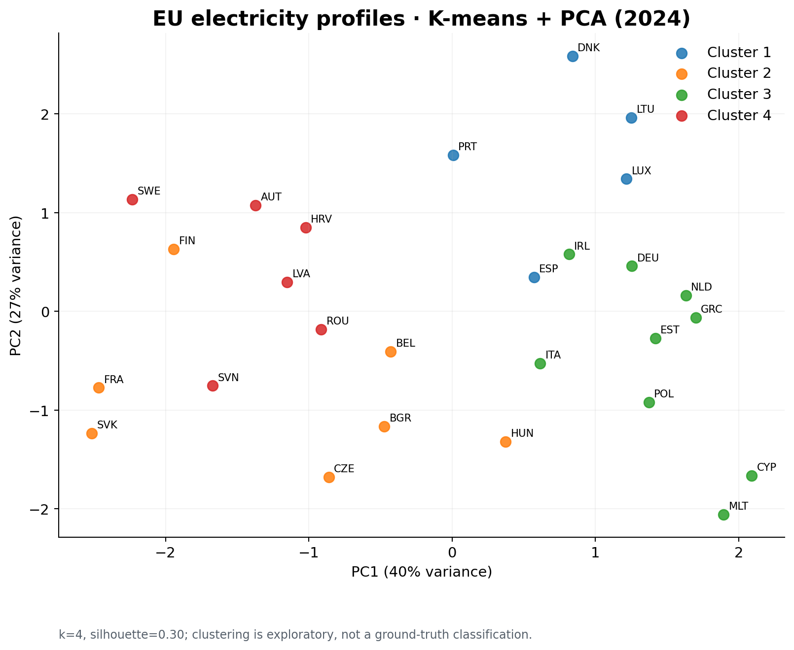
Country profiles · exploratory K-means + PCA
Best k = 4 among 2–5, but silhouette = 0.30 (weak) · PCA 2D explains ~67% variance
Weak separation
Silhouette ≈ 0.30 for every candidate k (0.28–0.30). Treat clusters as a visual aid, not natural regimes.
Prefer
Describe continuous portfolio differences (RE / nuclear / fossil) over hard cluster labels.
OWID Energy 2026-09-10 · electricity mainly Ember · gCO₂eq/kWh = lifecycle intensity
Notes:
Be explicit: exploratory, weak silhouette, no ground-truth typology.

Slide 13
Conclusions, limitations & sources
EU mix transition
Limitations
• No causal identification
• Generation ≠ consumption / imports
• Lifecycle ≠ stack-only CO₂
• Clustering silhouette 0.30 → weak
Reproducibility
analysis.py --year 2024
outputs/verified_findings.md
1
Generation-weighted renewables rose 22%→48%; fossil fell 49%→29%; intensity 369→211 gCO₂eq/kWh (2010–2024).
Divergent pathways
2
Low-carbon leaders use different recipes: renewables-led, nuclear-led, or both.
Nuclear in the story
3
Renewables↔intensity ρ=−0.46; low-carbon↔intensity ρ=−0.93 (n=27). Descriptive, not causal.
Source: Our World in Data, Energy dataset version 2026-09-10 (electricity indicators mainly Ember; lifecycle intensity draws on Ember).
https://catalog.ourworldindata.org/garden/energy/2026-09-10/owid_energy/owid_energy.csv
Also credit underlying providers via the OWID catalog. Full EU-27 charts remain in outputs/figures/.
https://catalog.ourworldindata.org/garden/energy/2026-09-10/owid_energy/owid_energy.csv
Notes:
Close with three conclusions. Restate URL. Clustering is weak. No causality.

