Slide 1
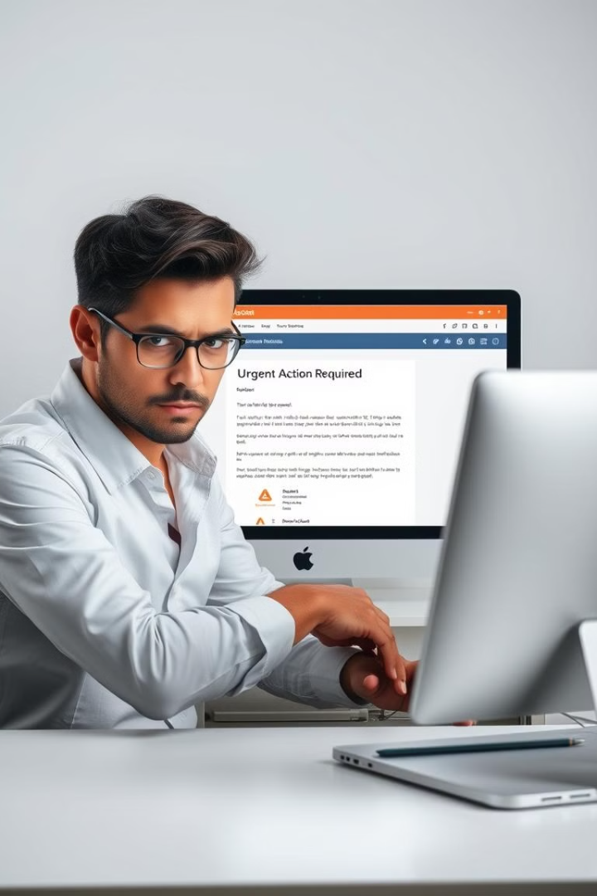

PHISHING AWARENESS TRAINING
Welcome to the Phishing Awareness Training. In this module, you will learn how to protect yourself from email, websites, and social engineering attacks. We will cover the basics of what phishing is and how to recognize phishing attempts.

Slide 2

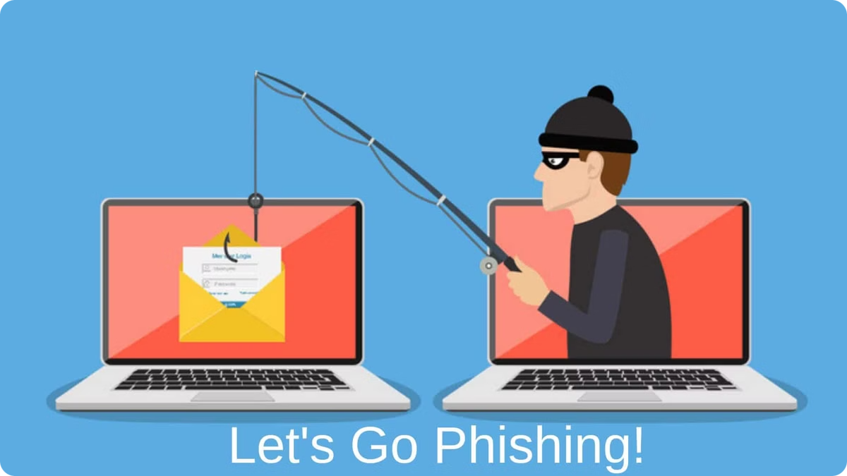
INTRODUCTION
Phishing is one of the most common and dangerous cybersecurity threats, where attackers deceive individuals into revealing sensitive information such as passwords, financial details, or personal data. Phishing awareness training is designed to educate individuals and organizations about identifying, avoiding, and responding to phishing attacks effectively.
By understanding the techniques used by cybercriminals, you can better protect yourself and your organization from falling victim to phishing scams. It is crucial to stay vigilant and verify the authenticity of emails and websites before sharing any personal or sensitive information. Remember to report any suspicious emails or messages to your organization's IT security team.
Notes:
• Phishing is a major cybersecurity threat where attackers trick people into revealing sensitive information • The goal of this presentation is to educate you on how to identify, avoid, and respond to phishing attacks • By understanding the techniques used by cybercriminals, you'll be better equipped to protect yourself and your organization • It's crucial to always verify the authenticity of emails and websites before sharing any personal or sensitive data • If you encounter a suspicious email or message, be sure to report it to your organization's IT security team

Slide 3
What is Phishing?
Definition
Goal
Methods
Phishing is a fraudulent attempt. Attackers obtain sensitive information by disguising themselves as a trustworthy entity.
The goal is to steal usernames, passwords, credit card details, or personal data.
Phishing methods include email, websites, phone calls, text messages, and social media.
About 3.4 billion phishing emails are sent daily. Phishing cost businesses $1.77 billion in 2022.

Slide 4



Email Phishing Techniques
Spoofed Addresses
Urgent Language
Grammatical Errors
Look-alike domains are common. For example, googgle.com instead of google.com.
Watch out for threatening language. For example, "Your account will be suspended!"
Poor English suggests a non-professional source.
Hover over links to preview the actual URL. Use URL expanders to check shortened links before clicking.

Slide 5
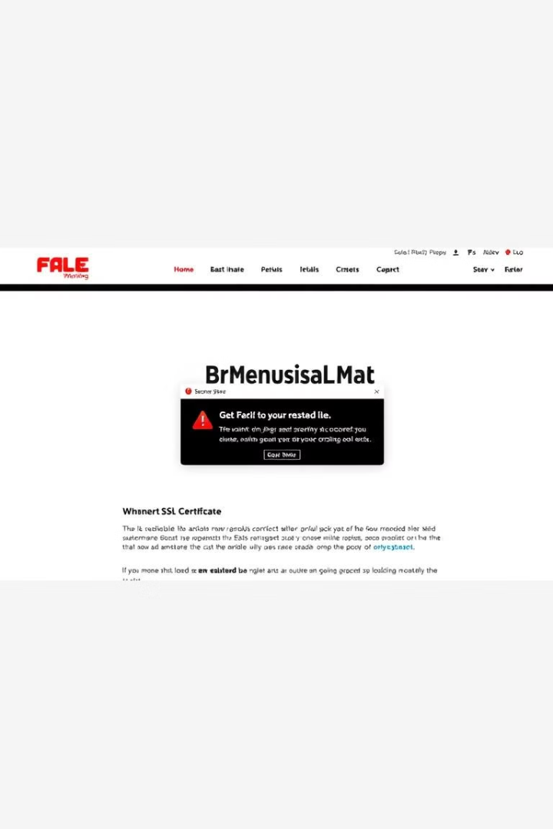
Website Phishing Techniques
Look-alike URLs
Invalid SSL Certificates
Subtle variations of legitimate websites are used. For example, Paypa1.com instead of Paypal.com.
"Not Secure" warnings appear in the browser address bar.
Poor Design
Malicious Pop-Ups
Amateurish appearance, broken images, or outdated content are red flags.
Phishing websites may generate fake pop-ups to collect your personal information surreptitiously.
No privacy policy or terms of service indicates a lack of transparency. Never provide excessive personal information.

Slide 6

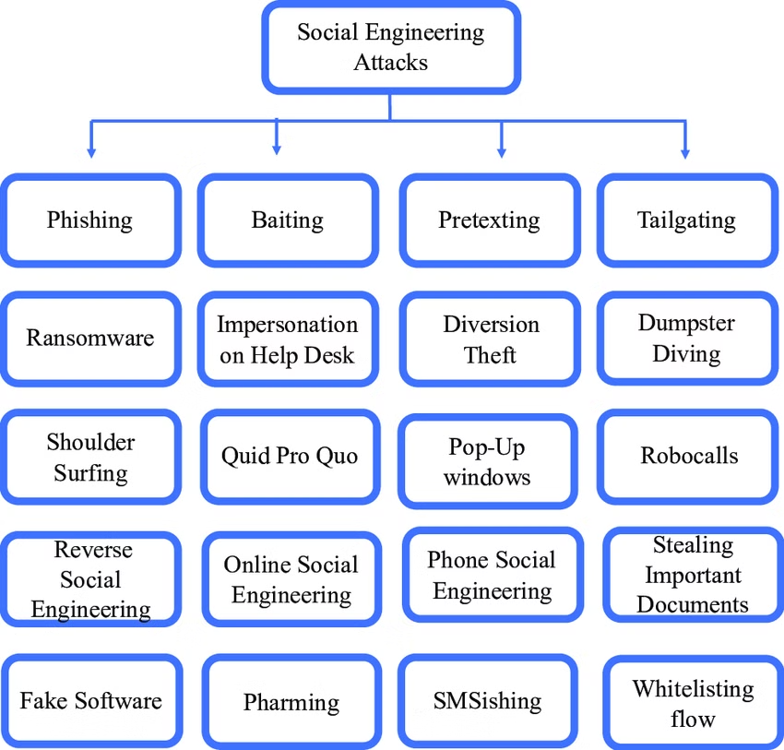
Social Engineering Tactics
1
Pretexting
Attackers create a false scenario. They trick victims into giving information, like posing as IT support.
2
Baiting
Offering something enticing lures victims. Free gift cards are often used to get users to click malicious links.
3
Quid Pro Quo
Promising a service for information is a common tactic. "Help us with this survey and get a $50 Amazon gift card."
4
Tailgaiting
This tactic relies on the politeness of individuals who hold the door for someone who appears to be an employee.
Be cautious of scareware that uses alarming messages. About 45% of phishing attacks steal credentials.

Slide 7

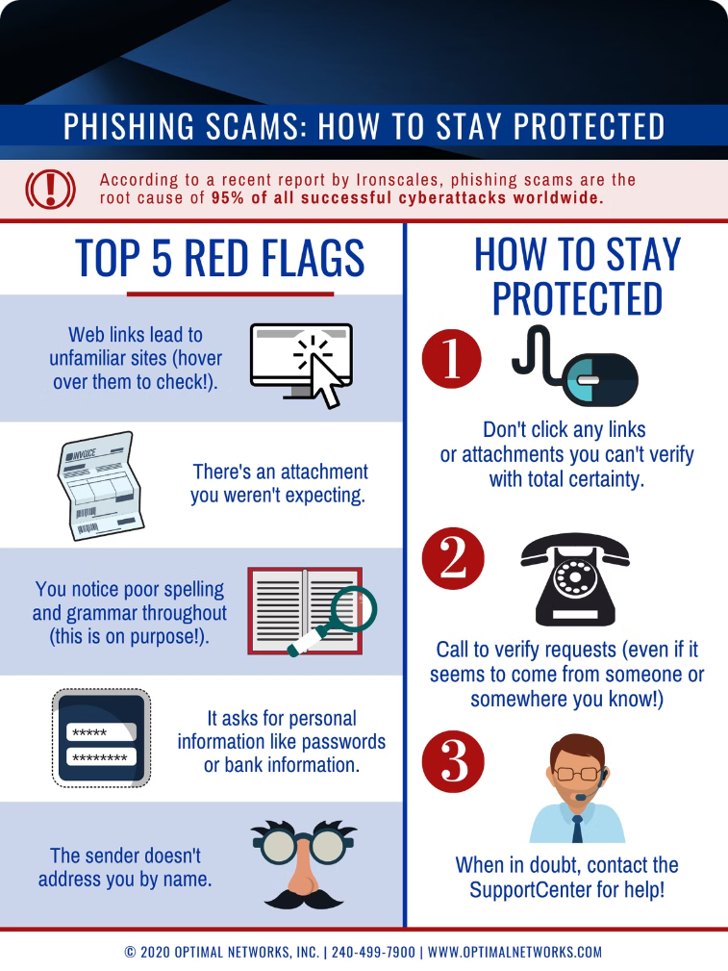
Phishing Red Flags: Examples
1
Fake Invoice Email
2
Social Media Message
Malicious attachments contain ransomware. In 2022, ransomware caused $76B in damages.
Promises a free product for personal information. 70% of consumers will share personal information for a reward.
3
IRS Phone Call
4
Unusual Sender Email Address
Someone claims to be from the IRS and demands payment. The IRS reported a 60% increase in tax scams in 2023.
Always verify the sender's email address to check for discrepancies or unusual wording.

Slide 8





Avoiding Phishing Attacks
Verify Sender Address
Contact the organization directly through official channels.
Don't Click on Suspicious Link
Manually type URLs into your browser. Do not click suspicious links or open attachments.
Use Strong Passwords
Implement a password manager. Use strong, unique passwords for each account.
Enable Multi-Factor Authentication
Add an extra layer of security to your accounts with multi-factor authentication.
Security awareness training reduces phishing susceptibility by 70%. Keep your software up to date.

Slide 9



Stay Vigilant, Stay Safe!
Report -
If you encounter a phishing attempt, report it to your company's IT department or IT security firm. Reporting such incidents can help prevent others from falling victim to similar attacks.
Question Everything -
2
If in doubt, verify the legitimacy of any request before sharing personal information. Be cautious of unexpected phone calls or emails requesting urgent action or payments. Trust your instincts and report any suspicious activity to relevant authorities.
1
Stay Updated -
Regularly check for updates from your software providers and install patches promptly to protect your devices against known vulnerabilities.
3
Remember, phishers constantly evolve. If it seems too good to be true, it probably is. Report any suspicious activity.

