Slide 1

Introduction to Analytics
By
Paurush Gaur

Slide 2
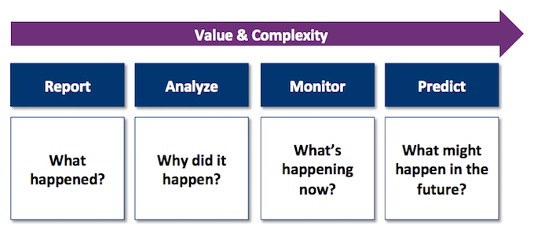
What is Analytics?
Top 10 Strategic Technology Trends
Key Areas of Analytics Application
Value of Business Analytics
Business Intelligence
Advance Analytics
Descriptive Analytics
Predictive Analytics
Prescriptive Analytics
Analytics Architecture
Acquire
Analyze
Organize
Deliver
Analytics Lifecycle
Types of Machine Learning
Supervised Learning
Unsupervised Learning
Basic Terminologies
Analytics Jobs Market Study

Slide 3
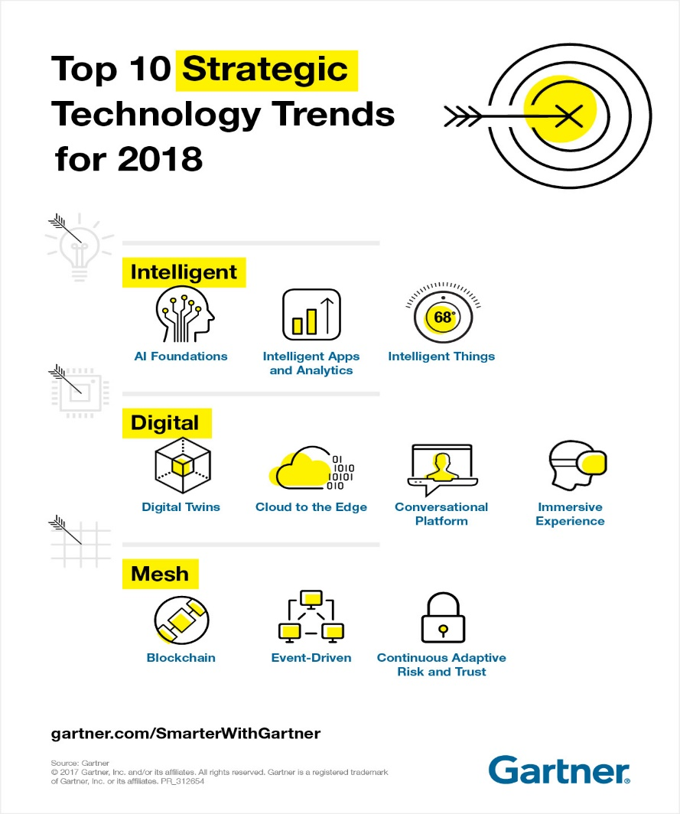
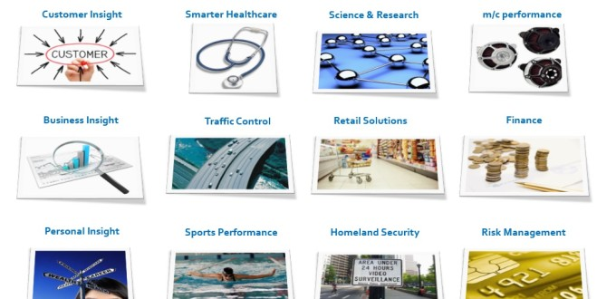
What is Analytics?
Analytics is an encompassing and multidimensional field that uses mathematics, statistics, predictive modeling and machine-learning techniques to find meaningful patterns and knowledge in recorded data.
Analytics can help answer the following types of questions:
What happened?
How or why did it happen?
What’s happening now?
What is likely to happen next?
What should we do ?
Few key areas of analytics application:

Slide 4
Examples of AI, Intelligent Apps and Intelligent Things
Commercial Flights Use an AI Autopilot: The New York Times reports that the average flight of a Boeing plane involves only seven minutes of human-steered flight, which is typically reserved only for takeoff and landing.
Facebook Facial Recognition Software: When you upload photos to Facebook, the service automatically highlights faces and suggests friends to tag.
Intelligent App: An intelligent app with a predictive analytics engine collecting data from industrial machines on a customer’s premise can automatically alert a field technician that a part approaching end of life needs to be replaced, and prevent downtime.
Home Automation: A secured door that automatically opens when you arrive home based on factors such as your face, manner of walking and an electronic card in your pocket.
Architecture: A building that prepares itself for an earthquake seconds before it arrives. For example, smart windows that go into a safety mode to prevent shattering.

Slide 5
Value of Business Analytics
Prescriptive analytics
Prescriptive analytics is the newest kid on the block. Knowing what will happen and knowing what to do are two different things.
To determine which decision and/or action will produce the most effective result against a specific set of objectives and constraints.
Advanced
analytics
Predictive analytics
Leverage past data to understand why something happened or to predict what will happen in the future across various scenarios.
Predictive analytics has surged in popularity. The desire to predict customer behavior has been a main driver.
Descriptive analytics
Mine past data to report, visualize and understand what has already happened – after the fact or in real time.
There are still plenty of descriptive analytics in use today – everything from how many clicks a page receives to how many units are produced vs. how many are sold.
Business
intelligence
Computational complexity
The goal of all organizations with access to large data collections should be to harness the most relevant data and use it for better decision making

Slide 6
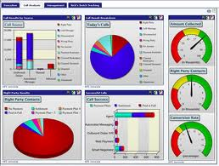
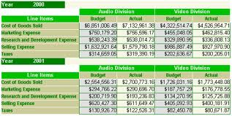
Descriptive Analytics
Descriptive analytics, such as reporting, dashboards, and data visualization have been widely used for some time.
They are the core of traditional BI.
What has occurred?
Key task: Data access / shaping – SQL Query does this
Formulas: Sum, Count, Average, Min, Max, Var, StdDev etc.
Descriptive analytics, such as data visualization, is important in helping users to understand the data properly.
Notes:
Descriptive analytics, such as reporting/OLAP, dashboards, and data visualization, have been widely used for some time. They are the core of traditional BI.

Slide 7
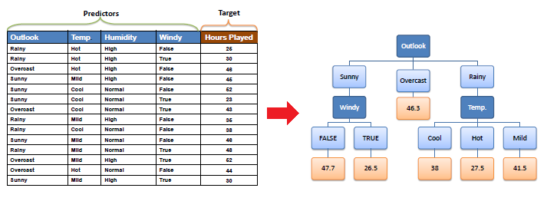
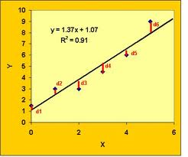
Predictive Analytics
Algorithms for predictive analytics, such as regression analysis, decision trees, and association analysis, have also been around for some time.
What will occur?
Marketing is the target for many predictive analytics applications.
Descriptive analytics, such as data visualization, is important in helping users interpret the output from predictive and prescriptive analytics.
Predict: ex. Good/Poor credit risk, Likely/Unlikely to churn
Forecast a time series: ex. next sales from past sales history
Associate: ex. People who bought this item also bought...
Notes:
Algorithms for predictive analytics, such as regression analysis, machine learning, and neural networks, have also been around for some time. Recently, however, software products have made them much easier to understand and use. They have also been integrated into specific applications, such as for campaign management. Marketing is the target for many predictive analytics applications. Descriptive analytics, such as data visualization, is important in helping users interpret the output from predictive and predictive analytics. Prescriptive analytics are often referred to as advanced analytics.

Slide 8

Prescriptive Analytics
Prescriptive analytics are often referred to as advanced analytics.
Regression analysis, machine learning, neural networks etc.
Prescriptive analytics answers the question of what to do by providing information on optimal decisions based on the predicted future scenarios. The key to prescriptive analytics is being able to use big data, contextual data and lots of computing power to produce answers in real time.
Image: Dijkstra’s algorithm
Image: Airline pricing
For example, Using anonymized location data from smartphones, Google Maps (Maps) can analyze the speed of movement of traffic at any given time. Access to vast amounts of data being fed to its proprietary algorithms means Maps can reduce commutes by suggesting the fastest routes to and from work.
Airline industry has been using analytics for airfare pricing for some time.
Notes:
Prescriptive analytics provide an optimal solution, often for the allocation of scarce resources. They, too, have been in academia for a long time but are now finding wider use in practice. For example, the use of mathematical programming for revenue management is common for organizations that have “perishable” goods (e.g., rental cars, hotel rooms, airline seats). Harrah’s has been using revenue management for hotel room pricing for some time.

Slide 9
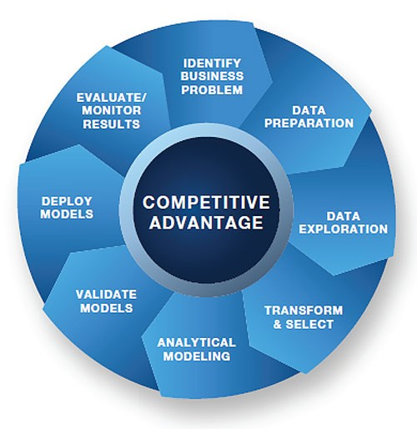
Analytics Lifecycle
Identify the problem. Business units specify the need/problem that they want to solve.
Prepare data for analysis. Specialized techniques to locate, access, clean and prepare the data for optimal results.
Explore data. Explore the data in an interactive and visual fashion to quickly identify relevant variables, trends and relationships.
Transform data and create models. Build the model using statistical, data mining or text mining software, including the critical capability of transforming and selecting key variables.
Test and validate models. The model is tested, approved and declared ready for use against your data.
Deploy models. When approved for production use, the model is applied to new data to generate predictive insights.
The analytical life cycle guides you through the steps needed to produce fact-based insights that ultimately lead to competitive advantage.
Monitor and assess models. The predictive performance of the model is monitored to ensure it is up to date and delivering valid results.

Slide 10
Types of Machine Learning Algorithms
Supervised learning: classification is seen as supervised learning from examples.
Supervision: The data (observations, measurements, etc.) are labeled with pre-defined classes. It is like that a “teacher” gives the classes (supervision).
Test data are classified into these classes too.
Unsupervised learning (clustering)
Class labels of the data are unknown
Given a set of data, the task is to establish the existence of classes or clusters in the data

Slide 11
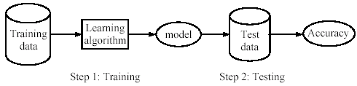
Supervised learning process: two steps
Learning (training): Learn a model using the training data
Testing: Test the model using unseen test data to assess the model accuracy
Example
Some popular examples of supervised machine learning algorithms are:
Linear and Logistic Regression
Classification and Regression Trees( Decision Tree)
Random Forest
Time Series Analysis( ARIMA Model)

Slide 12
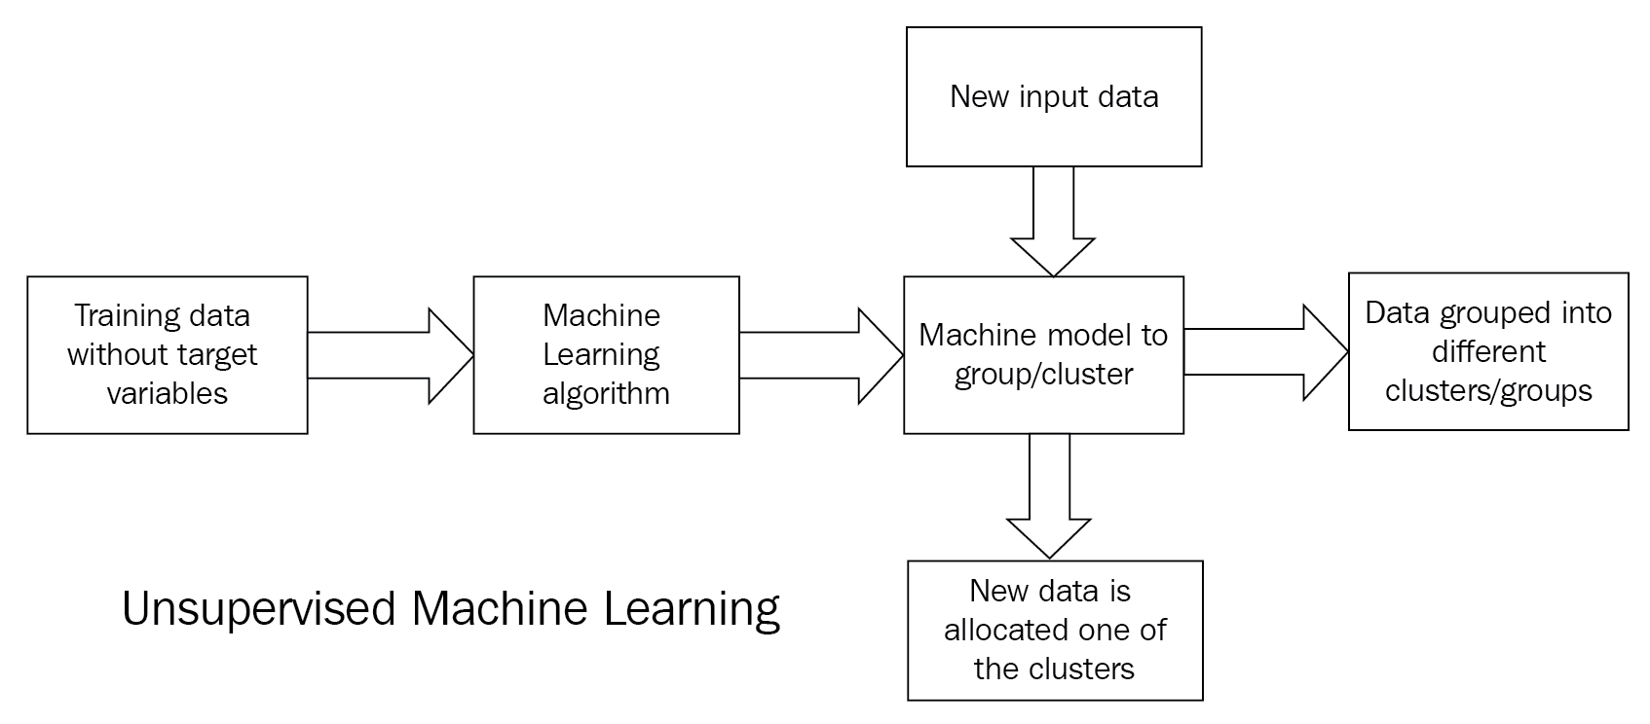
Unsupervised learning process:
Learning: Learn a model using the whole dataset
Testing: We don’t have data with labels to test
Can be used to cluster the input data in classes on the basis of their statistical properties.
Example
Some popular examples of unsupervised machine learning algorithms are:
Clustering: A clustering problem is where you want to discover the inherent groupings in the data,
such as grouping customers by purchasing behavior.
Association: An association rule learning problem is where you want to discover rules that describe
large portions of your data, such as people that buy X also tend to buy Y.

Slide 13
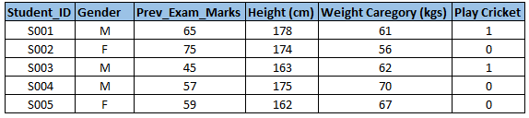
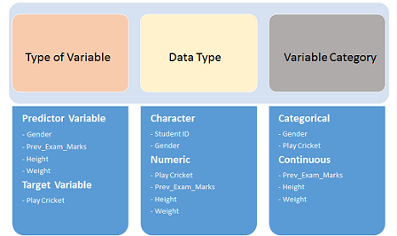
Variable Identification
First, identify Predictor (Input) and Target (output) variables. Next, identify the data type and category of the variables
Let’s understand this step more clearly by taking an example.
Example:- Suppose, we want to predict, whether the students will play cricket or not (refer below data set). Here you need to identify predictor variables, target variable, data type of variables and category of variables
Below, the variables have been defined in different category:

Slide 14
Types of Variable
Variables
Qualitative
Quantitative
Nominal
Ordinal
Discrete
Continuous
Gender, marital status, hair color
Student Rank(1,2 or 3), Any other order
Children in family, Strokes on a golf hole
Amount of income tax paid, weight of a student

Slide 15
Nominal Variable: A qualitative variable that categorizes (or describes, or names) an element of a population.
Ordinal Variable: A qualitative variable that incorporates an ordered position, or ranking.
Discrete Variable: A quantitative variable that can assume a countable number of values. Intuitively, a discrete variable can assume values corresponding to isolated points along a line interval. That is, there is a gap between any two values.
Continuous Variable: A quantitative variable that can assume an uncountable number of values. Intuitively, a continuous variable can assume any value along a line interval, including every possible value between any two values.

Slide 16
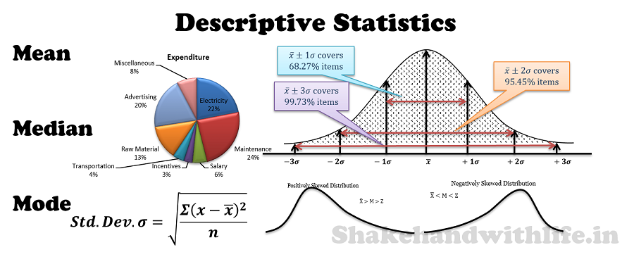
Descriptive Statistics
Descriptive Statistics are used to present quantitative descriptions in a manageable form. In a research study we may have lots of measures. Or we may measure a large number of people on any measure. Descriptive statistics help us to simplify large amounts of data in a sensible way. Each descriptive statistic reduces lots of data into a simpler summary.
Measures of Frequency
Measures of Central Tendency
Measures of Dispersion
Measures of Position
Count
Percent
Mean
Median
Mode
Variance
Standard Deviation
Range
Quartile
Percentile

Slide 17
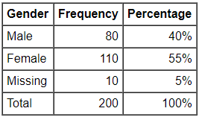
Frequency Statistics
Frequency statistics should be reported whenever the data is discrete, meaning that there are separate categories that the participant can tick. For example, marital status can have categories of single, married, divorced, widowed, and separated. Educational qualifications can have categories of secondary school, diploma, degree, post-graduate diploma, masters, and doctorate.
A frequency/count is simply the number of participants who indicated that category (aka "Male"). However, it is oftentimes difficult to interpret frequency distributions because the frequency by itself is meaningless unless there is a reference point to interpret the number.
Measures of Frequency
Count
Percent

Slide 18



Central Tendency Statistics
Mean, median, and mode are different measures of center in a numerical data set. They each try to summarize a dataset with a single number to represent a "typical" data point from the dataset.
Mean (μ)
The "average" number found by adding all data points and dividing by the number of data points.
Here's the same formula written more formally:
Example
Find the mean of this data: 1, 2, 4, 5
Start by adding the data:1+2+4+5=12
There are 4 data points.
The mean is 3.

Slide 19

Central Tendency Statistics Contd..
Median
The middle number; found by ordering all data points and picking out the one in the middle (or if there are two middle numbers, taking the mean of those two numbers).
To find the median:
Arrange the data points from smallest to largest.
If the number of data points is odd, the median is the middle data point in the list.
If the number of data points is even, the median is the average of the two middle data points in the list.
Example 1
Find the median of this data: 1, 4, 2, 5,0
Put the data in order first:0,1,2,4,5
There is an odd number of data points, so the median is the middle data point.
The median is 2.
Example 2
Find the median of this data: 10, 40, 20, 50
Put the data in order first:10,20,40,50
There is an even number of data points, so the median is the average of the middle two data points.
The median is 30.

Slide 20
Central Tendency Statistics Contd..
Mode
The most frequent number—that is, the number that occurs the highest number of times.
Example 1
Ms. Norris asked students in her class how many siblings they each have.
Find the mode of the data: 0,0,1,1,1,1,1,1,2,2,3,4,4
Look for the value that occurs the most:1
The mode is 1.
Example 2
Ms. Rubin asked students in her class how many siblings they each have.
Find the mode of the data: 0,0,0,1,1,1,1,2,2,2,2,4
Look for the value that occurs the most:1 and 2
There is a tie for the value that occurs the most often.
The modes are 1 and 2.

Slide 21
Measures of Dispersion
Measures of central tendency- Mean, Median, Mode, etc. indicate the central position of a series. They indicate the general magnitude of the data but fail to reveal all the peculiarities and characteristics of the series. In other words, they fail to reveal the degree of the spread out or the extent of the variability in individual items of the distribution. This can be explained by certain other measures, known as ‘Measures of Dispersion’ or Variation.
Range
The Range is the difference between the lowest and highest values.
Example 1
Find the Range of the data: 4,6,7,8,9
The lowest value is 4 and highest value in 9
So the range is 9-4 = 5
The Range is 5.
Example 2
Range can sometimes be misleading when there are extremely high and low values.
Find the Range of the data: 8,11,5,9,7,6,3616
The lowest value is 8 and highest value in 3616
So the Range is 3616-8 = 3608
The single value of 3616 makes the range large but most values are around 10.

Slide 22
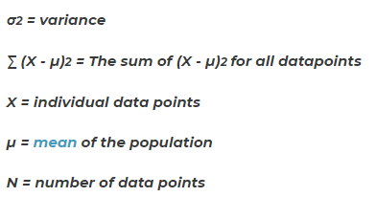

Measures of Dispersion Contd..
Variance
The average of squared differences from the mean.
To calculate the variance follow these steps:
Work out the Mean( the simple average of the numbers).
Then for each number: Subtract the mean and square the result(the squared difference)
Then work out the average of those differences.
Example
suppose you want to find the variance of scores on a test. Suppose the scores are 67, 72, 85, 93 and 98.
Calculate the mean (µ) for the five scores: 67 + 72 + 85 + 93 + 98 / 5, so µ = 83.
Now, compare each score (x = 67, 72, 85, 93, 98) to the mean (µ = 83)
σ² = [ (67 - 83)²+(72 - 83)²+(85 - 83)²+(93 - 83)²+(98 - 83)² ] / 5
σ² = [256 + 121 + 4 + 100 + 225] / 5
Then summarize the numbers inside the brackets:
σ² = 706 / 5
σ² = 141.2

Slide 23

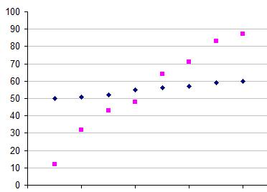
Measures of Dispersion Contd..
Standard Deviation
The Standard Deviation is a measure of how spread out numbers are.
Its symbol is σ (the greek letter sigma)
The formula is easy: it is the square root of the Variance.
To calculate the Standard Deviation follow these steps:
Work out the Mean( the simple average of the numbers).
Then for each number: Subtract the mean and square the result(the squared difference)
Then work out the average of those differences.
Take square root of the result obtained in above pointer
For example, the data points 50, 51, 52, 55, 56, 57, 59 and 60 have a mean at 55 (Blue).
Another data set of 12, 32, 43, 48, 64, 71, 83 and 87. This set too has a mean of 55 (Pink).
Standard Deviation for Blue dots: 3.46
Standard Deviation for Pink dots: 24.27
URL: http://www.mathsisfun.com/data/standard-deviation.html

Slide 24
Measures of Position
Measures of position are techniques that divide a set of data into equal groups.
To determine the measurement of position, the data must be sorted from lowest to highest. The different measures of position are:
Quartile
The quartiles are the three values of the variable that divide an ordered data set into four equal parts.
Q₁, Q₂ and Q₃ determine the values for 25%, 50% and 75% of the data.
Q₂ coincides with the median.
Percentile
The percentiles are the 99 values of the variable that divide an ordered data set into 100 equal parts.
The percentiles determine the values for 1%, 2%... and 99% of the data.
P₅₀ coincides with the median.
Practice Problem 1: For the data set below, which value is in the 75th percentile?
{1, 3, 3, 4, 6, 7, 7, 7, 8, 9, 9, 10, 12, 15, 16, 17}
Solution: There are a total of 16 values in the set. Thus 75% of the data set is 12 values. Because the data set is ordered, we need simply find the 12th data value. The number 10 is the 75th percentile: 75% of the values in the set are less than or equal to 10.
Practice Problem 2: What is Q3 for the following data set? {20, 40, 50, 65, 70, 75, 80, 100}
Solution:Q3 is the value x for which 75% (three out of four) of the data values are at most x. Since there are eight members in the data set, the sixth value is Q3-75. This value is also the 75th percentile.

Slide 25
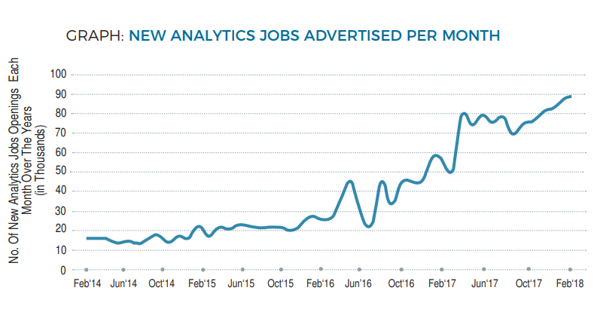
Recent Study on Analytics Job Market
The number of new analytics jobs advertised per month increased by almost 76% from April 2017 to April 2018
The number of new analytics jobs increased by 52% from April 2015 to April 2016, and by 40% from April 2014 to April 2015. It had almost doubled from April 2016 to April 2017.

Slide 26
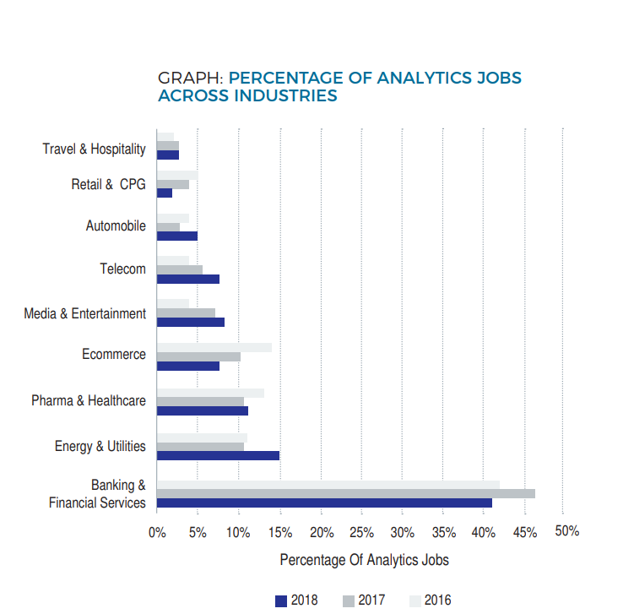
Analytics Jobs by Industry
Banking & financial sector continues to be the biggest influencer in analytics job market. 41% of all jobs posted for analytics were from the banking sector. This is a decrease from 46% a year ago.

Slide 27
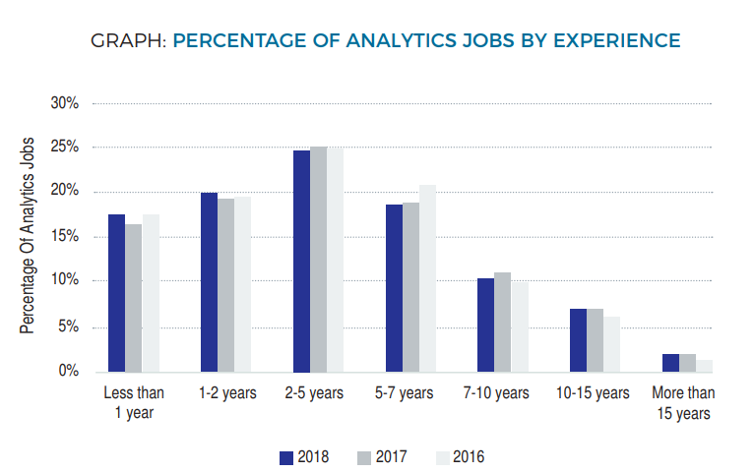
Experience in Analytics Jobs
Around 62% of analytics requirements are looking for candidates with less than 5 years of experience
17% analytics jobs are for freshers.

Slide 28
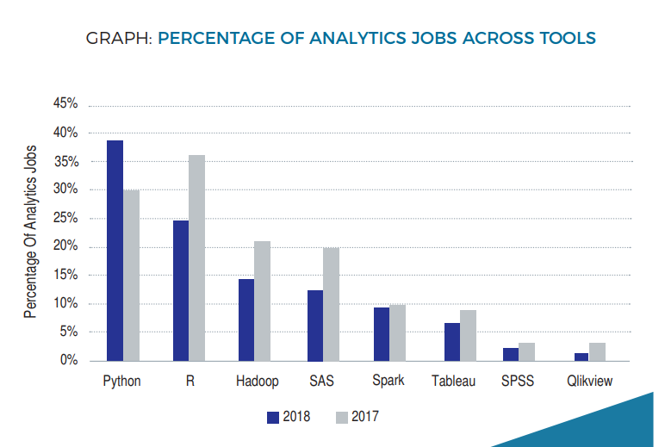
Requirement of Tools
Python also saw the biggest jump in analytics requirements this year, replacing R as the most in-demand
R skills comes second, at 25% of all analytics jobs looking for R professionals. This is decrease from last year of 36%.
Among visualization tools, Tableau skills are most in-demand.

Slide 29
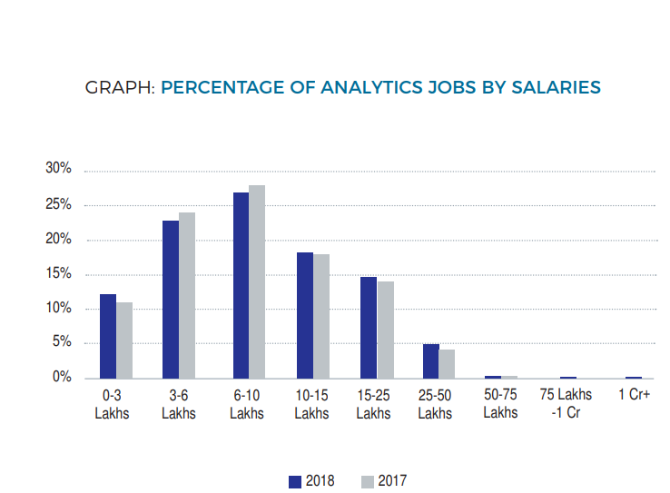
Analytics Jobs by Salaries
The median salaries being offered by advertised analytics jobs in India is INR 10.8 Lakh per annum
27% of all analytics jobs offer a salary range of 6-10 Lakh, followed by 23% for 3-6 Lakh.

Slide 30
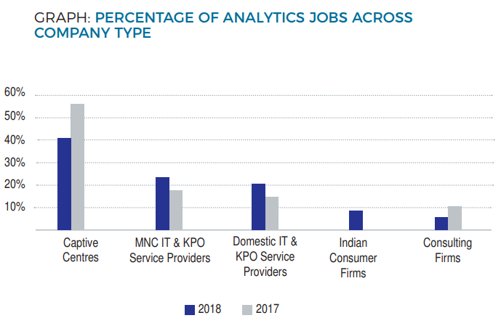
Analytics Jobs Across Company Type
Almost 41% of all analytics demand is with Captive centers in India. These are organizations that mostly utilize analytics for internal consumption (for primarily their global businesses).
21% of all analytics jobs advertised are by Domestic IT & KPO service providers, up from 15% a year ago.

Slide 31
Glossary
Examples of AI: https://www.techemergence.com/everyday-examples-of-ai/
Analytics Market Study: https://analyticsindiamag.com/wp-content/uploads/2018/06/Jobs-Study-2018-Final.pdf
Gartner’s Top 10 Technologies: https://www.gartner.com/smarterwithgartner/gartner-top-10-strategic-technology-trends-for-2018/?utm_source=social&utm_campaign=sm-swg&utm_medium=social
Analytics Application: https://www.digitalvidya.com/blog/data-analytics-applications/
Analytics Architecture: https://www.gartner.com/binaries/content/assets/events/keywords/catalyst/catus8/2017_planning_guide_for_data_analytics.pdf
Analytics Lifecycle: https://www.sas.com/en_in/insights/analytics/what-is-analytics.html
Companies want to specialize their Employees: https://timesofindia.indiatimes.com/business/india-business/accenture-says-india-employees-have-to-specialise-or-go/articleshow/65144526.cms
Key Areas of Application : https://www.digitalvidya.com/blog/data-analytics-applications/
Intelligent Things: https://simplicable.com/new/intelligent-things

Slide 32
Thank You

