Slide 1

Basic Statistics and Data Exploration Techniques
By
Paurush Gaur

Slide 2
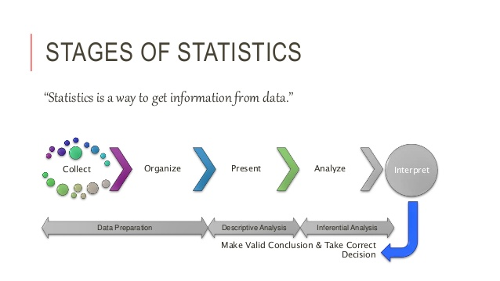
Statistics Overview
What is Statistics?
Introduction to basic terms
Sampling Techniques
Simple Random Sample
Stratified Random Sample
Systematic
Statistics Variable
Variable Identification
Types of Variable
Descriptive Statistics
Measures of Frequency
Measures of Central Tendency
Measures of Dispersion
Measures of Position
Missing Values and their Treatment
Outliers in Dataset
Outliers Detection
Impact of Outliers
Box Plot

Slide 3
What is Statistics?
Statistics: The science of collecting, describing, and interpreting data.
Two areas of statistics:
Descriptive Statistics: collection, presentation, and description of sample data.
Inferential Statistics: making decisions and drawing conclusions about populations.
Example:
A recent study examined the math and english scores of high school seniors across the country. Which of the following statements are descriptive in nature and which are inferential.
The mean math score was 75.
The mean english score was 72.
Students in the Northeast always score higher marks.
South Indian students always score good marks in english.
The math scores are higher than they were 10 years ago.
The maximum marks scored in math was 99

Slide 4
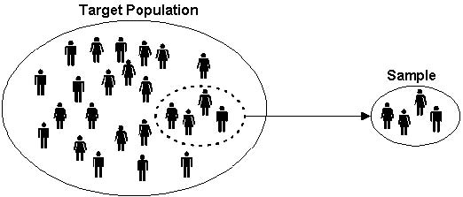
Introduction to Basic Terms
Population: A collection, or set, of individuals or objects or events whose properties are to be analyzed.
Sample: A subset of the population which contains almost every property of population.
Variable: A characteristic about each individual element of a population or sample.

Slide 5

Sampling Techniques
Simple Random Sample
Stratified Random Sample
Systematic

Slide 6
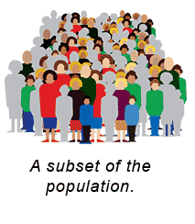
Simple Random Sample
Every subset of a specified size n from the population has an equal chance of being selected

Slide 7
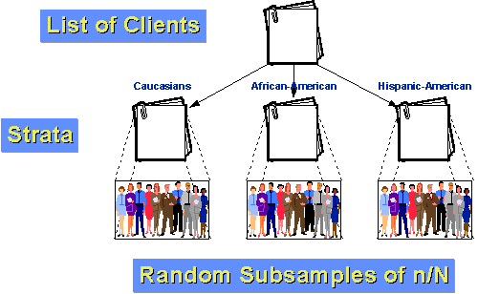
Stratified Random Sample
The population is divided into two or more groups called strata, according to some criterion, such as geographic location, grade level, age, or income, and subsamples are randomly selected from each strata.

Slide 8
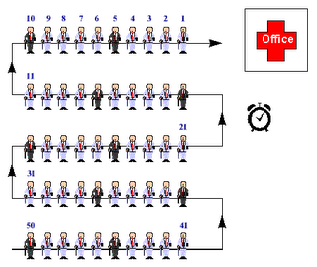
Systematic Sample
Every kth member ( for example: every 10th person) is selected from a list of all population members.

Slide 9
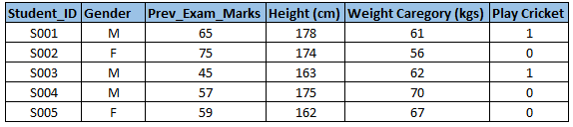
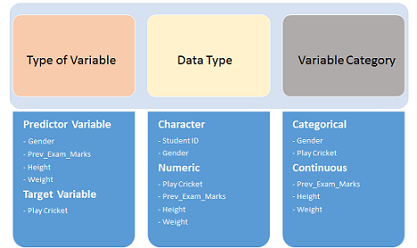
Variable Identification
First, identify Predictor (Input) and Target (output) variables. Next, identify the data type and category of the variables
Let’s understand this step more clearly by taking an example.
Example:- Suppose, we want to predict, whether the students will play cricket or not (refer below data set). Here you need to identify predictor variables, target variable, data type of variables and category of variables
Below, the variables have been defined in different category:

Slide 10
Types of Variable
Variables
Qualitative
Quantitative
Nominal
Ordinal
Discrete
Continuous
Gender, marital status, hair color
Student Rank(1,2 or 3), Any other order
Children in family, Strokes on a golf hole
Amount of income tax paid, weight of a student

Slide 11
Nominal Variable: A qualitative variable that categorizes (or describes, or names) an element of a population.
Ordinal Variable: A qualitative variable that incorporates an ordered position, or ranking.
Discrete Variable: A quantitative variable that can assume a countable number of values. Intuitively, a discrete variable can assume values corresponding to isolated points along a line interval. That is, there is a gap between any two values.
Continuous Variable: A quantitative variable that can assume an uncountable number of values. Intuitively, a continuous variable can assume any value along a line interval, including every possible value between any two values.

Slide 12
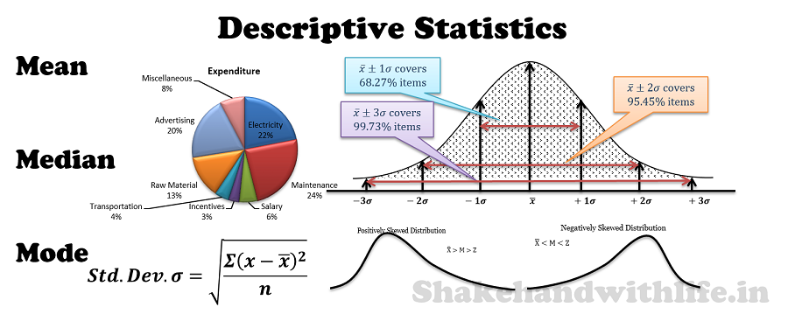
Descriptive Statistics
Descriptive Statistics are used to present quantitative descriptions in a manageable form. In a research study we may have lots of measures. Or we may measure a large number of people on any measure. Descriptive statistics help us to simplify large amounts of data in a sensible way. Each descriptive statistic reduces lots of data into a simpler summary.
Measures of Frequency
Measures of Central Tendency
Measures of Dispersion
Measures of Position
Count
Percent
Mean
Median
Mode
Variance
Standard Deviation
Range
Quartile
Percentile

Slide 13
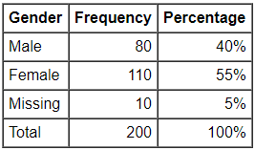
Frequency Statistics
Frequency statistics should be reported whenever the data is discrete, meaning that there are separate categories that the participant can tick. For example, marital status can have categories of single, married, divorced, widowed, and separated. Educational qualifications can have categories of secondary school, diploma, degree, post-graduate diploma, masters, and doctorate.
A frequency/count is simply the number of participants who indicated that category (aka "Male"). However, it is oftentimes difficult to interpret frequency distributions because the frequency by itself is meaningless unless there is a reference point to interpret the number.
Measures of Frequency
Count
Percent

Slide 14



Central Tendency Statistics
Mean, median, and mode are different measures of center in a numerical data set. They each try to summarize a dataset with a single number to represent a "typical" data point from the dataset.
Mean (μ)
The "average" number found by adding all data points and dividing by the number of data points.
Here's the same formula written more formally:
Example
Find the mean of this data: 1, 2, 4, 5
Start by adding the data:1+2+4+5=12
There are 4 data points.
The mean is 3.

Slide 15

Central Tendency Statistics Contd..
Median
The middle number; found by ordering all data points and picking out the one in the middle (or if there are two middle numbers, taking the mean of those two numbers).
To find the median:
Arrange the data points from smallest to largest.
If the number of data points is odd, the median is the middle data point in the list.
If the number of data points is even, the median is the average of the two middle data points in the list.
Example 1
Find the median of this data: 1, 4, 2, 5,0
Put the data in order first:0,1,2,4,5
There is an odd number of data points, so the median is the middle data point.
The median is 2.
Example 2
Find the median of this data: 10, 40, 20, 50
Put the data in order first:10,20,40,50
There is an even number of data points, so the median is the average of the middle two data points.
The median is 30.

Slide 16
Central Tendency Statistics Contd..
Mode
The most frequent number—that is, the number that occurs the highest number of times.
Example 1
Ms. Norris asked students in her class how many siblings they each have.
Find the mode of the data: 0,0,1,1,1,1,1,1,2,2,3,4,4
Look for the value that occurs the most:1
The mode is 1.
Example 2
Ms. Rubin asked students in her class how many siblings they each have.
Find the mode of the data: 0,0,0,1,1,1,1,2,2,2,2,4
Look for the value that occurs the most:1 and 2
There is a tie for the value that occurs the most often.
The modes are 1 and 2.

Slide 17
Measures of Dispersion
Measures of central tendency- Mean, Median, Mode, etc. indicate the central position of a series. They indicate the general magnitude of the data but fail to reveal all the peculiarities and characteristics of the series. In other words, they fail to reveal the degree of the spread out or the extent of the variability in individual items of the distribution. This can be explained by certain other measures, known as ‘Measures of Dispersion’ or Variation.
Range
The Range is the difference between the lowest and highest values.
Example 1
Find the Range of the data: 4,6,7,8,9
The lowest value is 4 and highest value in 9
So the range is 9-4 = 5
The Range is 5.
Example 2
Range can sometimes be misleading when there are extremely high and low values.
Find the Range of the data: 8,11,5,9,7,6,3616
The lowest value is 8 and highest value in 3616
So the Range is 3616-8 = 3608
The single value of 3616 makes the range large but most values are around 10.

Slide 18
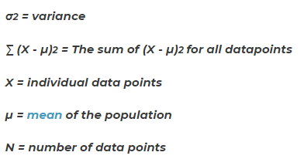

Measures of Dispersion Contd..
Variance
The average of squared differences from the mean.
To calculate the variance follow these steps:
Work out the Mean( the simple average of the numbers).
Then for each number: Subtract the mean and square the result(the squared difference)
Then work out the average of those differences.
Example
suppose you want to find the variance of scores on a test. Suppose the scores are 67, 72, 85, 93 and 98.
Calculate the mean (µ) for the five scores: 67 + 72 + 85 + 93 + 98 / 5, so µ = 83.
Now, compare each score (x = 67, 72, 85, 93, 98) to the mean (µ = 83)
σ² = [ (67 - 83)²+(72 - 83)²+(85 - 83)²+(93 - 83)²+(98 - 83)² ] / 5
σ² = [256 + 121 + 4 + 100 + 225] / 5
Then summarize the numbers inside the brackets:
σ² = 706 / 5
σ² = 141.2

Slide 19

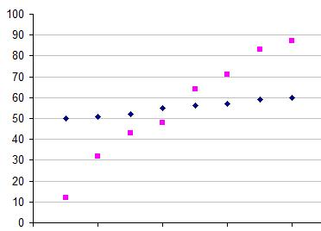
Measures of Dispersion Contd..
Standard Deviation
The Standard Deviation is a measure of how spread out numbers are.
Its symbol is σ (the greek letter sigma)
The formula is easy: it is the square root of the Variance.
To calculate the Standard Deviation follow these steps:
Work out the Mean( the simple average of the numbers).
Then for each number: Subtract the mean and square the result(the squared difference)
Then work out the average of those differences.
Take square root of the result obtained in above pointer
For example, the data points 50, 51, 52, 55, 56, 57, 59 and 60 have a mean at 55 (Blue).
Another data set of 12, 32, 43, 48, 64, 71, 83 and 87. This set too has a mean of 55 (Pink).
Standard Deviation for Blue dots: 3.46
Standard Deviation for Pink dots: 24.27
URL: http://www.mathsisfun.com/data/standard-deviation.html

Slide 20
Measures of Position
Measures of position are techniques that divide a set of data into equal groups.
To determine the measurement of position, the data must be sorted from lowest to highest. The different measures of position are:
Quartile
The quartiles are the three values of the variable that divide an ordered data set into four equal parts.
Q₁, Q₂ and Q₃ determine the values for 25%, 50% and 75% of the data.
Q₂ coincides with the median.
Percentile
The percentiles are the 99 values of the variable that divide an ordered data set into 100 equal parts.
The percentiles determine the values for 1%, 2%... and 99% of the data.
P₅₀ coincides with the median.
Practice Problem 1: For the data set below, which value is in the 75th percentile?
{1, 3, 3, 4, 6, 7, 7, 7, 8, 9, 9, 10, 12, 15, 16, 17}
Solution: There are a total of 16 values in the set. Thus 75% of the data set is 12 values. Because the data set is ordered, we need simply find the 12th data value. The number 10 is the 75th percentile: 75% of the values in the set are less than or equal to 10.
Practice Problem 2: What is Q3 for the following data set? {20, 40, 50, 65, 70, 75, 80, 100}
Solution:Q3 is the value x for which 75% (three out of four) of the data values are at most x. Since there are eight members in the data set, the sixth value is Q3-75. This value is also the 75th percentile.

Slide 21
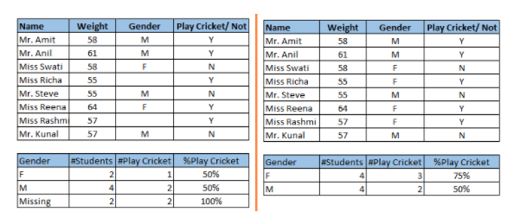
Missing Values
Missing data in the data set can reduce the power / fit of a model or can lead to a biased model because we have not analyzed the behavior and relationship with other variables correctly. It can lead to wrong prediction or classification.
Notice the missing values in the image shown above: In the left scenario, we have not treated missing values. The inference from this data set is that the chances of playing cricket by males is higher than females. On the other hand, if you look at the second table, which shows data after treatment of missing values (based on gender), we can see that females have higher chances of playing cricket compared to males.

Slide 22
Missing Values Treatment
There are mainly three methods to treat the missing values
Deletion: we delete observations where any of the variable is missing. Simplicity is one of the major advantage of this method, but this method reduces the power of model because it reduces the sample size.
Mean/ Mode/ Median Imputation: Imputation is a method to fill in the missing values with estimated ones. The objective is to employ known relationships that can be identified in the valid values of the data set to assist in estimating the missing values. Mean / Mode / Median imputation is one of the most frequently used methods. It consists of replacing the missing data for a given attribute by the mean or median (quantitative attribute) or mode (qualitative attribute) of all known values of that variable.
Prediction Model: Prediction model is one of the sophisticated method for handling missing data. Here, we create a predictive model to estimate values that will substitute the missing data.
In this case, we divide our data set into two sets: One set with no missing values for the variable and another one with missing values. First data set become training data set of the model while second data set with missing values is test data set and variable with missing values is treated as target variable.

Slide 23
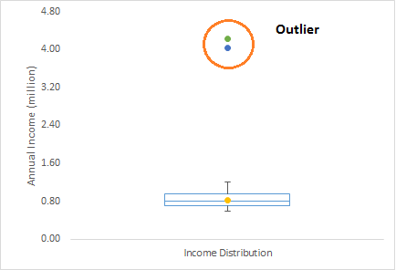
Outliers Detection
Outliers are extreme values that deviate from other observations on data. In other words, an outlier is an observation that diverges from an overall pattern on a sample.
Types of Outliers
Univariate: Univariate outliers can be found when looking at a distribution of values in a single feature space.
Multivariate: Multivariate outliers can be found in a n-dimensional space (of n-features).
Example: Let’s take an example, we do customer profiling and find out that the average annual income of customers is $0.8 million. But, there are two customers having annual income of $4 and $4.2 million. These two customers annual income is much higher than rest of the population. These two observations will be seen as Outliers.

Slide 24
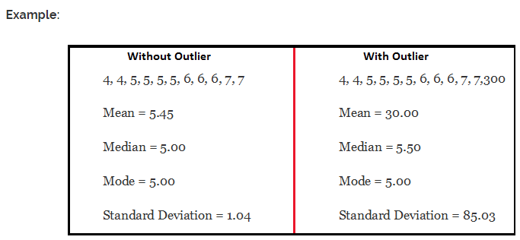
Impact of Outliers
Outliers can drastically change the results of the data analysis and statistical modeling. Below are two unfavorable impacts of outliers in the dataset.
It increases the error variance and reduces the power of statistical tests.
They can bias or influence estimates that may be of substantive interest.
To understand the impact deeply, let’s take an example to check what happens to a data set with and without outliers in the data set.
As you can see, data set with outliers has significantly different mean and standard deviation. In the first scenario, we will say that average is 5.45. But with the outlier, average soars to 30. This would change the estimate completely.

Slide 25
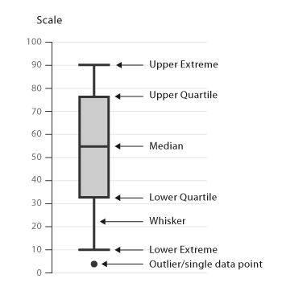
Outliers Detection Using Box Plot
A Box and Whisker Plot (or Box Plot) is a convenient way of visually displaying the data distribution through their quartiles.
The lines extending parallel from the boxes are known as the “whiskers”, which are used to indicate variability outside the upper and lower quartiles. Outliers are sometimes plotted as individual dots that are in-line with whiskers. Box Plots can be drawn either vertically or horizontally.
Definitions
Inter-quartile range: The middle “box” represents the middle 50% of scores for the group. The range of scores from lower to upper quartile is referred to as the inter-quartile range. The middle 50% of scores fall within the inter-quartile range.
Upper quartile: Seventy-five percent of the scores fall below the upper quartile.
Lower quartile: Twenty-five percent of scores fall below the lower quartile.
Whiskers: The upper and lower whiskers represent scores outside the middle 50%.

Slide 26
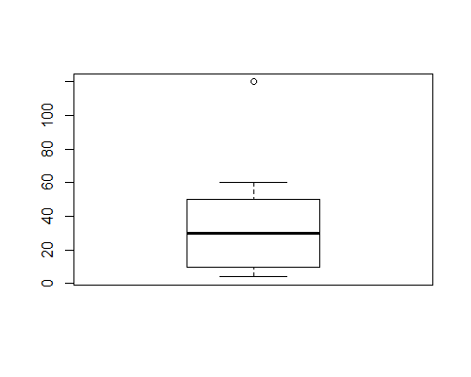
Box Plot Contd..
Steps to identify the outliers in the dataset
• Inter-Quartile Range (IQR) is the distance between the first and second quartiles • Multiply the IQR by 1.5 • Subtract that value from the 1st Quartile to get your lower boundary • Add that value to the 2nd Quartile to get your upper boundary • Values in the data set that fall outside of these limits are considered outliers
For example, the data points are 4,6,10,12,30,40,50,60,120
Median for the above dataset is 30
Q1 is 10 and Q3 is 50
Find the inter quartile range IQR = Q3-Q1
IQR is 40
Lower limit of box plot would be: Lower Limit = Q1- 1.5*IQR
Lower Limit = -50
Lower limit of box plot would be: Lower Limit = Q3+1.5*IQR
Upper Limit = 110

Slide 27
Thank You

