Slide 1

FOSS
Tony Pau

Slide 2


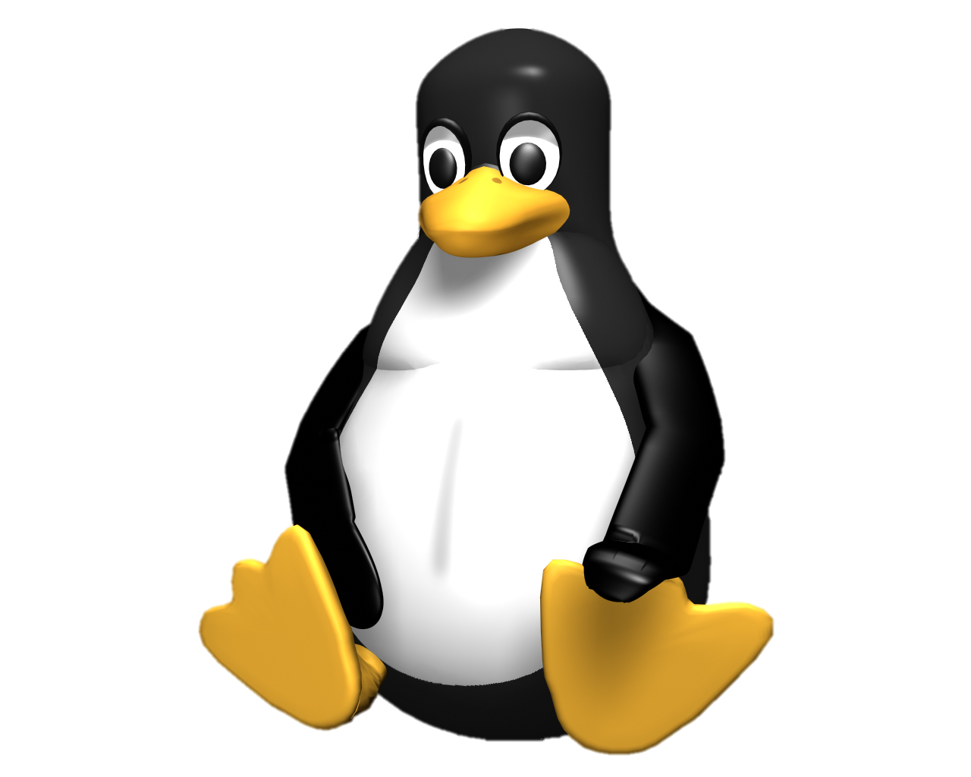




What is FOSS?
Free Open Source Software

Slide 3
Pros and Cons
Pros
Cons
Free
Open-source
Probably not industry standard
Less tutorials
Smaller community
Developers have no financial incentive

Slide 4




Operating Systems
FOSS
Proprietary
GNU/Linux
Windows
MacOS

Slide 5

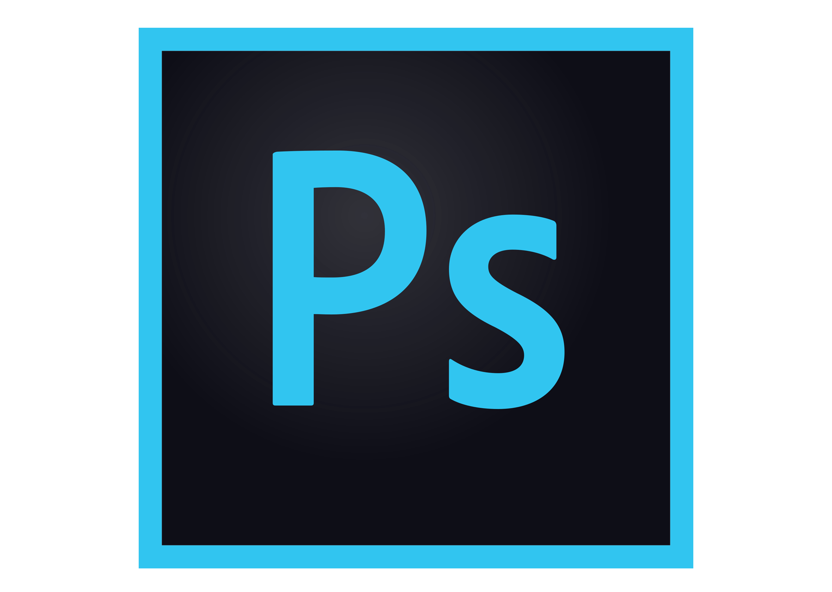
Image Manipulation
FOSS
Proprietary
GIMP
Krita
Photoshop

Slide 6

Digital Audio Workstation
FOSS
Proprietary
LMMS
Fruity Loops / FL Studio

Slide 7


Game Engine
FOSS
Proprietary
Godot
Unity
Unreal Engine

Slide 8
More…
https://github.com/pautx/foss-presentation

