Slide 1
Comp 420 Term Project
By: Matt Brierley

Slide 2
Proposal
My dad is a small business owner. My idea was to create a database that would be used to manage client info, service/service history, payment history, products, inventory, and employees. This database would need to link a client, employee, and potentially inventory items to a list of services and products. He is very unorganized with his billing and still does everything on paper, so this is definitely a problem that needs addressing. This is not a new idea, but could be a solution to his specific needs.

Slide 3
Primary Entities, Data Source, and Needed Functionality
Appointment
Customer
Customer Invoice
Employee
Inventory
Payment
Product
Service
Supplier
Supplier Invoice
Initial Data is all randomly generated
Customer lookup
View Appointments (by day or zip code)
Get listing of unbilled, overdue, or lapsed clients
Get product inventory (totals and by employee)
Listing of all products used over an interval, for order projection.
Daily work schedules
Process payments, and payment history
Create a new invoices

Slide 4
Design
Built in python, with MySQL Connector and Tkinter GUI framework
System interaction with the database is almost entirely done through stored procedures and views, with very few executions of custom queries
Predominantly seeks to facilitate ease of use for a customer that is not familiar with SQL or databases, and is perhaps not even computer savy at all

Slide 5
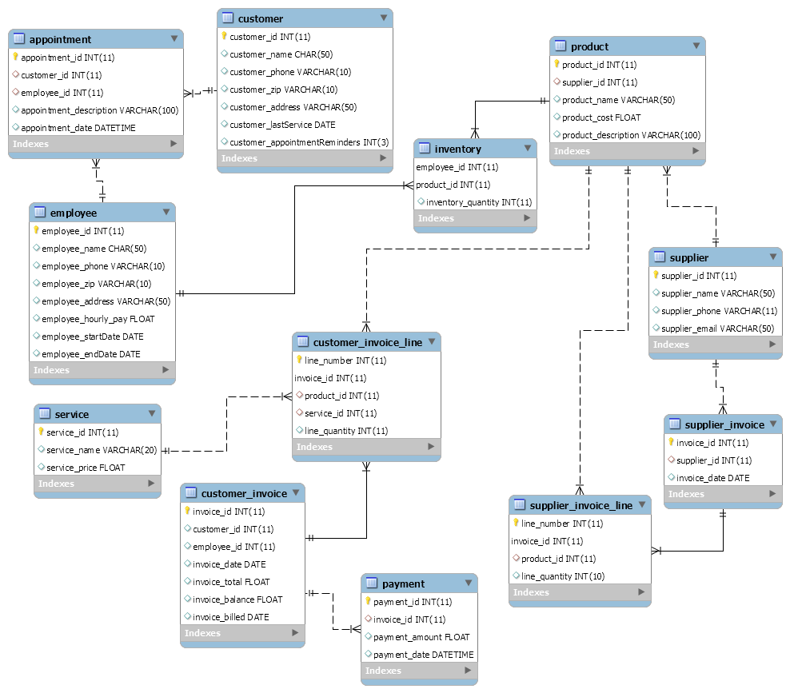

Slide 6
DML
29 stored procedures, including:
delete/addAppointment
update/addCustomerInvoiceLine (must insert, update 3 tables, and ensure QOH bounds)
getEmployeeInventory
getProductsOverInterval
14 views, including:
appointmentReminders
billingReminders
unassignedAppointments
unbilledClients

Slide 7
System
On to the demo and accompanying screenshots.

