Slide 1


Scuola di Specializzazione in Malattie dell’Apparato Cardiovascolare
Direttore Prof. Massimo Volpe
Facoltà di Medicina e Psicologia, Università di Roma Sapienza
Anno Accademico 2013-2014
Dr.ssa/Dr. Nome e Cognome
Progetto Formazione Avanzata in Cardiologia nel Web 2014
Scuola di Specializzazione in Malattie dell’Apparato Cardiovascolare
Direttore: Prof. Massimo Volpe
E-mail: massimo.volpe@uniroma1.it
Coordinatore: Dr. Giuliano Tocci
E-mail: giuliano.tocci@uniroma1.it

Slide 2
Short-term water demand forecasting using traditional and deep learning models
Name: Poompavai Chandrprakash(1853976) Course: Masters in Data Science
Advisor: Prof. Simone Scardapane
Co-Advisors: Dr. Pietro Dicosta

Slide 3
Outline
Introduction
Motivation and Objectives
Project Modules
Implementation
Results
Conclusions
References

Slide 4
Introduction
In today’s world, we could see enormous amounts of big data in every domain. The volume of data that one must deal with has exploded to unimaginable levels in the past decade.
Private companies and research institutions capture terabytes of data about their users’ interactions, business, social media, and sensors from cell phones and automobiles. This leads to the evolution of big data analytics.
Big Data Analytics largely involves collecting data from different sources and making it an available way for the consumer.
Time series forecasting is one such domain, which uses enormous amounts of sensor data with the application of artificial intelligence, and data science. Analysing time series data with effective visualization can help to produce various insightful inferences.

Slide 5
Objectives
The main objective of the thesis is to perform a time series forecast, for planning the business in terms of seasonality, annual patterns and so on.
The project involves short term water demand forecasting using traditional and deep learning models.
This prediction helps to identify and plan for seasonality, annual patterns, production capacity, and expansion over a longer period. which in turn drives a long-term business strategy (e.g., plans to launch a facility or store internationally and expand into new markets). External factors are also considered like weather conditions, to check the water demand forecasting in a shorter term.

Slide 6
Models
Traditional models
Deep learning models
Missing values can really affect the performance of the models
They cannot recognize complex patterns in the data;
They usually work well only in few-step forecasts, not in long term forecast.
Example: AR, MA, ARIMA, VAR etc.
They are not affected by missing values. (e.g RNN)
They can find complex patterns in the input time series.
They can perform on long term forecasts.
RNNs can model a sequence of data so that each sample can be assumed to be dependent on previous ones.
Example: RNN, LSTM, GRU etc.

Slide 7
Project Modules
The problem was divided into 2 main tasks:
Univariate time series analysis: The main goal of the project was to compare traditional and deep learning models to perform, the forecast on the dataset. The forecast was carried on an hourly, monthly and weekly basis. Here “Yorkshire” water demand dataset was used.
Univariate time series analysis: The main goal of the project was to compare traditional and deep learning models to perform, the forecast on the dataset. The forecast was carried on an hourly basis. External factors are considered like weather conditions, for the water demand prediction. With respect to weather conditions, the online weather dataset is considered, and values are retrieved with respect to the Yorkshire dataset.

Slide 9
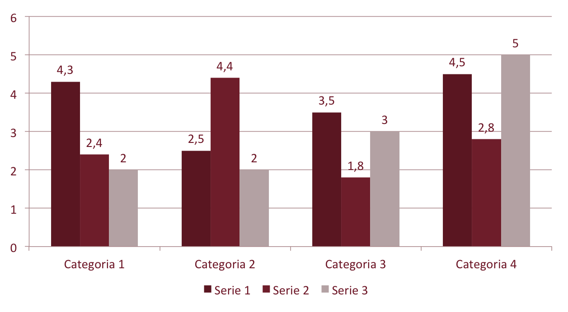

Slide 10
Scuola di Specializzazione in Malattie dell’Apparato Cardiovascolare
Direttore Prof. Massimo Volpe
Facoltà di Medicina e Psicologia, Università di Roma Sapienza
Anno Accademico 2013-2014
Dr.ssa/Dr. Nome e Cognome
Grazie per la Vostra Attenzione!
Progetto Formazione Avanzata in Cardiologia nel Web 2014
Scuola di Specializzazione in Malattie dell’Apparato Cardiovascolare
Direttore: Prof. Massimo Volpe
E-mail: massimo.volpe@uniroma1.it
Coordinatore: Dr. Giuliano Tocci
E-mail: giuliano.tocci@uniroma1.it

