Slide 1
Ultrasonography
Uday kiran Reddy J
Veghana Gowda
T Pavan Kumar
Manoj H R

Slide 2
Ultra Sonography
Medical imaging technique/ ultrasound imaging or sonography that uses high-frequency sound waves to produce images of the internal organs and tissues of the body.
Emits high-frequency sound waves (usually in the range of 2 to 20 MHz) that travel through the body and bounce back off of the internal organs and tissue.
The returning echoes are captured by the ultrasound machine and used to create images of the internal structures.
Transducer: Emit and receive high-frequency sound wavesThe transducer is placed in direct contact with the skin or inserted into the body through a gel.
Emission of sound waves: Emits high-frequency sound waves 2 to 18 MHz
Reflection of sound waves: Encounter boundaries between different tissues and organs and bounce back, creating echoes

Slide 3
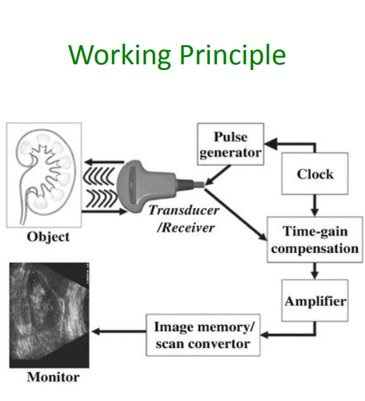
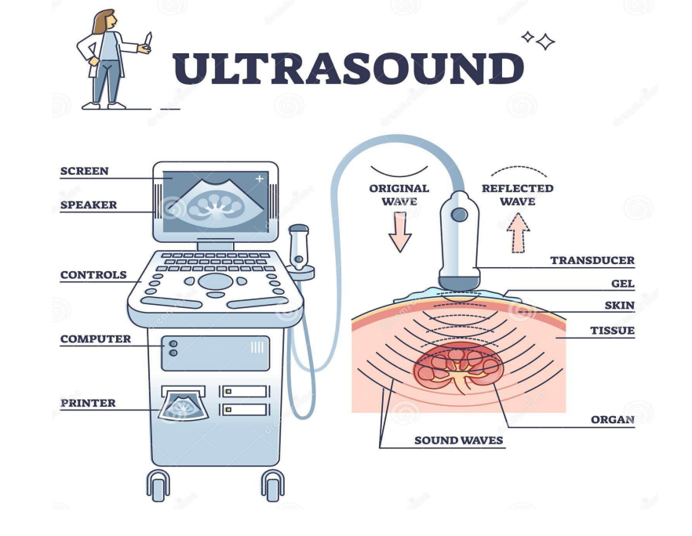
Reception of echoes: The transducer receives echoes and sends the information to a computer, which processes the data to create images.
Image formation: The computer uses the information from the echoes to create images of the internal organs and tissues of the body. The images are displayed on a screen, allowing the operator to see the structure and movement of the internal organs and tissues.

Slide 4
Advantages of Ultrasonography
Non-invasive: Does not involve any incisions or injections, making it a safe and convenient imaging method.
No ionizing radiation: Ultrasonography does not use ionizing radiation making it a safer option for patients, especially pregnant women and children. option for patients, especially pregnant women and children.
Real-time imaging: Ultrasonography provides real-time images that can be used to monitor the movement and function of internal organs tissues.
Portable: Ultrasonography machines are portable an making it a valuable tool for emergency.
Cost-effective: Ultrasonography is a cost-e any special preparation or recovery time
Versatile: Ultrasonography can be used to image a wide range of structures within the body, including the organs of the abdomen pelvis, and chest, as well as the uterus, fetus, and other soft tissues.

Slide 5
Limitations of Ultrasonography
Limited depth: Ultrasonography has limited depth and is not as effective at imaging deep structures or those obscured by bones or gas.
Operator dependence: The quality of the images produced by ultrasonography depends heavily on the skills and experience of the operator.
Limited resolution: Ultrasonography has limited resolution compared to other imaging methods, making it less effective at visualizing small structures or detecting small changes in tissue.
Limitations in overweight patients: Ultrasonography may have limited usefulness in overweight patients due to the difficulty in obtaining clear images through the layers of fat.
Limitations in detecting some types of cancer: Ultrasonography may not be as effective at detecting certain types of cancer, such as pancreatic cancer, due to the lack of characteristic signs on ultrasound images.

Slide 6
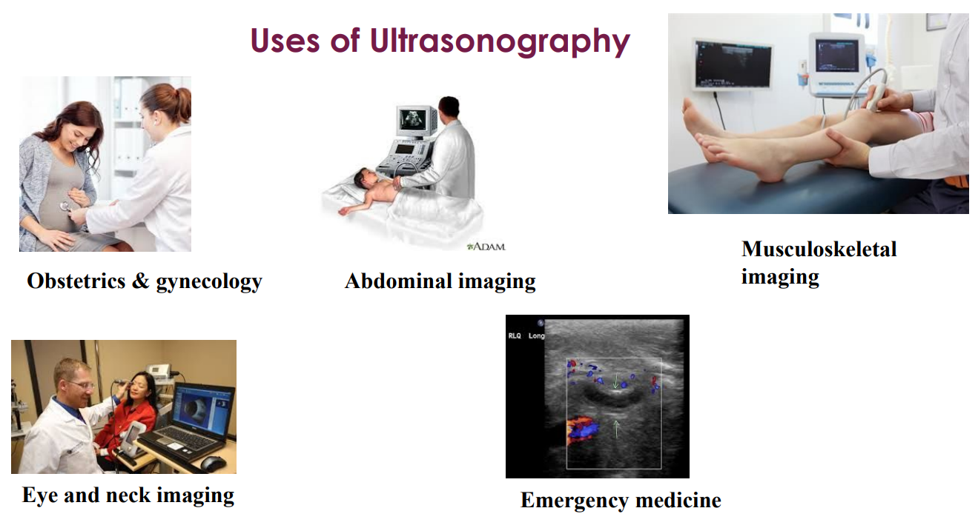

Slide 7
THANK YOU

