Slide 1
Multi-Task Federated Learning for Personalised Deep Neural Networks in
Edge Computing
Batch.No : 21
T . Jatin Y20CS173
V . Pavan Kumar Y20CS184
U . Leela Krishna Y20CS181
Guide : S.Karthik sir

Slide 2
What is FEDERATED learning…..?

Slide 3
Abstract :
Federated Learning is an approach for collaboratively training Deep Neural Networks on mobile devices, without private user data leaving the devices.
most existing work on FL measures global-model accuracy, but in many cases, such as user content-recommendation, improving individual User model Accuracy (UA) is the real objective.
we propose a Multi-Task Federated Learning algorithm that introduces Batch-Normalization layers into the Deep Neural Networks.
Multi-Task Federated Learning benefits User model Accuracy by allowing users to train models personalised to their own data

Slide 4
Existing Technique:
Federated Averaging (Fed-Avg) by B. McMahan, E. Moore, D. Ramage, and B. A. Y. Arcas
Federated Averaging using optimisation strategy (FedAvg – Adam)

Slide 5
Existing Technique:
Federated Averaging (Fed-Avg):
Federated learning is a machine learning approach that allows multiple parties to collaborate on a model without sharing their data with each other.
Federated learning allows data to remain confidential, which is important for industries such as healthcare, finance, and telecommunications, where privacy is a primary concern.
The Fed-Avg algorithm works as follows:
Initialization: A central server initializes the model parameters.
Client Selection: The server selects a subset of clients (e.g., mobile devices) to participate in the training process.

Slide 6
Local Training: The selected clients download the current model parameters from the server, train the model on their local data, and send the updated model parameters back to the server.
Aggregation: The server aggregates the updated model parameters from the clients by taking a weighted average of the parameters based on the number of data samples each client has.
Model Update: The server updates the global model parameters with the aggregated parameters and repeats the process for the next round of training.

Slide 7
Existing Technique:
2. FedAvg – Adam
FedAvg-Adam is a variant of the Federated Averaging (FedAvg) algorithm used in federated learning
FedAvg-Adam is a modification of FedAvg that uses the Adam optimizer, which is a popular optimization algorithm used in machine learning
The use of Adam optimizer in FedAvg-Adam is expected to improve the convergence speed and overall performance of the federated learning system.

Slide 8
Limitations of existing technique :
Clients usually do not have Independent and Identically Distributed (IID) training data. Each client has data generated by itself, and can have noisy data or only a subset of all features/labels. These factors can all substantially hinder training of the FL model.
It requires more number of rounds in order to reach target user model accuracy .
Due to the non Independent and Identically Distributed nature of client datasets, the performance of the global FL model may be higher on some clients than others. This could even lead some clients to receive a worse model than the one they could have trained independently.

Slide 9
Proposed Technique :
Multi-task Federated Learning (MTFL)
That allows clients to train personalised Deep Neural Networks that both improve local model accuracy, and help to further enhance client privacy.
Multi-task Federated Learning approach takes the Batch-Normalisation (BN) layers that are commonly incorporated into DNN architectures, and keeps them private to each client.
MTFL can substantially reduce the number of rounds to reach target UA, regardless of the optimization strategy used.

Slide 10
The MTFL algorithm is based on the client-server framework. Multiple rounds are initiated by the server as shown in the figure.

Slide 11
Steps :
First, the server selects all, or a subset of all, known clients from its database and asks them to participate in the FL round ,and sends a Work Request message to them.
Clients will accept a Work Request depending on user preferences (for example, users can set their device to only participate in FL if charging and connected to WiFi). All accepting clients then send an Accept message to the server.
The server sends the global model (and any associated optimization parameters) to all accepting clients, who augment their copy of the global model with private patches.

Slide 12
Clients then perform local training using their own data, creating a different model. Clients save the patch layers from their new model locally, and upload their nonprivate model parameters to the server.
The server waits for clients to finish training and upload their models .
After this, the server will aggregate all received models to produce a single global model which is saved on the server, before starting a new round.

Slide 13
Proposed methodology and algorithms :
The main intention is to create a model that has good performance on non IID data.
However, in many FL scenarios, the desire is to create a model that has good performance on individual user devices .
For example, Google have used FedAvg for their GBoard next-word-prediction software .
The objective was to improve the prediction score for individual users. Hence we consider the user accuracy as our metric.

Slide 14
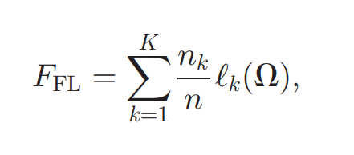
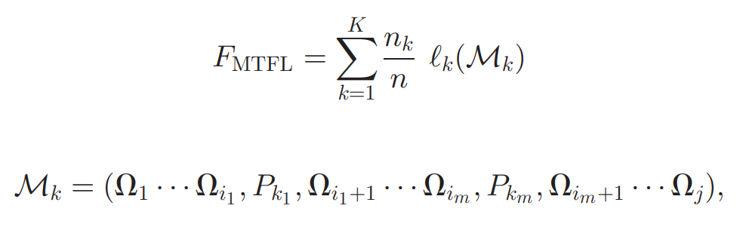
In FL, the aim is to minimize the following objective function
Adding unique client patches to the FL model changes the objective function of MTFL to

Slide 15
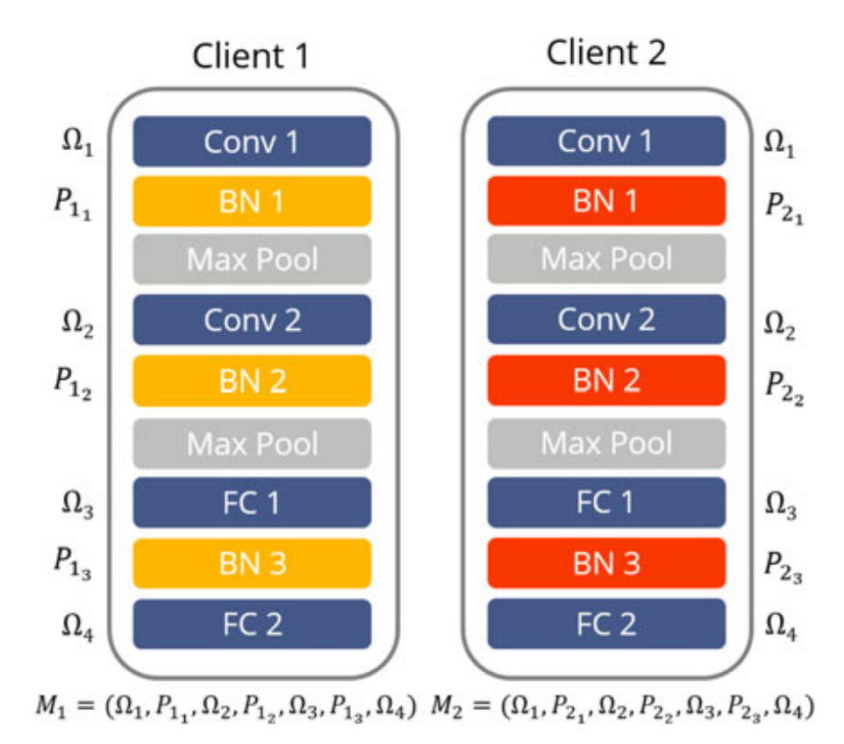

Slide 16
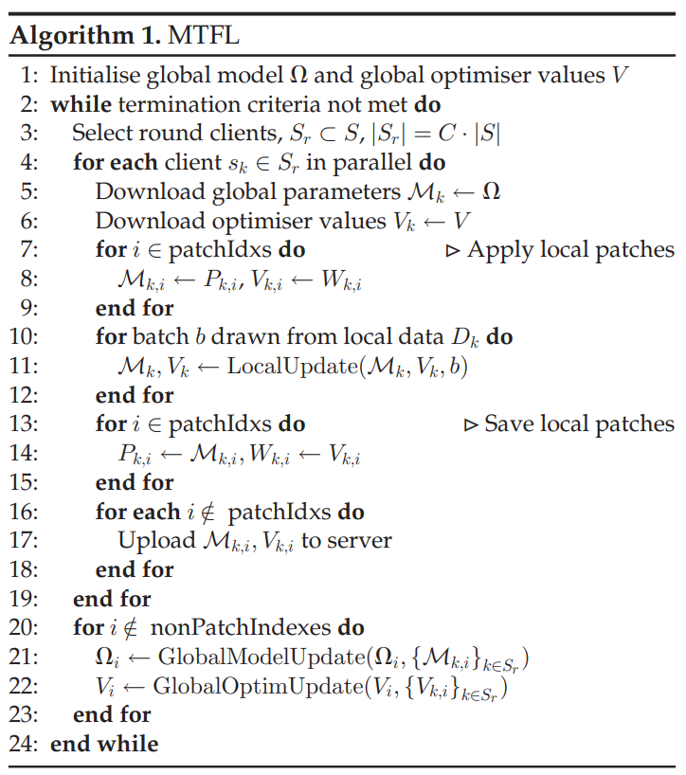

Slide 17
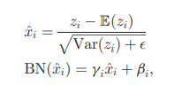
Batch Normalisation (BN) layers can act as model patches for MTL
BN layers are given by
where E(zi) and Var(zi) are the mean and variance of a neuron’s activations across a minibatch, and beta and gamma are parameters learned during training

Slide 18
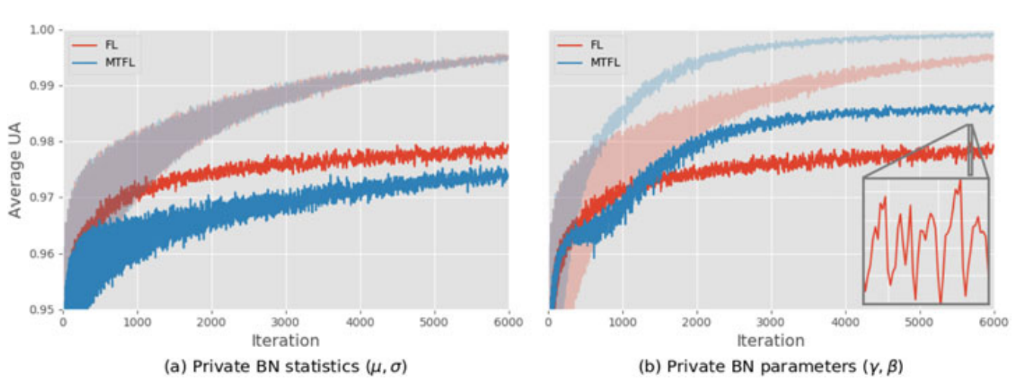

Slide 19
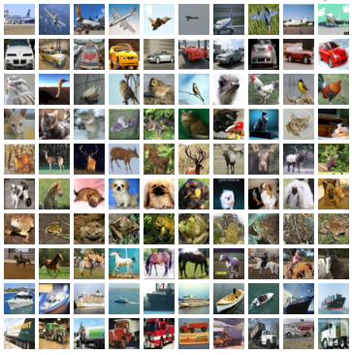
Details of Data sets:
We conduct experiments using two image-classification datasets: MNIST and CIFAR10 , and two DNN architectures.
CIFAR-10 : is a popular image classification dataset that consists of 60,000 images in 10 classes, with 6,000 images per class.

Slide 20
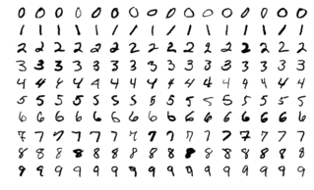
MNIST : is a popular dataset in the field of machine learning .It consists of a set of 70,000 handwritten digit images, with 60,000 images for training and 10,000 images for testing.

Slide 21
Conclusion :
BN layers allow users to have personalized models and significantly improves average User model Accuracy
Experiments using MNIST and CIFAR10 show that MTFL with FedAvg significantly reduces the number of rounds to reach a target average UA compared to FL, by up to 5 times .
Further experiments show that MTFL with FedAvg-Adam reduces this number even further, by up to 3 times .

Slide 22
These experiments also indicate that using private BN trainable parameters (g; b) instead of statistics (m; s) in model patches gives better convergence speed.
Comparison to other state-of-the-art personalized FL algorithms show that MTFL is able to achieve the highest average UA given limited communication rounds.

Slide 23
Future work :
The positive results we obtained justify further investigation of this approach.
In the current investigation we consider image classification as our concern . This work can be extended to other type of classification other than the image classification

Slide 24
