Slide 1
UNIT-6 SOCIAL MEDIA ANALYTICS AND TEXT MINING
By
Dr. Prasanta Kumar Sahoo

Slide 2
Contents:-
Introducing Social Media.
Keyelements of Social Media.
Text mining; Understanding Text Mining Process.
Sentiment Analysis, Performing Social Media Analytics and Opinion Mining on Tweets

Slide 3
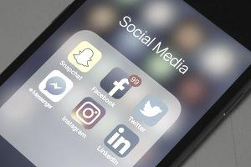
What is social media
Social media is computer-based technology that facilitates the sharing of ideas, thoughts, and information through the building of virtual networks and communities.

Slide 4
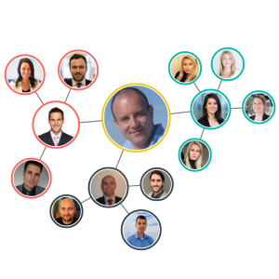
VIRTUAL NETWORKS IN THE CONTEXT OF SOCIAL MEDIA

Slide 5
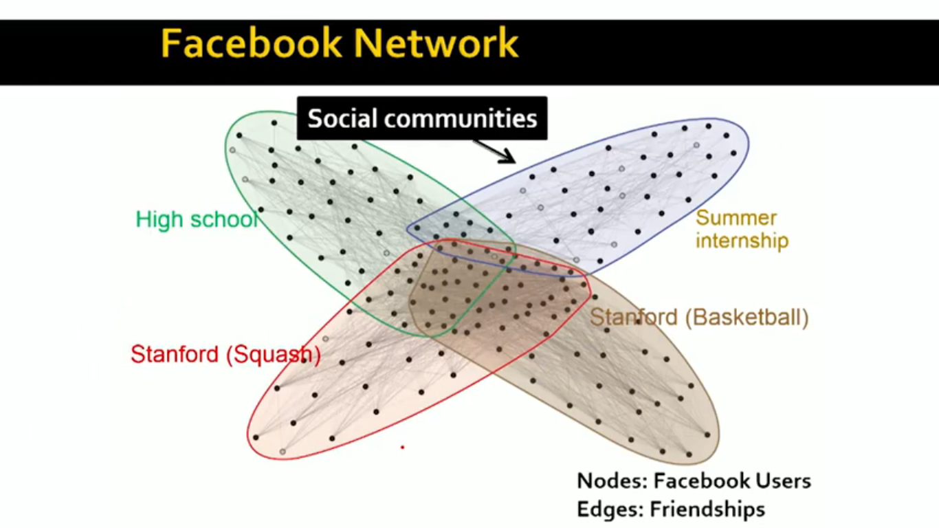
COMMUNITIES IN THE SOCIAL NETWORK

Slide 6
Social media provides a collaborative environment which can be employed for:
Building relationships
Distributing content
Rating products and services
Engaging target audience

Slide 7
DIFFERENT FORMS OF SOCIAL MEDIA
Social networking websites
Blogs
Microblogs
Content communities and media sharing sites
Wiki
Social bookmarking websites

Slide 8
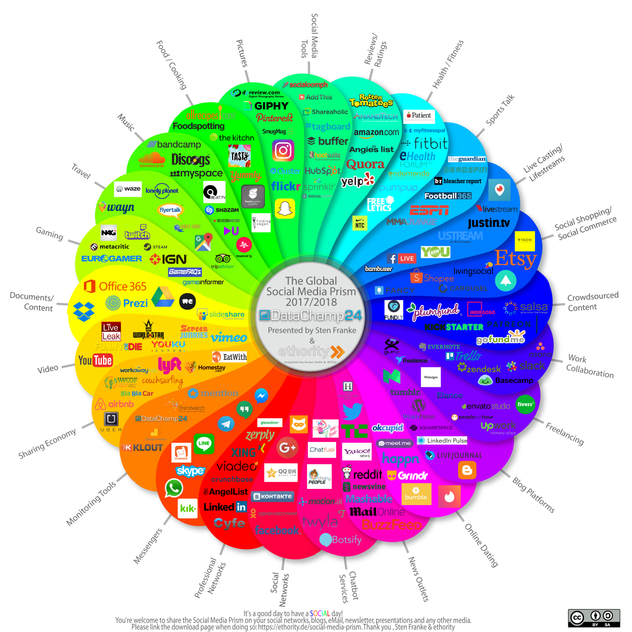

Slide 9
KEY ELEMENTS OF SOCIAL MEDIA
Collect – information from various social media sources by using various tools.
Curate – Cleanse the collected information in the careful manner so as to support effective insights discovery using tools.
Create – Developing useful objects and models that is focused on the specific problem through various programs and shared routines.
Share – Share the developed solution in the social media for expanding the social network (customer base) using tools.
Engage - Grab the regularly monitored consumer views for identifying drawbacks in the solution (Product/Brand/Company Reputation) in the timely manner so as to expand the realm of reaching more and more people.

Slide 10
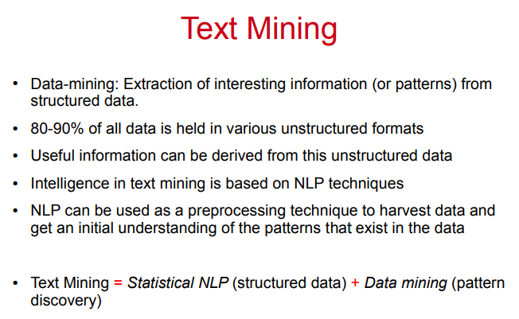

Slide 11
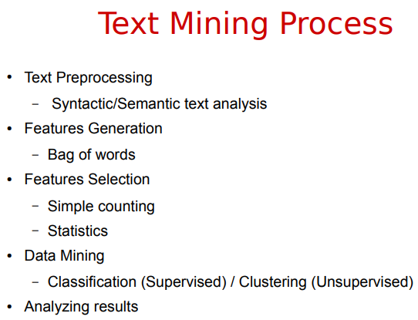

Slide 12
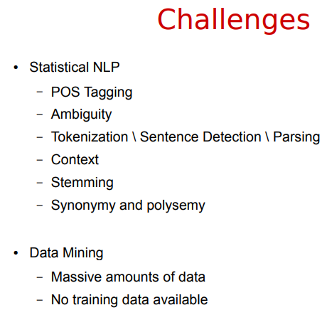

Slide 13
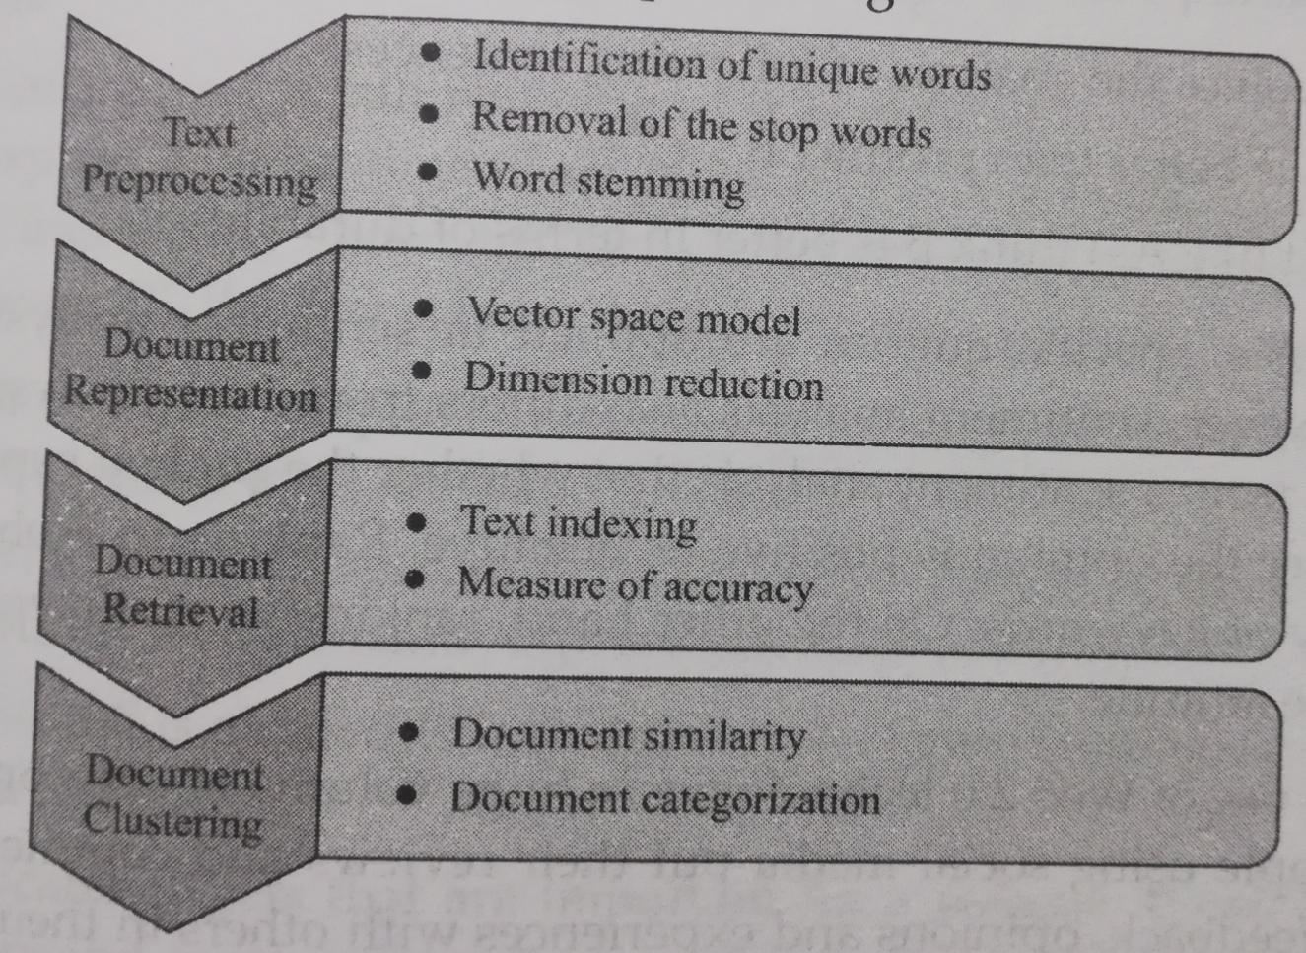
STAGES OF DOCUMENT PROCESSING IN TEXT MINING

Slide 14
SENTIMENT ANALYSIS
Sentiment analysis refers to the use of natural language processing, text analysis, computational linguistics, and biometrics to systematically identify, extract, quantify, and study affective states and subjective information.

Slide 15

AFFECTIVE STATES

Slide 16
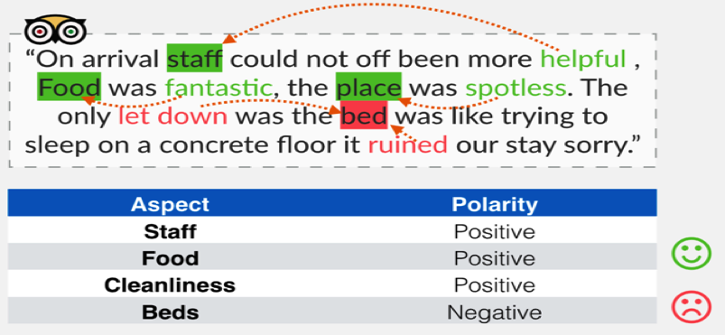
Aspect based Sentiment Analysis

Slide 17
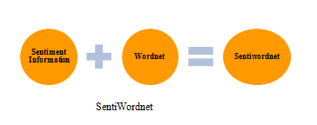
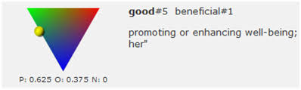
SENTIWORDNET

Slide 18
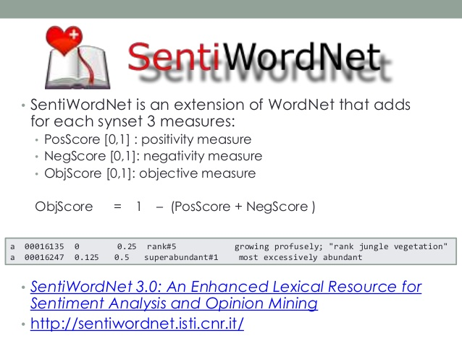

Slide 19
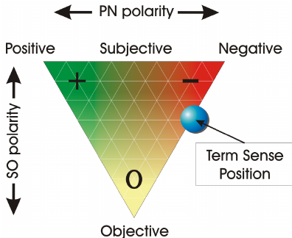
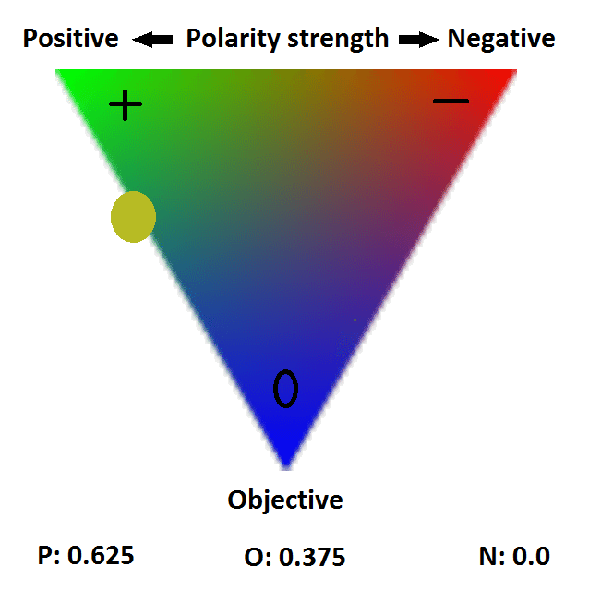

Slide 20
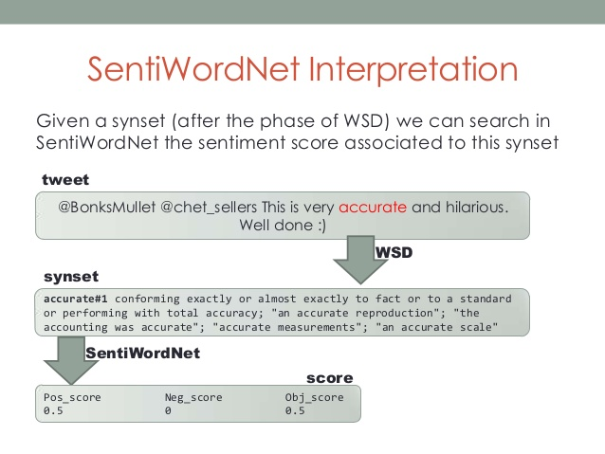

Slide 21
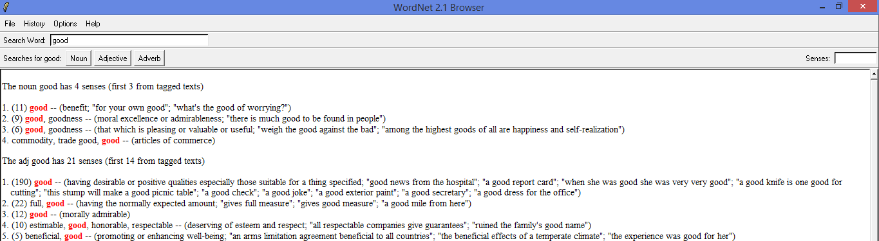
WORDNET – A LEXICAL RESOURCE FOR NLP

Slide 22
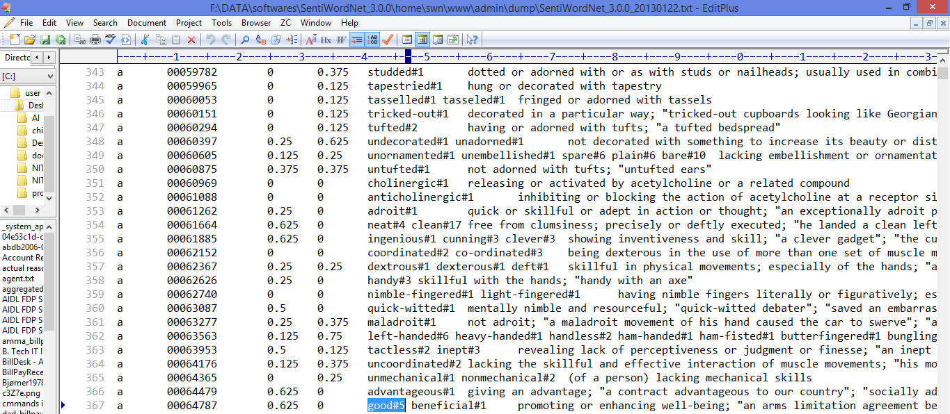
SENTIWORDNET – A LEXICAL RESOURCE FOR SENTIMENT ANALYSIS IN TERMS OF SCORES

Slide 23
Performing Social Media Analytics and Opinion Mining on Tweets
Twitter’s analytics help you understand how the content you share on Twitter grows your business.
Understanding the content is through exploring/visualizing the analyzed twitter data for extracting the insights from re-tweets and replies.
These insights are obtained from customized audience insights dashboard.
Audience insights dashboard contains valuable information about the people who follow you on Twitter. You can track your follower growth over time and learn more about your followers’ interests and demographics.

Slide 24
Opinion Mining of Tweets for social media analytics

Slide 25
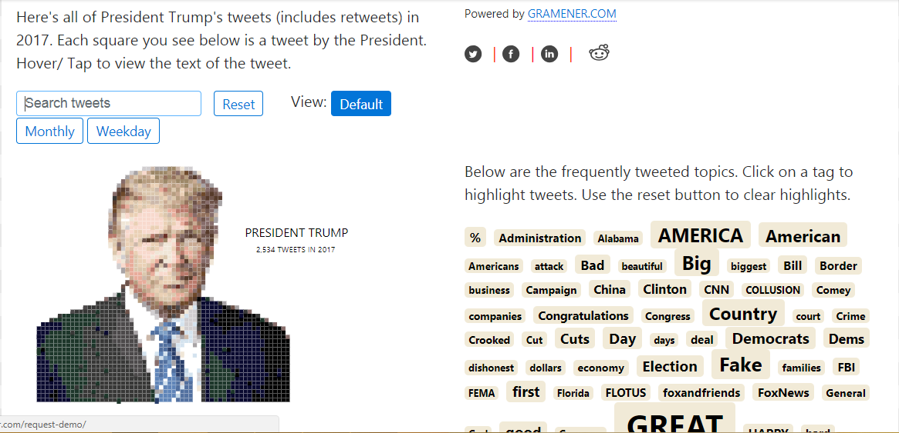
Reference Link: https://gramener.com/2018/02/08/a-data-portrait-of-president-donald-trump/
So will his tweets have a clue to what is in his mind?
*
Dr. D Teja Santosh, Associate Professor in I.T., SNIST, Ghatkesar
‹#›

Slide 26
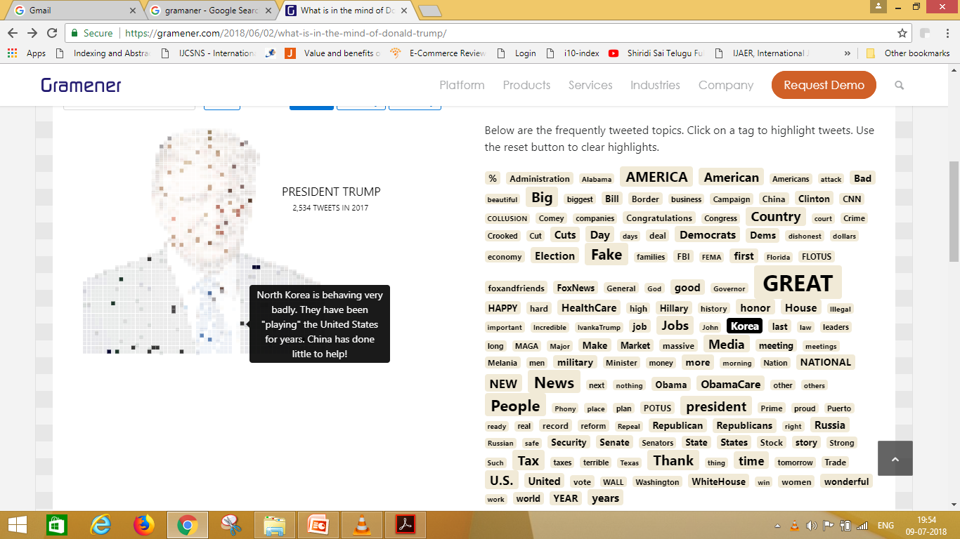
VISUAL INSIGHTS ABOUT TRUMP WITH HIS TWEETS AND RETWEETS
*
Dr. D Teja Santosh, Associate Professor in I.T., SNIST, Ghatkesar
‹#›

Slide 27
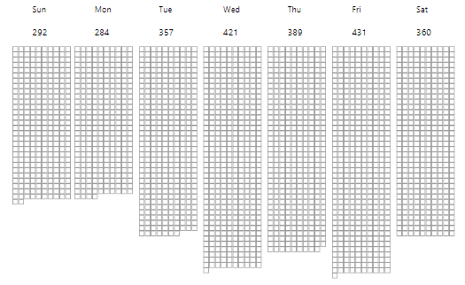
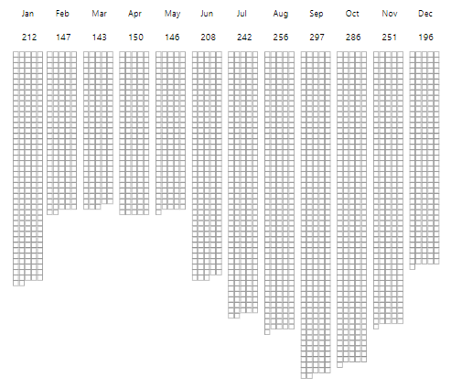
No. of tweet reactions in a given month of the year 2017
No. of tweet reactions in a given day of the week in 2017
Reference Link: https://gramener.com/2018/06/02/what-is-in-the-mind-of-donald-trump/
*
Dr. D Teja Santosh, Associate Professor in I.T., SNIST, Ghatkesar
‹#›

Slide 28
USE CASE – ANALYTICS OF ECOMMERCE PRODUCT BASED TWEETS

Slide 29
Analysis of public information from social media could yield interesting results and insights into the world of public opinions about almost any product, service or personality.
Social network data is one of the most effective and accurate indicators of public sentiment.
Utilization and interpretation of twitter data to determine public opinions is the need of this talk.
Analysis on tweets about the iPhone 6 as a use case was carried out.
https://link.springer.com/content/pdf/10.1186%2Fs40165-015-0016-4.pdf

Slide 30
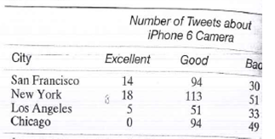
Twitter Opinions of iphone 6 Camera by Cities of USA

Slide 31
The clearest deductions were the highly generalized negative sentiments towards the iPhone 6 screen and touch which is because of the bending issue plaguing iPhone 6 users since its release.
And also a general high sentiment towards the iPhone 6 camera which has been praised by general users, reviewers and photographers for having near lens based camera image quality and sharpness.

