Slide 1
TokenLand: A Blockchain--Based Real Estate Management system
Pavan Kalam
16358242

Slide 2
Introduction
TokenLand is a real estate marketplace that uses blockchain technology and Non-Fungible Tokens (NFTs) to perform property transactions.
This decentralized application (DApp) allows users to tokenize real estate properties, list them for sale, and facilitate secure, transparent purchases.
Every property is a unique NFT token, which ensures immutable ownership records and streamlined transactions.
Local Hardhat network is used for performing blockchain interactions.

Slide 3
Key Features
In TokenLand properties are represented as unique NFTs on the blockchain.
This platform supports two types of users - administrators who are the sellers, and they can mint new property tokens, and buyers who can only purchase listed properties.
Property owners can list their tokenized properties (i.e., minted properties) for sale, while buyers can browse and purchase available properties.
This platform maintains a temporary record of all property-related transactions.

Slide 4
System Manual

Slide 5
System Architecture
The smart contract written in Solidity code, and it inherits from ERC721.
Key functions of this smart contract is as below,
mintProperty: To create a new property NFT.
buyProperty: It allows users to purchase a property.
listPropertyForSale: Lets owners list their property for sale.
getProperty: To retrieve property details.
Frontend was developed using React.js. Also, frontend provides a user interface to interact with smart contract.
Hardhat network has been used to create a local blockchain network.

Slide 6
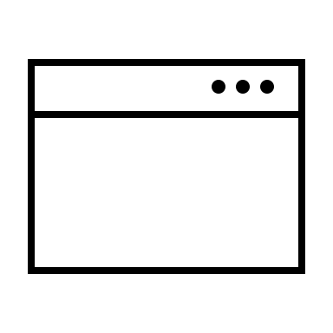
SYSTEM ARCHITECTURE
Browser
TokenLand
User Interface
MetaMask
Local
Hardhat Network
Python
Localhost
Server
Project Files
Coingecko API

Slide 7
Wallet Integration
MetaMask wallet has integrated with the blockchain, to enable secure interactions.
Wallet connection is initiated through the connectWallet() function.
Once the MetaMask is detected, this function requests access to the user's accounts, which can be available in hardhat node server.
MetaMask triggers a popup, asking the user for permission to connect their wallet to TokenLand.
Once all this, the connected wallet address, current block number and user balance will be fetched and shown in the interface.

Slide 8
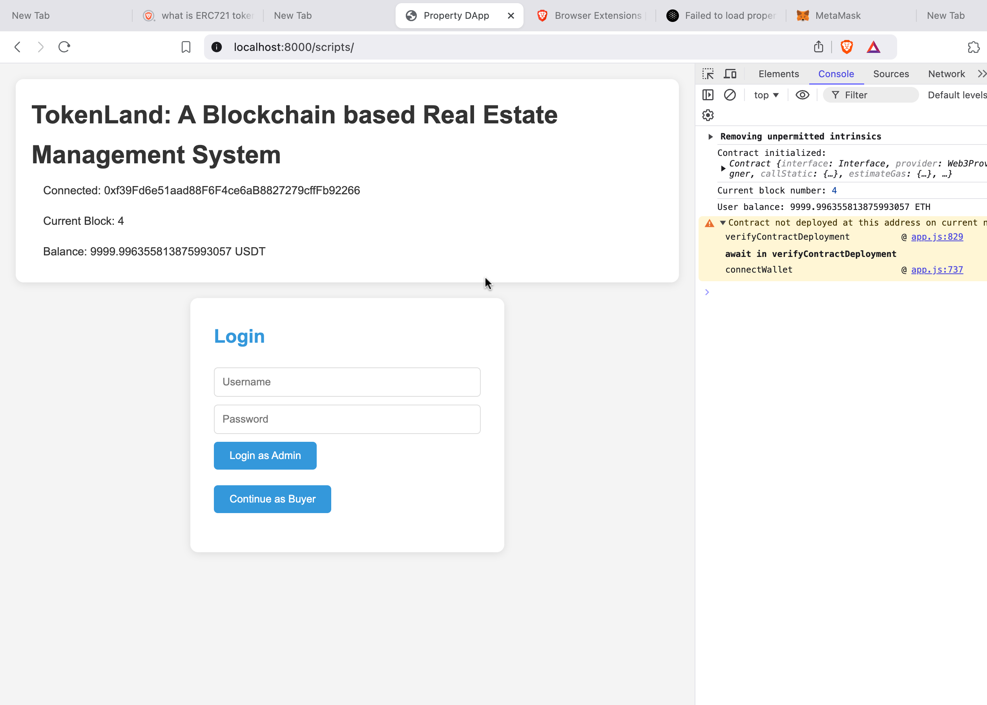
Security Considerations
To maintain Security, we had implemented a user authentication page for buyer and seller.
Also, contract verification has implemented to compare the deployed contract address and the wallet address.
If this is not matched user can’t get access to buy the properties.

Slide 9
User Manual

Slide 10
Connecting MetaMask to DApp
Install MetaMask wallet extension in the browser.
Add a hardhat network in MetaMask, and import the hardhat wallet account to MetaMask through it’s private key.
Make sure to connect to the deployed contract account.
Once connected it will show the account balance and wallet address.

Slide 11
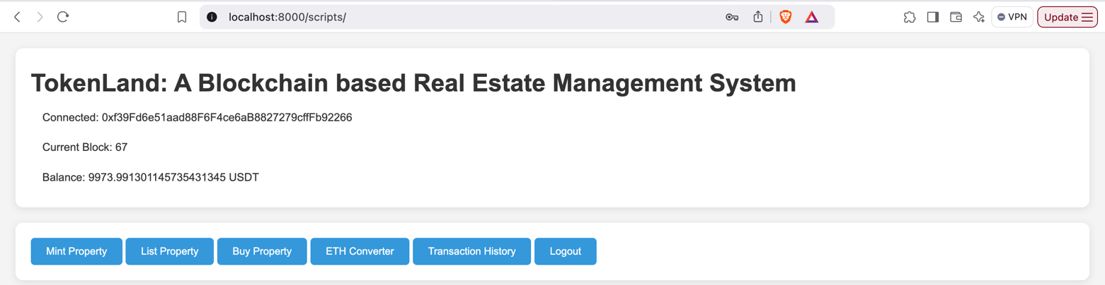
Admin and Buyer roles
Before to start any operation in TokenLand, user must connect to the wallet.
Once connected, the interface will load authentication page, for the user to login either as ‘admin’ which is seller or as only a ‘buyer’.
If the user is admin or the the seller, then the user must provide the admin credentials, to get complete options for minting, listing, buying and everything as shown below,

Slide 12
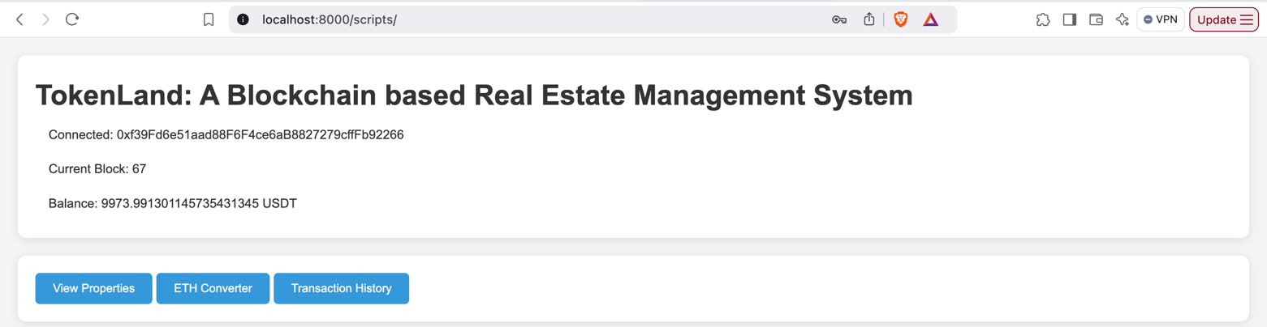
Admin and Buyer roles
If the user wants to be only a buyer, then the user can directly click on the ‘Continue as Buyer’ button in the user authentication page.
In this case the user will only have access to buy the property, check the conversion rate and the transaction history he made.

Slide 13
Features of TokenLand
1. Minting Property
Only property sellers have the access to mint the property.
During minting, provide the property location and value of the property.
2. Listing Property
List the property using the token Id.
The user can only list the property with value, less than or equal to the minted property value, and not more than that value.
MetaMask will pop up for transaction confirmation.

Slide 14
Features of TokenLand
3. Buying Property
Buying the property can be available to any user which is the user be either admin or buyer.
Here property is ready for selling, with the property information like value of the property, it’s availability.
4. Transaction History
As it is local hardhat network, it can’t be possible to track all the transactions.
This option will be helpful to track the minting, listing and buying information.
5. USDT to USD Converter
coingecko API has been used to monitor the live currency exchange rates.

Slide 15
Error Handling
If MetaMask is not available in the user browser, it will show the error like, ‘Please install MetaMask’.
If the user tries to list the property with more value than the minted value of the property, then the error message will be like, ‘New property must be less than or equal to the minted price’.
If the user tries to buy the property which is not available, that is the property is already sold, then the error message will be like, ‘Property is not for sale’.
If there is any contract connection issues, the error message will be like, ‘Contract verification is matched with the deployed contract’.
If the transaction is not tracked, then the error will be like ‘Transaction list element not found’.

Slide 16
GitHub Repository
All the project code and the relevant deliverables has been uploaded to the GitHub and the repository link is as below, https://github.com/pavan-kalam/Blockchain-based-realestate-management-system

Slide 17
Project Live Demo

Slide 18
Conclusion
TokenLand project was successfully implemented, by property tokenization as NFT .
The potential usage of blockchain technology, makes real estate transactions intermediate free and it also helps in maintain the transparency and reducing the potential fraud, in the real estate field.

