Slide 1

Blockchain Based Real Estate Management System
PAVAN KALAM
16358242

Slide 2
Introduction
TokenLand is a real estate marketplace that uses blockchain technology and Non-Fungible Tokens (NFTs) to perform property transactions.
Every property is a unique NFT token.
Local Hardhat network is used for performing blockchain interactions.

Slide 3
Key Features
Wallet integration with MetaMask for secure transactions
Property tokenization and management (minting, listing, and buying)
Role-based access control for administrators and buyers
Real-time USDT to USD conversion for easier price comprehension
Transaction history tracking for transparency

Slide 4
Core Functions
mintProperty: Allows creating new property tokens with location and price.
listPropertyForSale: Enables property owners to list their tokens for sale.
buyProperty: Allows users to purchase listed properties.
getProperty: Retrieves details of a specific property.

Slide 5
Wallet Integration
The DApp integrates with MetaMask, allowing users to connect securely and perform transactions.
Users can mint, list, and purchase properties directly through their wallets,

Slide 6
Smart Contract Interactions
The frontend uses ethers.js to interact with the deployed smart contract, enabling functions such as minting properties, listing them for sale, and purchasing NFTs.
All interactions are authenticated through user wallets, ensuring that only authorized actions are executed on the blockchain.

Slide 7
Blockchain Network
Local Hardhat network has been configured for development of this TokenLand.
The contract is deployed with the deployer's address as the initial owner.
Frontend connects to the local network through MetaMask

Slide 8
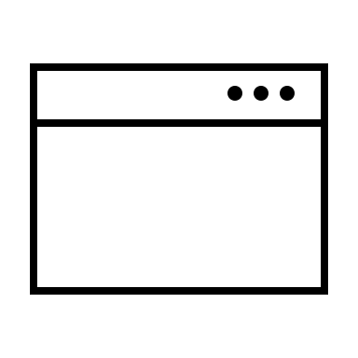
SYSTEM ARCHITECTURE
Browser
TokenLand
User Interface
MetaMask
Local
Hardhat Network
Python
Localhost
Server
Project Files
Coingecko API

Slide 9

Error Handling
If MetaMask is not available in the user browser, it will show the error like, ‘Please install MetaMask’.
If the user tries to list the property with more value than the minted value of the property, then the error message will be like, ‘New property must be less than or equal to the minted price’.
If the user tries to buy the property which is not available, that is the property is already sold, then the error message will be like, ‘Property is not for sale’.

Slide 10
Advantages
This digital representation allows for easier transfer of property ownership, and also provides security.
All transactions are recorded on the blockchain, providing a transparent and tamper-proof history of property ownership and sales
Integration with cryptocurrency wallets enables seamless international transactions
Reduces the need for multiple intermediaries

Slide 11
GitHub
All the project code and the relevant deliverables has been uploaded to the GitHub and the repository link is as below, https://github.com/pavan-kalam/Blockchain-based-realestate-management-system

Slide 12

Project Live Demo
Please follow this below link to check the presentation of the project, https://drive.google.com/file/d/1v-iFO4ePGvCNYfknaUHvFdA3m_lhX_w3/view?usp=sharing

Slide 13

Conclusion
TokenLand project was successfully implemented, by tokenizing the property as NFT .
The potential usage of blockchain technology, makes real estate transactions intermediate free and it also helps in maintain the transparency and reducing the potential fraud, in the real estate field.

