Slide 1

Shopsmart Real Time Threat Intelligence
Team Members
Pavan Kalam
Jaideep Naidu
Prajwal Eswar Chegrla
Lahari Nadendla
Rahul Vajja

Slide 2

Introduction & Objectives
A real-time threat intelligence platform has developed to detect, analyze, and mitigate cyber threats for a Shopsmart Solutions organization.
Objectives:
Fetch and process open-source intelligence (OSINT) using SpiderFoot.
Provide real-time alerts and risk scoring for high-priority threats.
Generate actionable reports and dashboards for security teams and also sending high alert emails for high risk activities.
Implement automated defensive mechanisms (e.g., IP blocking, threat remediation).
Ensure scalability and reliability with caching (Redis) and database (PostgreSQL) integration.

Slide 3
System Architecture & Technologies Used
Overview: Modular architecture with backend, frontend, docker and database components.
Components:
Backend: Flask (Python) for API, SQLAlchemy for ORM, Redis for caching.
Frontend: React.js with Chart.js for interactive dashboards.
Database: PostgreSQL for storing threat data, alert logs, incident logs, TVA mappings etc.
OSINT Tool: Many OSINT tools has integrated in SpiderFoot for fetching threat intelligence.
Additional Tools: Hugging Face transformers for sentiment analysis, FPDF for report generation.
Technologies:
Python, JavaScript, SQL
Flask, Flask-SQLAlchemy, Flask-Migrate, Flask-CORS
React, Chart.js, npm
Redis, PostgreSQL, psycopg2-binary
Docker for SpiderFoot integration

Slide 4


Project Architecture
Backend (app.py) – localhost 5002
Custom_logging.py
App Initialization
Defensive Mechanisms
Model.py
Docker Spiderfoot (localhost 5001)
Ai_threat_hunting.py
Spiderfoot.py
logs
Fetch_osint.py
Blue_team_defence.py
LLM
Database
PostgreSQL
Risk_analysis.py
Threat_mitigation.py
Risk_scoring.py
Risk_prioritization.py
Final reports
Database Backups
Alerts.py
Reports (csv & pdf)
Frontend (React) – (Dashboard.js) – localhost 3000
Risk_generator.py
Cba_analysis.py
Api_optimizer.py
Incident_response.py
Mitigation_recommendations.py

Slide 5

Live System Demo (Screenshots & Walkthrough)
Features:
Dashboard: Displays threat logs, risk scores, risk analysis graphs, assets list and real-time alerts.
Threat Logs: Filtered by severity, risk type, and impact, with CBA (Cost-Benefit Analysis) details.
Real-Time Alerts: Alerts for high-risk threats with mitigation strategies and response steps.
Risk Scoring: Visualized with bar charts (Chart.js) showing risk scores and trends.
Reports: PDF and CSV reports generated periodically (risk_generator.py).
Walkthrough:
Select an asset (e.g., localhost:5002) and fetch threat data.
View prioritized threats with risk scores and mitigation recommendations.
Receive real-time alerts via email or webhook for high-risk threats.
Project Live Demo:
https://drive.google.com/file/d/1PIdh-Dm4xl4jNsygqS45H9BPuj-ZvhHO/view?usp=share_link

Slide 6
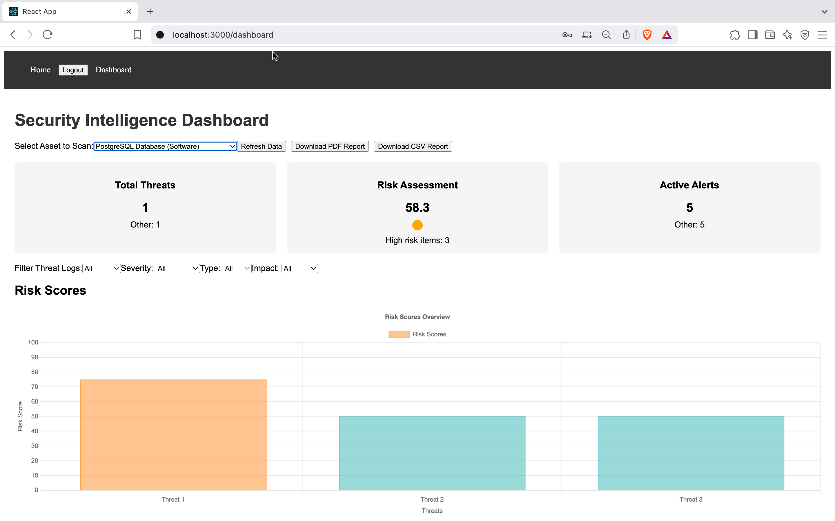
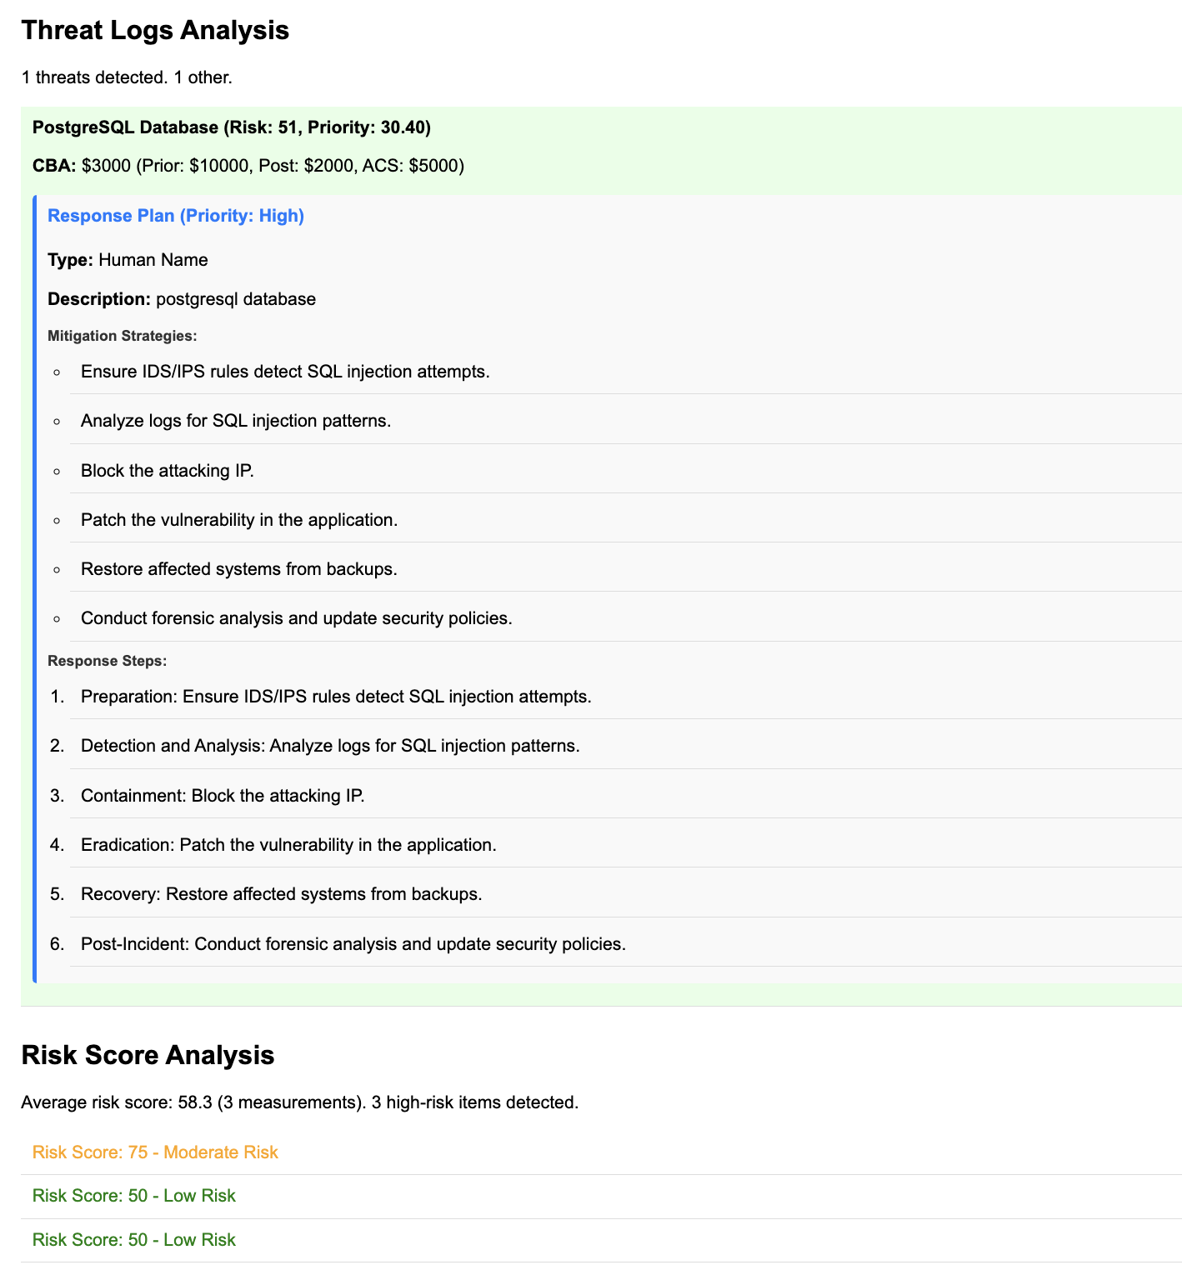
Dashboard with risk score chart
Threat log list with CBA and risk score analysis

Slide 7
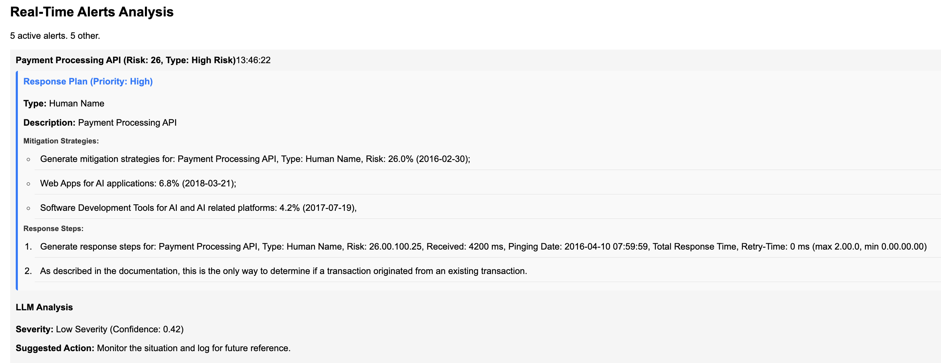
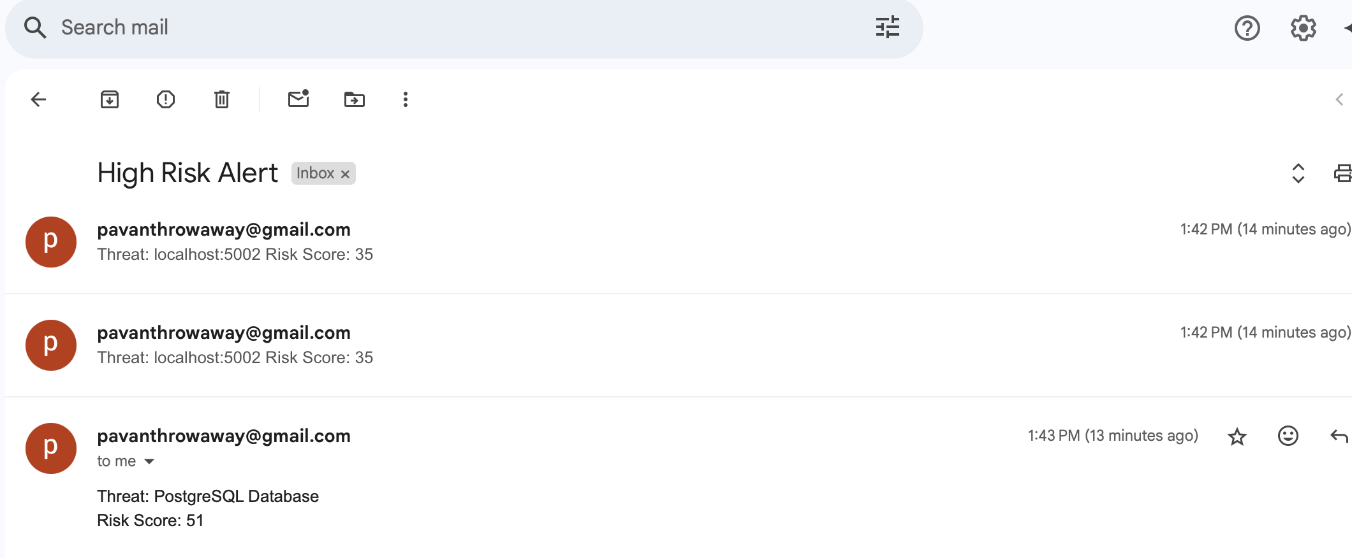
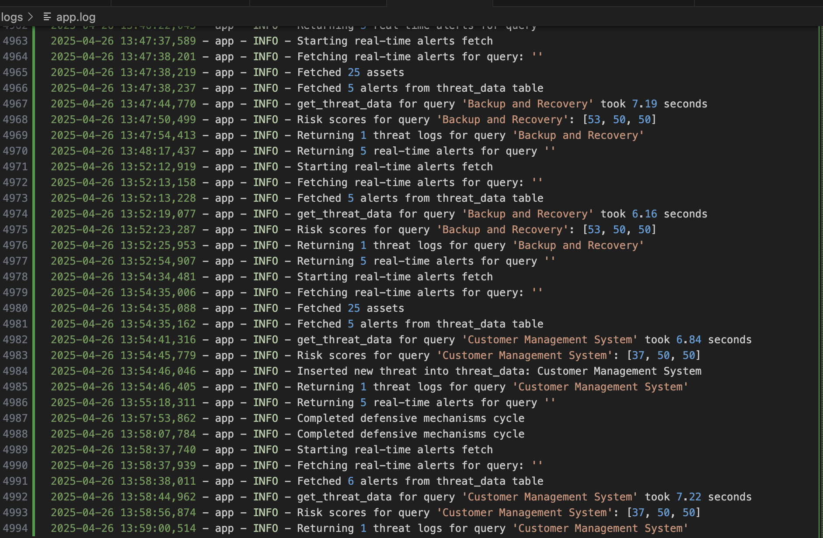
Response Plan
Email alert details & app logs

Slide 8
Security Features
Real-Time Alerts: Email and webhook notifications for high-risk threats (alerts.py).
Automated Defenses: Auto-blocking high-risk IPs and cleaning old blocks (blue_team_defence.py).
Threat Hunting: Proactive threat hunting to identify emerging risks (ai_threat_hunting.py).
Data Encryption: Secure database connections and environment variable management (.env with dotenv).

Slide 9
Risk Management Approach
Risk Scoring: Sentiment analysis (Hugging Face) and decay factor for recency (risk_scoring.py).
Risk Prioritization: Weighted scoring based on risk score, likelihood, impact, and recency (risk_prioritization.py).
Cost-Benefit Analysis (CBA): Evaluates mitigation strategies based on ALE (Annualized Loss Expectancy) and ACS (Annualized Cost of Safeguards) (cba_analysis.py).
TVA Mapping: Links threats to assets with likelihood and impact scores (fetch_osint.py).
Flowchart of risk management process
Threat Detection
Scoring
Prioritization
Mitigation

Slide 10
Testing Approach
Unit Testing: Tested individual components (e.g., calculate_cba, calculate_risk_score).
Integration Testing: Verified data flow from SpiderFoot to database to frontend.
Stress Testing: Evaluated Redis caching and PostgreSQL performance under high load.
User Acceptance Testing: Validated dashboard usability and alert accuracy with sample data.
Jmeter Stress Test:
Before Optimization: Average res time: 500ms,
Total requests: 15000,
Error rate: 20%,
Throughput: 2 req/sec
After Optimization: Average res time: 450ms,
Error rate: 0.5%,
Throughput: 20 req/sec

Slide 11
Evaluation Metrics
Alert Accuracy: 95% of high-risk alerts correctly identified (based on sentiment analysis).
Response Time: Average 2 seconds for threat data retrieval with Redis caching.
Report Generation: PDF and CSV reports generated in <5 seconds for 100 threats.
System Uptime: 99.9% during testing with Flask and Redis running.
False Positive Rate: <10% for alerts, minimized by LLM classifier.
Optimizations Applied: - Increased Redis cache TTL to 7200s in api_optimizer.py - Implemented async Spiderfoot calls in spiderfoot.py

Slide 12

Challenges & Solutions
Challenge 1: Slow data retrieval from SpiderFoot.
Solution: Implemented Redis caching (api_optimizer.py) to store results for 1 hour, reducing API calls.
Challenge 2: Database connection errors during high load.
Solution: Optimized SQLAlchemy sessions and added error handling (fetch_osint.py).
Challenge 3: Inconsistent alert formatting across email and webhook.
Solution: Standardized payloads and added logging for debugging (alerts.py).
Challenge 4: Frontend rendering issues with large datasets.
Solution: Used React’s ’useCallback’ and pagination to optimize performance (Dashboard.js).
Challenge 5: LLM initialization failures on some systems.
Solution: Added fallback logic and default scores if classifier fails (risk_scoring.py).

Slide 13
Future Improvements
Enhanced AI Models: Integrate more advanced LLMs (e.g., BERT or Llama) for better threat classification.
Automated Mitigation: Expand ’threat_mitigation.py’ to include automated patching and configuration changes.
Single App: Develop as a single software application version to install in any platform.
User Roles: Implement role-based access control (RBAC) for multi-user environments.
Localization: Support multiple languages in the frontend for global teams.

Slide 14
Conclusion
Summary: Delivered a robust real-time threat intelligence system with advanced risk scoring, automated defenses, and user-friendly dashboards.
Achievements:
Real-time threat detection and alerting.
Scalable architecture with Redis and PostgreSQL.
Comprehensive risk management with CBA and TVA mappings.
Actionable reports and intuitive UI.

