Slide 1



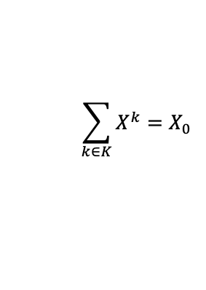

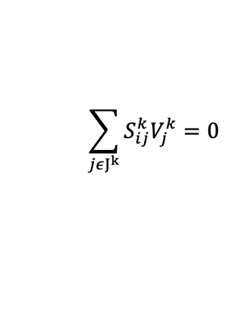
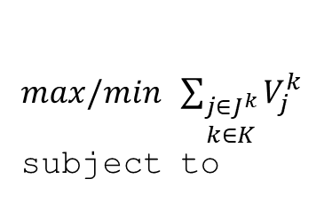
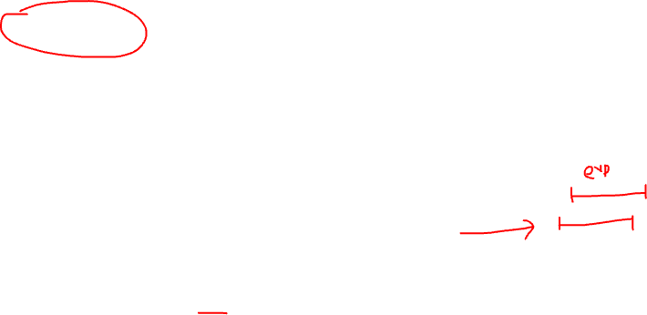





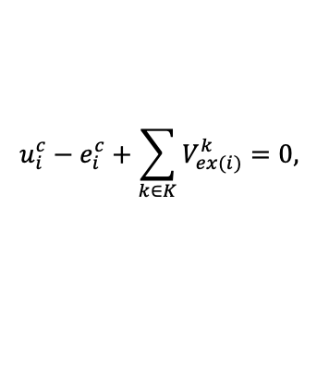



FVA to look at range of optimal solutions
$max/min$ $\sum_{\begin{aligned}j∈J^{k} \\ k∈K\end{aligned}}{V_{j}^{k}}$
subject to
$$\sum_{jεJ^{k}}{S_{ij}^{k}V_{j}^{k}=0}$$
$$∀i∈I^{k}$$
$$∀k∈K$$
${LB}_{j}^{k}X^{k}≤V_{j}^{k}≤{UB}_{j}^{k}X^{k}$,
$$∀j∈J^{k}$$
$$V_{biomass}^{k}=X^{k}μ$$
$$X^{k}≥0$$
$$u_{i}^{c}−e_{i}^{c}+\sum_{k∈K}{V_{ex(i)}^{k}=0,}$$
$$∀i∈I^{com}$$
Range of flux
$$\sum_{k∈K}{X^{k}=X_{0}}$$
Here $X^{k∗}$ refers to the value obtained in metagutpred simulation
$X^{k}=$ $X^{k∗}$
$$μ$$
,
$$e_{i}^{c}≥0$$
,
$$∀i∈I^{com}$$
Chan SHJ, Simons MN, Maranas CD. SteadyCom: Predicting microbial abundances while ensuring community stability. PLoS Comput Biol. 2017 May 15;13(5):e1005539

