Slide 1
Hotel Booking Cancellation Prediction Using ML algorithm
119EC0037
Nagoor Pavan Pradeep

Slide 2
Outline :
Problem Statement
Given Data
Visualization
Steps Involved
Model Chosen
Conclusion

Slide 3
Problem statement:
Hotel booking cancellation status predicting with binary classification is a problem based on data analysis techniques which gives an idea to create best classification model.
With given a data set containing the details of applicants for hotel booking and status of their booking application approval whether cancelled or not . By using above details we need to create an binary classification model with maximum accuracy.

Slide 4
Given Data:
Given dataset is "Hotel_Bookings". Number of hotel bookings cancelled(Data Set). Shape of the given dataset is (119390, 32).
There few datatypes such as objects, int, float.
Below is the link for dataset.
https://raw.githubusercontent.com/Premalatha-success/Datasets/main/hotel_bookings.csv

Slide 5
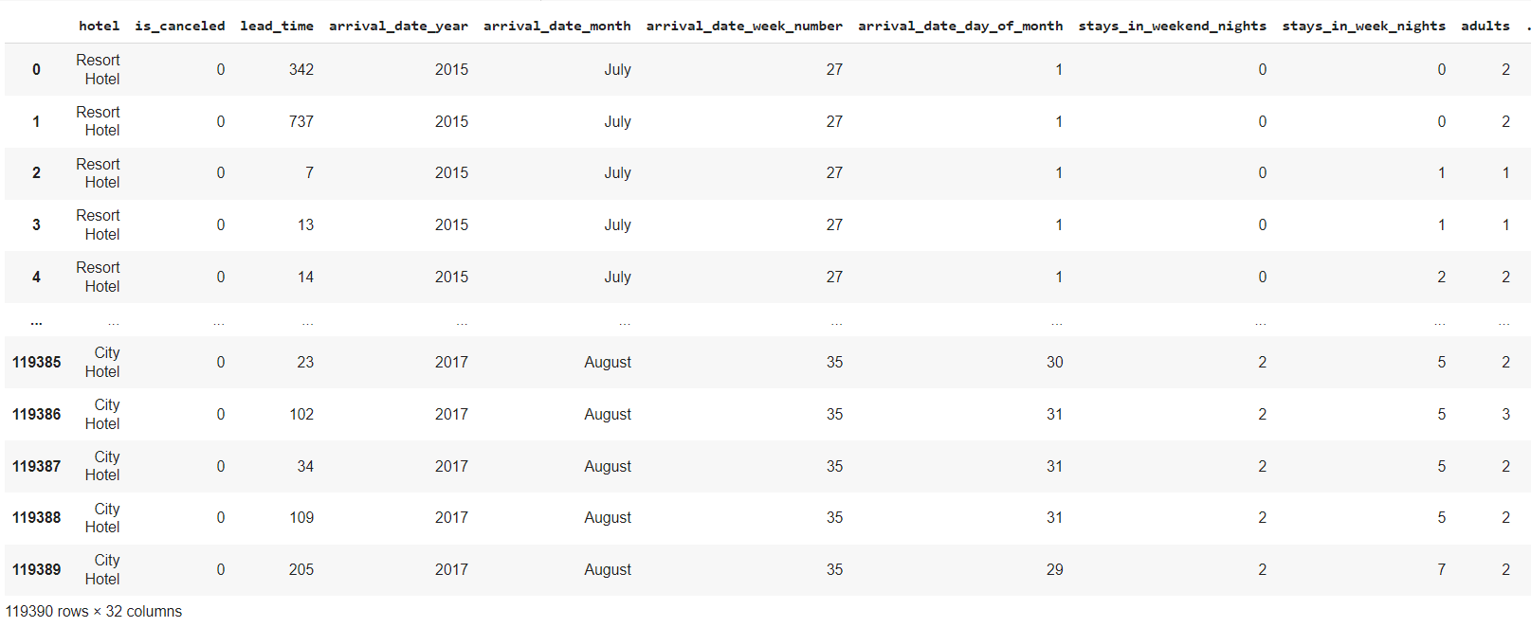
Data set info:

Slide 6
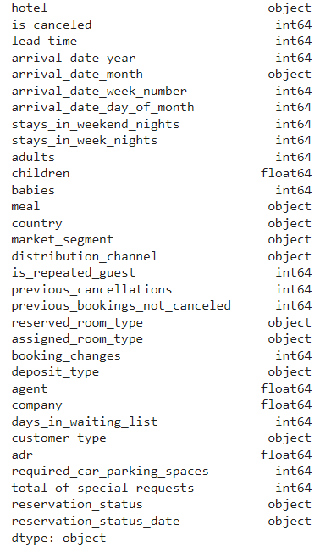
Data Types:

Slide 7
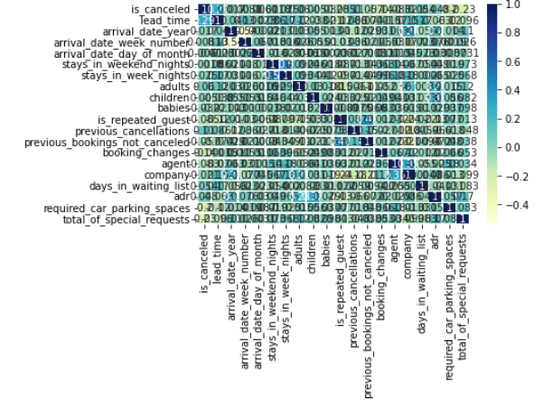
Correlation Heatmap

Slide 8
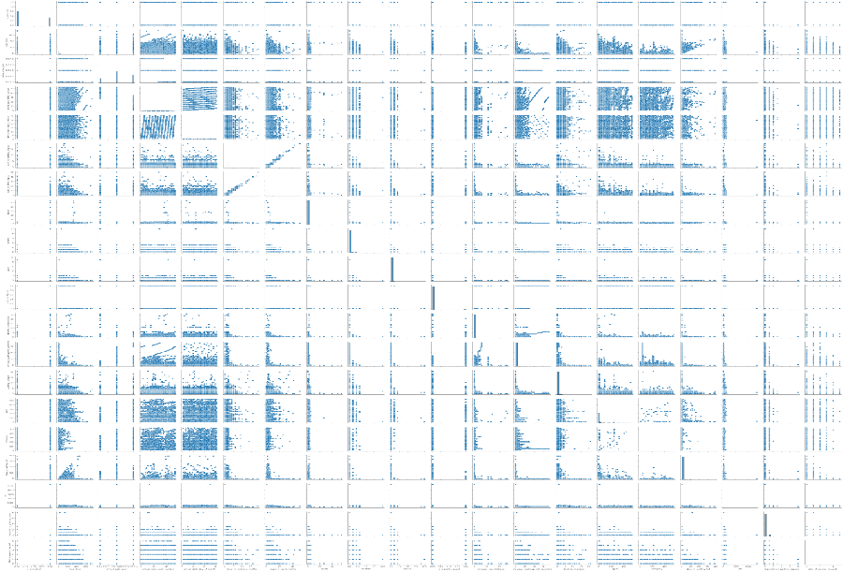
PairPlot:

Slide 9
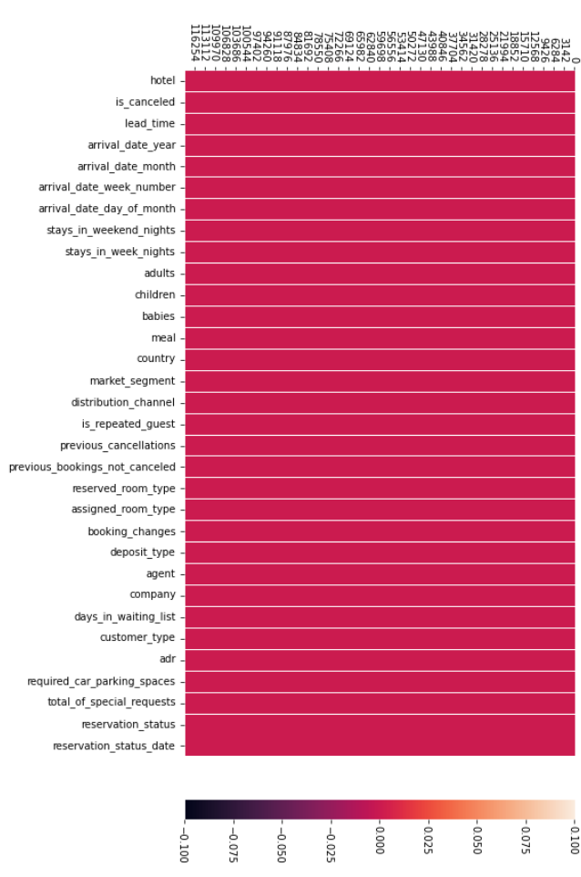
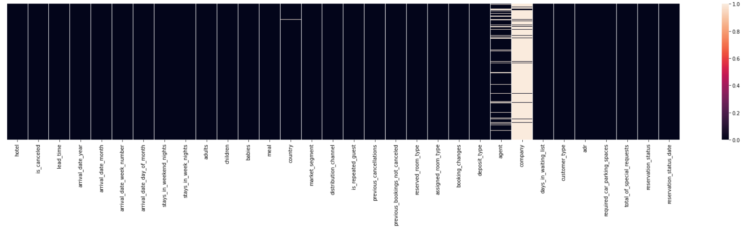
Null Values Visualization :
Heatmap after filling null values:

Slide 10
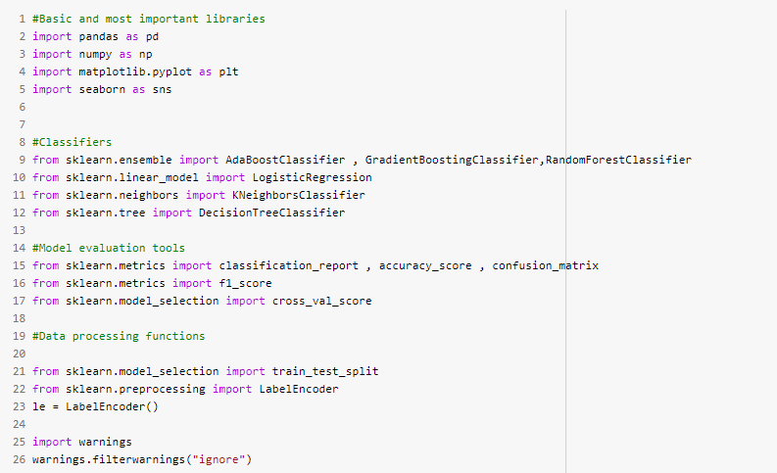
Steps Involved :
Step 1: Import the packages numpy,pandas,matplotlib,seaborn,sklearn,train test split,metrics. After importing libraries we should analyze data using shape, describe and info attributes.

Slide 11
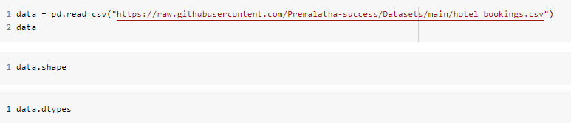
Step 2: Load the dataset using read_csv() command to a variable.

Slide 12
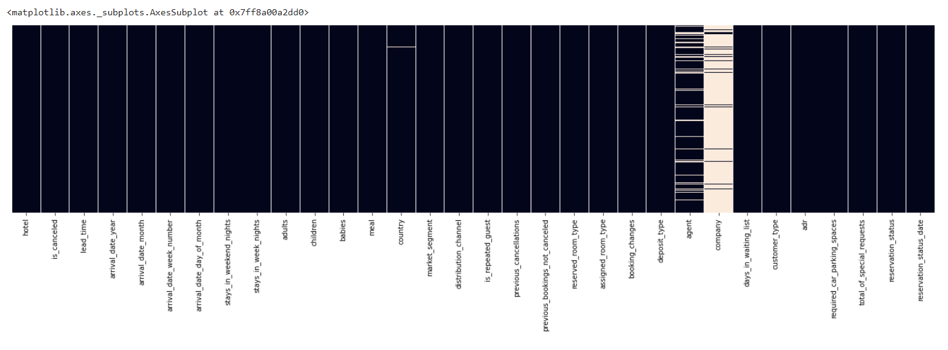
Step 3: Exploring Data through Visualization. Visualizing data is the crucial step among all the steps. We check the null values in data through heatmaps. We also use heatmaps for confusion matrix and correlation matrix.

Slide 13
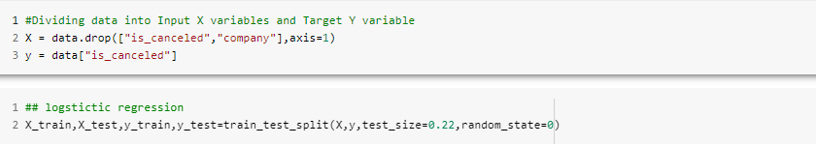
Step 4: Splitting data into dependent X variables and Target y variables. Later we implement different Binary Classification models.

Slide 14
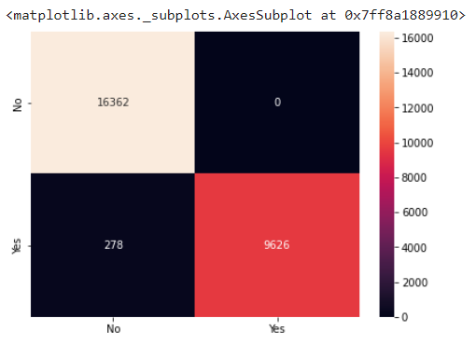
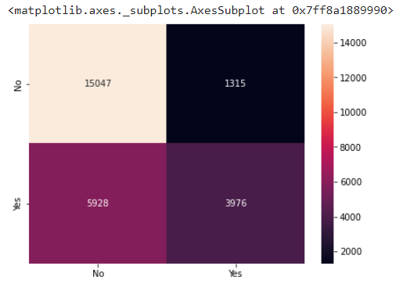
Choosing best Model
Regression Model:
SVM Model:
Train set score : 0.9900240539495726 Test set score : 0.9894159750247469
Train set score : 0.7263218933894592
Test set score : 0.7242442701591411

Slide 15
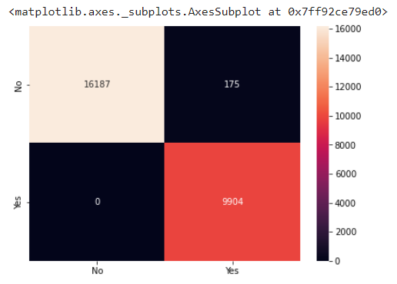

Gaussian Naïve Bayes Model:
Random Forest Model:
Train set score : 0.9928482453502856
Test set score : 0.9933373943501104
Train set score : 0.9999570465186204 Test set score : 0.9993527754511535

Slide 16
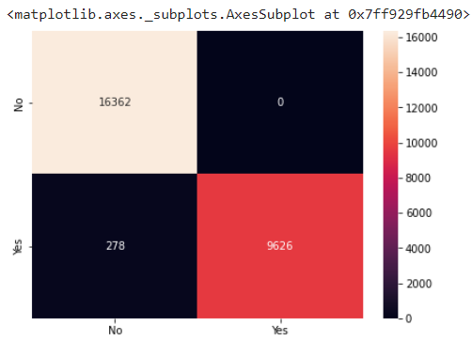
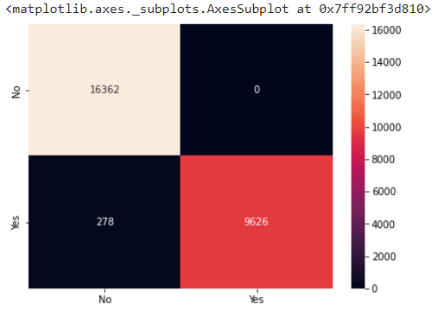
Bagging Classifier Model:
Decision Tree Classifier:
Train set score : 0.9900240539495726
Test set score : 0.9894159750247469
Train set score : 1.0
Test set score : 1.0

Slide 17
From the data and graphs of different models we can conclude that SVM model gives the least score of all and takes more time to compile.
Where as Logistic Regression Model, Naïve Bayes model, Random Forest model gives better performance than SVM model and also takes less runtime.
Best Model: I choose Bagging classifier for this problem statement as it gives the score of 1.0 for both train set and test set. Adaboost classifier also serves same like Bagging Classifier.

Slide 18
Conclusion
After trying all Binary Classifiers such as Logistic Regression Model, Naïve Bayes model, Random Forest, SVM, Bagging Classifier. There is similar performance among all the classifiers. Based on the compiling time, accuracy and performance we can conclude that Bagging classifier is best fit for this problem statement.

