Slide 1
Welcome

Slide 2
Presented By…..
Sandeep Rupnar
Akshay Magar

Slide 3
Topic Name
“Home Insurance”

Slide 4
What is Home Insurance ?
Home insurance is designed to protect your property from damage caused by insured such as floods, fire, storm damage, and more. It helps to cover the cost of repairing or replacing damage to your home, garage, other outbuildings, and permanent fixtures such as built-in plumbing. It also helps to cover the cost of legal liability if someone should be injured while visiting your property.

Slide 5
Types of Home Insurance :-
Home Structure/Building Insurance:- This type of home insurance cover the structure of your house from any kinds of dangers and risks. In addition to this, the policy also protects any permanent fixtures within the house.
Public Liability Coverage:- If any guests or third party experience damage caused to them or their property inside the insured’s home, then this type of home insurance policy provides coverage against the same.
Personal Accident:- This type of home insurance covers you and your family. A compensation is given in case of permanent disablement or death of the insured person due to accidental or physical injury, even if it has happened anywhere is the world.
Burglary & Theft:- In case of an occurrence of burglary or theft in the insured house, if any valuable contents are stolen or damaged, the policy covers you for it.
Contents Insurance:- This type of home insurance policy protects the goods inside your house from damages and loss owing to theft, fire, flood and other such mishaps. Your documents, portable equipment, jewelery, TV, refrigerator, etc. are covered.

Slide 6
Benefit of Home Insurance:-
Complete coverage against financial liabilities arising from the damage/loss of your home and/or its contents due to natural or man-made reasons.
Thoughtful additional covers including Burglary and Theft Cover, Earthquake Cover, etc. for specialized protection.
Applying for a home insurance policy is simple, the turnaround times are quick and almost all banks in India offer this very dynamic product.
After the calamity that resulted in the damage/loss of your home, the on-time home insurance payouts will massively assist in helping the family put their lives back together. A big relief in such a trying time.
Cost of premium is small. The cost of the insurance premium in comparison with the value and cost of the structure and content, domestic and electronic appliances, is less than 1%.

Slide 7
What is not Covered in Home Insurance?
Destruction of property willfully.
Damages to property due to wear and tear.
Loss to property due to war.
Loss to property unoccupied for more than a certain specified period
Money in the form of cash, antiques and collectibles
What is not covered will vary from company to company. For example, certain insurers will not cover contents if you live in a shared accommodation.

Slide 8
Eligibility for Home Insurance:-
Home Insurance Policy can be bought by individuals or by companies. Individuals who are Indian residents and the owner / occupant of a property can get a Home Insurance Policy. Home Insurance - multi year policy, however, can be purchased only by the owner of the house/flat.
To buy Home insurance for a society, any authorized member of the particular society’s managing committee can make the purchase. The policy will be issued in the name of the society and will cover the society building as well as the utilities that are for common use in the society.
It’s not just owners who can get home insurance. Many insurance companies provide cover for contents to tenants as well. Contents insurance will cover your possessions against loss or damage by lightning, fire, theft, smoke, flood etc. Everything from personal belongings, furniture and electrical items including washing machines, dryers etc. can be covered.

Slide 9
Documents for Buy Home Insurance Policy:-
Rented or owned accommodation
Policy cover required only for structure or structure and contents.
Details about the property like location, age of property, home type, sum insured, construction / built area, etc.
Your own details like name and contact number
You can Buy policy online it is simple and easy to buy Home Insurance. Just log on to any of Insurance companies website, fill the necessary details to buy a policy, make the payment and you have “Home Insurance”
The cost of home insurance varies from state to state and even between specific property address. Premiums are based partially on the specific risks associated with your property location. So for example, homes in a flood-prone area can expect to pay more.

Slide 10
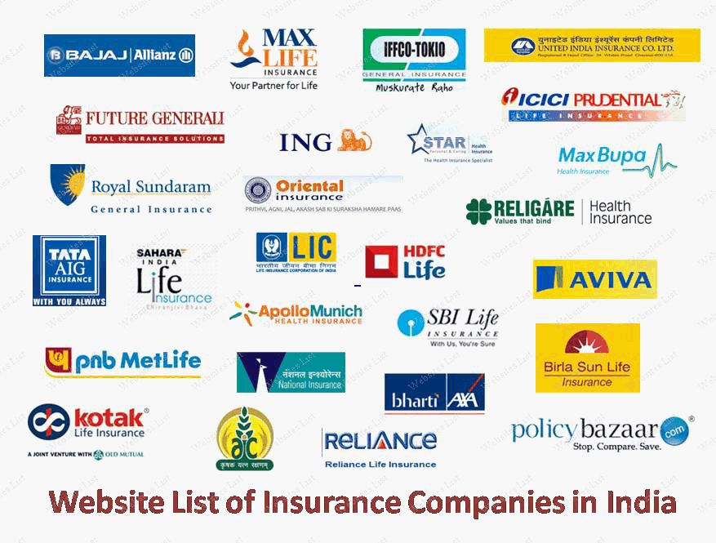
List of Home Insurance Companies:-

Slide 11
Home Insurance Premium :-
Following are some factors affecting the premium on your homeowner insurance policy.
Location – The location of your house can also affect the premium rates. For example, your house is located in an area frequented by storms, hurricanes, cyclones etc., or in close proximity to a flood prone water body, in a region experiencing frequent earthquakes or in a neighborhood where theft, robberies and other such activities are rampant.
Features & Characteristics Of The House – Factors like the age of the house, structure type, roof, wiring, and garage can affect the premium amount. The older the house, the higher it might cost to insure it. Also, the materials your house is made of - brick, stone, frame or synthetic siding - can also affect your premium amount.
Personal Factors — Often, personal factors like your credit history and lifestyle habits can also affect your house insurance premium. For example, a smoker may pay more towards their home insurance premium than a non-smoker would. Also, a good credit history can help lower your insurance premium.
Installation of Protective Devices - Installation of protective devices like smoke detectors, fire alarms, deadbolt locks, burglar alarm systems, sprinkler systems, fire extinguishers, etc., can also help bring down the premium amount as all of these contribute to the safety of your house.

Slide 12
Home Insurance Claim Process:-
In case of an accident, ensure your safety and the safety of the home first. If you can, take all possible steps to avert the damage.
Contact your insurance provider through the helpline number, fax or mail and explain the damage caused.
If possible, take snaps of the damaged parts of your property. Also ensure that you keep the bills and receipts of the services that you have availed after the accident.
Depending on the nature of accident and extent of damage, your insurer will ask for supporting documents. Make sure you submit all necessary documents along will duly filled claims form.
A surveyor may be appointed by the insurer to assess the damage.
After the claim is validated, you will be offered a suitable reimbursement by the insurer.

Slide 13
Home Insurance Claim Process:-
Policyholders must immediately inform the company about the claim by calling on their 24/7 helpline number (toll free).
Following the intimation to the insurance company, the policyholder must provide them with all necessary or relevant information not only pertaining to their policy but also details regarding the damage that has been caused. Once the claim request is Consequently, your claim request is verified and validated, the claim settlement request is forwarded to the insurance company’s Claims Department.
Once the company has validated and registered the claim request, the insurance company will appoint and send across a surveyor within the next 48 hours.
Following the Surveyor’s report, you must submit all the necessary documents to the Surveyor. Once the Surveyor has inspected the damage caused, they will prepare and submit a Final Survey Report (FSR) and the required documents to the company within 7 days.

Slide 14
Documents Required for filling a Home Insurance Claim:-
Having all the necessary documents in place will ensure a quick claims process. Below are some of the necessary documents for filing a Home Insurance Claim .
Duly filled claims form signed by the insurer and the insurer’s legal representative
Evidence of the event, extent of loss and nature of accident - some of the valid independence evidence reports include First Information Report (FIR), rent agreement, court summons, repair bills, legal opinion if applicable, fire brigade report, invoices of owned belongings, hospital bills, bills of suppliers for replacement etc.
Depending on the nature of claims made, additional documents may be asked for. Also, keep a copy of the policy, policy number, identity and address proof to be shown if required.

Slide 15
Documents Required for filling a Home Insurance Claim:-
In case of a burglary claim, you must submit the following documents:
-The original invoice stating the value of the items stolen.
-Cost of repair / replacement of the stolen items.
-First Instance Report (FIR).
-Duly filled Claim Form.

Slide 16
Tips For Home Insurance Claim Process:-
The following tips will help you make your home insurance claims process faster.
Read the policy document carefully to understand your inclusions and exclusions. You must know what can be claimed for and what is excluded from your policy.
Always store your documents carefully. Safely file all the receipts and bills regarding the contents of your house. This will greatly simplify the process of making a claim.
Enter the correct details when it comes to the valuation of household goods.
Always make it a point to follow up with the insurance provider after you have made a claim.
Ensure that your claims form is carefully filled with all necessary details to avoid any bureaucratic delays.

Slide 17

Thank You…!

