Slide 1

SAP SERVICE CLOUD · IN-SCREEN AI COMPANION
Ask C4S
AI COMPANION
A production-grade AI copilot that lives inside SAP C4C — combining MCP, dual RAG, and a hardened gated-write layer so agents can act on tickets — not just chat about them.
Extension v0.27.82
Tenant Thermo Fisher · my340573
Manifest V3
MCP tools 60

Slide 2




ONE-CLICK ACTIONS · GROUPED BY THE VISIT LIFECYCLE
What it does
01
02
03
04
DISCOVERY
TROUBLESHOOT
RESOLUTION
CLOSURE
/interactions
/knowledge
/order-parts
/book-time
Emails, calls & notes
Serial history + KB fixes
Add parts (ZRP3)
Log labor & travel
/map
/triage
/prep-pm
/close-out
Geographic ticket view
AI ticket summary
Pre-visit briefing
Draft response report
/pulse
/history
/parts-check
/nearby
Customer sentiment
Past service on serial
Van-stock check
Nearby PMs for routing

Slide 3







ONE BACKEND · TWO CONSUMERS
How it works
CLIENT
BRAIN · localhost:3031
SYSTEM OF RECORD
Chrome Extension
HTTP shim & MCP server
SAP C4C
MV3 side panel + popup
Detects ticket from URL
Scrapes SAP across iframes
60 custom tools
Gated writes + self-heal
Claude + embeddings + KB
OData v1 reads & writes
Tickets, parts, notes
Authoritative truth
GENERATION
RETRIEVAL
PRICING
Claude
Dual RAG
ECC via mTLS
Summaries, drafts, close-out reports, KB fix-step extraction — over SSE streaming.
OpenAI embeddings for similar tickets; KB body-fetch for fix steps.
Client-certificate SOAP / CPI call to SAP Business Suite for part prices.

Slide 4
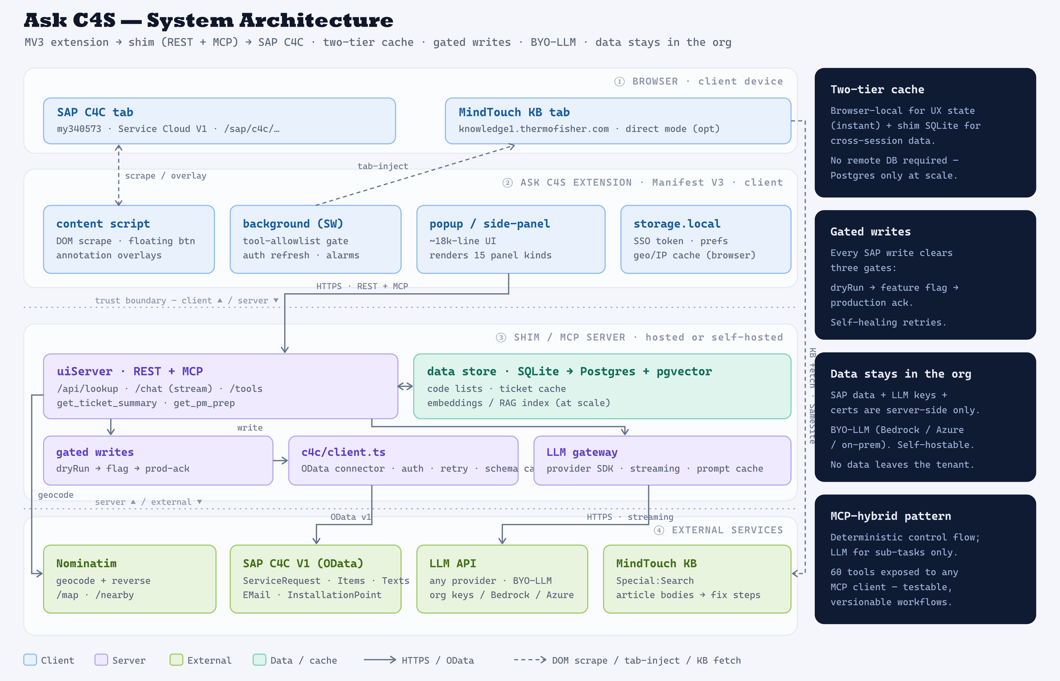

Slide 5
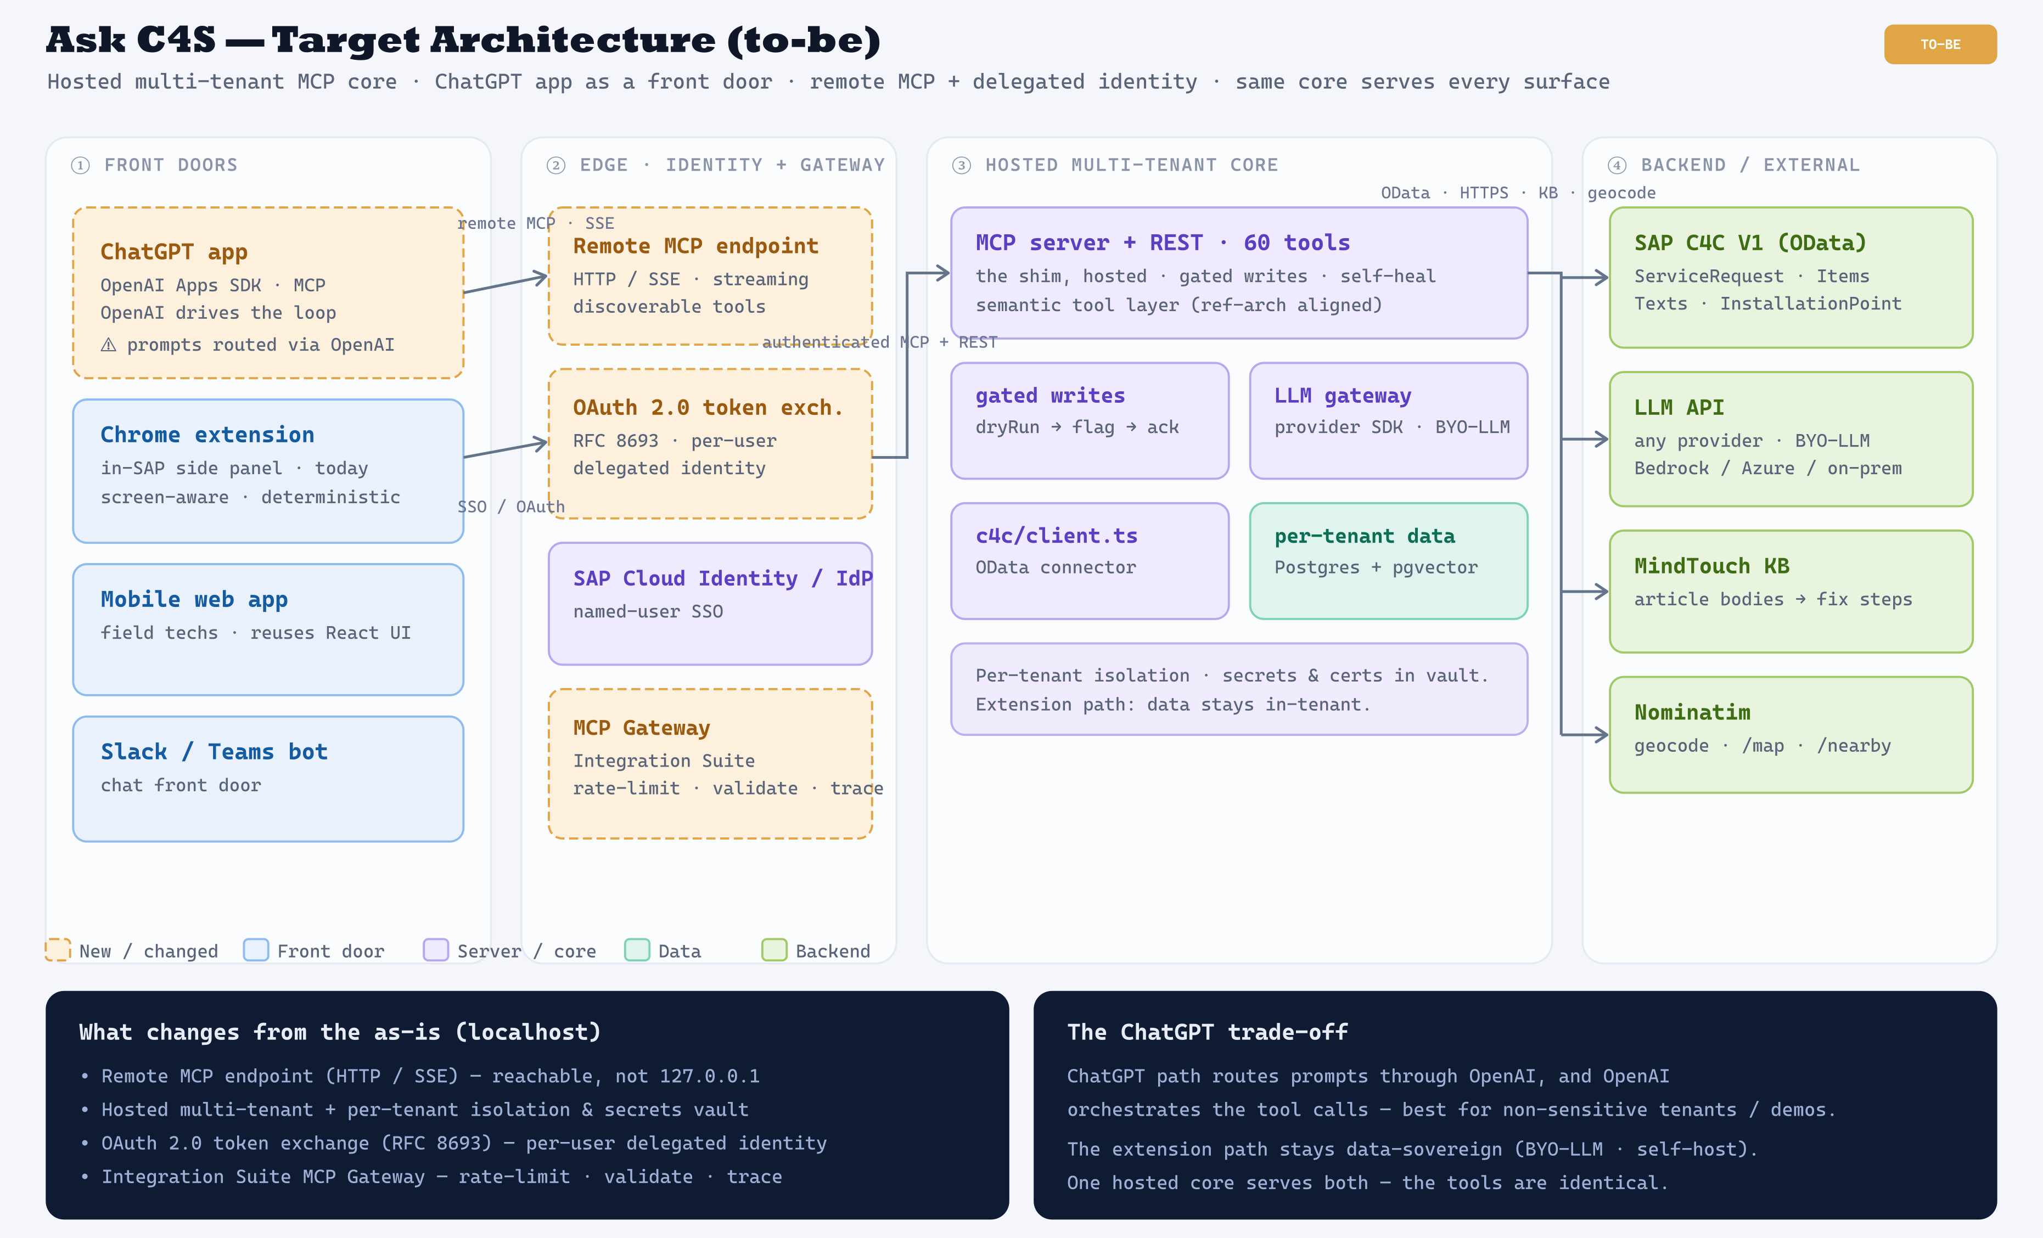

Slide 6




GREENFIELD · CHATGPT-APP-ONLY
If built from scratch as a ChatGPT app
MCP · SSE + OAuth
OData · HTTPS
ChatGPT
Remote MCP server
SAP C4C + KB
client · orchestrator · model (OpenAI)
hosted · ~15 focused tools
OData v1 · MindTouch
user states the ticket ID
SAP connector · gated writes · auth
the only backend calls
★ the only thing you build
You build (greenfield)
You skip (vs. extension-first)
MCP server — ~15 focused tools
SAP C4C OData connector
Gated-write safety (dryRun → ack)
OAuth · SAP identity
Optional Apps SDK UI widgets
Chrome extension (MV3, ~18k-line popup)
DOM scraping · auto-ticket context
Companion React UI
BYO-LLM gateway (OpenAI is the model)
Browser-local cache tier
The trade-off — far less to build, but OpenAI is the model + data path, and there's no ambient SAP-screen context (the user states the ticket).

Slide 7






WHAT IT'S BUILT ON — AND WHY IT'S MORE THAN A CHATBOT
The stack, in ten pillars
MCP server
HTTP shim
Chrome MV3
SAP C4C OData
LLM · Claude
60 hand-authored tools exposed over stdio.
Local Node bridge on :3031; serves the UI.
Side panel + DOM scraping across iframes.
Structured reads & writes — the real work.
Summaries, drafts, extraction — SSE stream.
Dual RAG
SQLite cache
Gated writes
Multi-auth
Geospatial
Vector (embeddings) + document (KB) retrieval.
Ticket, code-list & embedding vector store.
Three-gate pipeline + self-healing retries.
Bearer, Google OAuth, Azure AD, mTLS.
Nominatim + OSM for /map and /nearby.

Slide 8
SAFETY & RETRIEVAL
Gated writes · two kinds of RAG
Write-safety — three gates
Two kinds of RAG
No SAP mutation reaches production until it clears every gate.
Retrieval that actually feeds generation — not just search.
1
Dry-run. Returns the exact would-be POST/PATCH body — nothing is written.
Vector RAG — similar tickets
OpenAI text-embedding-3-small · SQLite cosine
2
Feature flag. auto_writeback_enabled must be on for the tenant.
Tickets auto-embed on every lookup; /similar, /parts-check & /order-parts retrieve the closest past resolutions to suggest parts.
3
Production ack. Live tenant requires explicit acknowledgeProduction.
Document RAG — knowledge base
Then self-healing retries parse SAP's own error text to drop rejected fields, append to single-instance texts, and ride out edit-locks.
KB search → body fetch → Claude extraction
/knowledge & /kb-resolve pull article bodies and extract the real fix steps — then write them back as the resolution.

Slide 9
BY THE NUMBERS · AND THE HONEST LIMITS
What to know before you rely on it
60
3
2
1
custom MCP tools
write-safety gates
RAG pipelines
panel, zero tab-switching
Known limits — the honest version
Single-tenant-hardened. Built and tuned against a live SAP Service Cloud V1 tenant; other source systems are out of scope.
RAG is only as rich as what's been visited. The vector index self-populates as tickets are browsed, so it's sparse on cold tenants — hence parallel OData fallbacks.
Some features need config. KB extraction depends on direct mode; ECC pricing needs client certs and a SOAP template that isn't fully wired yet.

Slide 10





WHAT IT TAKES TO BUILD
The skill set
Core engineering
SAP C4C domain
AI / applied ML
Supporting
TypeScript / Node.js
Vanilla JS — 22k-line MV3 extension
Chrome MV3 APIs (inject, side panel)
React + Tailwind (admin UI)
THE DIFFERENTIATOR
LLM app engineering + streaming
RAG — embeddings + KB retrieval
MCP tool-surface design
Judgment: when NOT to use the LLM
SQLite / caching & TTLs
Write-safety & security
OAuth · Azure AD · bearer
Geospatial — geocode + tiles
OData v1 + entity model
Codes: ZRP3 · ZALT · TypeCode 10022
Tenant-quirk reverse-engineering
SOAP / CPI · client-cert mTLS
The hiring bottleneck. Modern AI + Chrome-extension web-dev and deep SAP C4C guts rarely live in one person.
Realistic team — full-stack TS/JS · SAP integration specialist · AI / LLM engineer · product owner

Slide 11





DELIVERY APPROACH
Can it be built in Scrum / Agile?
Fits Scrum cleanly
Strains Scrum estimation
Extension UX · Field app · Admin page
MCP tools — one story per command
Analytics, settings, caching
SAP integration & write-back
Evidence: 17 versions (order-parts) · 22 (interactions) · 13 (map)
Blocked on live-SAP discovery & access grants
Estimable · demoable each sprint
Empirical R&D — not fixed-scope construction
The fix — an Agile shell, spikes for the uncertain core
Dual-track spikes
Time-box, don't point
DoD = a live SAP write
Capture tenant knowledge
Vertical slice / command
Discovery separate from delivery
Commit effort, not outcome
Tests passing isn't done
Engineering notes as a practice
Ship /triage, then /order-parts
Bottom line — Scrum for the product & UI layer; Kanban-with-spikes for the SAP-integration core.

Slide 12
PLANNING ESTIMATE · SMALL TEAM, FROM SCRATCH
Timeline to build
◆ MVP · ~wk 8–10
PILOT WINDOW · mo 6–9
MONTHS
0
1
2
3
4
5
6
7
8
9
P0 · Foundations & access
2–4 wks
P1 · Read-only core
4–6 wks
P2 · Write-back + safety
4–8 wks
P3 · AI / RAG
3–5 wks
P4 · Breadth + polish
4–6 wks
P5 · Hardening + pilot
3–6 wks
Bars overlap by design (dual-track). ⚠ P2 · Write-back is the high-variance SAP-integration core.
MVP ~8–10 wks · Typical small team ~6 months (9 with SAP-access friction)
Wildcard that moves everything: SAP tenant access + a seasoned C4C integrator on the team.

Slide 13






CHANNELS & SURFACE ROADMAP
One core, many front doors
LIVE
REUSES REACT UI
MCP-READY
SAME PATTERN
Chrome extension
Mobile web app
ChatGPT app
Slack / Teams bot
In-SAP side panel · screen-scrape · auto-ticket context
Field techs — /nearby, /book-time, /parts on-site
Apps SDK is MCP — mind enterprise data governance
A chat front door on the very same tool layer
THE SHARED CORE
Hosted multi-tenant shim · 60-tool MCP + HTTP layer
SAP C4C OData
Claude / BYO-LLM
Dual RAG
Gated writes
Per-tenant auth + certs
The unlock — build the hosted multi-tenant shim once; every front door then falls out nearly for free.
Doesn't port: screen-scrape + auto-ticket context are Chrome-extension-only — other surfaces pass a ticket ID / deep link.

Slide 14
SAP REF-ARCH 137800 · THIRD-PARTY MCP ACCESS TO SAP
Aligning to SAP's blessed pattern
SAP now documents third-party MCP → SAP as a supported pattern. Ask C4S is squarely inside Pattern 1 (external MCP server calling SAP APIs).
SAP-RECOMMENDED CONTROL
ASK C4S TODAY
STATUS
Semantic enrichment over raw OData
Curated 60 business-named tools + gated writes
PARTIAL
RFC 8693 token exchange + agent identity
Shared integration user + bearer tokens
GAP
Integration Suite MCP Gateway
Direct OData from a local shim (bypassed)
GAP
Hosting on SAP BTP (CF / Kyma)
localhost / self-hosted (hosted milestone planned)
PARTIAL
Rate limiting · validation · tracing
Gated writes; no standardized tracing yet
PARTIAL
Write correctness (no bad transactions)
3-gate + self-heal + single-instance recovery
STRONG
Path to conformant — close two gaps: per-agent identity (RFC 8693) + route via Integration Suite MCP Gateway.
Then market it as reference-conformant & Joule-consumable. (API/MCP core only — scraping & Digital Access licensing stay out of scope.)

Slide 15





DEPLOYMENT ARCHITECTURE
What runs where — and where to host it
Server side
Local user / client side
one shared deployment
per user · thin client
Shim + MCP server (60 tools)
SAP C4C connection + OAuth
mTLS certs · LLM keys · secrets
Data + RAG index (SQLite → Postgres at scale)
Feature flags + write-safety gates
Per-user identity (RFC 8693) + tracing
Chrome extension — UI + slash commands
User's SAP browser session (context)
SSO token + personal preferences
Endpoint config (pushed via managed storage)
Local UI caches (geocode, InstallationPoint)
No secrets · no certs · no Node runtime
Security boundary — certs, SAP credentials & LLM keys stay server-side only; the client holds just the user's token + preferences.
PACKAGE ONCE · STORE IN ANY PRIVATE REGISTRY · RUN ON ANY CLOUD
Package once
Private registry · your pick
Run on any cloud
One container image — bundled / bytecode. Source is NOT shipped.
GHCR · AWS ECR · Azure ACR · GCP Artifact Registry · Harbor
AWS · Azure · GCP · SAP BTP — managed containers (default); Kyma only for SAP-conformant.
Data: SQLite (single-node) → Postgres + pgvector (only at scale). Avoid raw serverless functions for the shim (SSE streaming + native deps).

Slide 16





CHANNELS · MORE FRONT DOORS
Every surface, one core
FIELD-FIT
AGENT DESK
SAP-NATIVE
Voice assistant
Outlook / email add-in
SAP Joule tool provider
Hands-free — book time, log parts & status while driving or on the tool
Draft replies & ticket summaries where service agents already work
Register the MCP server so Joule agents call it (A2A / ref-arch)
MCP-NATIVE
LIGHTWEIGHT
EMERGING
Any MCP client
WhatsApp / SMS
AR glasses / wearables
Claude Desktop, IDEs & other agents connect with zero new integration
Quick status & updates for techs who never install the app
Hands-free fix steps overlaid on the equipment in front of you
Same shared core — every door is just another client of the hosted 60-tool MCP + HTTP layer. No new backend.
MCP-native surfaces (Joule, Claude Desktop, other agents) need zero integration — they discover the tools automatically.

Slide 17
SURFACE COMPARISON
This app vs. a ChatGPT app
Ask C4S — this app
ChatGPT app
Lives in
SAP C4C side panel — in-context
ChatGPT chat window
Ticket context
Auto-detected · screen-aware
You type / paste the ID
Orchestration
Your code · deterministic
OpenAI's model decides
LLM / model
Agnostic · Claude · BYO-LLM
Locked to OpenAI
Data path
Stays in your control
Flows through OpenAI
Write safety
3-gate · deterministic
Model-driven · needs guardrails
Distribution
Install extension (force-install)
App directory — huge reach
Best fit
Governed SAP enterprise
Reach · prosumer · demo
Verdict — same MCP core powers both. This app: in-context, deterministic, data-sovereign (enterprise). ChatGPT app: broad reach — but OpenAI drives the loop and data flows through them.

Slide 18
In one sentence
A production-grade, SAP-C4C-native AI companion that combines MCP, dual RAG, and a gated-write layer to let field-service agents act on tickets from inside their SAP screen.
MV3 extension → HTTP / MCP shim → SAP C4C OData
Ask C4S · Service Ops MCP · overview v0.27.82

