Slide 1
IBM University Engagement Project Submission
“Exploring the Power of Agentic AI with IBM Granite and IBM Bob”

Slide 2

Project Tile – [AI Agent for Smart Farming Advice]
Domain of Project – [ Agriculture]
Student Name | Recent Passport Photo | Email ID | Mobile number [WhatsApp]
Pavan Kumar Koneti |  | Pavankumarkoneti63@gmail.com | 8297165945

Slide 3
Problem Statement -
AI Agent for Smart Farming Advice
Small-scale farmers often need timely and reliable information to make better agricultural decisions.
Important information such as:
Weather forecasts
Soil conditions
Crop recommendations
Pest and disease control
Irrigation requirements
Fertilizer management
Market prices
Government agricultural schemes
may come from different sources.
The proposed AI Agent provides localized and personalized agricultural guidance through natural-language interaction.
The official AICTE statement describes this as a RAG-powered agent that retrieves trusted agricultural information and helps farmers make timely, data-driven decisions.

Slide 4
Proposed Solution -
Proposed Solution: Smart Farming Advice Agent
We developed an AI-powered agricultural advisory application using Python Flask and IBM watsonx.ai Granite models.
The system provides a single platform where farmers can obtain different types of farming advice.
Main Components
KisanMitra AI Chatbot
Soil Analysis
Irrigation Advisory
Fertilizer Planning
Pest & Disease Advisory
Weather Advisory
Crop Planning
Government Schemes
Cost Estimation
Sustainable Farming
Multi-Farm Management
These capabilities are documented in the actual GitHub project.

Slide 5
Technology Used
Technology Stack
IBM Technologies
IBM Cloud
IBM watsonx.ai
IBM Granite
Backend
Python
Flask
REST APIs
Frontend
HTML
CSS
JavaScript
Development Tools
Git
GitHub
VS Code
AI Model
IBM Granite 3.3 8B Instruct

Slide 6
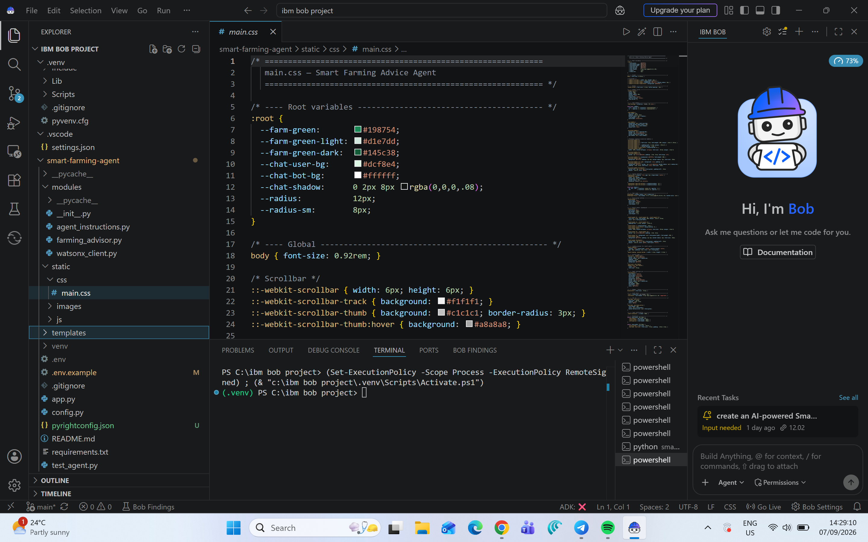
Required Files created using IBM bob -

Slide 7
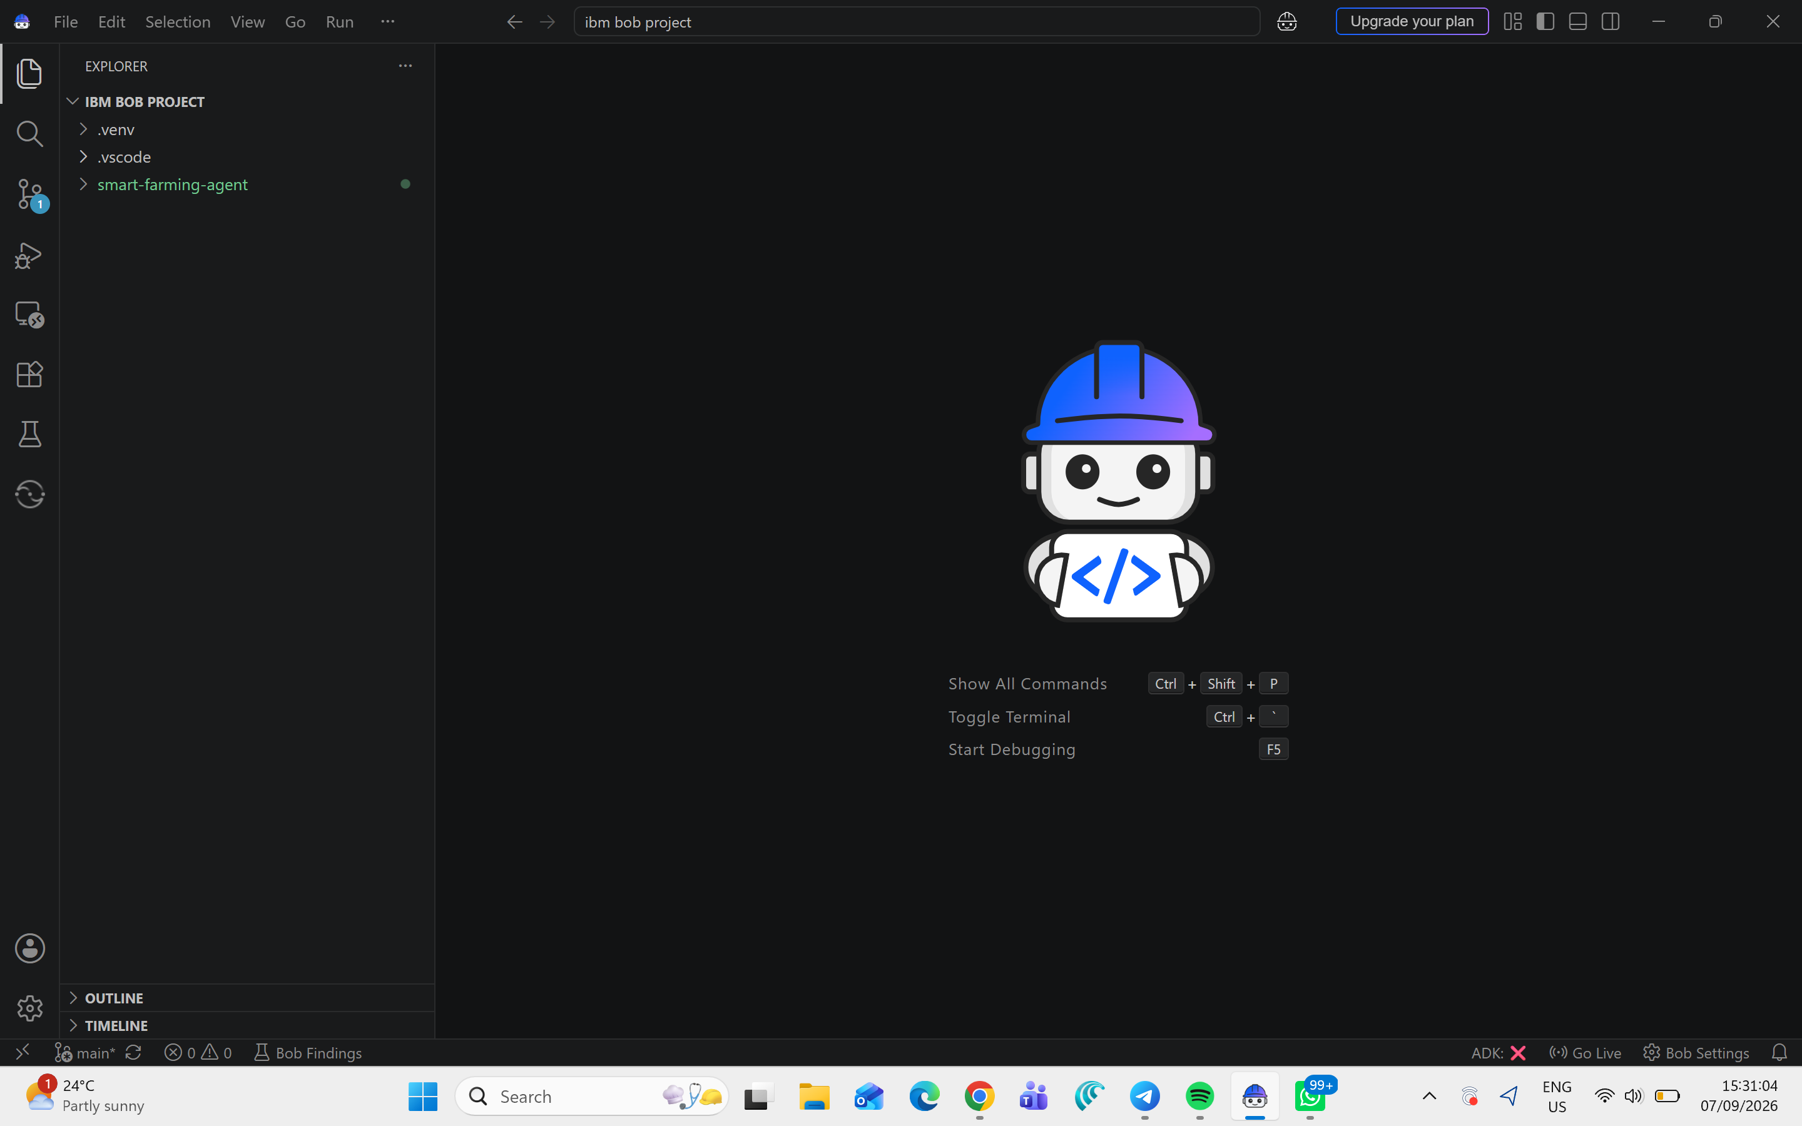
IBM Bob Screenshots:

Slide 8
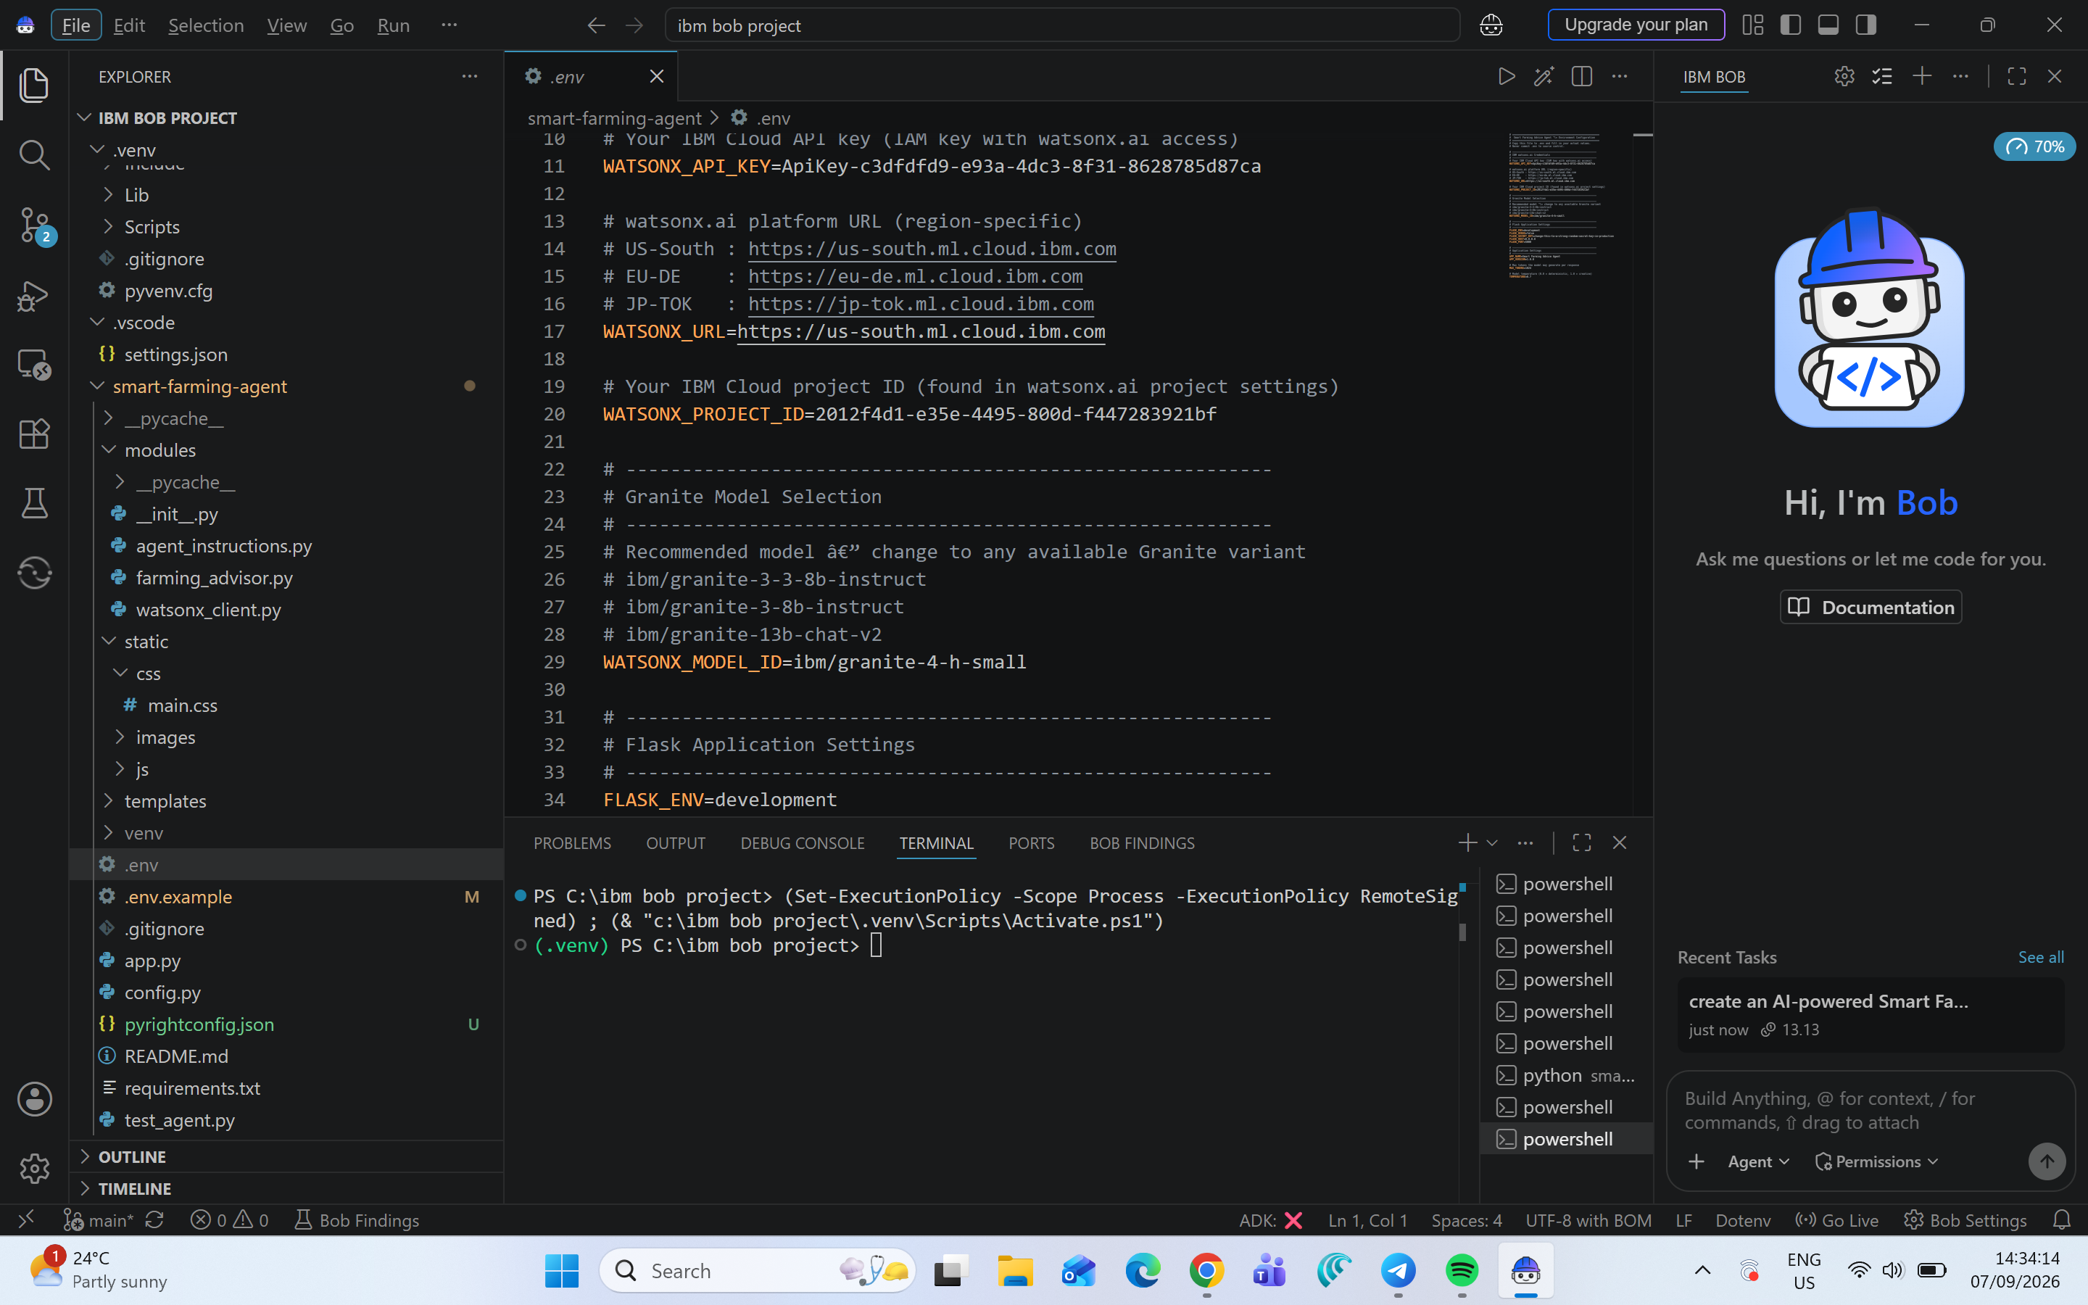

Slide 9
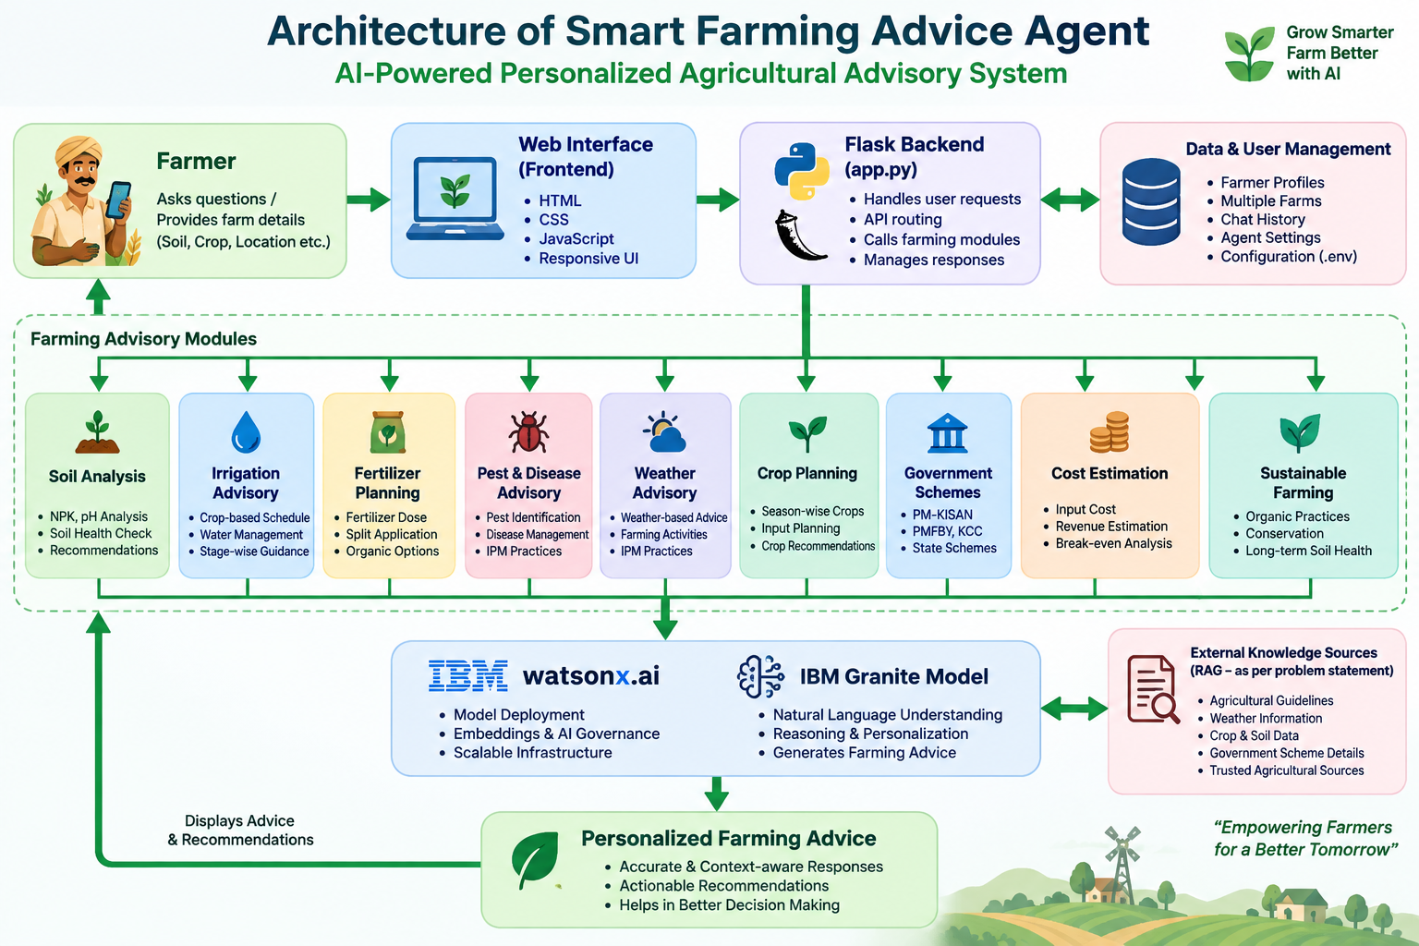
Architecture blueprint for IBM bob:

Slide 10

Role of Agentic AI in the solution
Role of Agentic AI
Agentic AI enables the farming assistant to go beyond a simple question-answer chatbot.
Agentic Capabilities
Understand farmer queries
Identify the farming requirement
Process relevant inputs
Apply farming-specific instructions
Generate personalized recommendations
Maintain conversational context
Support multiple farming advisory tasks
Adapt responses according to farmer and farm information
Example
Farmer:
"My crop is at the flowering stage. Give me irrigation advice."
Agent:
Understands the crop stage and generates relevant irrigation guidance.
Your project includes editable agent persona, expertise domains, Indian agriculture context, safety rules and response-format instructions.

Slide 11


Token Usage
11,761 token are used
Before Prompt
After the Prompt
·
·
·

Slide 12
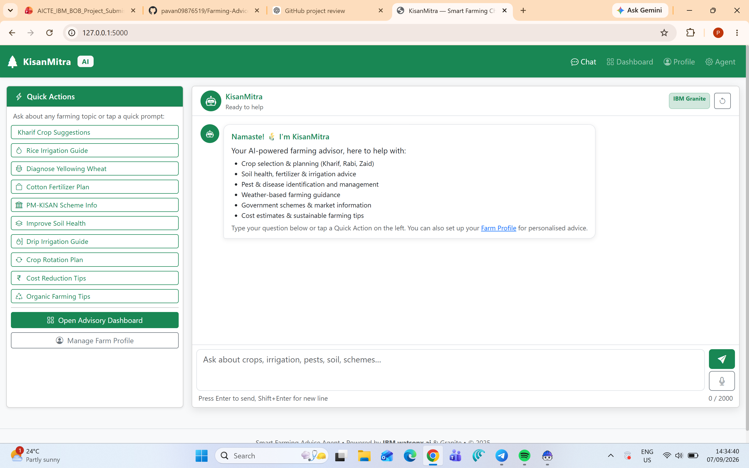
Project Output Screenshot
Please put IBM Bob output screenshots with 2-3 prompts.
You can take 2-3 more slides for each screenshot
·
·
·

Slide 13
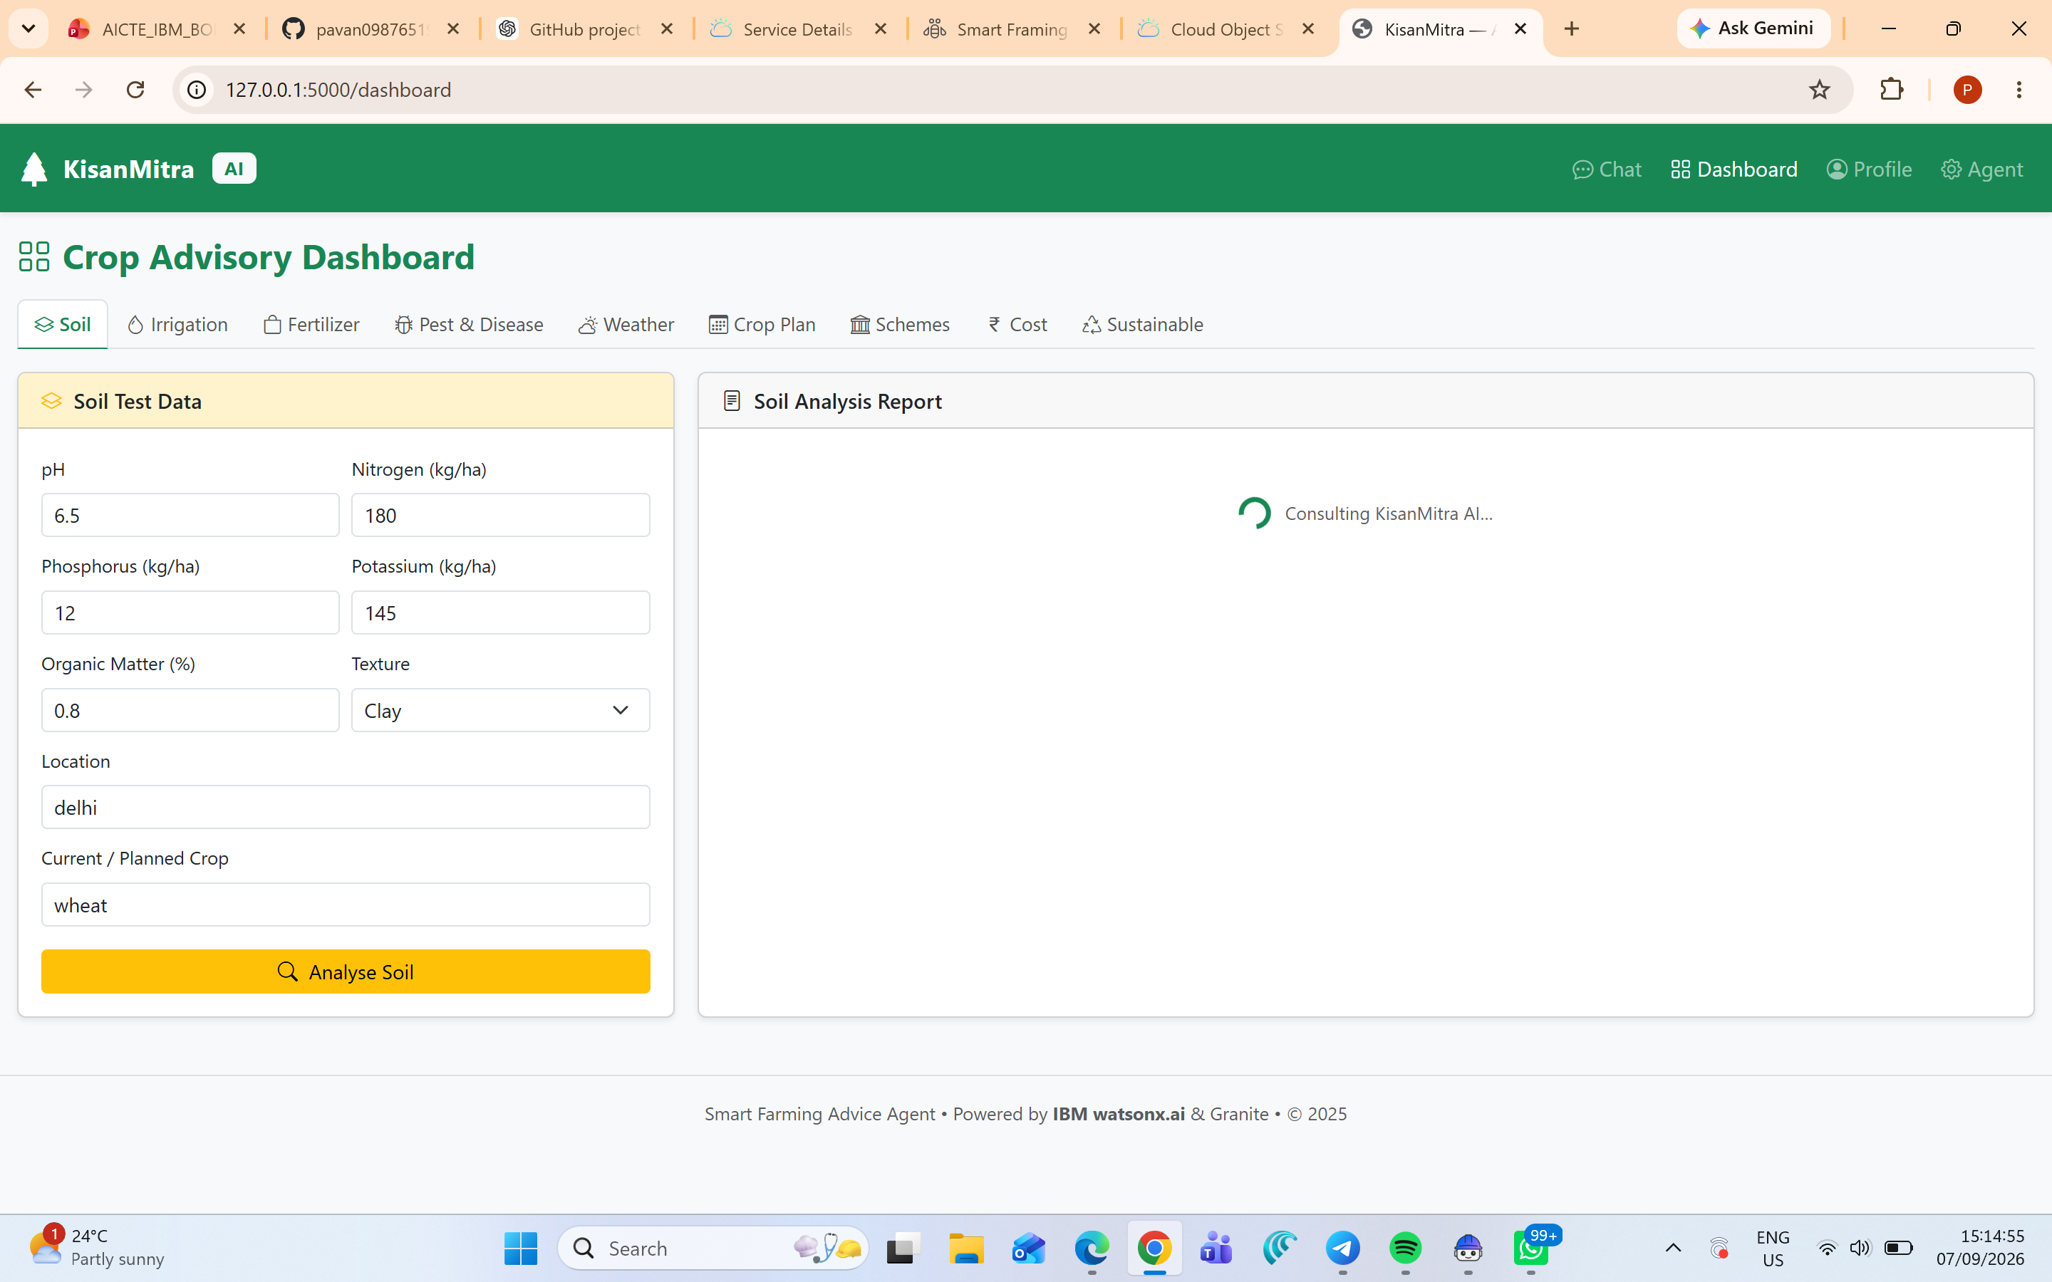
Project Output Screenshot
Please put IBM Bob output screenshots with 2-3 prompts.
You can take 2-3 more slides for each screenshot
·
·
·

Slide 14
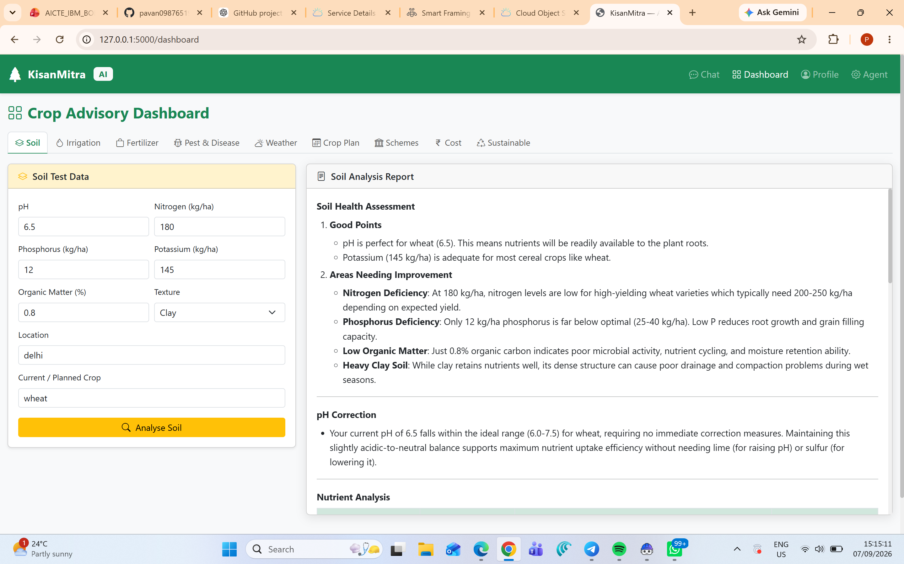
Project Output Screenshot
Please put IBM Bob output screenshots with 2-3 prompts.
You can take 2-3 more slides for each screenshot
·
·
·

Slide 15
Novelty and Uniqueness
The Smart Farming Advice Agent combines multiple agricultural advisory functions into a single AI-powered platform.
Key Innovations
1. Unified Agricultural Assistant
Multiple farming services are available through one platform.
2. Personalized Advice
Recommendations can consider farmer and farm context.
3. Conversational AI
Farmers can interact using natural-language questions.
4. Multi-Domain Farming Support
Soil, irrigation, fertilizer, pests, weather, crops, schemes and cost analysis are integrated.
5. Indian Agriculture Focus
The system includes Indian agriculture context and Indian government schemes.
6. Customizable AI Agent
The AI persona, tone, expertise and safety rules can be customized.
These capabilities are reflected in the actual repository.

Slide 16
Git Hub Link
·https://github.com/pavan09876519/Farming-Advice-Agent.git
·
·
·

Slide 17
Future Scope
1. Multilingual Support
Support Telugu, Hindi and other regional languages.
2. Voice Assistant
Allow farmers to ask questions through voice.
3. Live Weather Integration
Connect real-time weather services for dynamic advisories.
4. Live Mandi Prices
Integrate current market prices from trusted agricultural sources.
5. Image-Based Disease Detection
Allow farmers to upload crop images for disease analysis.
6. IoT Integration
Use soil-moisture and environmental sensors.
7. Mobile Application
Develop Android/iOS applications for easier access.
8. Advanced RAG
Connect trusted agricultural knowledge bases and government sources.
·
·
·

Slide 18
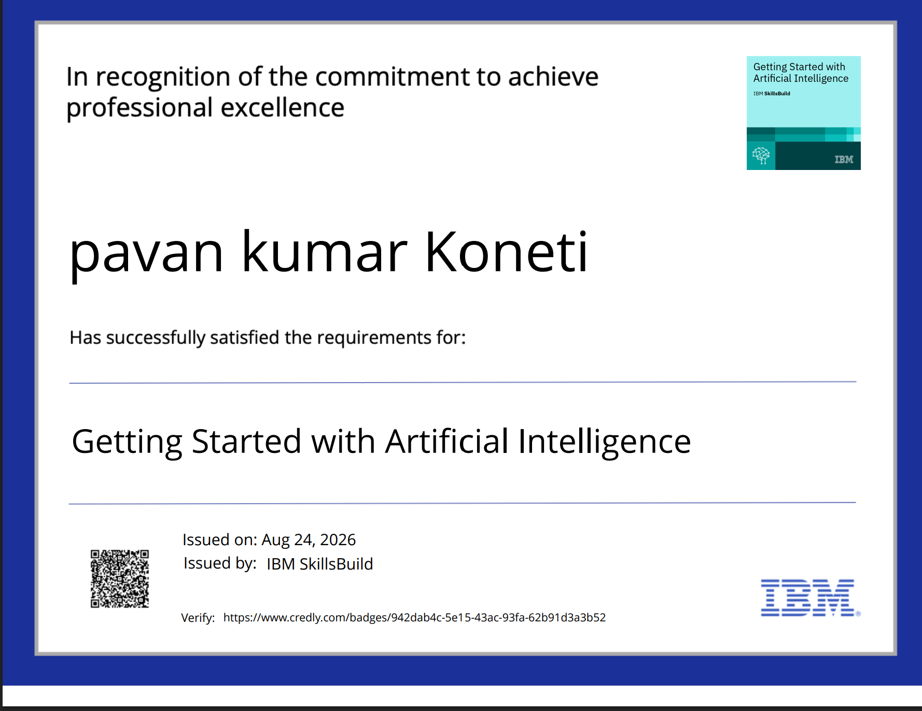
Certificates Earned:
Please add your credly certificate(Getting Started with Artificial Intelligence)

Slide 19
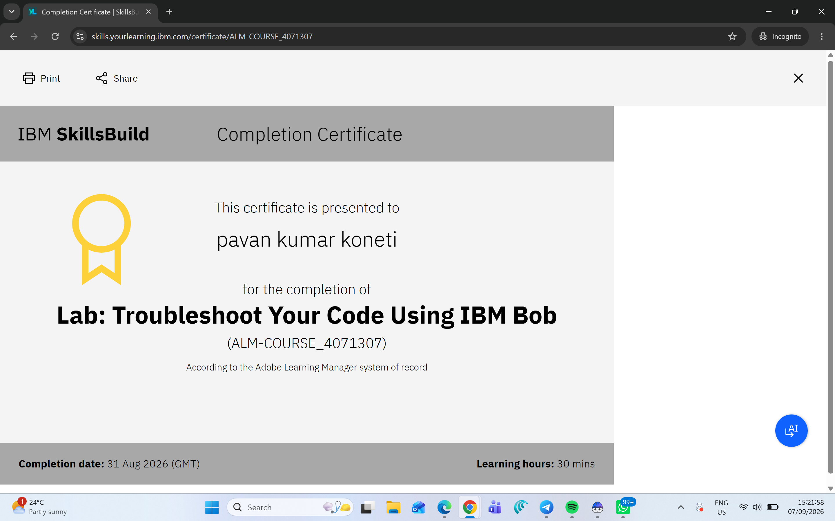
Certificates Earned:​
Add your IBM BOB Certificate

Slide 20


