Slide 1
SQL Injection
Made By: Lyea Palathuruthil Jinil Parekh
Navaneeth Krishnan
Pavan Mistry

Slide 2
DEFINITION
A web security vulnerability that allows an attacker to interfere with the queries that an application makes to its database allowing an attacker to view data that they are not normally able to retrieve.
An attacker can modify or delete this data, causing persistent changes to the application's content or behavior.
Allows attackers to become administrators of the database server.

Slide 3
OBJECTIVE OF ATTACK
Getting unauthorized access to sensitive data.
For obtaining a persistent backdoor into an organization's systems.
Retrieving hidden data
Subverting application logic
UNION attacks
Blind SQL injection

Slide 4
Notable Examples
The GhostShell gang on Saturday posted online what it claims are accounts and records from various financial services, consulting firms, academia, law enforcement, and the CIA. "Team GhostShell final form of protest this summer against the banks, politicians and for all the fallen hackers this year," the post said in part. "One million accounts/records leaked. We are also letting everyone know that more releases, collaborations with Anonymous and other, plus two more projects are still scheduled for this fall and winter. It's only the beginning."
Researchers at Imperva say the attackers appea to have employed mostly SQL injection, but also exploited weak passwordsr and vulnerable content management systems. The attackers used the popular SQLmap tool, and some of the hacked databases included more than 30,000 records.

Slide 5
Types of Attack & Examples
Line comments
Inline comments
Stacking Queries
If Statements
Bypassing login screens

Slide 6
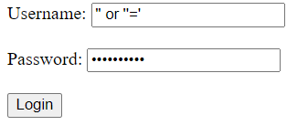
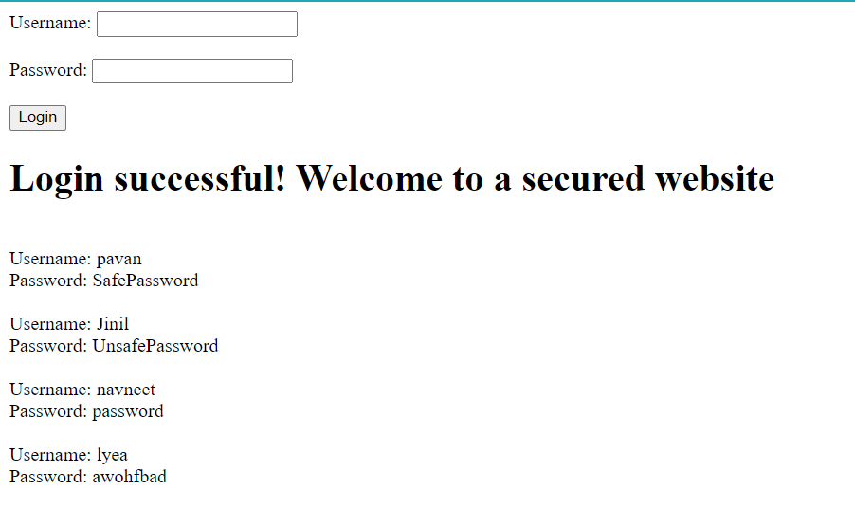
Demo of SQL Injection with passing form

Slide 7
Prevention

Slide 8
References
https://www.darkreading.com/cyberattacks-data-breaches/ghostshell-haunts-websites-with-sql-injection
https://portswigger.net/web-security/sql-injection#sql-injection-examples
https://www.invicti.com/blog/web-security/sql-injection-cheat-sheet/#LineCommentAttacks
https://www.acunetix.com/websitesecurity/sql-injection/

