Slide 1
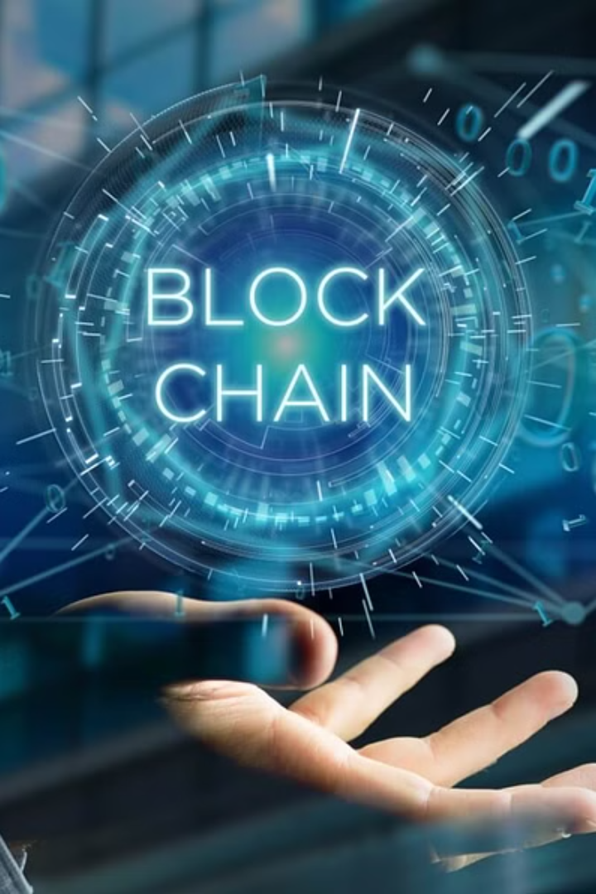
TrustNetAI: Solana's Intelligent Guardian
Discover AI Sentinel: Revolutionizing Blockchain Security. With AI-driven anomaly detection, pattern recognition, and proactive monitoring, we're enhancing safety and trust on the blockchain for everyone.

Slide 2
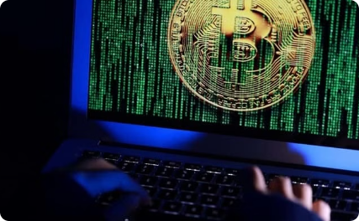
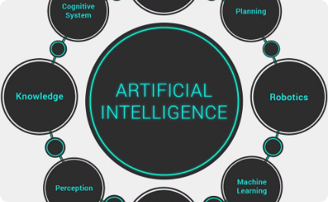
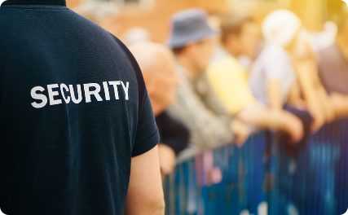
Challenges Faced by the Solana Blockchain
Real-Life Scenarios
Existing Poor Solutions
Empowering the Community
Scammers exploit fake Solana giveaways, risking the safety of digital transactions, rug-pulls, financial scams.
Other solutions lack real-time detection and community incentives, leaving vulnerabilities, not a personalized solution and self learning and improving ai security models.
Our approach incentivizes community participation, ensuring a self-improving system, safer marketplace.

Slide 3

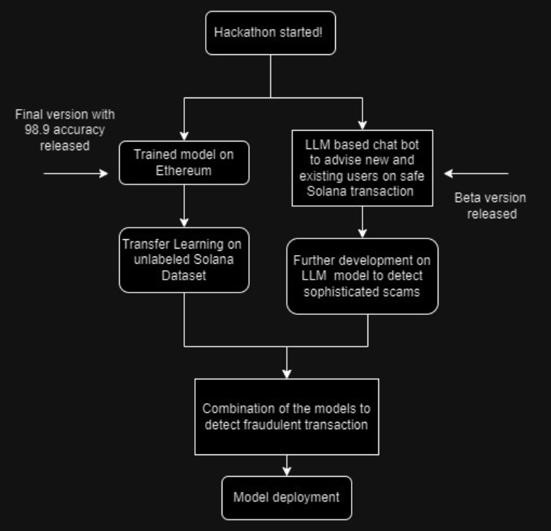
Overall workflow

Slide 4
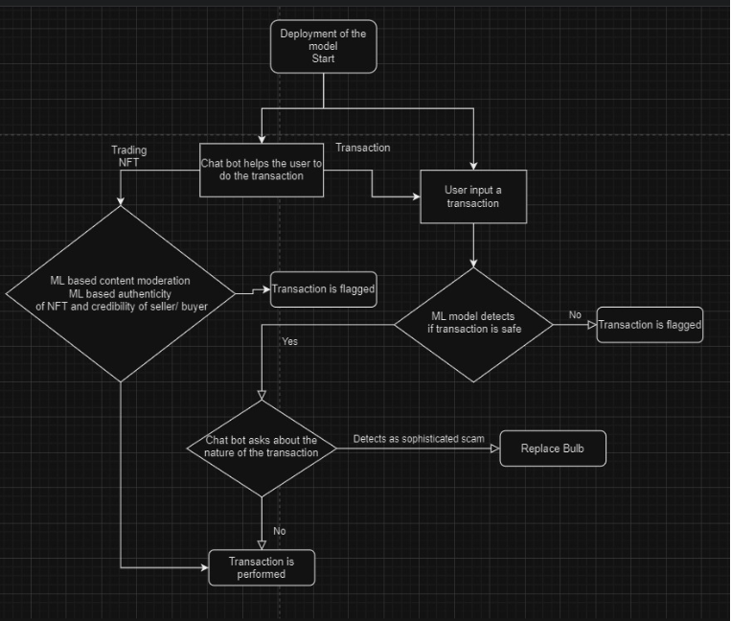
Deployment model workflow

Slide 5


A Futuristic Vision
Use Case 1
Use Case 2
Leveraging LLM for fraud detection and creating an open-source platform.
Developing an open-source platform for global collaboration and deployment.

Slide 6
Performance Assessments
0.9898
100K
Model Accuracy
Future Projections
Our model showcases a remarkable accuracy of 98.98% in fraud detection.
By Q4, targeting over 100,000 active users with robust security measures.

Slide 7
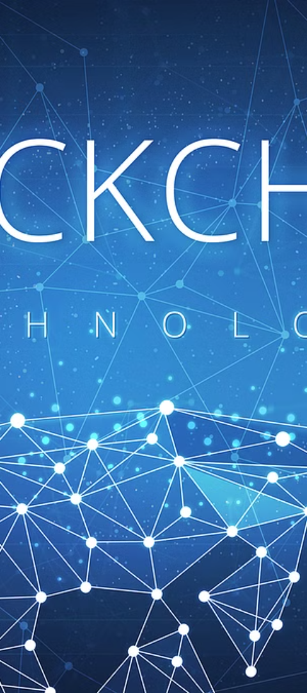
Timing and Relevance
1
Prompt Necessity
Sophisticated AI and the scalability of the Solana network are now pivotal.

Slide 8



Impacting the Future
Q1
Finalizing AI model training and integration with major Solana platforms.
Q2
Launching a public beta and refining models based on user feedback.

Slide 9

Driving Our Mission
1
A Day in the Life
2
AI Exploration
3
Testimonials
Visual representation of Solana users before and after our solution.
Illustration of AI's role in detecting fraud and profanity.
Feedback from early adopters on our fraud prevention measures.

Slide 10
Our Unique Approach
Computational Power
Community Incentives
Comparative Solution
Integrating the Solana network's computing capabilities with AI.
Rewarding true positives and penalizing false flags for a self-improving system.
Distinguishing our model's superiority in detecting fraudulent transactions.
Ensuring automatic monitoring of content and transactions for violations and fraud.

Slide 11
Staying Ahead of the Curve
Blockchain Watchdog
Limited by manual reporting mechanisms, lacks real-time detection, and doesn't incentivize community engagement.
Solsniffer
Estimates if previous Solana tokens are scams, lacking in predicting future fraudulent transactions.

Slide 12
THANK YOU

