Slide 1
BTP 2022 End Evaluation
Design of MIMO Antenna
BTP Code - B22DB03
Members:
Kakarla Venkata Seshasai Pavan Teja (S20190020216)
Divishad Reddy (S20190020236)
Phase - 2
Mentor - Dr. Divyabramham K
Notes:
` \\

Slide 2
Title - Design of MIMO Antenna
Introduction
Problem statement
Simulators
Intro to microstrip antenna, inset feeding method
Design methodology of microstrip (or patch) antenna
Results
Challengers for design MIMO microstrip Antenna
References

Slide 3
Introduction to Antenna (Recap)
Antenna converts electrical energy into radio waves and vice versa.
It is usually used with a radio transmitter or radio receiver or both.
Transmitter converts electrical signals into radio microwaves
This waves can travel thousands of kilometers.
Receiver convert EM waves in to electrical energy.
Radiation pattern of an antenna is a plot of the relative field strength of the radio waves emitted by the antenna at different angles.

Slide 4
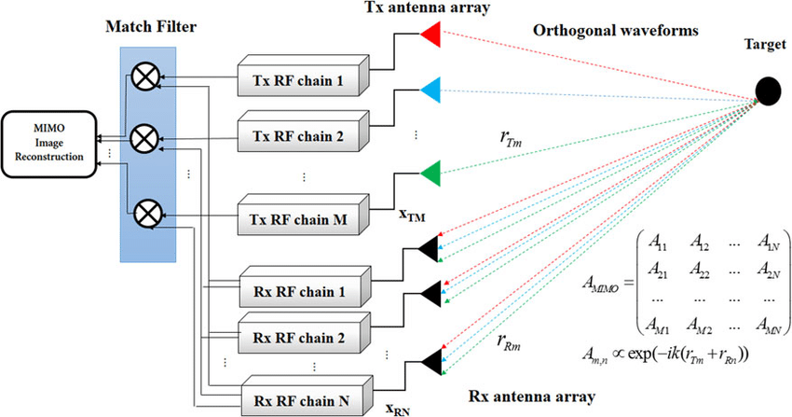
MIMO Antenna (Recap)
MIMO: Multiple-Input-Multiple-Output.
It deploys multiple transmitters to simultaneously transmit arbitrary waveforms.
Utilizing multiple receivers to receive signals which are processed jointly.
Distinguishing property of MIMO antenna
Waveform diversity
Transmits different waveform
In every MIMO antenna receiver, there are many matched filters as the number of transmitted signals, the received signals from target are passed through these filters and matched to every transmitted signal.

Slide 5
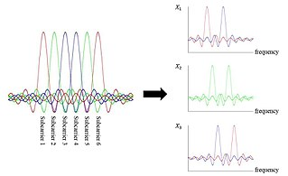
Problem statement (Recap)
Design of MIMO antenna setup.
Let’s assume there is 4x4 MIMO antenna.
4 - transmitters and 4 - receivers.
MIMO antenna system consists of transmitting (4 transmitters) and receiving (4 receivers) arrays, one inside the other arrangement.
All elements (transmitters) of the transmitting array simultaneously radiate mutually orthogonal signals shift in frequency (OFDM).
These transmitting signals don’t interface because of orthogonality.

Slide 6
Problem statement (Recap)
At a target we have the sum of all radiated signals with their specific phase shifts depending on the target position and velocity as well as on the frequency and position of the transmitting array elements.
Each element of the receiving array receives reflected signals of all frequencies. This signals can be separated and then processed properly.
Modeling and simulation are done using feko and other simulator.
Implementation of MIMO antenna.

Slide 7
Simulators
MIMO patch antenna built using FEKO simulator
Single patch antenna converted into MIMO by changing appropriate variables
Antenna input is feeded using method(Inset feeding method)
Patch antenna are for low profile application of frequency above 100 MHz.
Visualization of plots
Reflection coefficient-Frequency
Current flow from source to patch material
VSMR(Voltage standing wave ratio)
Radiation Pattern
The calculations need to be done for parameters like angle of arrival, gain of antenna, etc which are essential in designing the MIMO antenna.

Slide 8
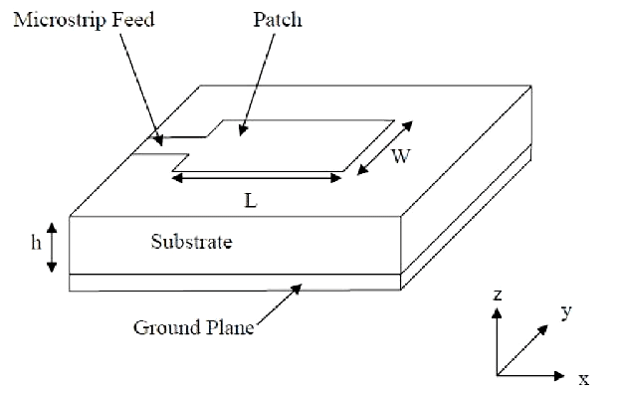
Microstrip or Patch Antenna
Micro-strip antenna
Has radiating patch on one side of the dielectric
Other side of substrate has a ground plane
L - length of micro-strip
W-width of micro-strip
h - Height of dielectric substrate.
It is lightweight and easy to integrate with circuits.
Microstrip feed line can be moved such way that we can get impedance matching.

Slide 9
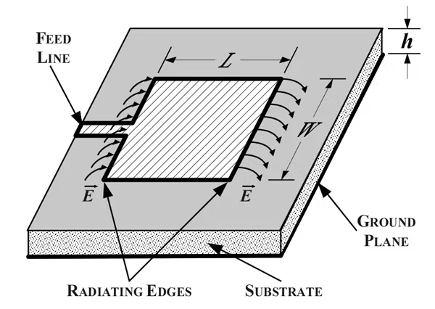
Microstrip or Patch Antenna - Radiation
It mainly radiate due to the fringing fields at the radiating edges.
Fringing fields have a great effect on the performance of antenna.
Radiation doesn't happen along the length(L) of microstrip.
Electric field at the center of the patch is zero.
The radiation is due to the fringing field between the periphery of the patch and the ground plane.

Slide 10
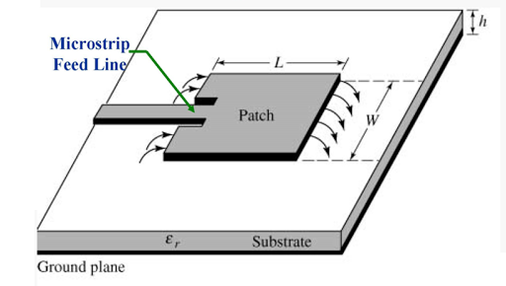
Inset feeding method
It is a conducting strip having width extremely smaller than the width of the radiating element.
The feed line to the structure can be provided either at the center, inset or offset.
Impedance of the antenna can be controlled by this feeding method due to planar structure.
An inset feed microstrip patch antenna is designed to increase the radiation.
Due to thinner dimensions of the strip, it's easy to fabricate and integrate in Printed circuit boards (PCBs).
Notes:
Inset feeding method is simple to implement and easy to know the behaviour of the antenna, by controlling the inset gap and inset length

Slide 11
What effects the patch antenna
Width controls -
Larger width, increase radiation from patch antenna
Wider patch, lower input impedance
Length of patch antenna controls resonant frequency of antenna.
Permittivity of dielectric material controls
Higher the permittivity -increases input impedance.
Lower the permittivity -increases the antenna bandwidth, efficiency, better radiation

Slide 12
What effects the patch antenna
Input impedance can be varied using inset feeding method
As the feed line (or transmission )comes closer to the center patch antenna.
The input impedance decreases allowing to flow more current which increases the radiation.
Impedance matching is done by varying the length and width of feed line (or transmission line).
Good impedance matching reduces the return loss of antenna.
Notes:
Because antenna occupying more space in a spherical volume will have a wider bandwidth.
Impedance matching is the process of designing the antenna's input impedance (ZL) or matching it to the corresponding RF circuitry's output impedance (ZO)

Slide 13
Design methodology
Calculate the width and length of patch antenna which are essential in designing microstrip antenna.
Length and width are calculated using online sources (link in references).
Variables defined - Frequency - 2.4GHz ( resonant frequency), Min Frequency - 1.8GHz, Max Frequency - 2.8GHz, Wavelength - speed of light/ operating frequency, permittivity of dielectric material (εr) - 3.4, width and length of patch material - 42mm, 32mm respectively, dielectric material dimensions are made appropriately but height of substrate is to be considered - 2mm, feed line dimensions width and length - 4.2mm(wavelength/30) and 4.99mm (wavelength/25), inset width - 1.25mm (wavelength/100), inset length - length of patch/(2*√εr) - 8.6mm (wavelength/15).
To design a microstrip structure we use polygon ( in construct of feko simulator).

Slide 14
Design methodology
Polygon with 13 corners are build with appropriate coordinates.
A cuboid is build with appropriate coordinates and ground plane is given below. the dielectric material (εr) - 3.4 and ground plane.
3 rectangles are used to connect ground plane and patch material which is split in middle.
Materials - patch and ground plane are perfect electric conductors and dielectric material of εr - 3.4
The split tool cuts the rectangular into two half below one is connected to ground and above one is connected to patch. In between a voltage source is used to provide excitation to the patch.
This is all done in CADFEKO for modeling the patch antenna. The POSTFEKO helps to analyze the antenna characteristics.
Feko solver converts the CADFEKO model to POSTFEKO (which helps in analyses of model).
3D view of model, plot - voltage source, current flow in patch, VSWR(Voltage standing wave ratio), gain plot in polar plot.

Slide 15
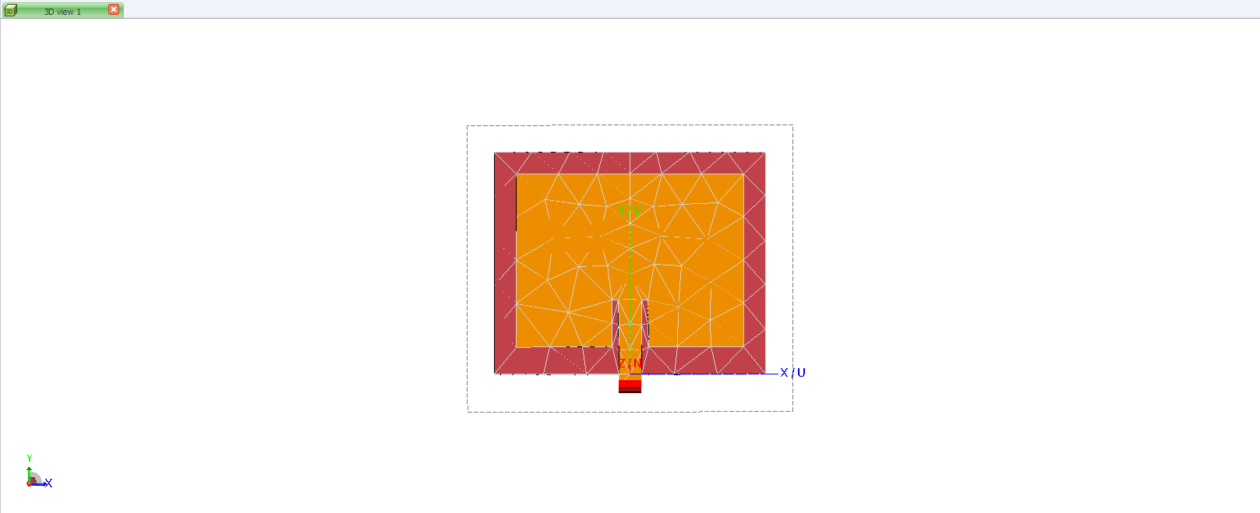
Results : Antenna Model

Slide 16
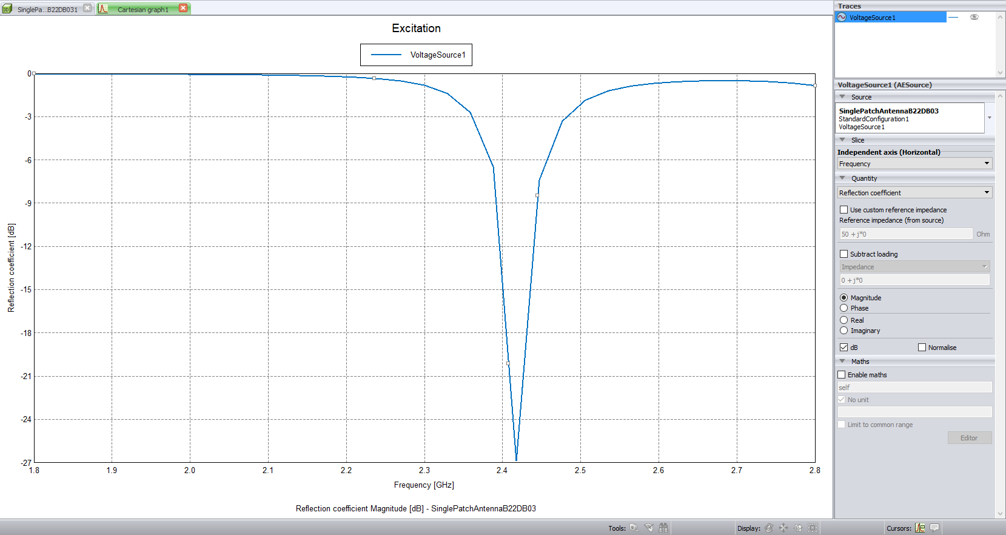
Results : Reflection Coefficient v/s frequency
Notes:
the reflection coefficient is defined as how much of an electromagnetic wave is reflected by an impedance discontinuity in the transmission medium

Slide 17

Results : Surface Current Flow (dB A/m)

Slide 18
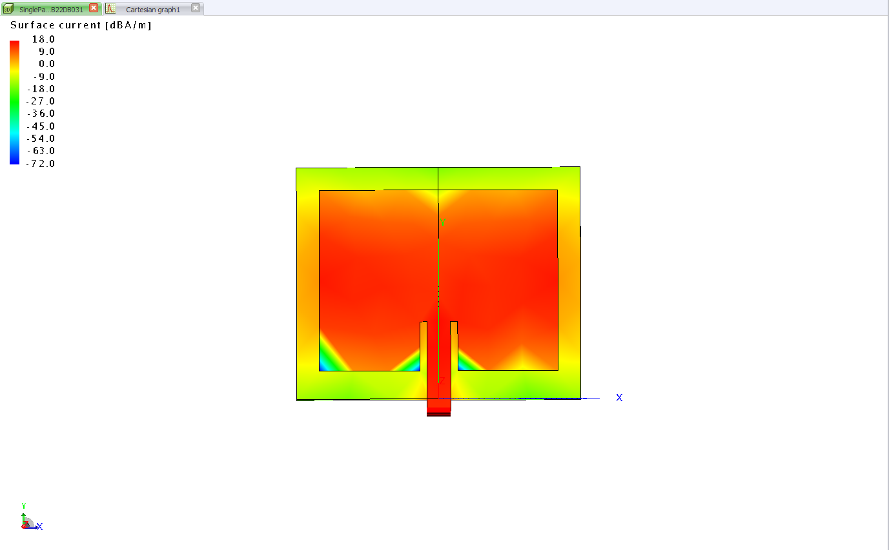
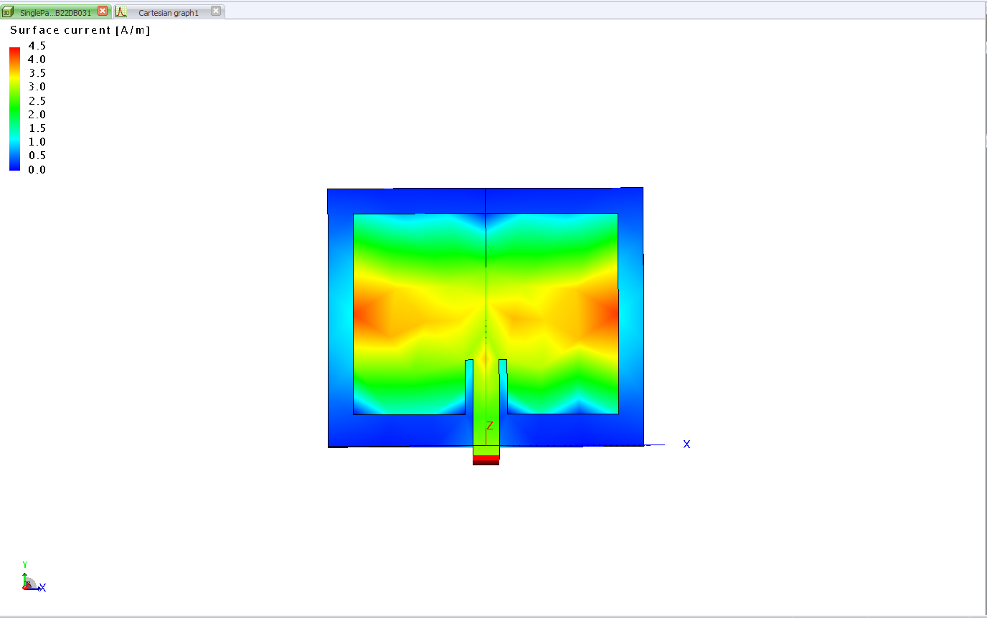
Results : Current Flow at resonant frequency
Surface Current A/m
Surface Current in dB A/m

Slide 19
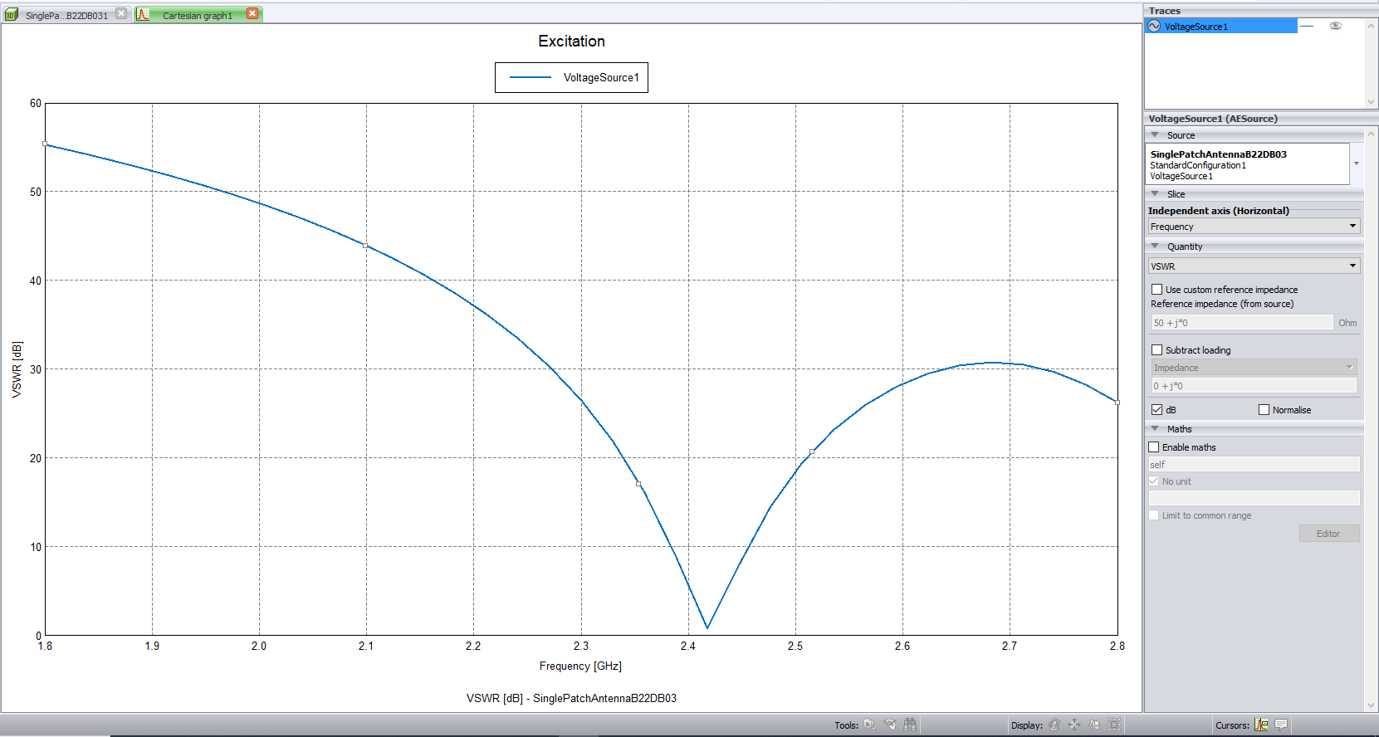
Results : VSWR (Voltage standing wave ratio)
Notes:
VSWR (Voltage Standing Wave Ratio), is a measure of how efficiently radio-frequency power is transmitted from a power source, through a transmission line, into a load.

Slide 20
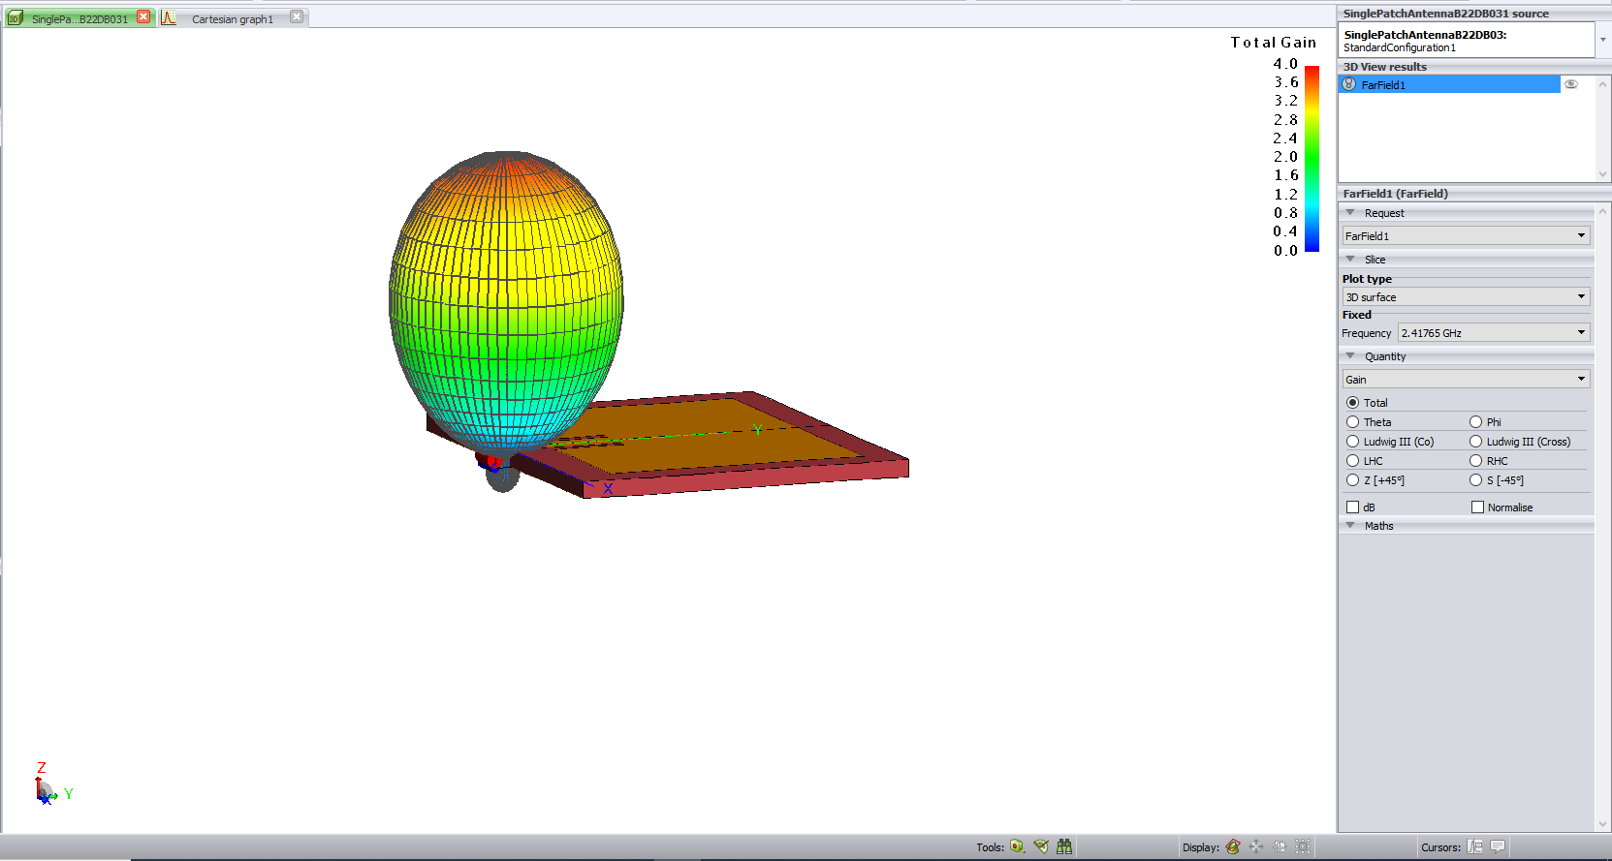
Results : Radiation pattern of antenna

Slide 21
Challenges to be faced
Converting of Single microstrip antenna to MIMO microstrip antenna is difficult.
The design of MIMO antenna from single antenna requires:
Calculating the area covered by each antenna on dielectric material(substrate material).
Inputs to the patch antenna changes depending on the applications.
Depending upon the no. of inputs (no. of transmitters) radiation of antenna changes.
The side lobes need to be reduced as low as possible which increases the efficiency of antenna.
Changing the width and length of patch also effects the radiation of MIMO antenna.

Slide 22
Challengers to be faced
Calculation of angle of arrivals, gain of antenna, etc which involves complex calculations and complex coding in simulators.
The design (or physical implementation) of MIMO microstrip is critical which decides the gain, efficiency of antenna.
Improper design of antenna leads to minimum radiation.
Improper design results in low efficiency and gain of antenna.
Design of MIMO antenna need to done.

Slide 23
Timeline
Introduction about antenna radars
Problem statement
Modeling of MIMO antenna
Simulation for antenna parameters
Phase - 1
Phase - 3
Phase - 2
Phase - 4
Modeling of Single antenna
Challengers
Designing of MIMO antenna

Slide 24
References
Z. Peng and C. Li “A Portable K-Band 3-D MIMO Radar with Nonuniformly Spaced Array for Short-Range Localization” in IEEE Transactions on Microwave Theory and Techniques, 2018. Reference Link
Zhengyu Peng, Prateek Nallabolu, Changzhi Li, “Design and calibration of a portable 24-GHz 3-D MIMO FMCW radar with a non-uniformly spaced array and RF front-end coexisting on the same PCB layer”, in Proceedings of the 2018 IEEE Dallas Circuits and Systems Conference, DCAS 2018. Reference Link
Sankar Sadasivam, Shaury Anand, “Multi Channel RF Transceiver Reference Design for Radar and Electronic Warfare Applications”, in Texas Instruments Incorporated, 2019. Reference Link
M A Matin, A. I. Sayeed, “A Design Rule for Inset-fed Rectangular Microstrip Patch Antenna“ in WSEAS Transcations on communications, jan 2010. Reference link
Microstrip Patch Antenna width and length Calculator
Antenna basics and designing

Slide 25
Thank you

