Slide 1
BTP 2022 Mid Evaluation
Design of MIMO Antennas for 3D Object Detection
BTP Code - B22DB03
Members:
Kakarla Venkata Seshasai Pavan Teja (S20190020216)
Divishad Reddy (S20190020236)
Mentor - Dr. Divyabramham K
Notes:
` \\

Slide 2
Title - Design of MIMO Antennas for 3D Object Detection
Introduction
Problem statement
Description of the problem
Applications
References

Slide 3
Introduction to Radar
Radar is an detection system which uses waves to determine the distance, angle or velocity of an object.
Waves (pulsed or continuous) from transmitter reflect off the object and return to the receiver as an echo, giving information about the object.
The information received by receiver is processed and object’s position (or) speed are obtained.

Slide 4
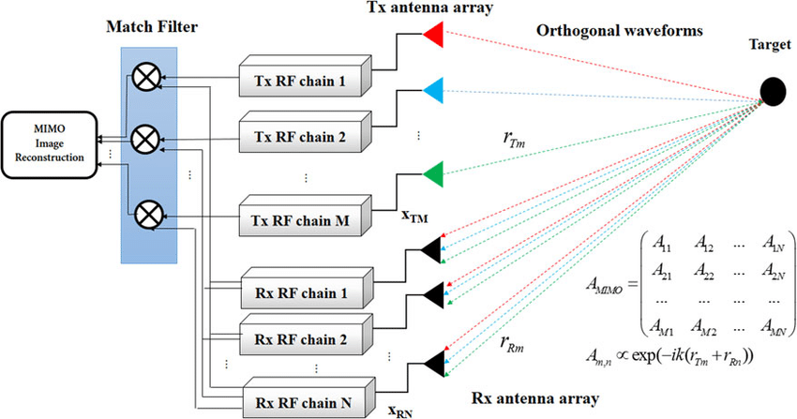
MIMO Radar
MIMO: Multiple-Input-Multiple-Output.
It is a radar system deploying multiple transmitters to simultaneously transmit arbitrary waveforms and utilizing multiple receivers to receive signals which are processed jointly.
Every transmitting element in a MIMO radar system transmits different waveforms. This is called waveform diversity and it is a distinguishing property of MIMO radar.
In every MIMO radar receiver, there are many matched filters as the number of transmitted signals, the received signals from target are passed through these filters and matched to every transmitted signal.

Slide 5
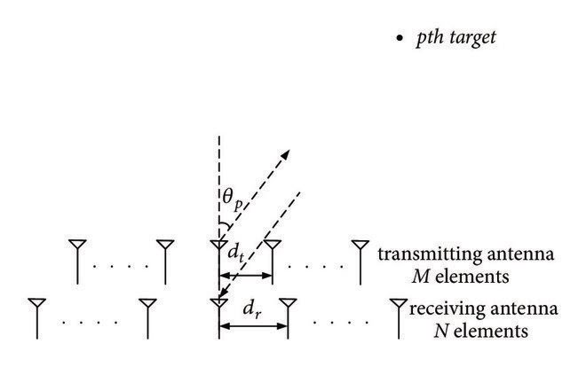
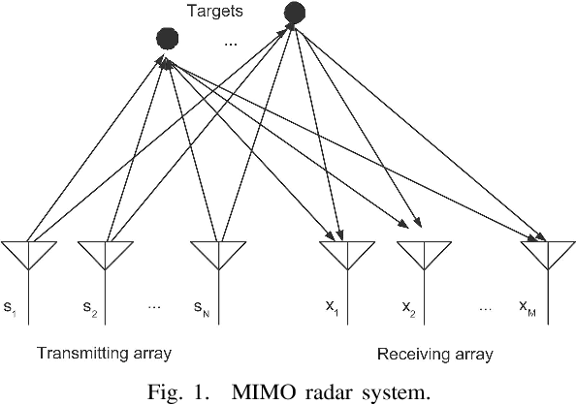
Types of MIMO radars
The MIMO radar systems can be classified into two categories:
MIMO radar with colocated antennas (so-called “Mono-Static” MIMO).
the transmitting antennas are close enough such that the target radar cross-sections (RCS) observed by the transmitting antenna elements are identical.
MIMO radar with widely separated antennas (so-called “Bi-Static” MIMO).
Bistatic MIMO radar is a radar system comprising transmitters and receivers that are separated by a distance.

Slide 6
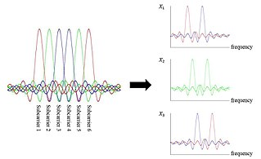
Problem statement
Design of MIMO antenna setup for radar application
Application: detection of 3D object
Let’s assume that there are MIMO antennas.
MIMO antenna system consists of transmitting and receiving arrays, one inside the other arrangement.
All elements (transmitters) of the transmitting array simultaneously radiate mutually orthogonal signals shift in frequency (OFDM).

Slide 7
Problem statement
These transmitting signals don’t interface because of orthogonality.
At a target we have the sum of all radiated signals with their specific phase shifts depending on the target position and velocity as well as on the frequency and position of the transmitting array elements.
Each element of the receiving array receives reflected signals of all frequencies. They are separated and then processed properly.
Target’s position and radial velocity can be determined by phase shifts of received signals.

Slide 8
Drawback of Single antennas
Let’s assume that there is a single antenna which transmit the signals in all directions and target as a 3D object.
Since it is 3d object, the transmitted signals hits the corners of the object at different time intervals and reflect off the object.
The reflected signals have propagation delays and arrival at the receiver at different time intervals.
Due to this propagation delays and different arrival time intervals, single antenna can’t classify whether it is a single object or multiple objects.

Slide 9
Applications of MIMO
MIMO technology in LTE,LTE advanced
MIMO technology in LTE,LTE advanced can improve network efficiency. It can be used to reduce signal disturbances due to multipath.
To increase signal quality and gain, multiple antennas can be placed in different directions.
MIMO in Wireless LAN
With MIMO technology in wireless LAN can be used to improve the data rate in wireless routers and mobile devices, for that both transmitting and receiving devices must be compatible.
Example: Router with 3 antenna have speed of 600 Mbps whereas router with 2 antenna have speed of 300 Mbps

Slide 10
References
Z. Peng and C. Li “A Portable K-Band 3-D MIMO Radar with Nonuniformly Spaced Array for Short-Range Localization” in IEEE Transactions on Microwave Theory and Techniques, 2018.
Reference Link
Zhengyu Peng, Prateek Nallabolu, Changzhi Li, “Design and calibration of a portable 24-GHz 3-D MIMO FMCW radar with a non-uniformly spaced array and RF front-end coexisting on the same PCB layer”, in Proceedings of the 2018 IEEE Dallas Circuits and Systems Conference, DCAS 2018.
Reference Link
Sankar Sadasivam, Shaury Anand, “Multi Channel RF Transceiver Reference Design for Radar and Electronic Warfare Applications”, in Texas Instruments Incorporated, 2019. Reference Link

Slide 11
Thank you

