Slide 1
PR Project
Wine Classification and correlation
Course Instructor: Dr. Anish Chand Turlapaty
Group - 6
Kakarla V S S Pavan Teja {S20190020216}
K Sreenivasulu Reddy {S20190020217}
K Litheesh Kumar {S20190020218}

Slide 2
Introduction
Here we will classify the wine on the basis of given features. We used the wine quality dataset downloaded from Kaggle and UCI.
This dataset has the fundamental features which are responsible for affecting the quality of the wine.
By the use of several Machine learning models, we will classify the wine.

Slide 3
Introduction
We use classification techniques to check further the correlation of fundamental features like
fixed acidity
volatile acidity
citric acid
residual sugars
chlorides
free sulphur dioxide
Density
pH
sulphates
alcohol
total sulphur dioxide
quality

Slide 4
Implementation - Matlab
Correlation of fundamental features and quality of wine which are almost negligible are deleted
Only features which has some preferable amounts of correlation are taken and analyzing the train and test accuracy of various classifiers i.e., how efficient they are to classify the wine.
Fundamental features and correlation of them with quality are mentioned below:
Chlorides (-0.2)
Density (-0.31)
alcohol (0.44)
pH (0.02)

Slide 5
Implementation - Matlab
Combined both white wine and red wine datasets
White wine -1
Red wine - 0
Normalized the features so that equal distribution of variance will be there for all features
Trained these features to Logistic Regression, Gaussian SVM, Neural Network Classifiers and Linear Discriminant, obtained confusion matrices, accuracy, ROC Curves
Tested the data using above trained models, result is the test accuracy

Slide 6
Implementation (Contd.)
Applied Principal Component Analysis or PCA
PCA is keeping enough components to explain 95% variance. After training, 4 components were kept.
Explained variance per component (in order): 47.5%, 26.0%, 18.6%, 7.9%.

Slide 7
Classifiers used
Logistic Regression
Gaussian SVM
Linear Discriminant
Neural networks

Slide 8
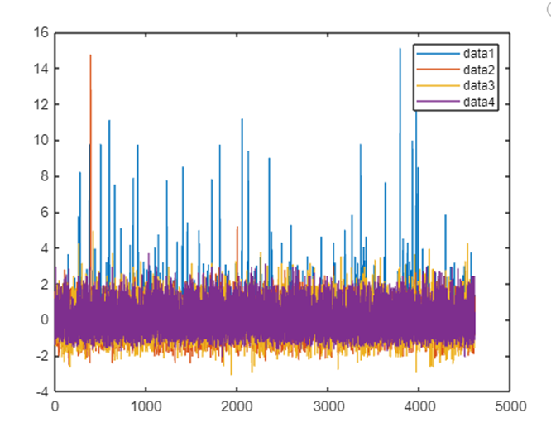
Results

Slide 9
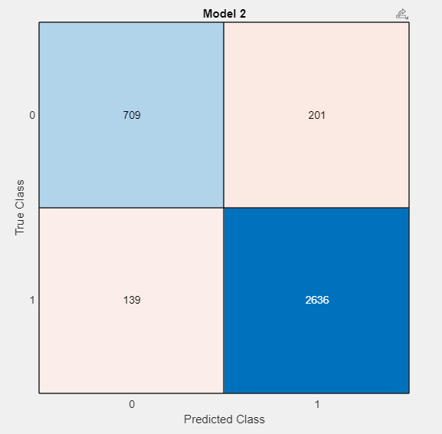
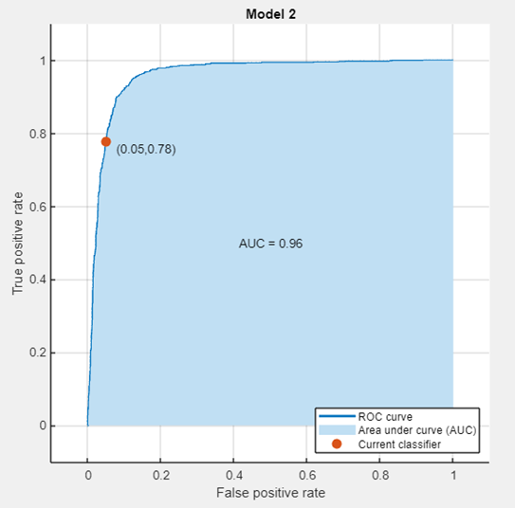
Results (Contd.) - Logistic Regression (Training)
Confusion Matrix
ROC Curve

Slide 10
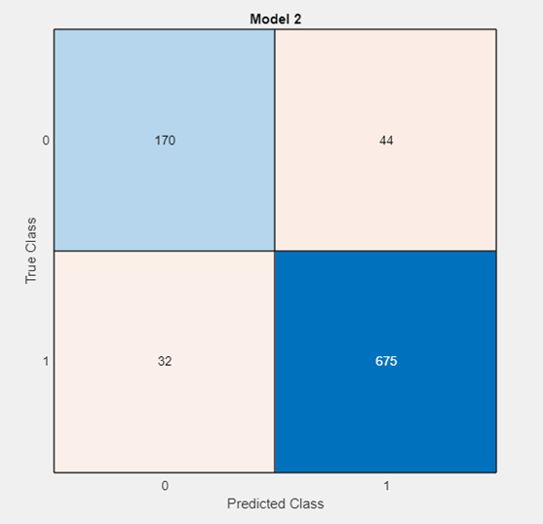
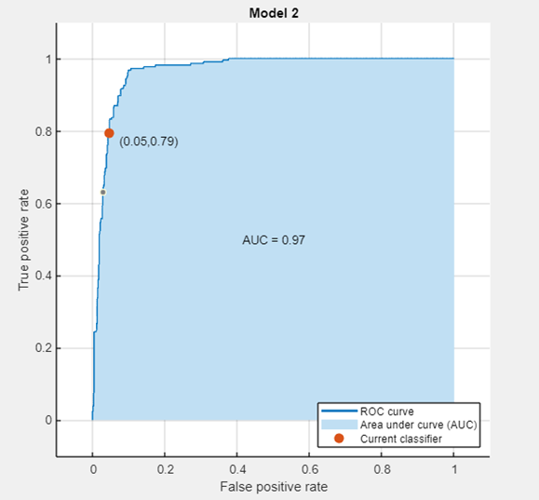
Results (Contd.) - Logistic Regression (Tested)
Confusion Matrix
ROC Curve

Slide 11
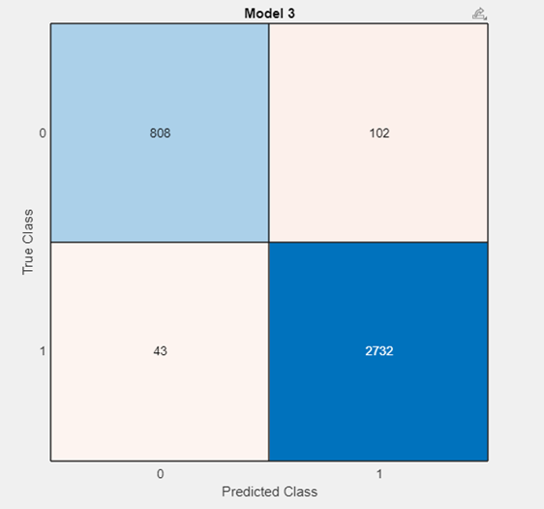
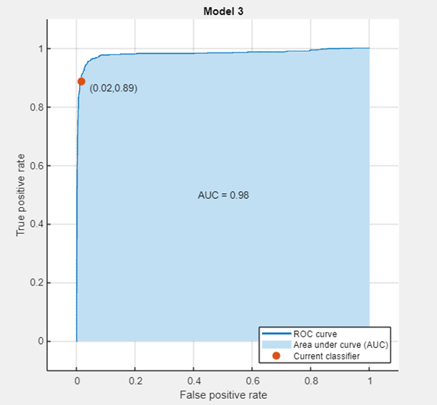
Results (Contd.) - Gaussian SVM (Training)
Confusion Matrix
ROC Curve

Slide 12
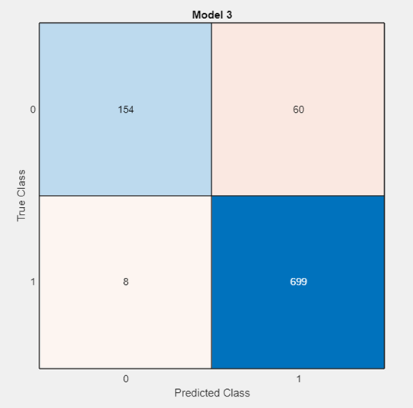
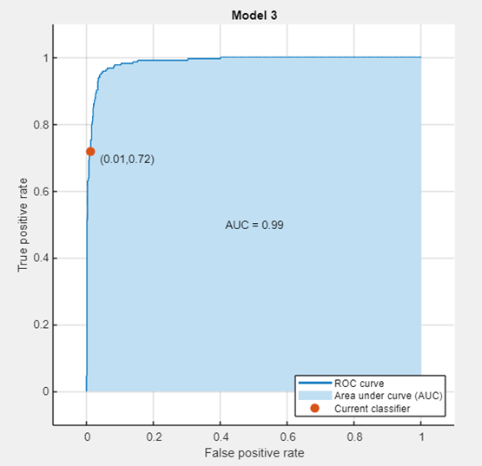
Results (Contd.) - Gaussian SVM (Tested)
Confusion Matrix
ROC Curve

Slide 13
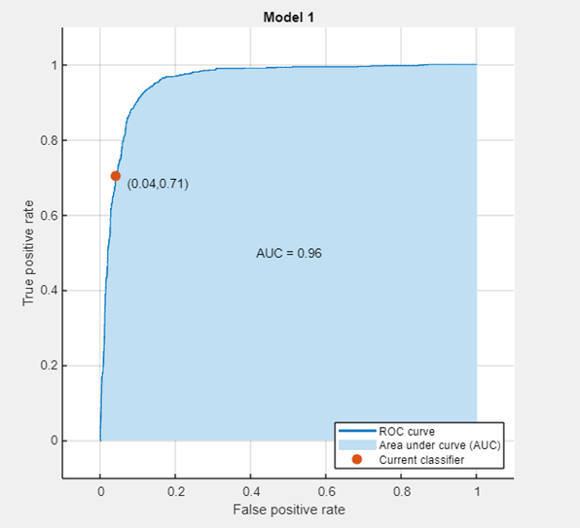
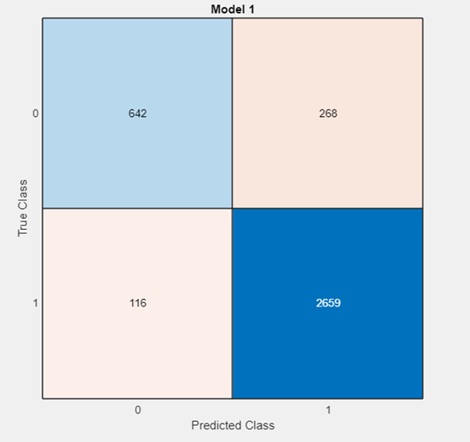
Results (Contd.) - Linear Discriminant (Training)
Confusion Matrix
ROC Curve

Slide 14

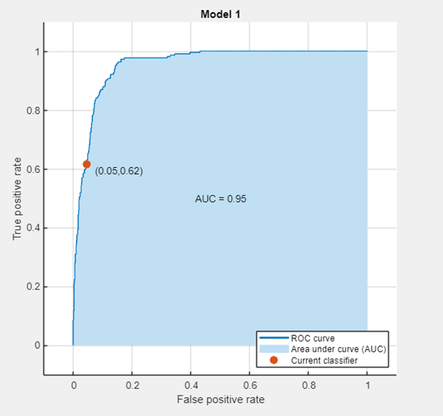
Results (Contd.) - Linear Discriminant (Tested)
Confusion Matrix
ROC Curve

Slide 15
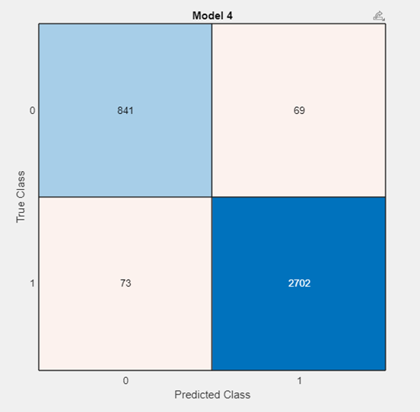
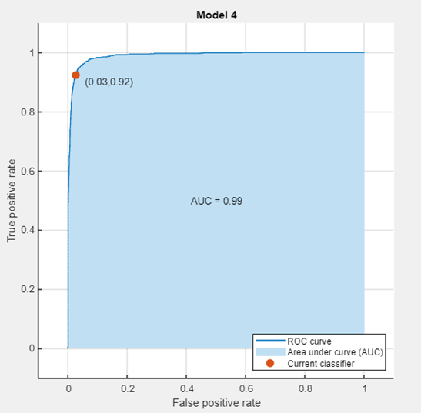
Results (Contd.) - Neural Networks (Training)
Confusion Matrix
ROC Curve

Slide 16
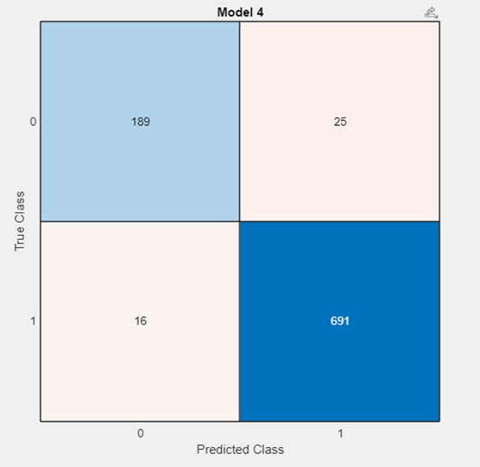
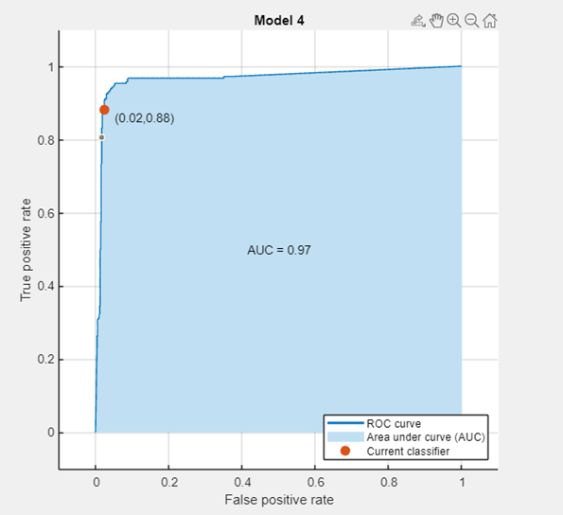
Results (Contd.) - Neural Networks (Tested)
Confusion Matrix
ROC Curve

Slide 17
Results (Contd.)
Logistic Regression:
Validation Accuracy – 99.3%
Test Accuracy – 99%
Gaussian SVM:
Validation Accuracy – 92.5%
Test Accuracy – 89%
Linear Discriminant:
Validation Accuracy— 97.5%
Test Accuracy – 98.3%
Neural Networks:
Validation Accuracy – 99.3%
Test Accuracy – 99.6%

Slide 18
New Results (Contd.)
Logistic Regression:
Validation Accuracy – 90.8%
Test Accuracy – 94%
Gaussian SVM:
Validation Accuracy – 96.2%
Test Accuracy – 92.2%
Linear Discriminant:
Validation Accuracy— 90.5%
Test Accuracy – 88.5%
Neural Networks:
Validation Accuracy – 96.2%
Test Accuracy – 95.3%

Slide 19
Implementation - Python
We are going to predict the quality of wine on the basis of given features.
Downloaded wine quality dataset from Kaggle
Dataset has the fundamental features which are responsible for affecting the quality of wine
Debited correlations of fundamental features and quality

Slide 20
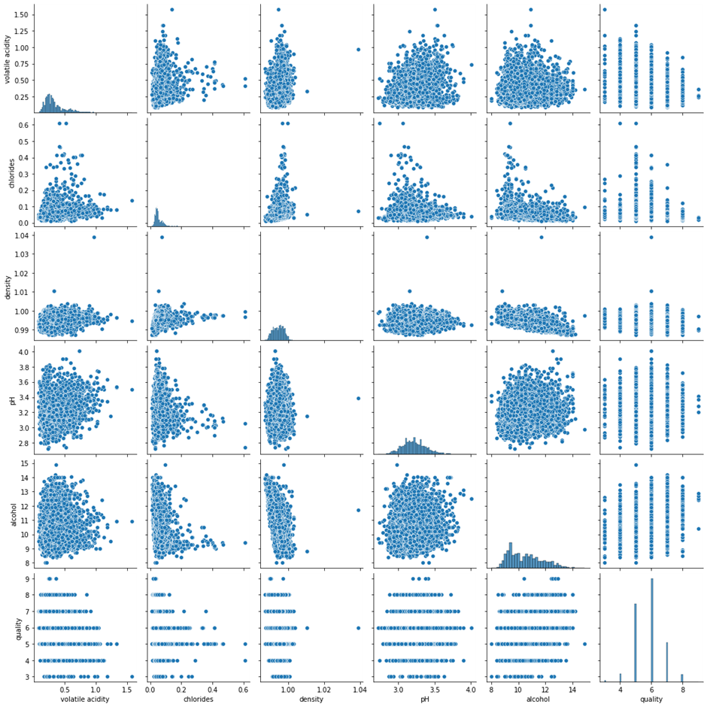
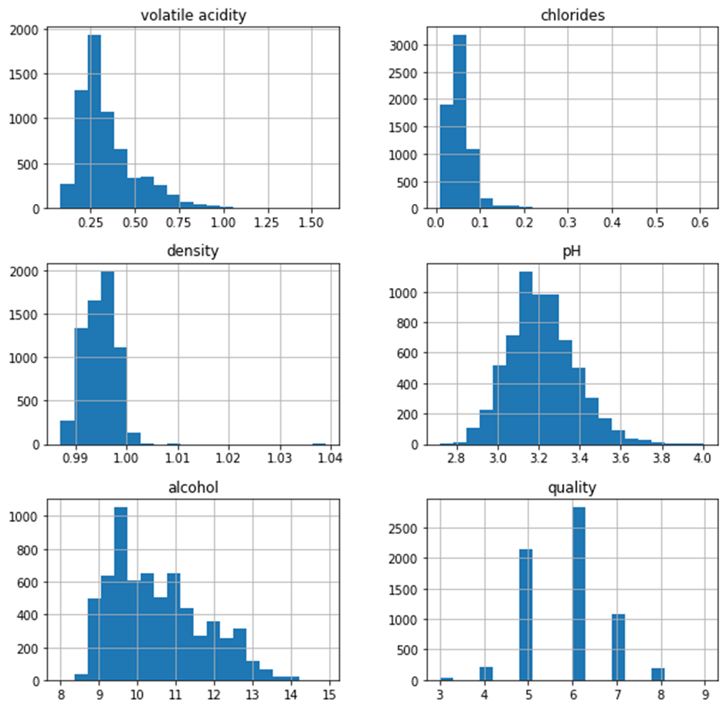
Results (Contd.) - Data Visualization and Histogram

Slide 21
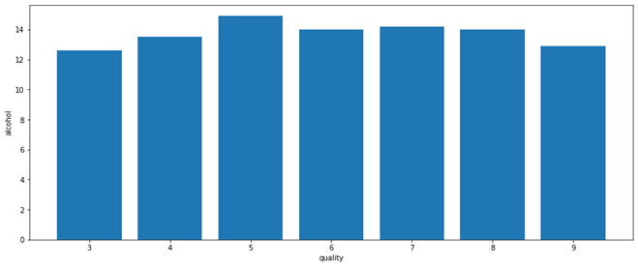
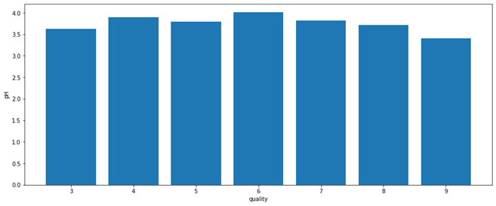
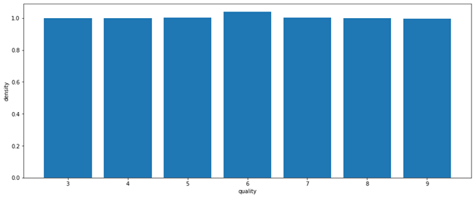
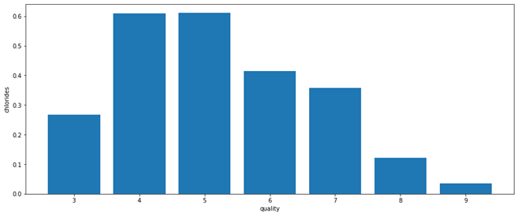
Results (Contd.) - Quality V/S Fundamental features
Quality V/S Alcohol
Quality V/S pH
Quality V/S Density
Quality V/S Chlorides

Slide 22
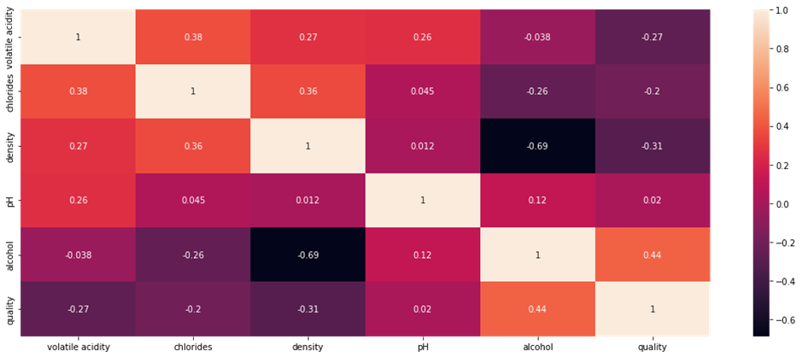
Results (Contd.) - Correlation of Quantitative Variables

Slide 23
Conclusions
Accuracy of the classifiers changed before removing some features which are less correlated with quality of wine
Logistic Regression:
Training — 99.3%
Testing --- 99%
Gaussian SVM:
Training — 92.5%
Testing --- 89%
Linear Discriminant:
Training — 97.5%
Testing --- 98.3%
Neural Network:
Training — 99.3%
Testing --- 99.6%

Slide 24
Conclusions
Accuracy of the classifiers changed after removing some features which are less correlated with quality of wine
Logistic Regression:
Training — 90.8%
Testing --- 94%
Gaussian SVM:
Training — 96.2%
Testing --- 92.2%
Linear Discriminant:
Training — 90.5%
Testing --- 88.5%
Neural Network:
Training — 96.2%
Testing --- 95.3%

Slide 25
Contribution
Kakarla V S S Pavan Teja(S20190020216) – Python code to plot histogram of all quantitative variables, to plot quality vs different variables, to correlate the quantitative variables, Wine Quality.
K Sreenivasulu Reddy(S20190020217) – Matlab code to classify the wine data using Gaussian SVM and Neural Network Classifier(Training and Testing), Classification App, Generation of Confusion Matrix, ROC Curves, Accuracy, Report.
K Litheesh Kumar(S20190020218) – Loading wine data, Matlab code to classify the wine data using Logistic Regression and Linear Discriminant Classifiers(Training and Testing), Classification App, Generation of Confusion Matrix, ROC Curves, Accuracy, PPT.

Slide 26
References
https://archive.ics.uci.edu/ml/datasets/Wine+Quality
https://www.geeksforgeeks.org/wine-quality-prediction-machine-learning/
https://in.mathworks.com/help/deeplearning/ug/wine-classification.html
https://www.javatpoint.com/classification-algorithm-in-machine-learning

Slide 27
Thank you

