Slide 1
Excel Sales Dashboard Mini Project
Vrinda Store Annual Sales Analysis (2022)

Slide 2
Objective
Create an annual sales report for 2022 to understand customer behavior and improve sales in 2023.
Analyze sales data using Excel.
Build an interactive dashboard with Pivot Tables, Charts, and Slicers.
Generate business insights for decision-making.

Slide 3

EXTRACT THE RAW FILE INTO EXCEL

Slide 4
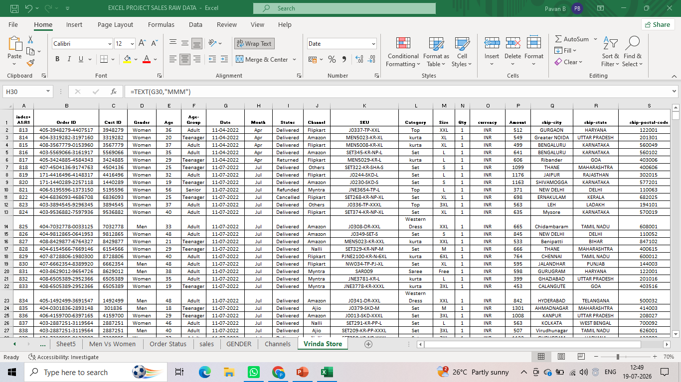
Step 1) Check the raw data

Slide 5
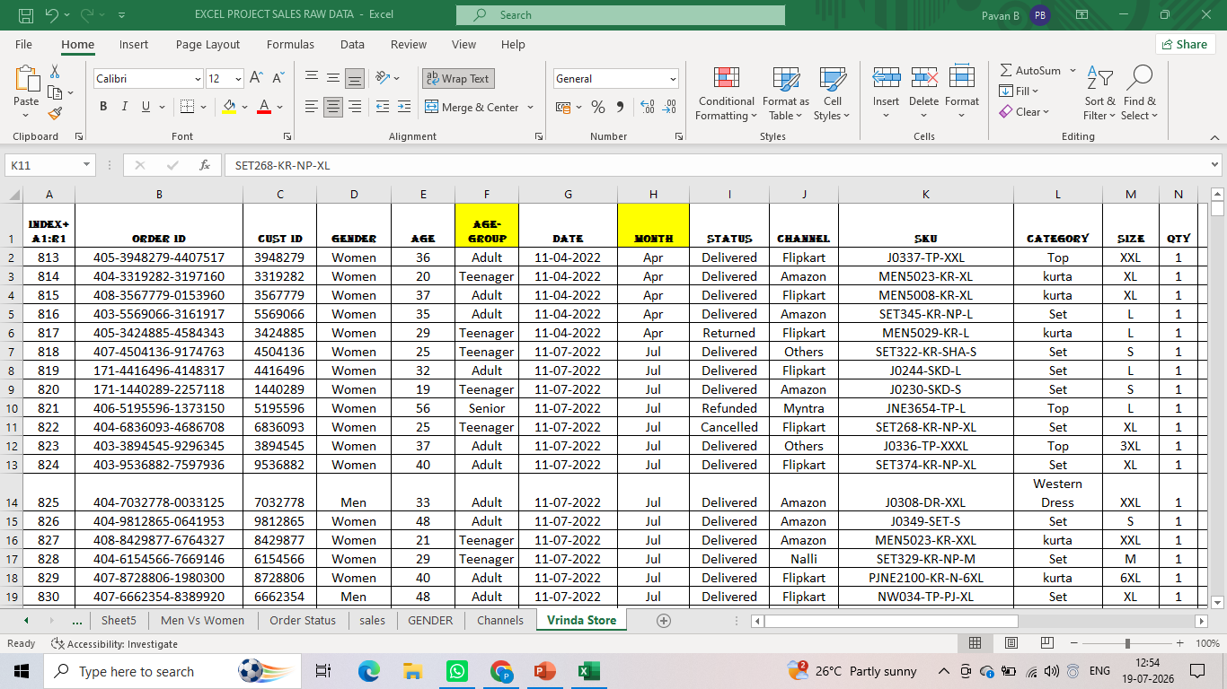
Step 2) Data Cleaning

Slide 6
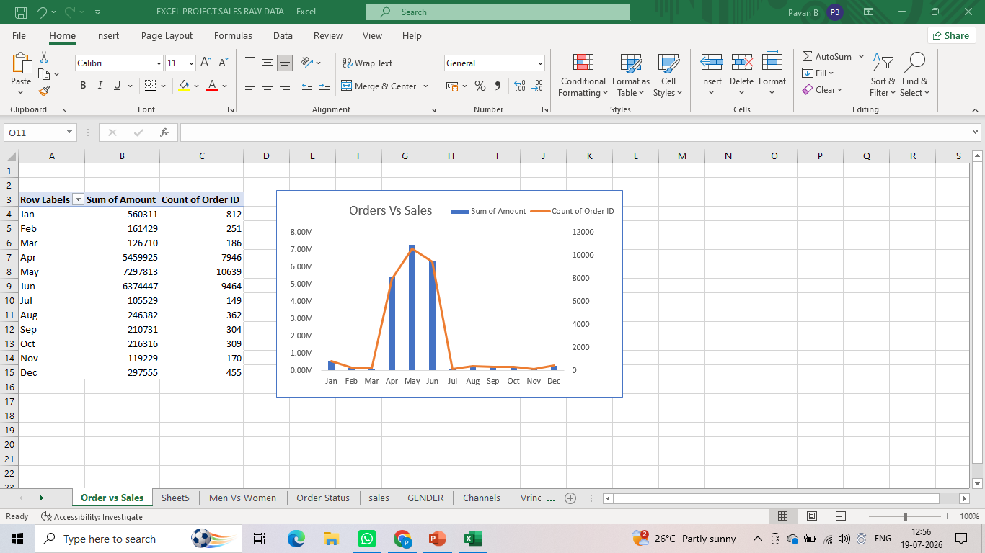
Step 4) Data processing
Compare the sales and orders using single chart ?

Slide 7
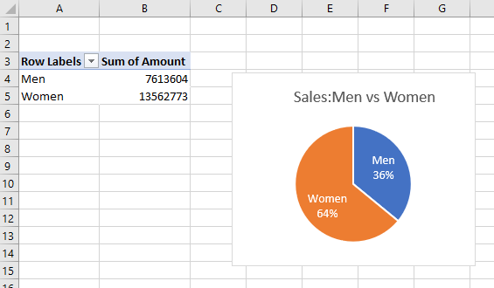
Who purchased more men or women in 2022 ?

Slide 8
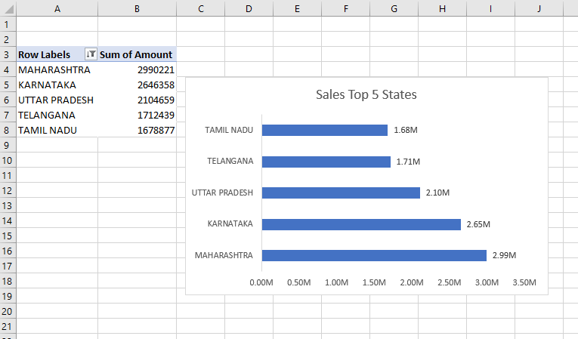
List top 5 States contributing ?

Slide 9
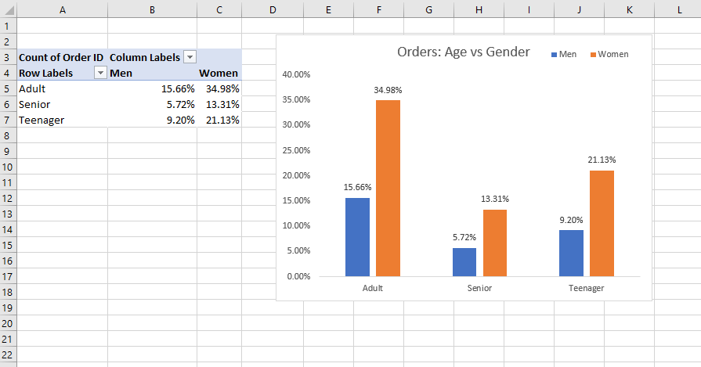
Relation between age and gender based on number?

Slide 10
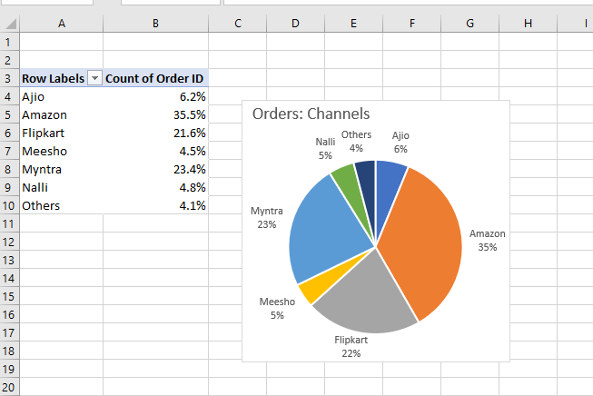
Highest product selling channel?

Slide 11
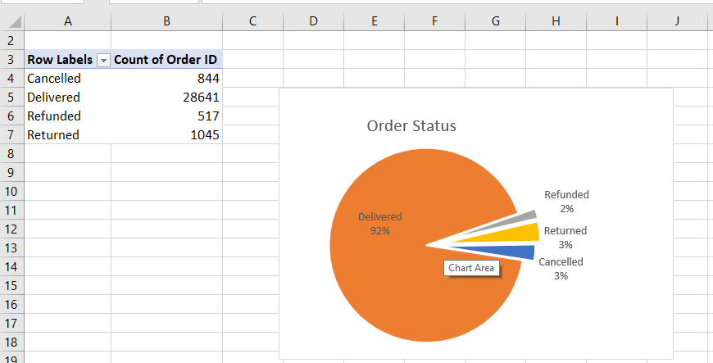
Final order status ?

Slide 12
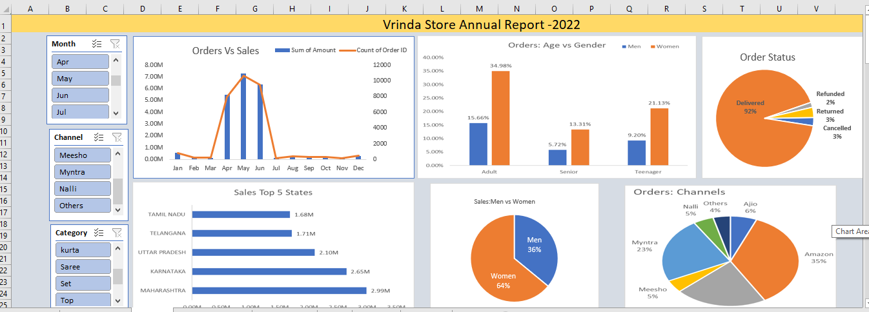
Vrinda Store Annual Report -2022

Slide 13
Final Insights
Women contributed ~65% of purchases.
Top states: Maharashtra, Karnataka, Uttar Pradesh (~35%).
Age group 30–49 contributed ~50% of sales.
Amazon, Flipkart, and Myntra contributed ~80% of sales.
Recommendation: Target women (30–49) in top states with offers on major marketplaces.

